Slide 1

GAME
Unit 20 – At summer camp
Period 1: activities 1,2,3

Slide 2
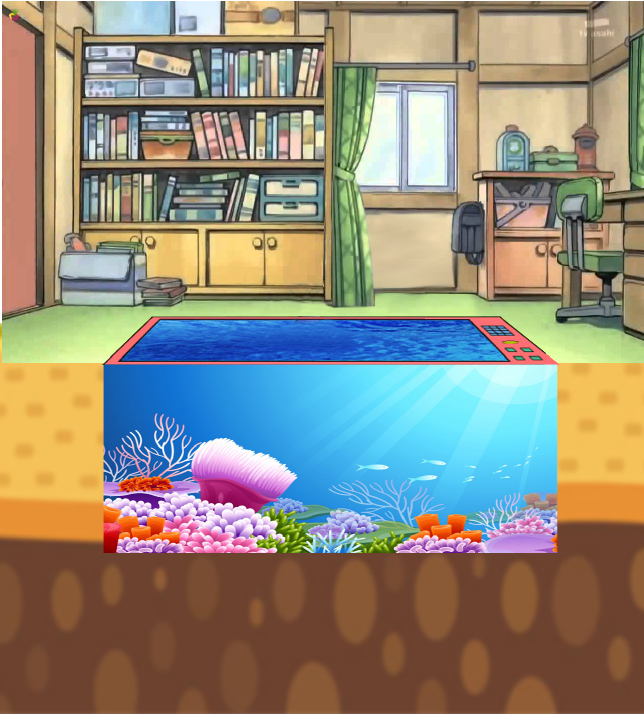


DORAEMON GO FISHING

Slide 3

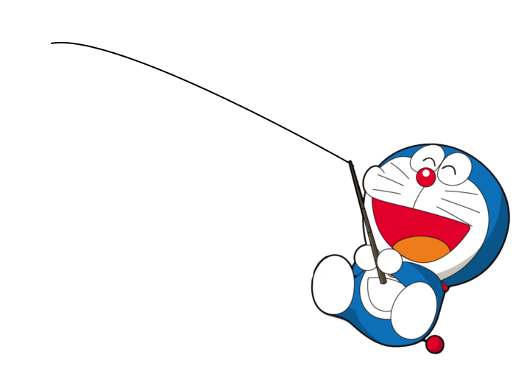

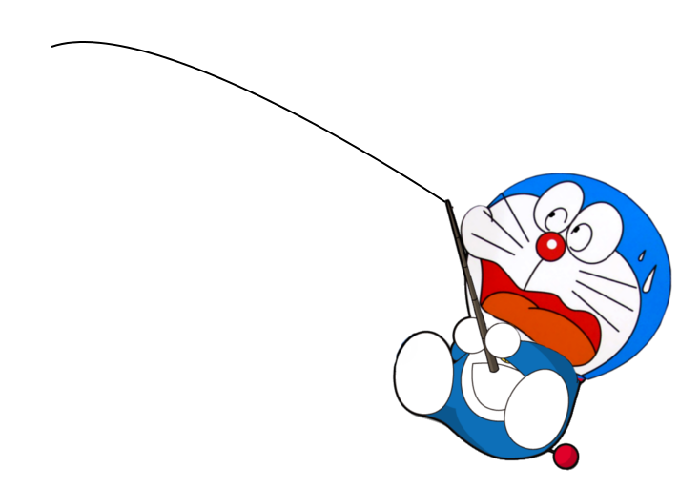



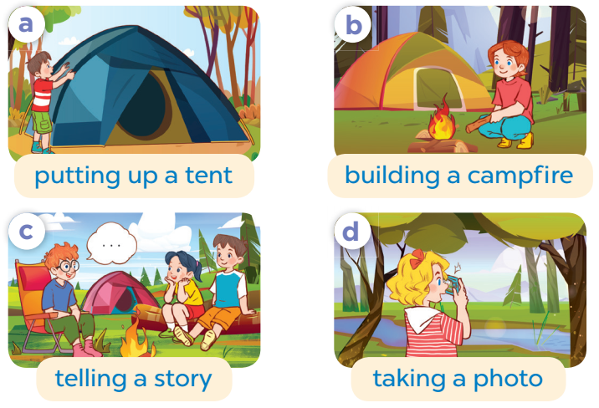

VERY GOOD
START!
SORRY
TIME OVER
A: What’s she doing?
B: He’s ................ .
a. putting up a tent
b. building a campfire
a.
b.

Slide 4
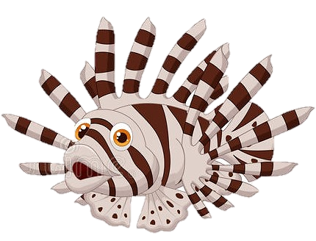

VERY GOOD
START!
SORRY
TIME OVER
Listen and choose:
a. b.
a
b

Slide 5


VERY GOOD
START!
SORRY
TIME OVER
Reorder the sentences:
is / what / he / doing / ?
a. What is doing he?
b. What is he doing?
a
b

Slide 6

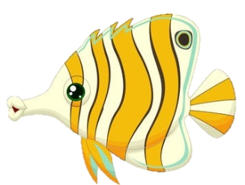
WELL DONE
START!
SORRY
TIME OVER
a. She’s telling a story.
b. He’s building a campfire.
a
b

Slide 7

WELL DONE
START!
SORRY
TIME OVER
Choose the best answer:
He is …………. a tent.
a. putting up b. telling
a
b

Slide 8

GIỎI QUÁ
Bắt đầu!
TIẾC QUÁ
HẾT GIỜ
A: What’s he doing ?
B: ………………….
a. She’s telling a story.
b. He’s telling a story.
a
b

Slide 9

WELL DONE
START!
SORRY
TIME OVER
Reorder the sentence:
sister / is / a / my / talking / photo /.
a. My sister is taking a photo.
b. My taking is sister photo.
a
b

Slide 10

WELL DONE
START!
SORRY
TIME OVER
Complete the word:
telling a ……………………
a. campfire b. story
a
b

Slide 11
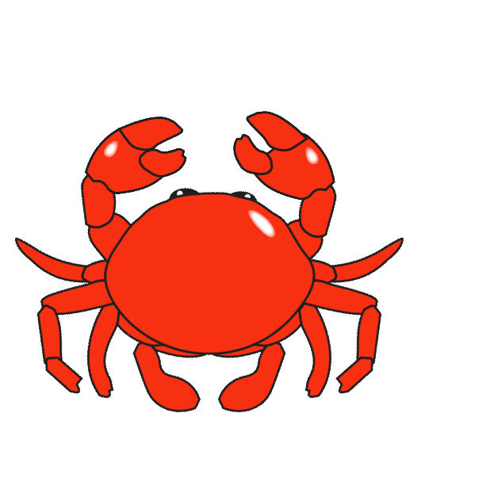
VERY GOOD
START!
SORRY
TIME OVER
Choose the best picture:
telling a story
a b
a
b

Slide 12
The end.
THANK YOU!

