Slide 1
Unit 19 – Lesson 1
They're in the park.

Slide 2
VOCABULARY

Slide 3
flying a kite
/flaɪ ə kaɪt/

Slide 4
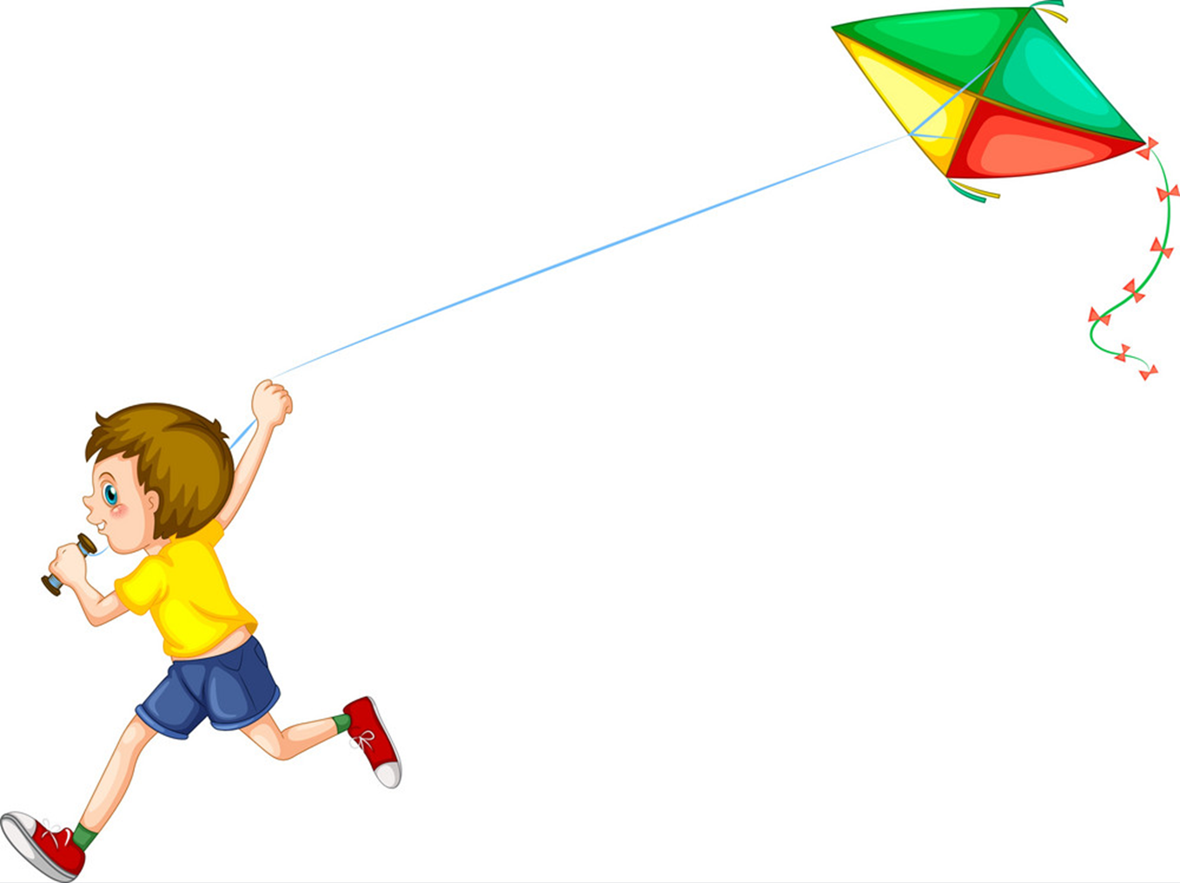
flying kites
/flaɪ ə kaɪts/

Slide 5
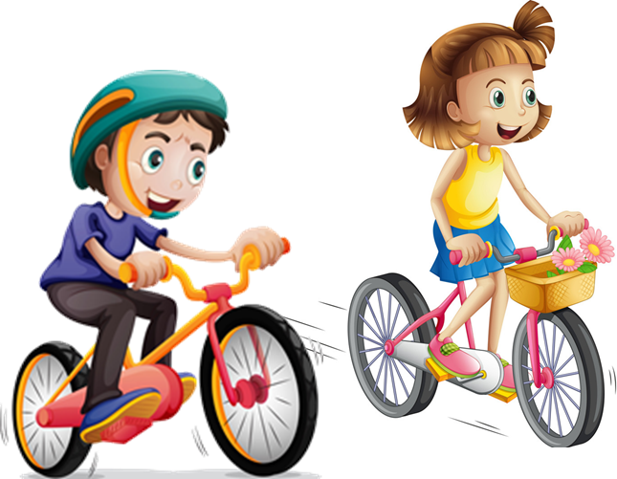
cycling
/ˈsaɪklɪŋ/

Slide 6
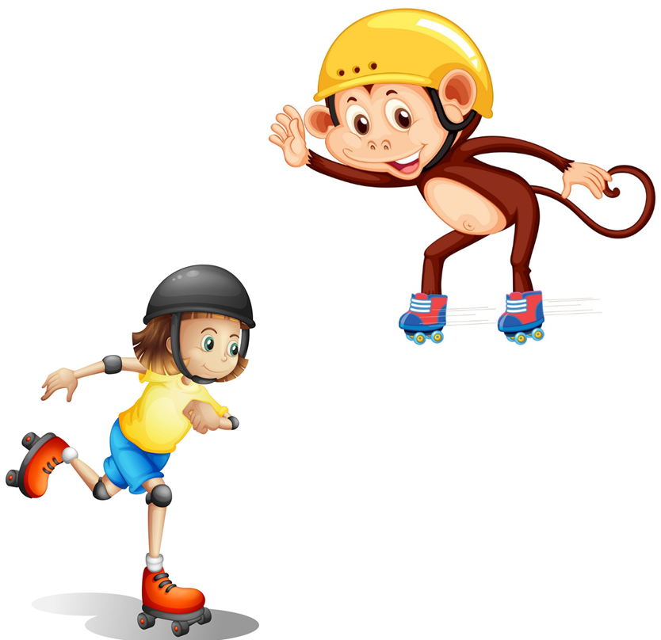
skating
/ˈskeɪtɪŋ/

Slide 7
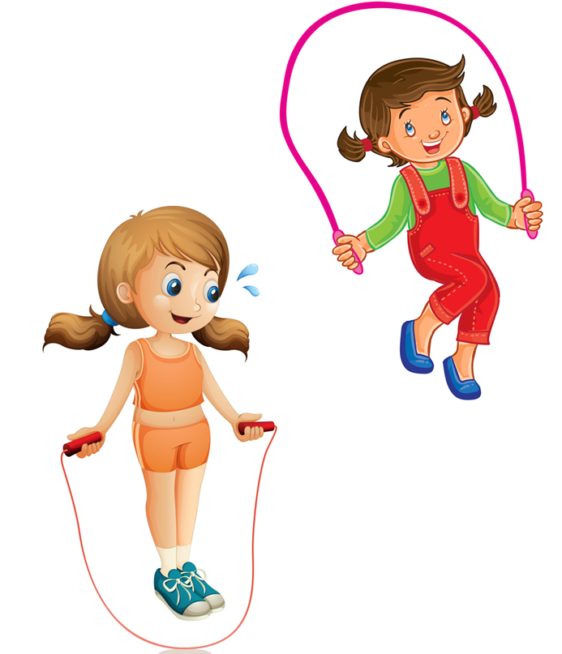
skipping
/skɪpɪŋ/

Slide 8
skipping
skating
flying kites
cycling

Slide 9
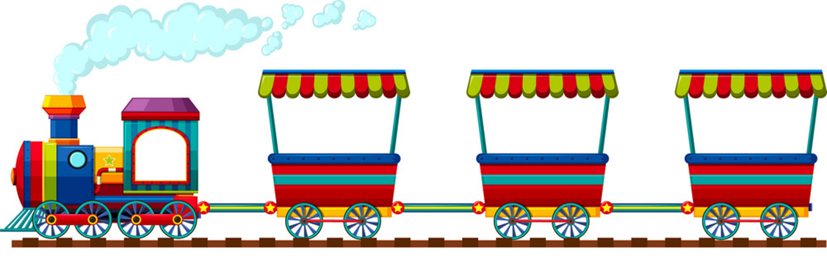
skipping

Slide 10
flying kites

Slide 11
skating

Slide 12
cycling

Slide 13
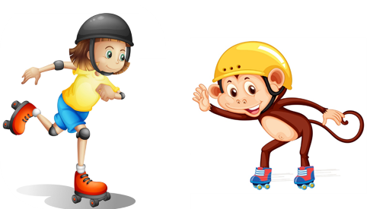
flying kites
skating
cycling

Slide 14
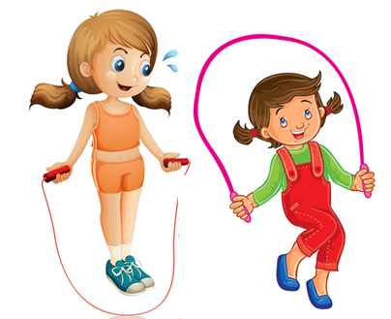
skating
skipping
skating

Slide 15
skipping
cycling
flying kites

Slide 16
cycling
skipping
flying kites

Slide 17
Grammar

Slide 18
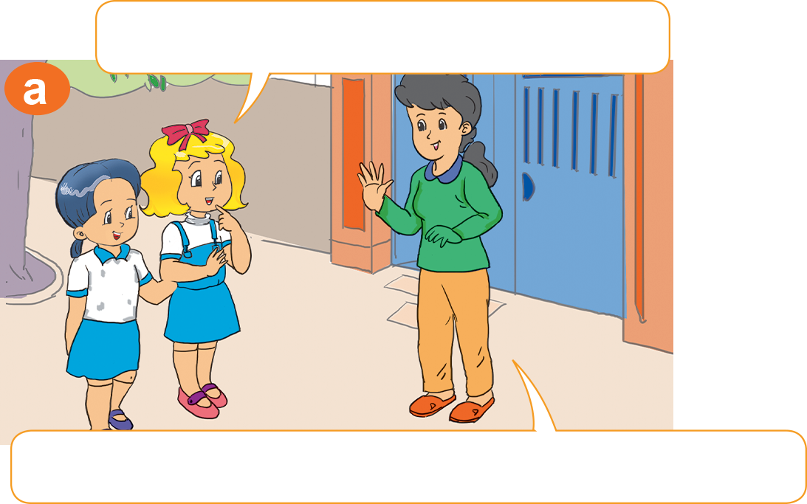
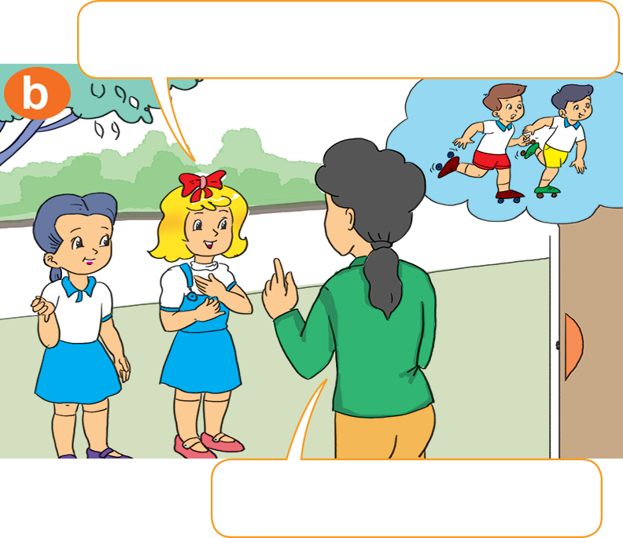
1. Look, listen and repeat
Are Nam and Quan here?
What are they doing?
No, they aren't. They're in the park.
They're skating.

Slide 19
2. Point and say
What are they doing?
cycling
They’re _____________.

Slide 20
2. Point and say
What are they doing?
skipping
They’re _____________.

Slide 21
2. Point and say
What are they doing?
skating
They’re _____________.

Slide 22
2. Point and say
What are they doing?
flying kites
They’re _____________.

Slide 23
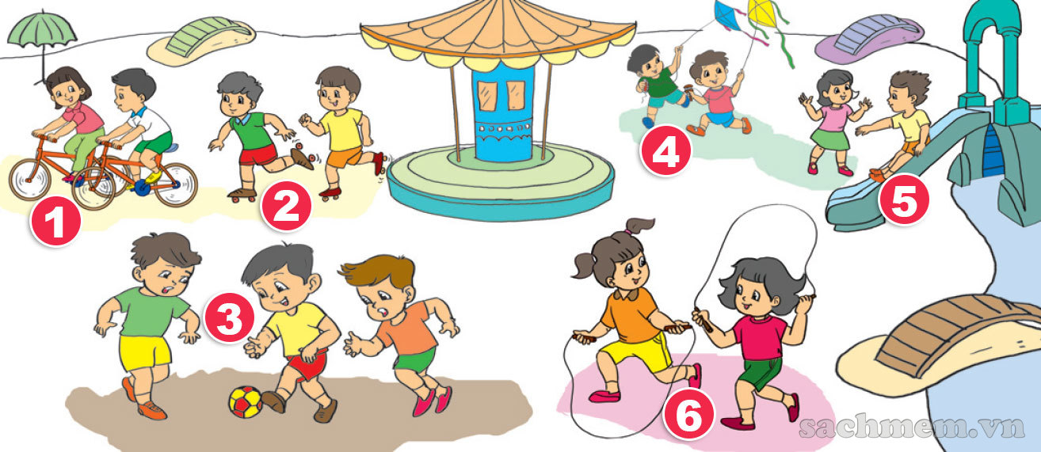
3. Let's talk
What are they doing?
They’re _____________.

Slide 24
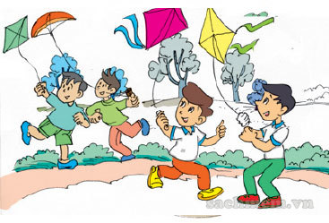
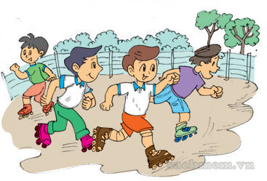
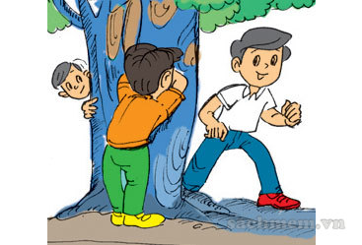
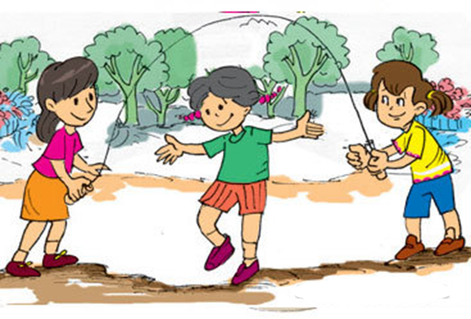
4. Listen and tick
a
b
1
✔
a
b
2
✔

Slide 25
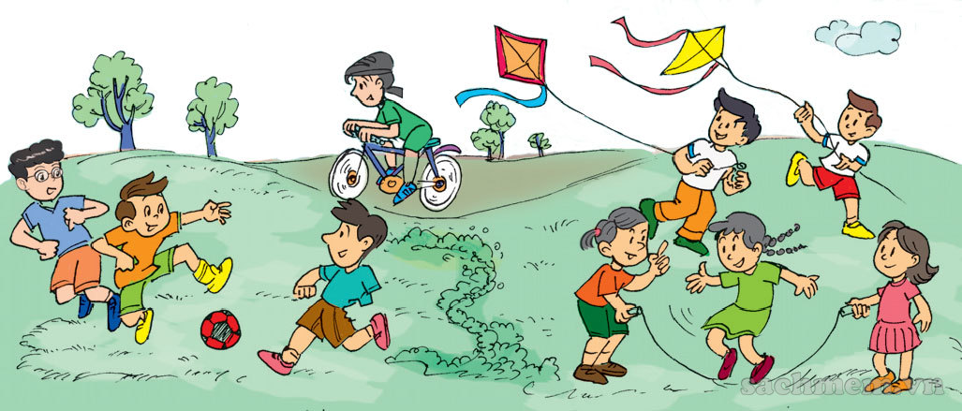
5. Read and write
My name is Phong. Today I am in the park with my friends. We are doing sports and playing games. Some of the boys and I are playing football. Some of the girls are skipping. My friend Mai is cycling. Nam and Quan are flying kites. We are happy in the park.
1. The children are in the park.
2. Some of the boys are playing football.
3. Some of the girls are skipping.
4. Mai is cycling.
5. Nam and Quan are flying kites.
________________.
_____________________.
________________.
________________.
________________.

Slide 26
Model sentence
What are they doing?
They’re _____________.
skipping
flying kites
skating
cycling

Slide 27
6. Let's write
Where are you now?
What are you doing?

Slide 28
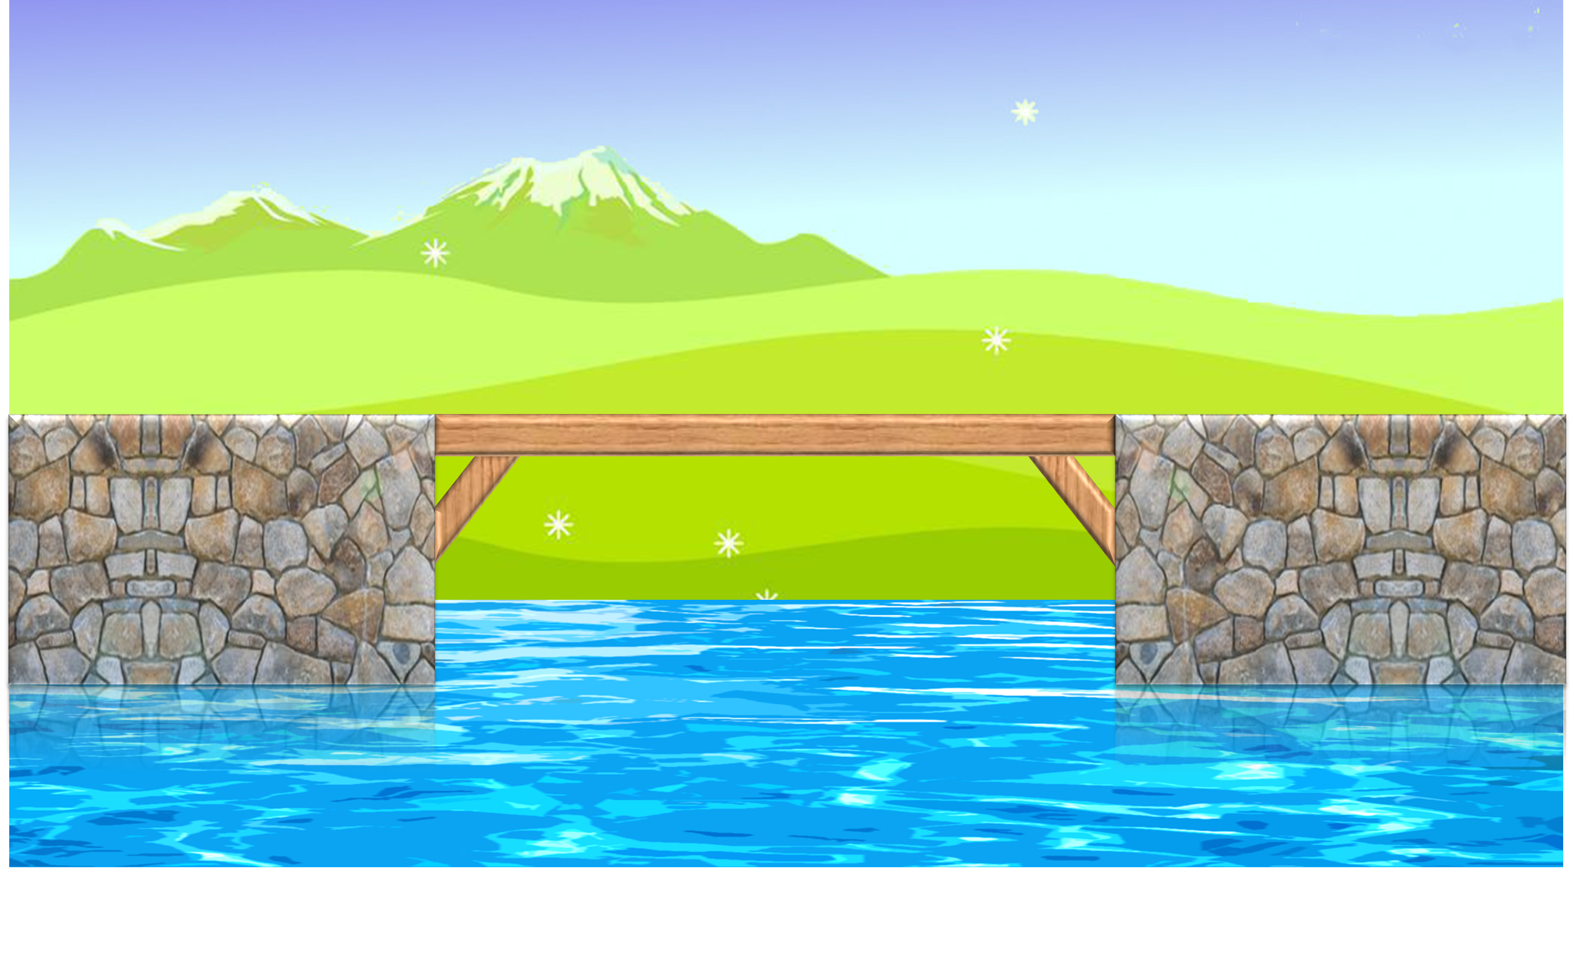
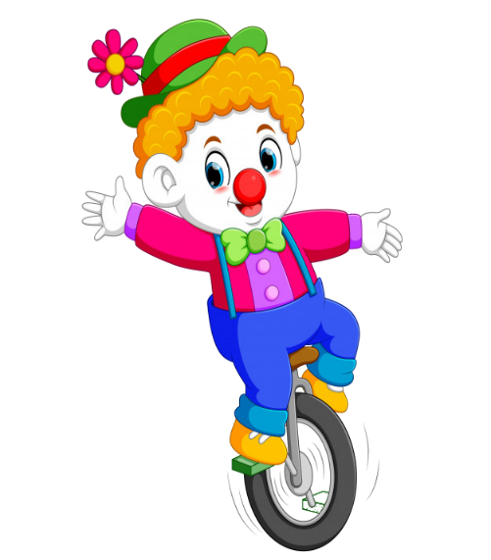
Notes:
Ms Huyền Phạm - 0936.082.789 – YOUTUBE: MsPham. Facebook: Dạy và học cùng công nghệ.

Slide 29
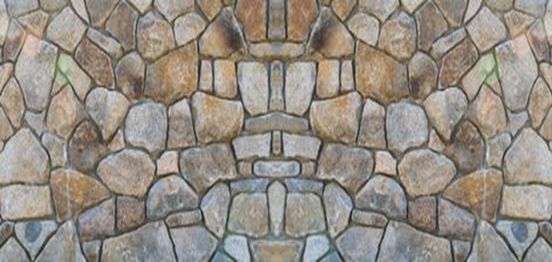
What are
they doing?
They’re skipping
They’re flying kites
They’re skating
They’re cycling
Notes:
Ms Huyền Phạm - 0936.082.789 – YOUTUBE: MsPham. Facebook: Dạy và học cùng công nghệ.

Slide 30
What are
they doing?
They’re skating
They’re flying kites
They’re cycling
They’re skipping
Notes:
Ms Huyền Phạm - 0936.082.789 – YOUTUBE: MsPham. Facebook: Dạy và học cùng công nghệ.

Slide 31
What are
they doing?
They’re flying kites
They’re skating
They’re skipping
They’re cycling
Notes:
Ms Huyền Phạm - 0936.082.789 – YOUTUBE: MsPham. Facebook: Dạy và học cùng công nghệ.

Slide 32
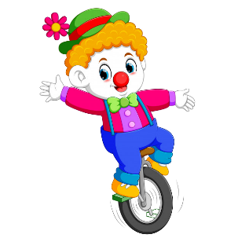
What are
they doing?
They’re cycling
They’re skipping
They’re skating
They’re flying kites
Notes:
Ms Huyền Phạm - 0936.082.789 – YOUTUBE: MsPham. Facebook: Dạy và học cùng công nghệ.

Slide 33
What are
they doing?
They’re playing hide and seek.
They’re skipping.
They’re playing football.
They’re playing tennis.
Notes:
Ms Huyền Phạm - 0936.082.789 – YOUTUBE: MsPham. Facebook: Dạy và học cùng công nghệ.

Slide 34
They’re playing hide and seek.
What are you doing?
What is she doing?
What are they doing?
What is he doing?
Notes:
Ms Huyền Phạm - 0936.082.789 – YOUTUBE: MsPham. Facebook: Dạy và học cùng công nghệ.

Slide 35
I’m flying a kite.
What is she doing?
What are you doing?
What is he doing?
What are they doing?
Notes:
Ms Huyền Phạm - 0936.082.789 – YOUTUBE: MsPham. Facebook: Dạy và học cùng công nghệ.

Slide 36
She’s cleaning the house.
What are you doing?
What is he doing?
What are they doing?
What is she doing?
Notes:
Ms Huyền Phạm - 0936.082.789 – YOUTUBE: MsPham. Facebook: Dạy và học cùng công nghệ.

Slide 37
He’s listenning to music.
What is he doing?
What are they doing?
What is she doing?
What are you doing?
Notes:
Ms Huyền Phạm - 0936.082.789 – YOUTUBE: MsPham. Facebook: Dạy và học cùng công nghệ.

Slide 38
What are ____ doing?
They’re skating.
you
she
they
he
Notes:
Ms Huyền Phạm - 0936.082.789 – YOUTUBE: MsPham. Facebook: Dạy và học cùng công nghệ.

Slide 39
____ are they doing?
They’re cycling.
Who
What
How
Where
Notes:
Ms Huyền Phạm - 0936.082.789 – YOUTUBE: MsPham. Facebook: Dạy và học cùng công nghệ.

Slide 40
What ___ they doing?
They’re playing the piano.
do
am
is
are
Notes:
Ms Huyền Phạm - 0936.082.789 – YOUTUBE: MsPham. Facebook: Dạy và học cùng công nghệ.

Slide 41
Notes:
Ms Huyền Phạm - 0936.082.789 – YOUTUBE: MsPham. Facebook: Dạy và học cùng công nghệ.

