Slide 2
REVIEW 1
Period 1

Slide 3
01
Warm-up and Review

Slide 4
Let's Play
The network Game
2. Our homes
3. My foreign friends
1. All about me
4. Our free time activities
5. My future job

Slide 5
02
Activity 1
Listen and circle a, b or c.

Slide 6
Listen and circle a, b or c.
a. I’d like to write stories
for children.
b. I’m a write.
c. I’d like to be a writer.
a. I have a dolphin.
b. It’s a dolphin.
c. I can see a dolphin.
a. Yes, I can.
b. Yes, I do.
c. Yes, I am.
a. He’s in the computer room.
b. He likes playing football.
c. He’s active.
a. I like watering flowers.
b. I’m watering flowers.
c. I like flowers.
Notes:
Step 3: Repeat Steps 1 and 2 for the rest of the questions.

Slide 7
Listen and circle a, b or c.
a. I have a dolphin.
b. It’s a dolphin.
c. I can see a dolphin.
Notes:
Step 2: Play the recording for Question 1. Play the recording again for pupils to do the task. Play the recording a third time for pupils to check their answers.

Slide 8
Let’s check!
a. Yes, I can.
b. Yes, I do.
c. Yes, I am.
Notes:
* Key: 1. b, 2. b, 3. c, 4. c, 5. a

Slide 9
Let’s check!
a. I’d like to write stories for children.
b. I’m a writer.
c. I’d like to be a writer.
Notes:
* Key: 1. b, 2. b, 3. c, 4. c, 5. a

Slide 10
Let’s check!
a. He’s in the computer room.
b. He likes playing football.
c. He’s active.
Notes:
* Key: 1. b, 2. b, 3. c, 4. c, 5. a

Slide 11
Let’s check!
a. I like watering flowers.
b. I’m watering flowers.
c. I like flowers.
Notes:
* Key: 1. b, 2. b, 3. c, 4. c, 5. a

Slide 12
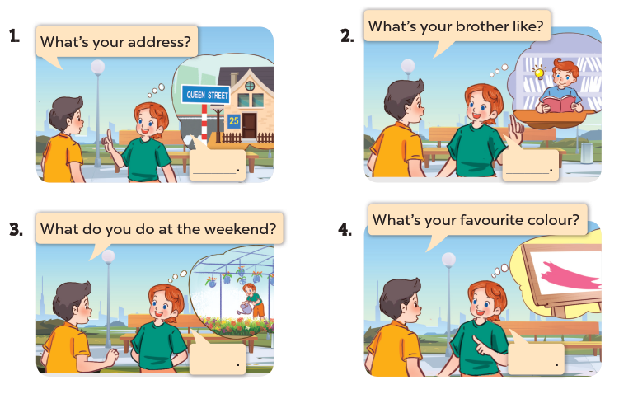
Ask and answer.
Notes:
Step 4: Have pupils work in pairs to role-play the four exchanges. Go around the classroom to monitor the activity.

Slide 13
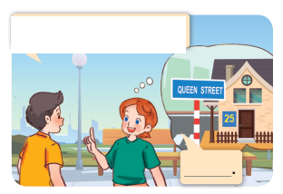
What’s your address?
It’s 25 Queen Street.
Notes:
Step 1: Draw pupils’ attention to the first picture. Get them to look at the bubble to identify the activity shown in it. Check pupils’ comprehension.
Step 2: Draw pupils’ attention to Question 1. Have pupils look at the bubble over Lucy’s head to answer the question.

Slide 14
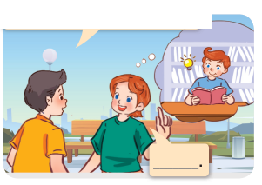
What’s your brother like?
He’s clever.
Notes:
Step 3: Repeat Step 1 and 2 with the rest of the questions.

Slide 15
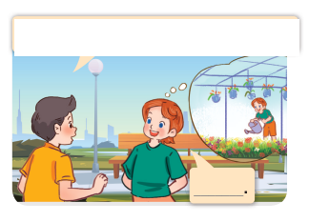
What do you do at the weekend?
I water flowers.
Notes:
Step 3: Repeat Step 1 and 2 with the rest of the questions.

Slide 16
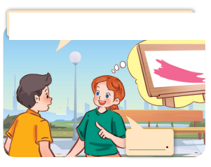
What’s your favourite color?
It’s pink.
Notes:
Step 3: Repeat Step 1 and 2 with the rest of the questions.

Slide 17
1. All about me!
Can you tell me about yourself?
- I’m in ………………..…….
I live in the ………………
………………………………..
city
class
What’s your favourite…….?
It’s ……………………………..
table tennis
countryside
dolphin
colour
sandwich

Slide 18
3. My foreign friends
What nationality is he/she?
He’s/ She’s ……………………..
American
Japanese
What’s he/she like?
He’s/ She’s ……….
helpful
Malayrian
clever
friendly
active
Australian

Slide 19
4. Our free time activities
What do you like doing in your free time?
I like ……………………..
Go for a walk
Surf the internet
What do you do at the weakend?
I ……………………. ………………….
always
play the violin
often
ussually
sometimes
Water the flowers

Slide 20
5. My future job
What would you like to be in the future?
I’d like to be a/an …………..
go for a walk
surf the internet
Why would you like to be a/ an ………………………………….?
Because I’d like to ……………………. ………………….
report the news
play the violin
plant the flowers
water the flowers
help people
water the flowers

Slide 21
Website: hoclieu.vn
Fanpage: https://www.facebook.com/tienganhglobalsuccess.vn/

