Slide 1
UNIT 11:FAMILY TIME
LESSON 2 ( 1, 2, 3)
Notes:
MADE BY FACEBOOK :TRAN THI THANH TAM

Slide 2
Warm - up
Game: SLAP THE BOAARD
Notes:
MADE BY FACEBOOK :TRAN THI THANH TAM

Slide 3
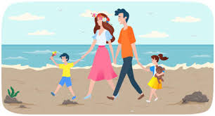
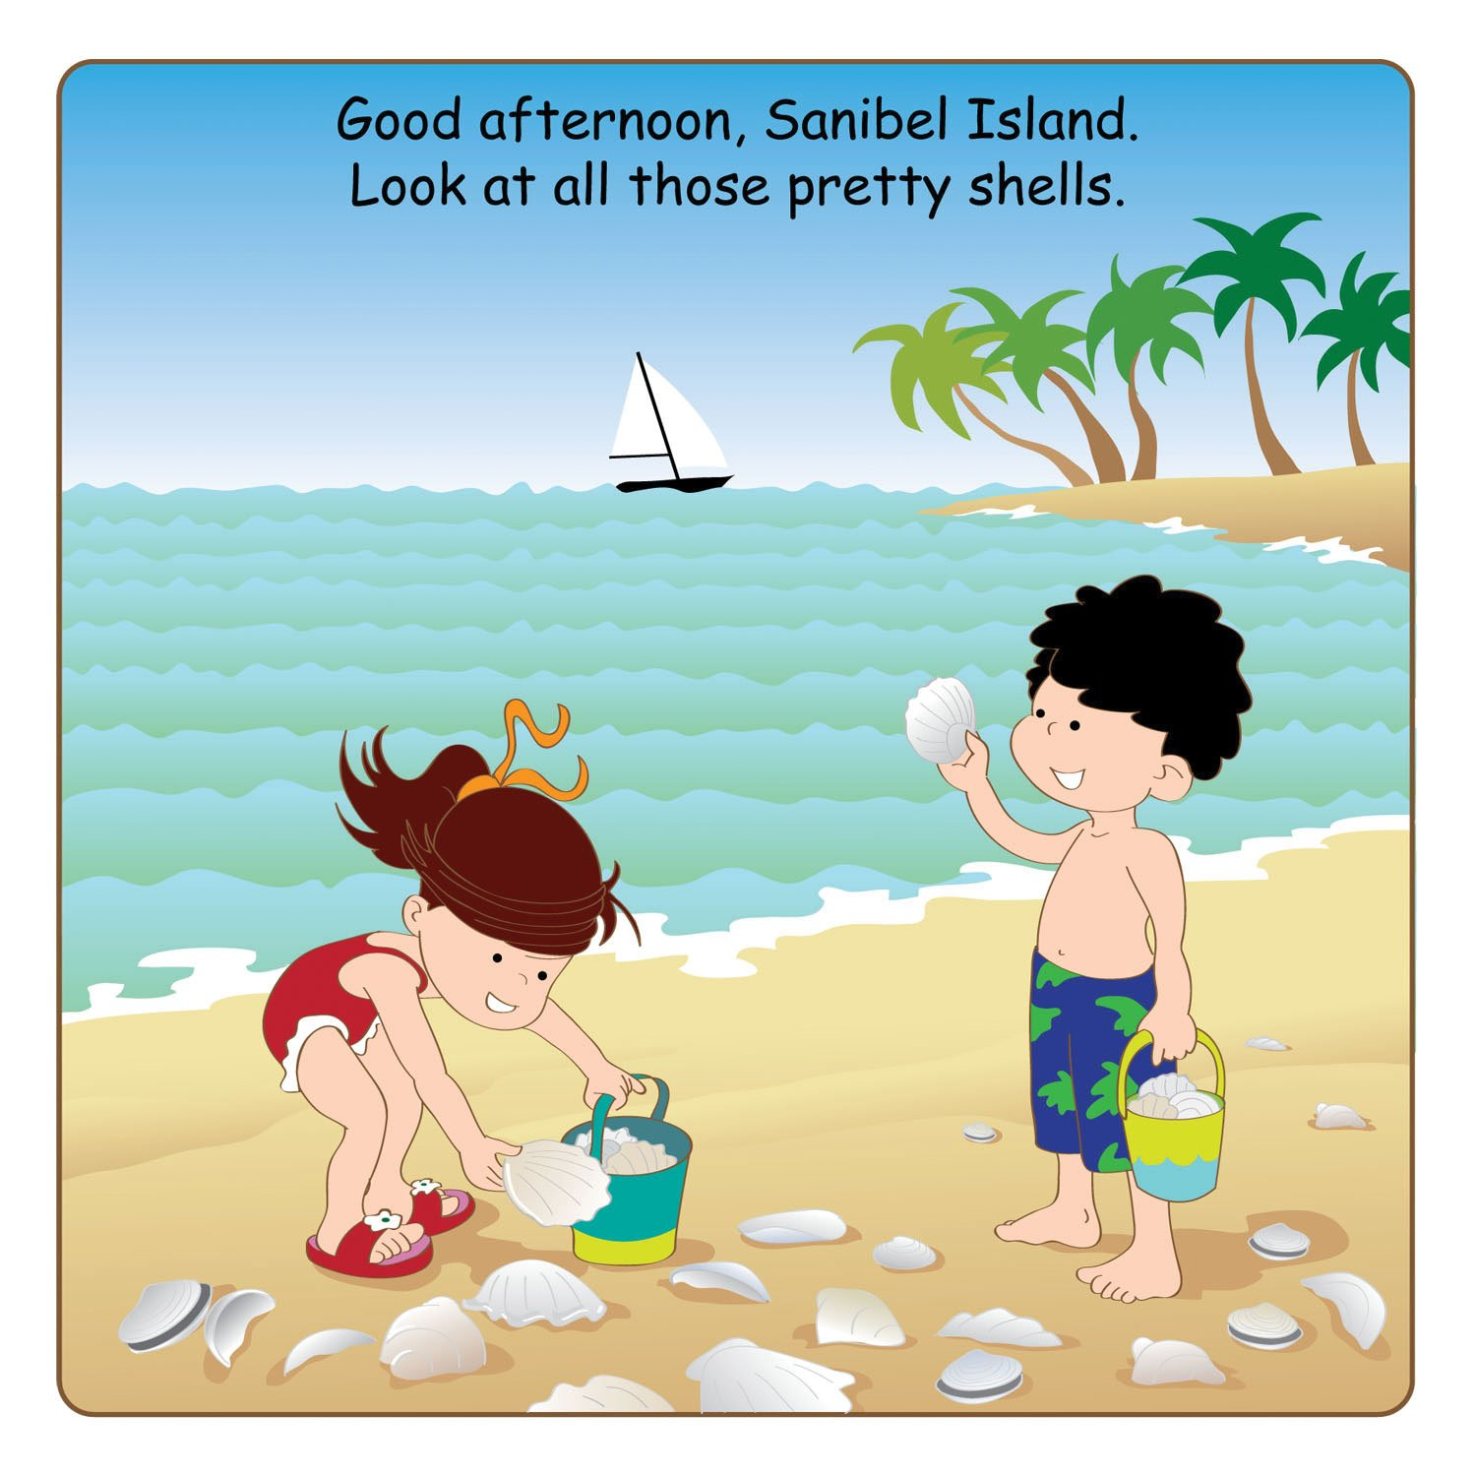
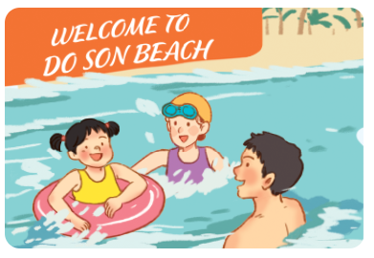
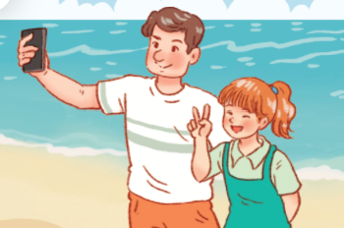
Slap the board

Slide 4
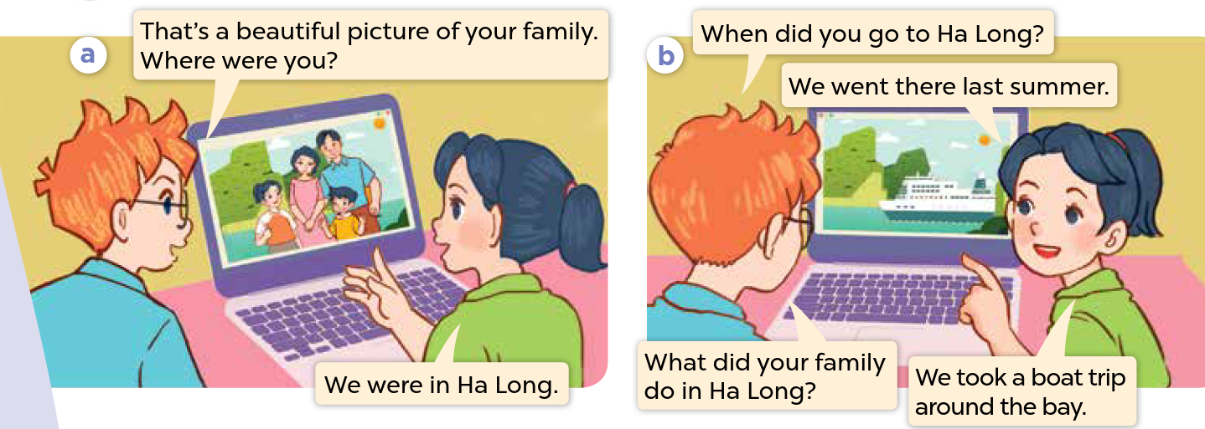
1.Look, listen and repeat
Notes:
MADE BY FACEBOOK :TRAN THI THANH TAM

Slide 5
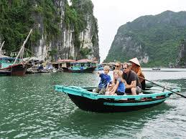
Take a boat trip around the bay
/ˌteɪk ə ˈbəʊt trɪp əˈraʊnd ðə beɪ /
: đi du lịch bằng tàu thủy xung quanh vịnh
Notes:
MADE BY FACEBOOK :TRAN THI THANH TAM

Slide 6
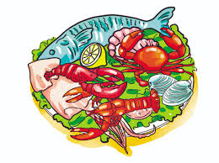
Eat seafood /iːt ˈsiːfuːd/:ăn hải sản
Notes:
MADE BY FACEBOOK :TRAN THI THANH TAM

Slide 7
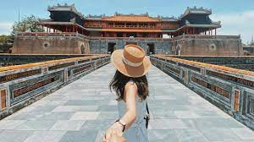
See some interesting places
/siː sʌmˈɪntrəstɪŋ pleɪsɪz/
: thăm những nơi thú vị
Notes:
MADE BY FACEBOOK :TRAN THI THANH TAM

Slide 8
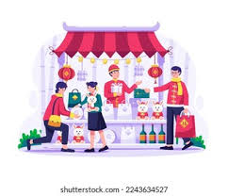
buy souvenirs/ baɪ ˌsuːvəˈnɪə(r)/
:mua quà lưu niệm
Notes:
MADE BY FACEBOOK :TRAN THI THANH TAM

Slide 9
What did your family do in Ha Long Bay?
(Gia đình của bạn đã làm gì ở vịnh Hạ Long?)
We took a boat trip around the bay.
(Chúng tôi đi du lịch bằng tàu thủy xung quanh vịnh.)
Notes:
MADE BY FACEBOOK :TRAN THI THANH TAM

Slide 10
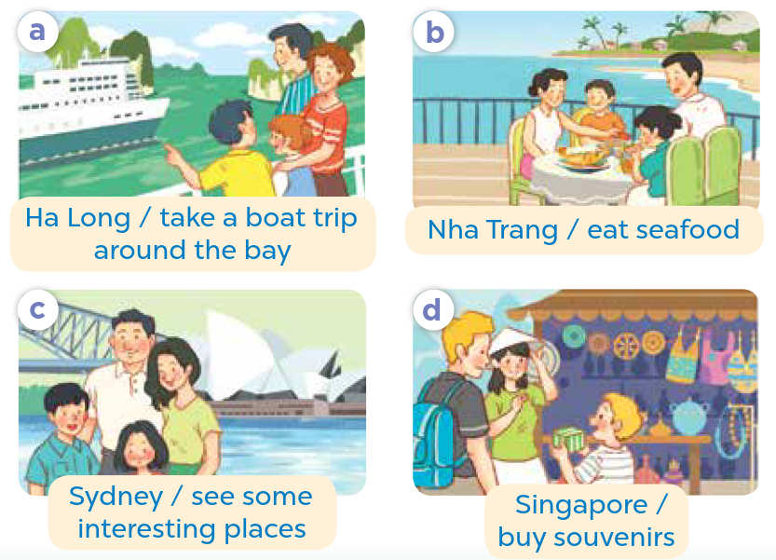
2.Listen, point and say
Ha Long Bay
What did your family do in............................?
took a boat trip around the bay
We…........................................................
Notes:
MADE BY FACEBOOK :TRAN THI THANH TAM

Slide 11
MATCHING
1. take
2. eat
3. see
4. buy
A. saw
B. bought
C. ate
D. took
Notes:
Step 5: Invite a few pairs to point at the pictures and say the questions and answers in front of the class.

Slide 12
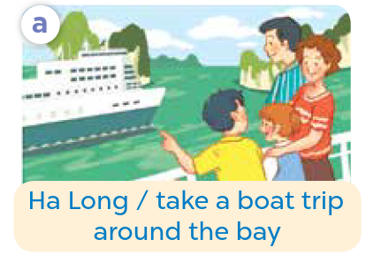
Ha Long Bay
What did your family do in............................?
took a boat trip around the bay
We…........................................................
Notes:
MADE BY FACEBOOK :TRAN THI THANH TAM

Slide 13
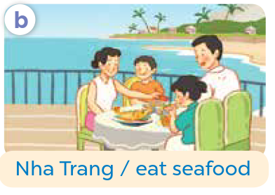
Nha Trang
What did your family do in............................?
ate seafood
We…...................................
Notes:
MADE BY FACEBOOK :TRAN THI THANH TAM

Slide 14
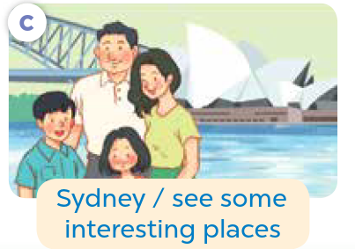
Sydney
What did your family do in......................?
saw some interesting places
We...................................................
Notes:
MADE BY FACEBOOK :TRAN THI THANH TAM

Slide 15
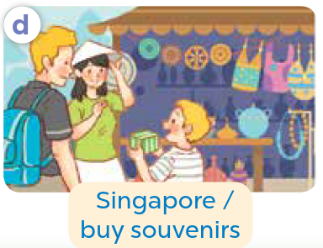
Singapore
What did your family do in............................?
bought souvenirs
We..........................................
Notes:
MADE BY FACEBOOK :TRAN THI THANH TAM

Slide 16
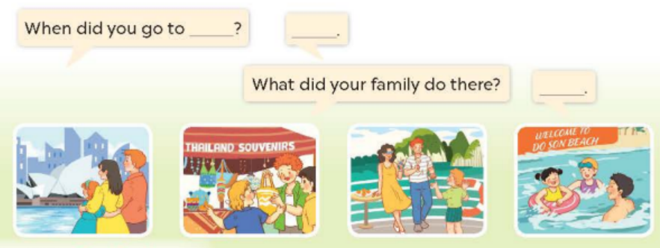
3. Let’s talk
Notes:
MADE BY FACEBOOK :TRAN THI THANH TAM

