Slide 1
UNIT 11:FAMILY TIME
LESSON 1 ( 1, 2, 3)
Notes:
MADE BY FACEBOOK :TRAN THI THANH TAM

Slide 2
Warm - up
Notes:
MADE BY FACEBOOK :TRAN THI THANH TAM

Slide 3
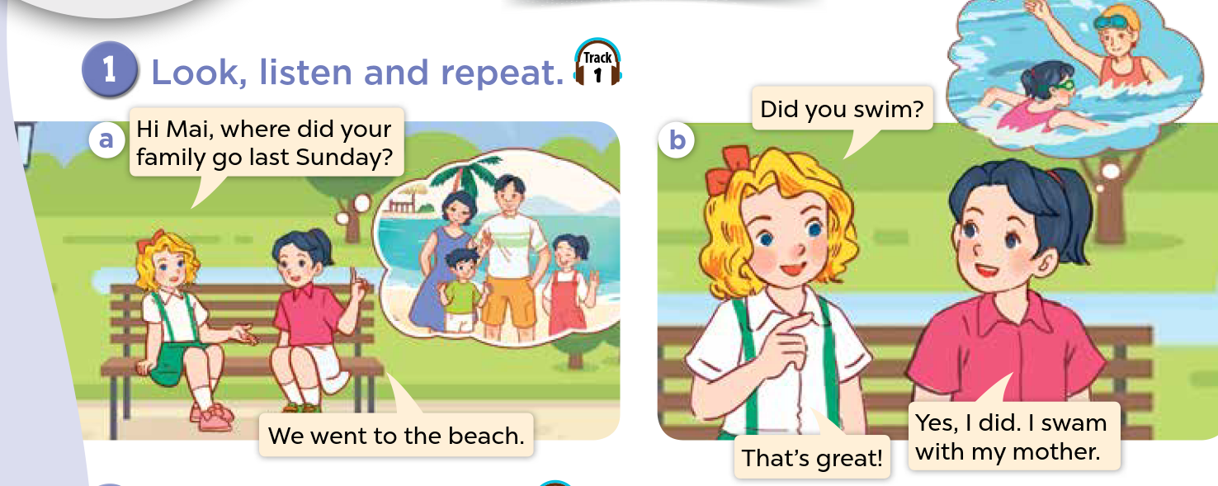
1.Look, listen and repeat.
Notes:
MADE BY FACEBOOK :TRAN THI THANH TAM

Slide 4
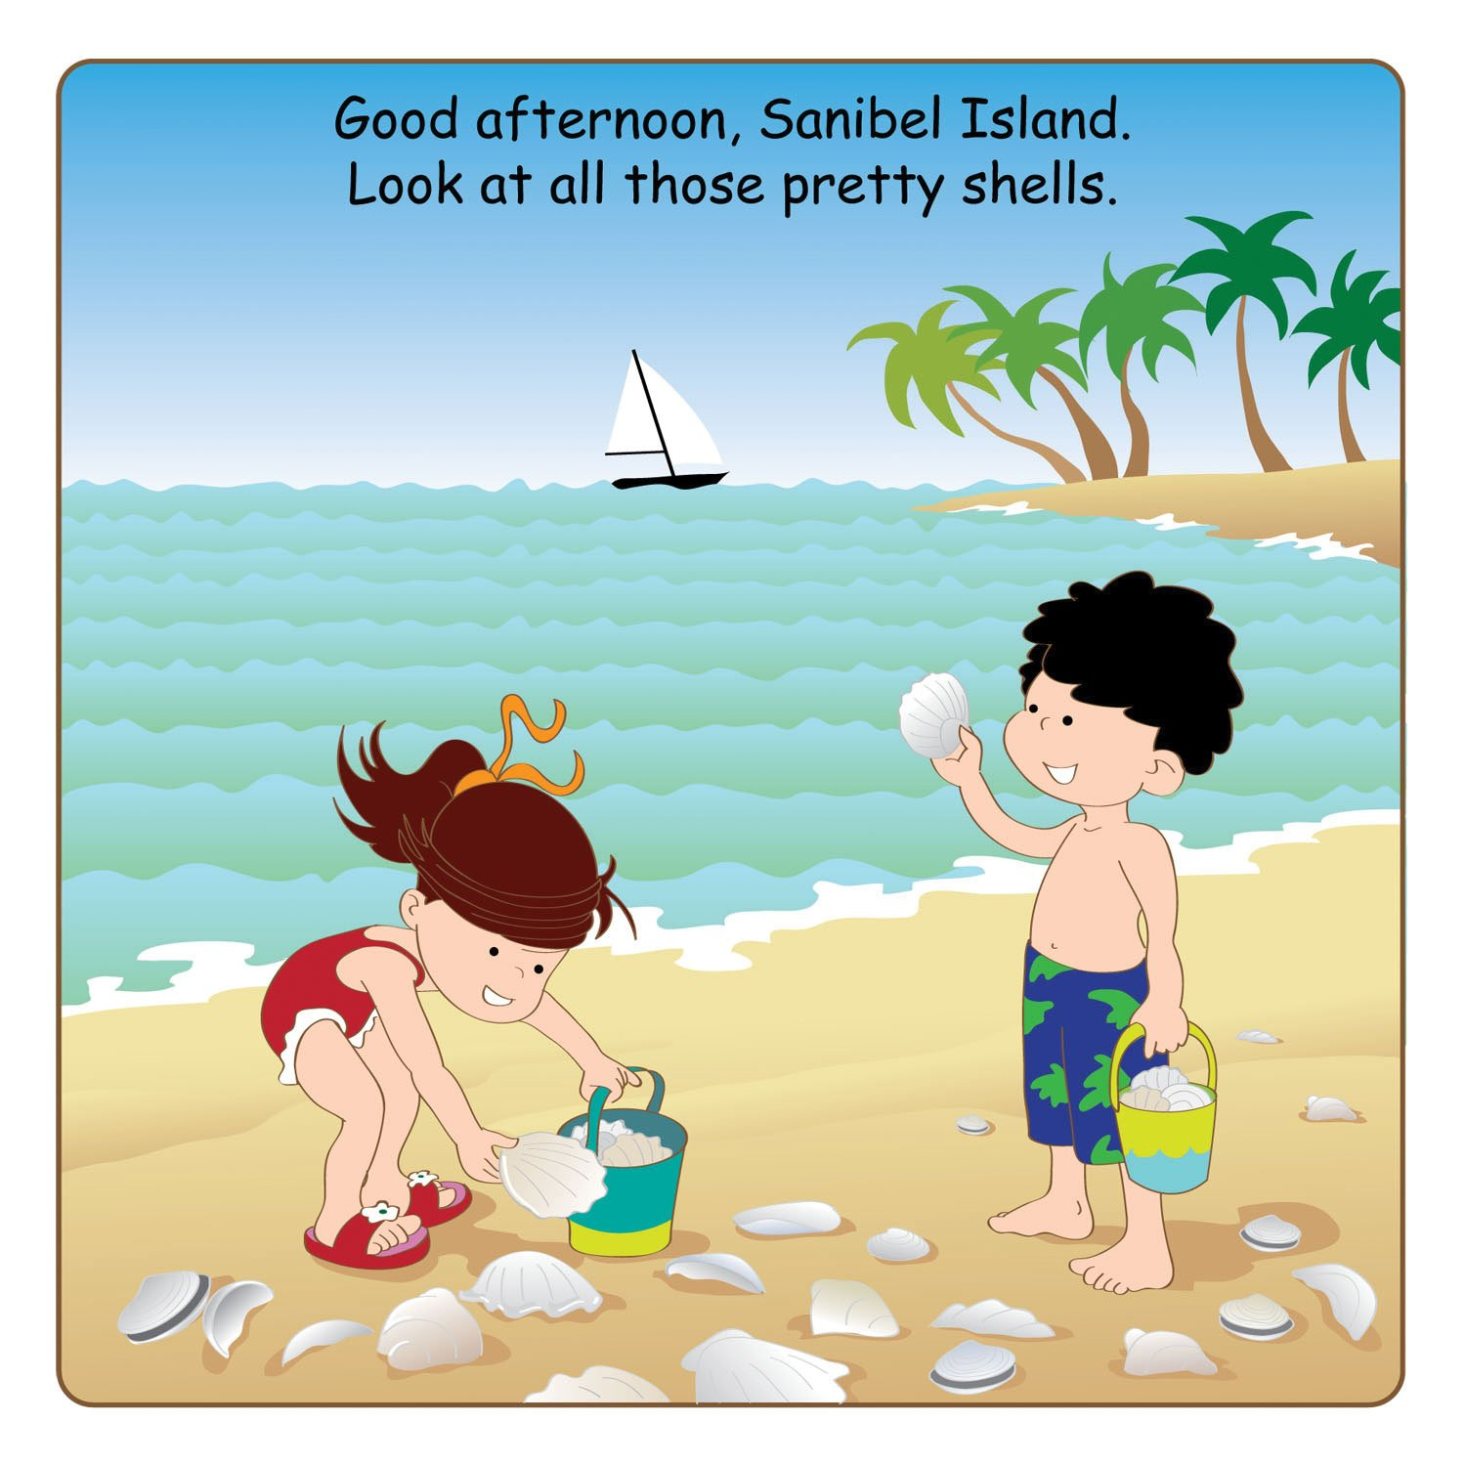
collect seashells/kəˈlektˈsiːʃelz/
thu lượm, đi lấy vỏ sò
Notes:
MADE BY FACEBOOK :TRAN THI THANH TAM

Slide 5
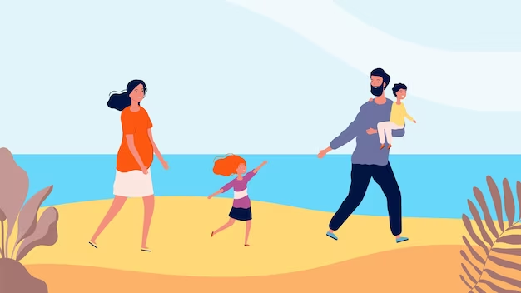
walk on the beach/ wɔːk ɒn ðə biːtʃ/
đi bộ trên bãi biển
Notes:
MADE BY FACEBOOK :TRAN THI THANH TAM

Slide 6
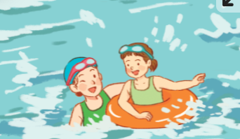
Swim:/swɪm/:bơi
Notes:
MADE BY FACEBOOK :TRAN THI THANH TAM

Slide 7
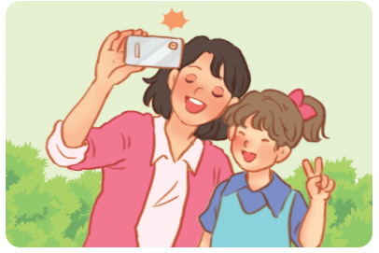
Take photos /teɪk ˈfəʊ.təʊ s/
:chụp ảnh
Notes:
MADE BY FACEBOOK :TRAN THI THANH TAM

Slide 8
Let's play
Check vocabulary
Guessing game
Notes:
Made by Facebook: TRAN THI THANH TAM

Slide 9
Guessing
Guessing?
swim
Notes:
MADE BY FACEBOOK :TRAN THI THANH TAM

Slide 10
Guessing
Guessing?
Take photos
Notes:
MADE BY FACEBOOK :TRAN THI THANH TAM

Slide 11
Guessing
Guessing?
walk on the beach
Notes:
MADE BY FACEBOOK :TRAN THI THANH TAM

Slide 12
Guessing
Guessing?
collect seashells
Notes:
MADE BY FACEBOOK :TRAN THI THANH TAM

Slide 13
Did you swim?
( Bạn đã đi bơi phải không?)
Yes, I did. I swam with my mother.
( Vâng. Tôi đã đi bơi với mẹ tôi.)

Slide 14
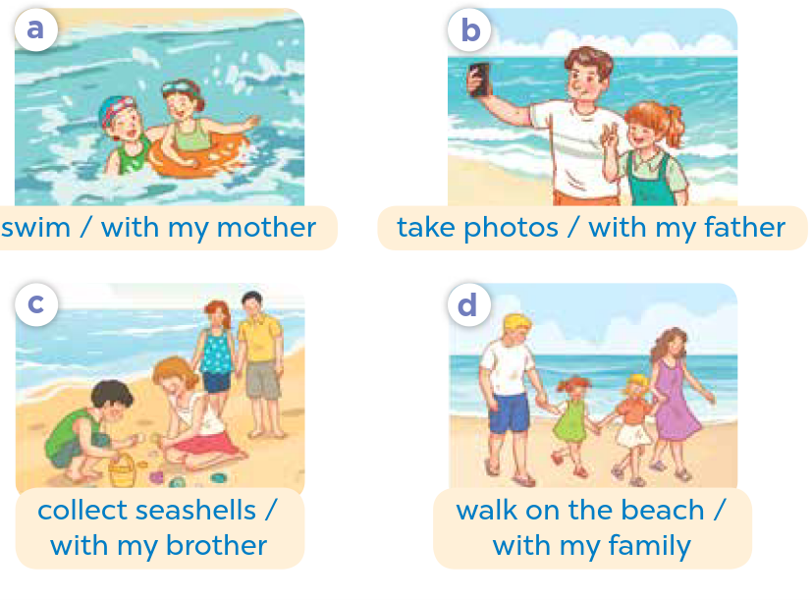
2.Listen, point and say
swim
Did you..................?
swam with my mother
Yes, I did. I…………………..............
Notes:
MADE BY FACEBOOK :TRAN THI THANH TAM

Slide 15
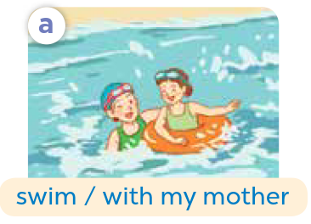
swim
Did you..................?
swam with my mother
Yes, I did. I…………………..............
Notes:
MADE BY FACEBOOK :TRAN THI THANH TAM

Slide 16
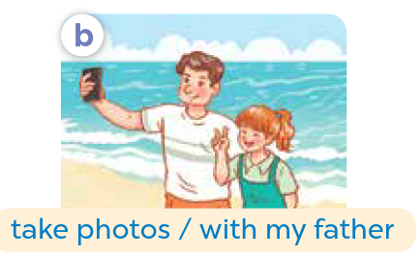
take photos
Did you……..................?
took photos with my father
Yes, I did. I………………………..............
Notes:
MADE BY FACEBOOK :TRAN THI THANH TAM

Slide 17
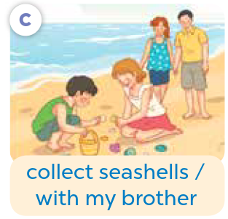
collect seashells
Did you….……...................?
collected seashells with my mother
Yes, I did. I…………..….………………..............
Notes:
MADE BY FACEBOOK :TRAN THI THANH TAM

Slide 18
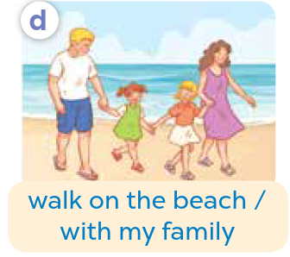
walk on the beach
Did you…………..................?
walked on the beach with my family
Yes, I did. I………………………………..............
Notes:
MADE BY FACEBOOK :TRAN THI THANH TAM

Slide 19
3. Let’s talk
swim
Did you..................?
swam with my mother
Yes, I did. I…………………..............
Notes:
MADE BY FACEBOOK :TRAN THI THANH TAM

