Slide 1
Unit 11
Lesson 1 – Period 1

Slide 2
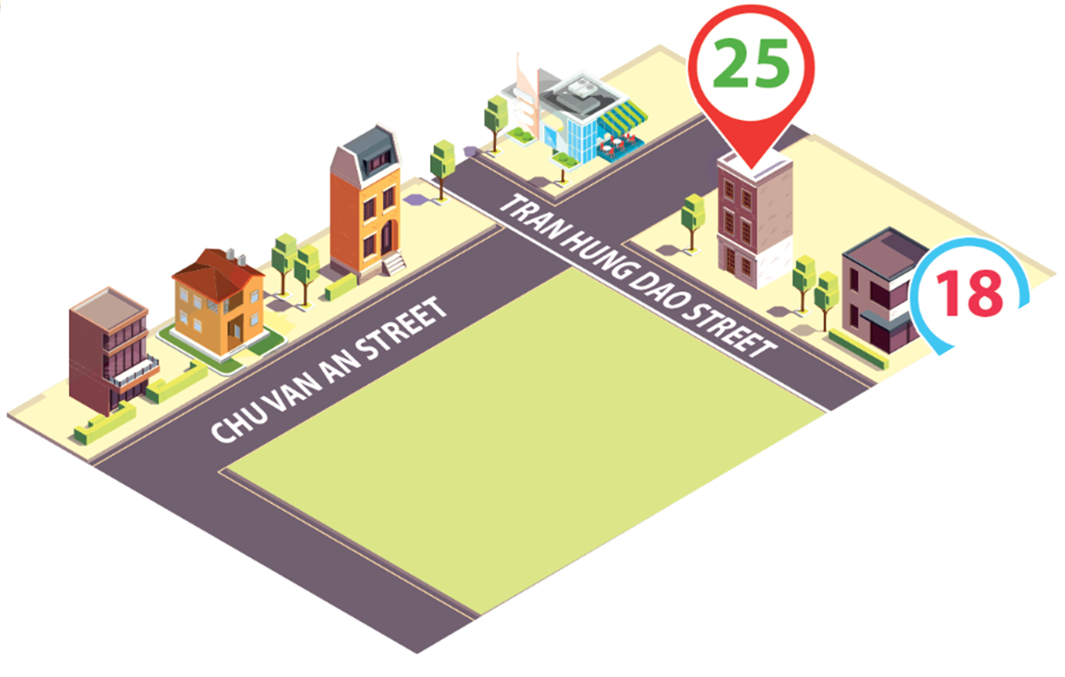
Vocabulary
street
/striːt/
(con) đường

Slide 3
Vocabulary
road
/rəʊd/
(con) đường

Slide 4
Vocabulary
My home
My home
live
/liv/
sống

Slide 5
Vocabulary
road
: (con) đường
MsPham
0936082789
street
: (con) đường
live
: sống

Slide 6
1
Look, listen and read.
MsPham
0936082789

Slide 7
1
Cách hỏi và trả lời bạn sống ở đâu?
Where do you live?
I live at + number + name of street/road.
I live in + name of street/road.

Slide 8
2
Listen, point and say.
Where do you live?
I live _________.
in Tran Hung Dao Street
in Quang Trung Road
at 81 Tran Hung Dao Street
at 9 Quang Trung Road

Slide 9
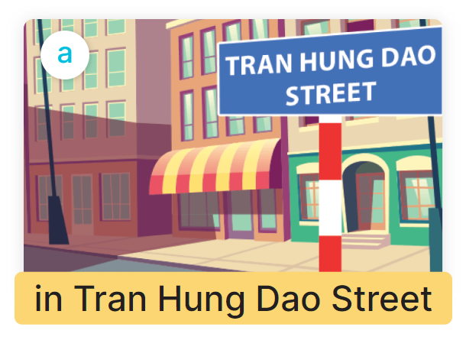
2
Listen, point and say.
Where do you live?
I live in Tran Hung Dao Street.

Slide 10
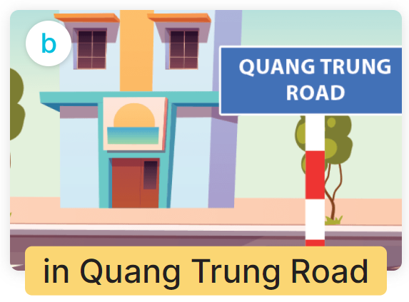
2
Listen, point and say.
Where do you live?
I live in Quang Trung Road

Slide 11
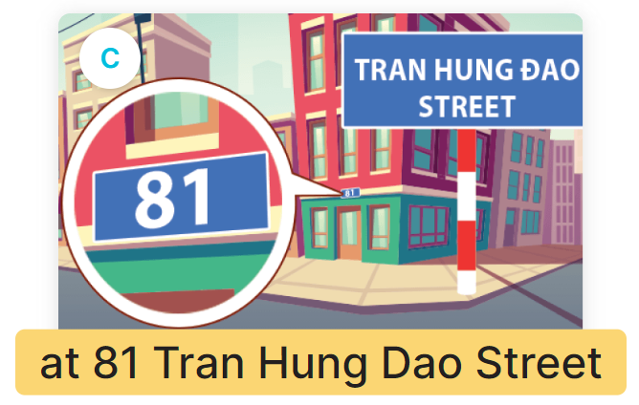
2
Listen, point and say.
Where do you live?
I live at 81 Tran Hung Dao Street.

Slide 12
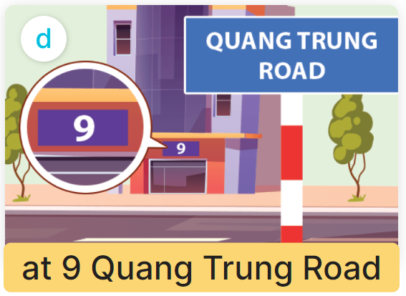
2
Listen, point and say.
Where do you live?
I live at 9 Quang Trung Road.

Slide 13
2
Listen, point and say.
Where do you live?
I live _________.
in Tran Hung Dao Street
in Quang Trung Road
at 81 Tran Hung Dao Street
at 9 Quang Trung Road

Slide 14
3
Let’s talk.
Where do you live?
I live at 25 Tran Hung Dao Street.

Slide 15
3
Let’s talk.
Where do you live?
I live in Hoa Binh Road.

Slide 16
MsPham
0936082789
(Bạn sống ở đâu?)
Where do you live?
I live _________.
(Tớ sống ở____)
in Tran Hung Dao Street
in Quang Trung Road
at 81 Tran Hung Dao Street
at 9 Quang Trung Road

