Slide 1


UBND QUẬN DƯƠNG KINH
TRƯỜNG TIỂU HỌC ANH DŨNG
WELCOME
To Our Class

Slide 2
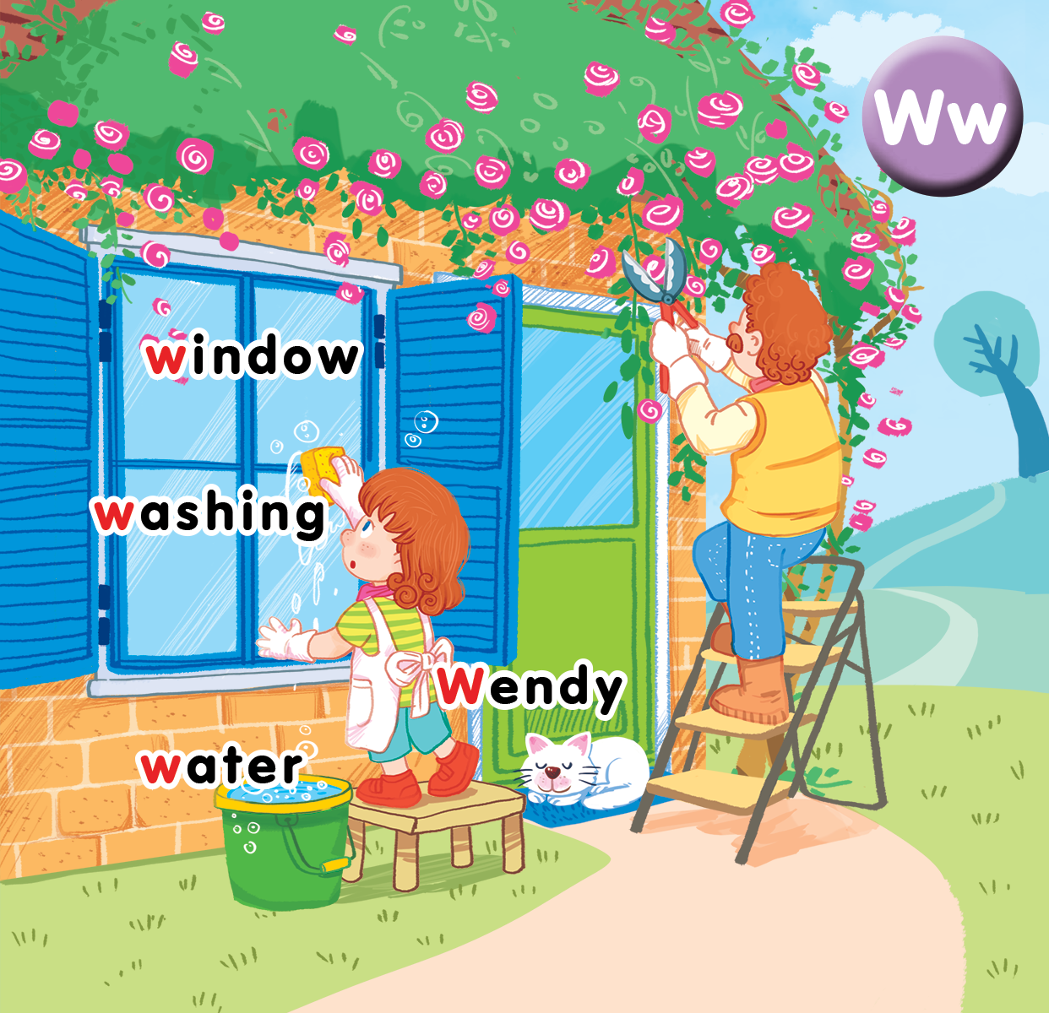
Unit 16 At home Lesson 3

Slide 3

Warm-up

Slide 4

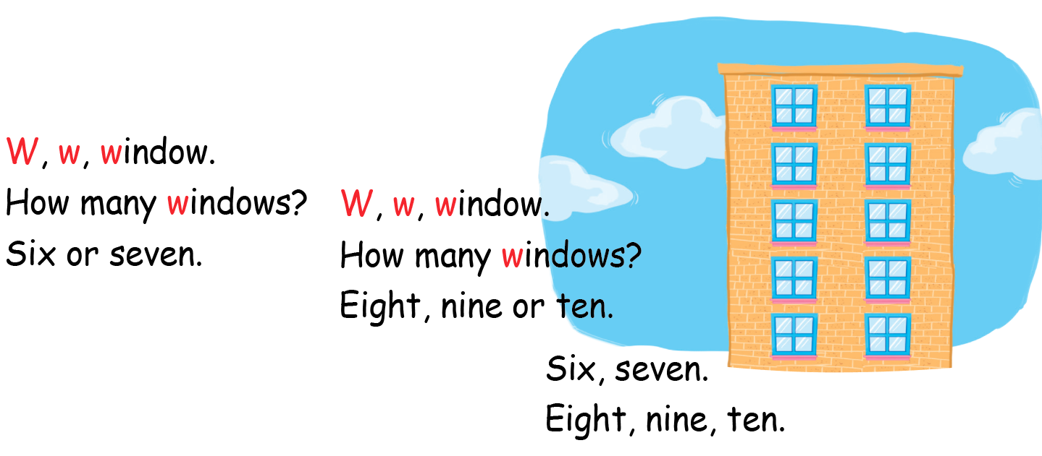
Listen and chant

Slide 5


Listen and repeat

Slide 6
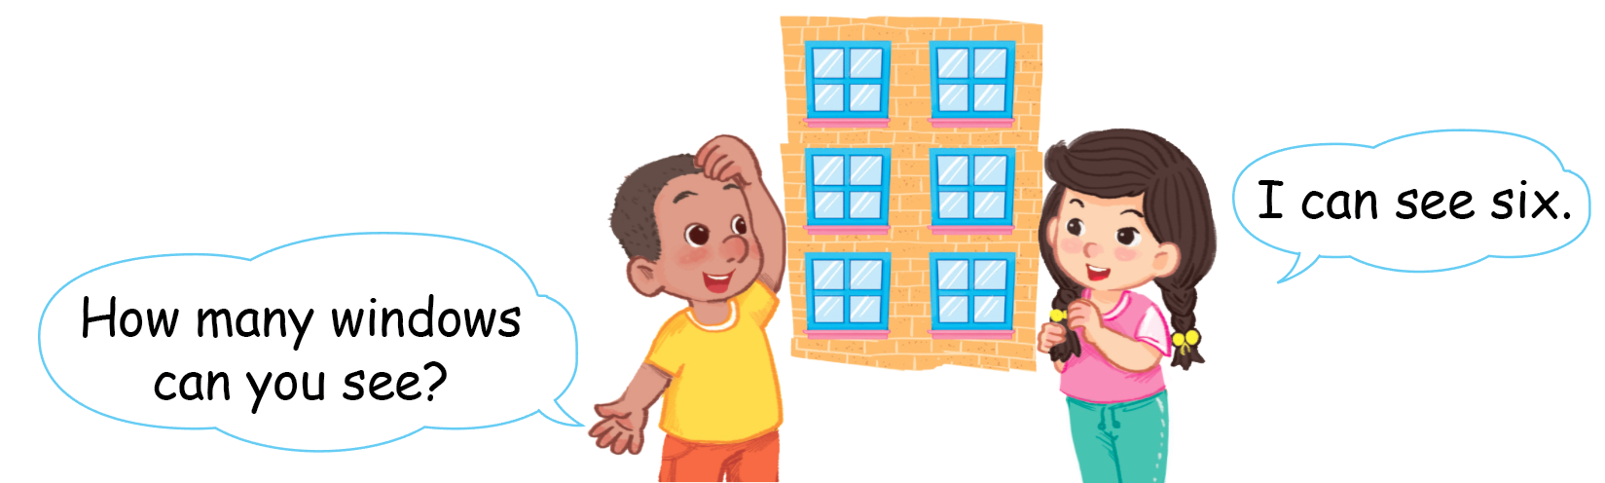
Listen and repeat

Slide 7


Let’s talk
Notes:
Let’s talk is divided into 2 steps.

Slide 8
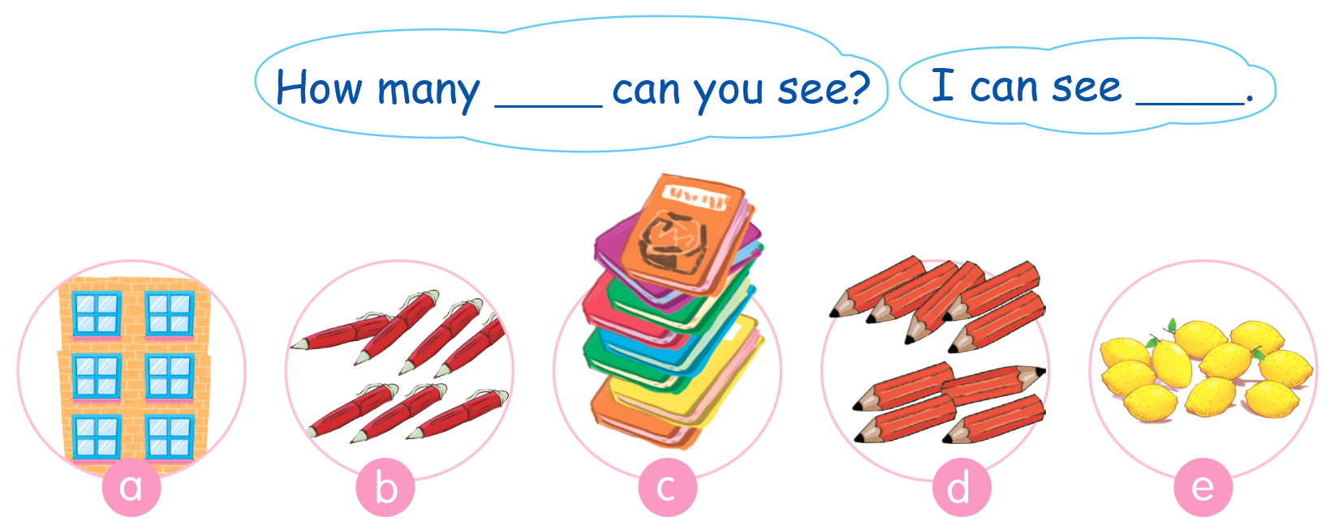
Let’s talk
Hình bài 7 trang70

Slide 9
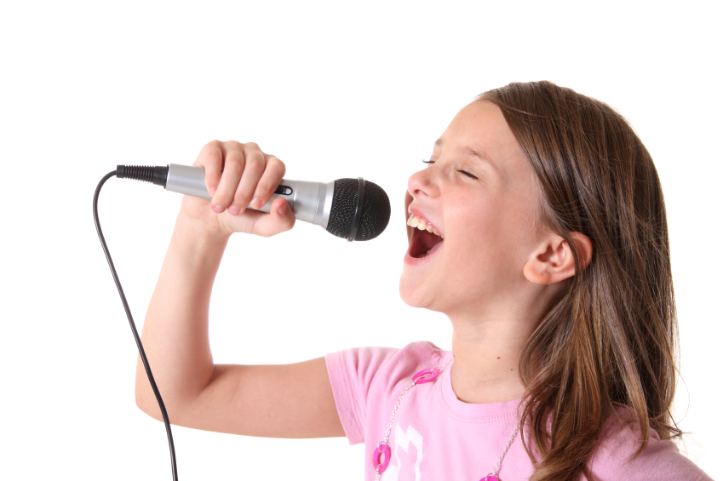

Let’s sing

Slide 10
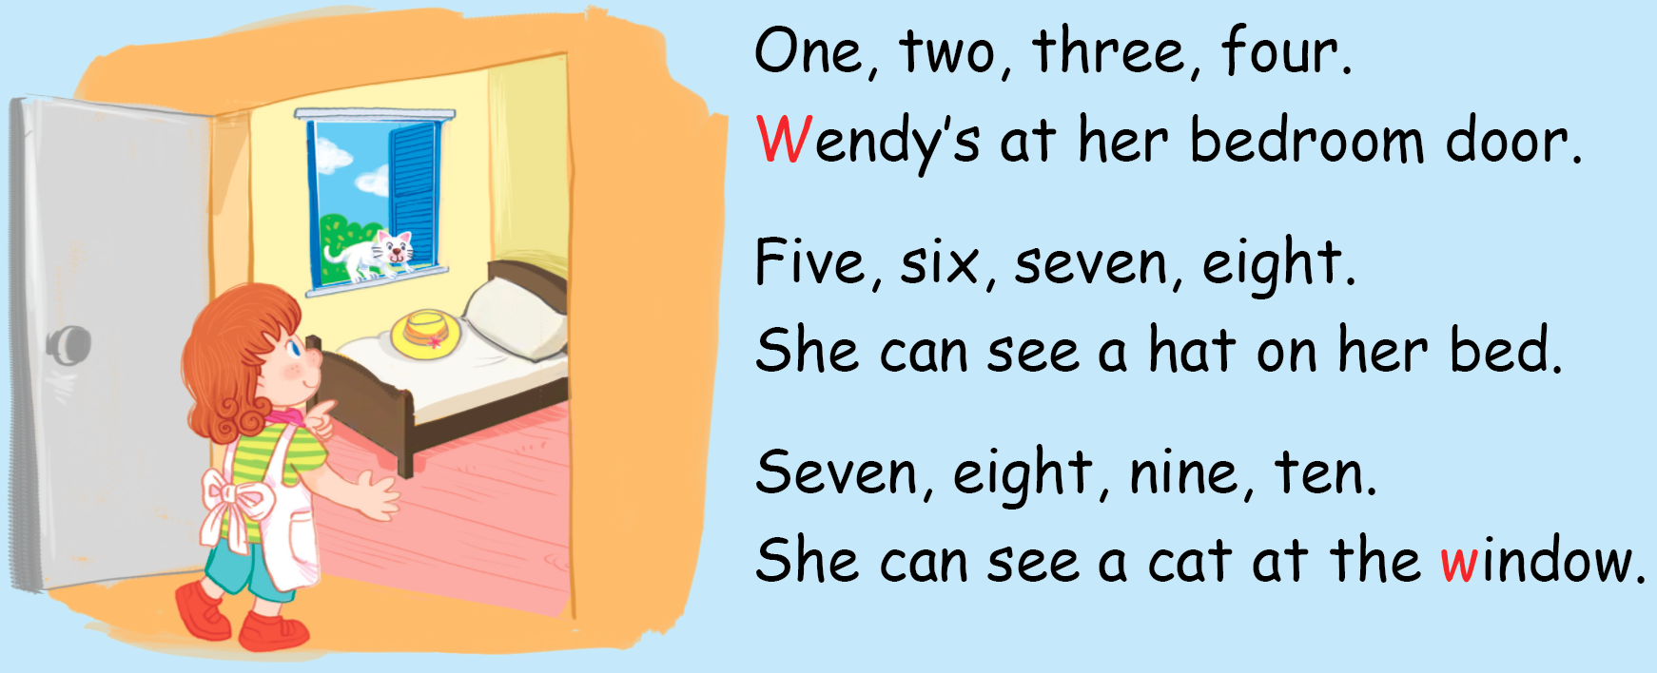
Let’s sing

Slide 11











TEAM 1:
TEAM 2:
TEAM 3:
TEAM 4:
Notes:
- Have pupils play in 4 groups.
- The groups take turns to choose a number. One member has to make a question with the picture, using the structure How many … can you see?. Then he/she can call another member of another group to answer.
- Correct question and answer can bring stars to the group.

Slide 12

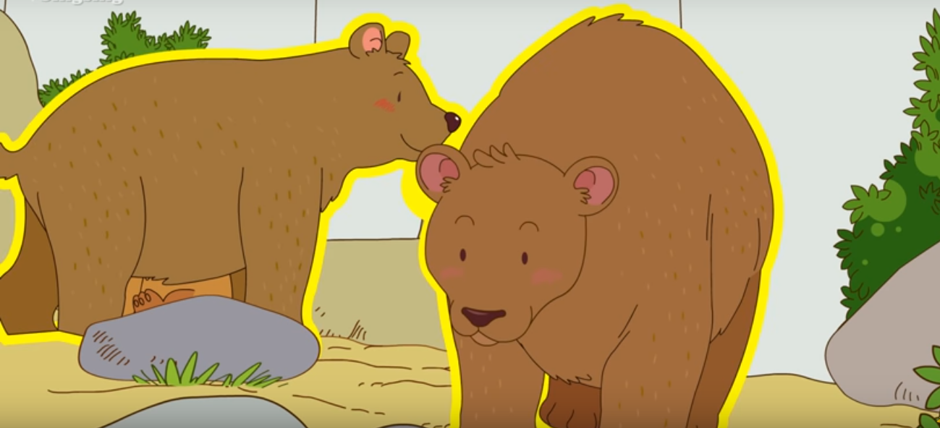
How many bears can you see?.
I can see two bears..

Slide 13
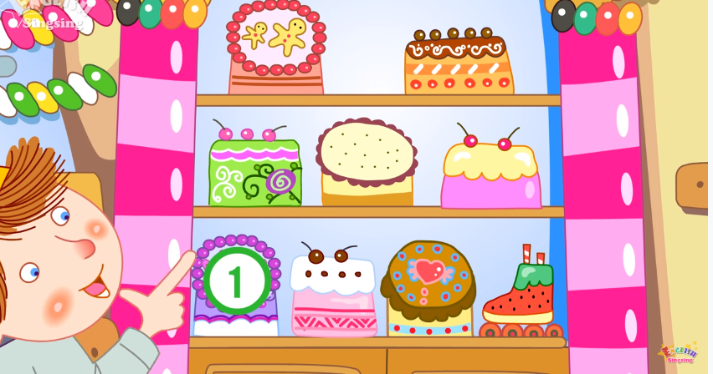
How many cakes can you see?.
I can see nine cakes..

Slide 14
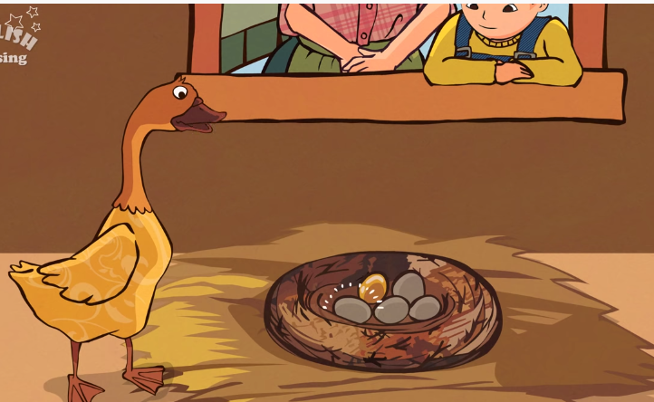

How many eggs can you see?.
I can see five eggs..

Slide 15
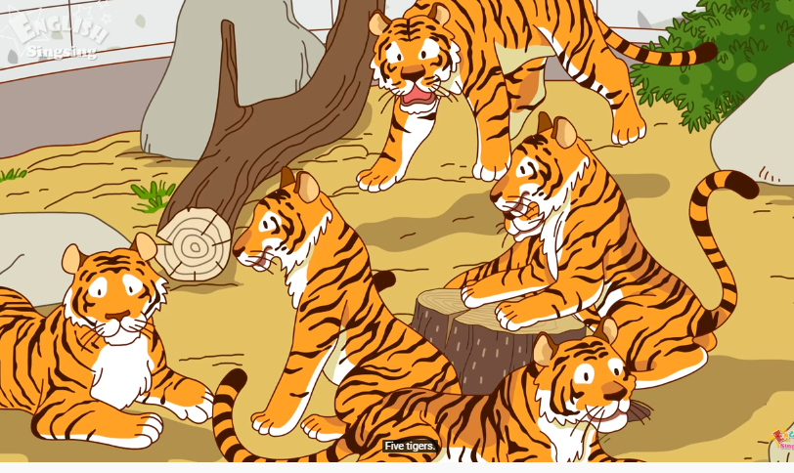

How many tigers can you see?.
I can see five tigers..

Slide 16
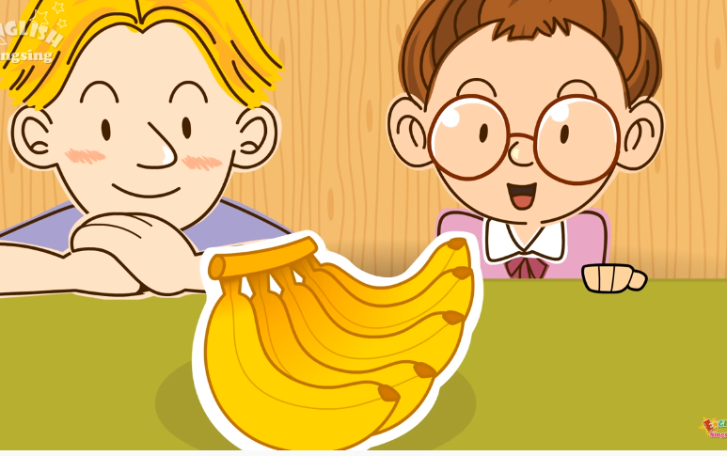
How many bananas can you see?.
I can see five bananas..

Slide 17

How many pencils can you see?.
I can see four pencils..

Slide 18
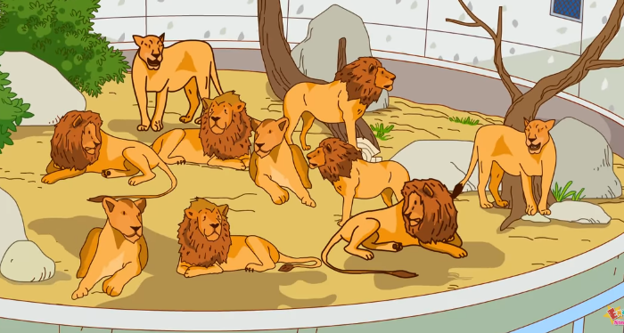
How many lions can you see?.
I can see ten lions..

Slide 19
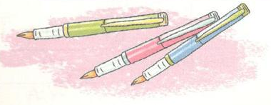
How many pens can you see?.
I can see three pens..

Slide 20

How many crayons can you see?.
I can see three crayons..

Slide 21
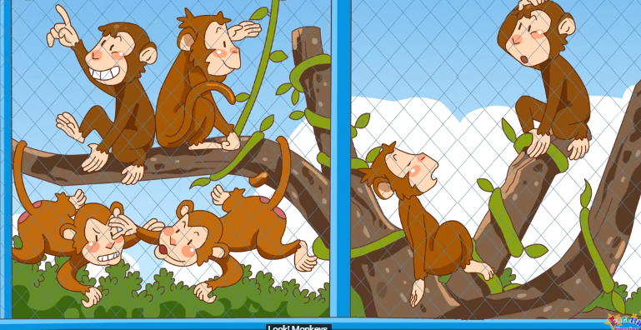
How many monkeys can you see?.
I can see six monkeys..

Slide 22
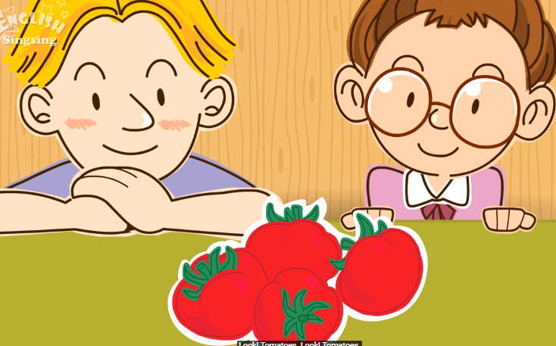
How many tomatoes can you see?.
I can see four tomatoes..

Slide 23

How many notebooks can you see?
I can see two notebooks..

Slide 24
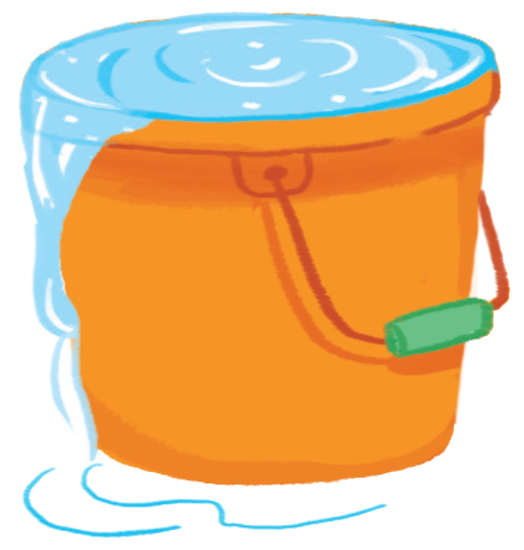
Goodbye
water
Notes:
Teacher shows the vocabulary of the lesson on slide.
Pupils say goodbye.

Slide 25

Goodbye
Wendy

Slide 26

Goodbye
window

Slide 27
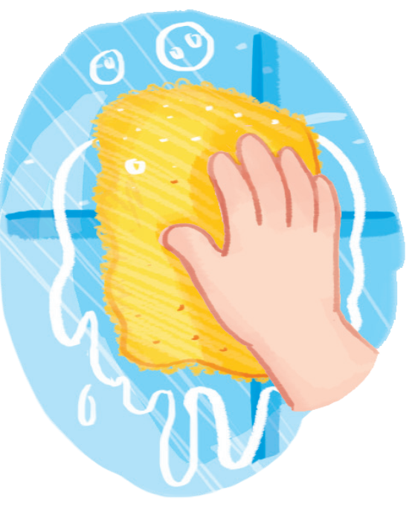
Goodbye
washing

Slide 28
Warm-up
THANK YOU!

