Slide 1
UBND QUẬN DƯƠNG KINH
TRƯỜNG TIỂU HỌC ANH DŨNG
HELLO AND WELCOME TO MY ENGLISH CLASS

Slide 2

FUN TIME 1
Period 1

Slide 3

Table of contents
01
Warm-up and Review
02
Activity 1.Find and circle. Then say.
03
Activity 2. Let’s play.
04
Fun corner and Wrap-up

Slide 4


01
Warm-up and Review

Slide 5


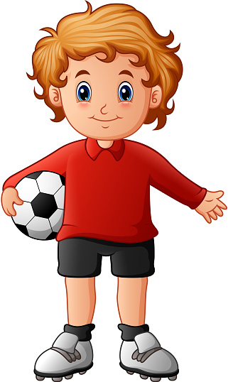
I have a ball.

Slide 6

I have a book.

Slide 7



I have a ball book.

Slide 8

I have a cup.

Slide 9
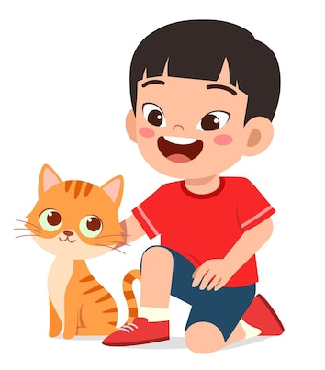
I have a cat.

Slide 10


I have a cat cup.

Slide 11




Let’s chant.
I have a ball.
I have a book.
I have a ball book.
I have a cup.
I have a cat.
I have a cat cup.

Slide 12
02
Activity 1.
Find and circle. Then say.

Slide 13
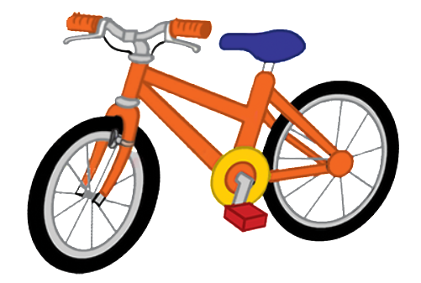
Find and circle. Then say.
b i k e c
a c u p p
b a l l c
c a r t a
b o o k t

Slide 14

b i k e c
a c u p p
b a l l c
c a r t a
b o o k t

Slide 15

b i k e c
a c u p p
b a l l c
c a r t a
b o o k t

Slide 16

b i k e c
a c u p p
b a l l c
c a r t a
b o o k t

Slide 17

b i k e c
a c u p p
b a l l c
c a r t a
b o o k t

Slide 18

b i k e c
a c u p p
b a l l c
c a r t a
b o o k t

Slide 19
b i k e c
a c u p p
b a l l c
c a r t a
b o o k t

Slide 20


GUESSING
GAME

Slide 21


What’s it?
1
2
4
3
bike
Notes:
Nháy chuột vào từng ô chữ để làm biến mất ô tương ứng.

Slide 22

What’s it?
1
2
4
3
ball

Slide 23

What’s it?
1
1
2
4
3
book

Slide 24
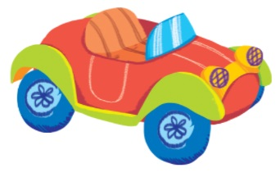
What’s it?
1
2
4
3
car

Slide 25
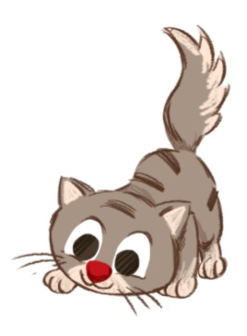
What’s it?
1
2
4
3
cat

Slide 26

What’s it?
1
2
4
3
cup

Slide 27
You Win!

Slide 28
03
Activity 2. Let’s play.

Slide 29
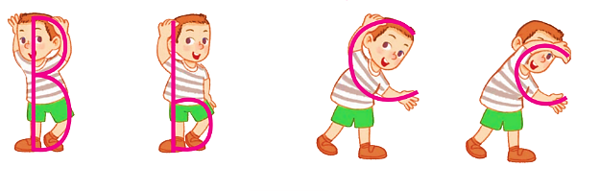
Let’s play.
Simon says

Slide 30
Simon says

Slide 31
Simon says

Slide 32
Simon says

Slide 33
Simon says

Slide 34
Simon says

Slide 35
04
Fun corner and Wrap-up

Slide 36


c
b
cup
Bill
bike
B
b
book
c
cake
c
cat
c
car
b
ball

Slide 37





THANK YOU!

