Slide 1
FUN TIME 3
UBND QUẬN DƯƠNG KINH
TRƯỜNG TIỂU HỌC ANH DŨNG
Period 1

Slide 2

Table of contents
01
Warm-up and Review
Activity 1.Trace and colour. Then point and say.
02
03
Activity 2. Let’s play.
04
Fun corner and Wrap-up

Slide 3


01
Warm-up and Review

Slide 4


HIDDEN PICTURES
GAME

Slide 5


What’s this picture?
clock

Slide 6

What’s this picture?
mop

Slide 7

What’s this picture?
pot

Slide 8

What’s this picture?
mango

Slide 9

What’s this picture?
monkey

Slide 10
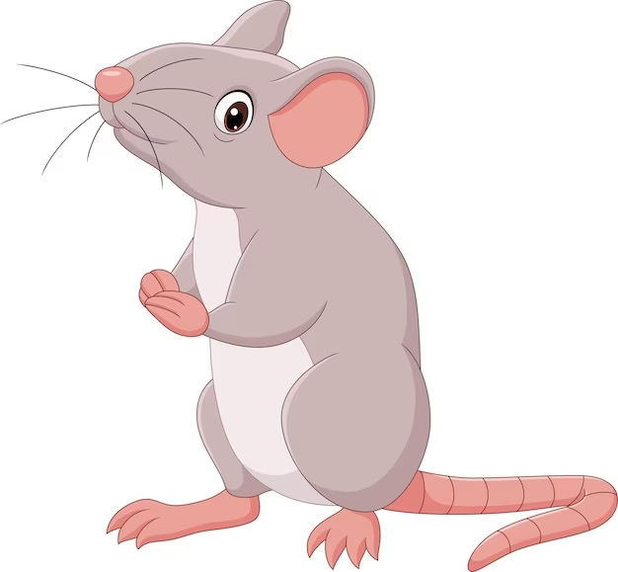
What’s this picture?
mouse

Slide 11


Very Good!

Slide 12
02
Activity 1. Trace and colour.
Then point and say.

Slide 13

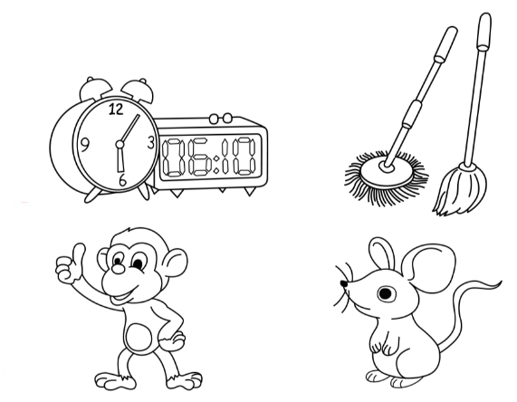
Trace and colour. Then point and say.
1
2
3
4

Slide 14
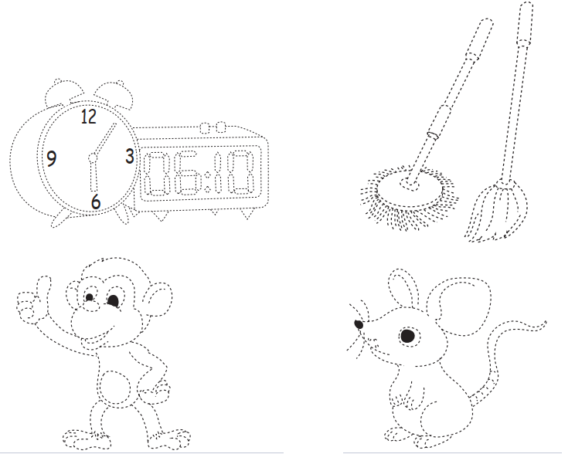







































Trace and colour. Then point and say.
1
clocks

Slide 15











Trace and colour. Then point and say.
2
mops

Slide 16

























Trace and colour. Then point and say.
3
monkey

Slide 17

















Trace and colour. Then point and say.
4
mouse

Slide 18

1
2
clocks
mops
3
4
monkey
mouse

Slide 19
03
Activity 2. Let’s play.

Slide 20
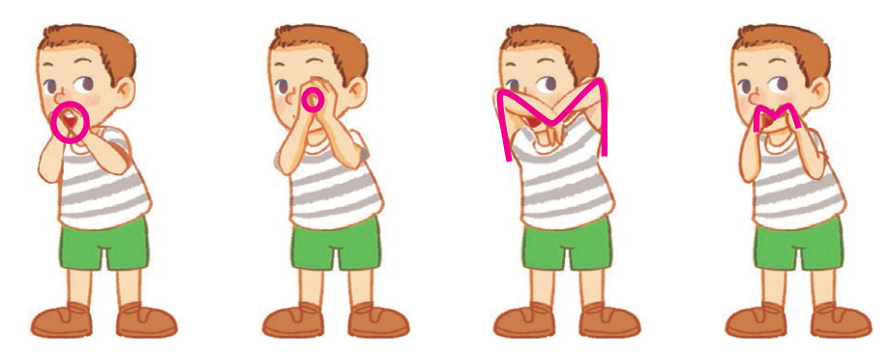
Let’s play.
Simon says

Slide 21

Let’s play.
Simon says

Slide 22

Let’s play.
Simon says

Slide 23

Let’s play.
Simon says

Slide 24

Let’s play.
Simon says

Slide 25
Let’s play.
Simon says

Slide 26
04
Fun corner and wrap-up

Slide 27
Wrap-up
m
/m/
o
/ɒ/

Slide 28


Slide 29

Pass the ball!
That’s a __.
That’s a __.

Slide 30

THANK YOU

