Slide 1

REVIEW 1
UBND QUẬN DƯƠNG KINH
TRƯỜNG TIỂU HỌC ANH DŨNG
Period 1

Slide 2

Table of contents
01
02
Warm-up and Review
Activity 1.
Listen and repeat.
03
04
Activity 2.
Look and circle.
Fun corner and Wrap-up

Slide 3


01
Warm-up and Review

Slide 4

GUESS THE WORDS
C
A
B

Slide 5


Look and choose.
a. cat
b. dog
c. duck

Slide 6

a. desk
b. door
c. duck

Slide 7

a. desk
b. bag
c. hat

Slide 8

a. ball
b. door
c. dog

Slide 9

a. cake
b. hat
c. bag

Slide 10

a. red
b. pen
c. bag

Slide 11

a. apple
b. cake
c. can

Slide 12

a. cat
b. can
c. cup

Slide 13


Very Good!

Slide 14
02
Activity 1. Listen and repeat.

Slide 15


Listen and repeat.
Hi! I’m Phonic Phil!
And I’m Super Sue!

Slide 16


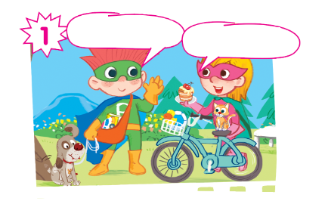
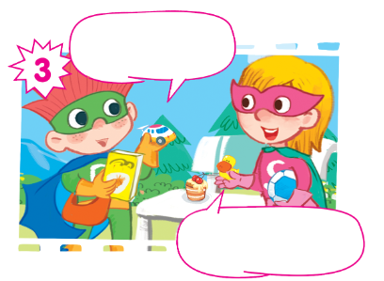
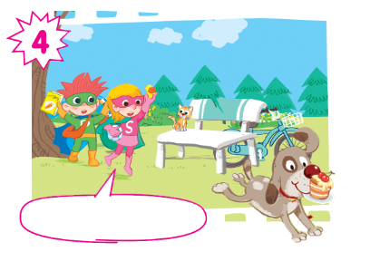
Oh, no! My cake!

Slide 17
Listen and repeat.
Hi! I’m Phil.
Hi! I’m Sue.

Slide 18
Listen and repeat.
Look! This is my dog.
And this is my cat.

Slide 19
Listen and repeat.
I have a car... and a book.
I have a ball... and a duck.

Slide 20
Listen and repeat.
Oh, no! My cake!

Slide 21
Listen and repeat.
Hi! I’m Phil.
Look! This is my dog.
Hi! I’m Sue.
And this is my cat.
I have a car... and a book.
I have a ball... and a duck.
Oh, no! My cake!
Oh, no! My cake!

Slide 22
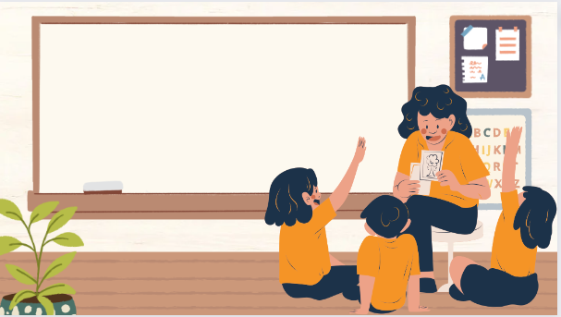
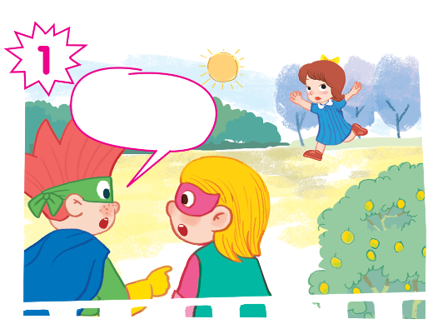
Play as a character

Slide 23
Hi! I’m Phil.
Look! This is my dog.
Hi! I’m Sue.
And this is my cat.
I have a car... and a book.
I have a ball... and a duck.
Oh, no! My cake!
Oh, no! My cake!

Slide 24
03
Activity 2. Look and circle.

Slide 25
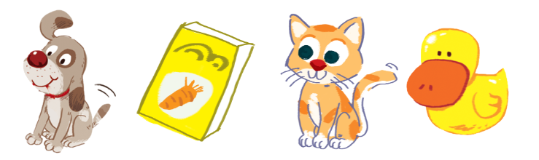
Look and circle.
dog cake cat duck book can car ball

Slide 26
Look and circle.
dog cake cat duck book can car ball

Slide 27
Look and circle.
cake cat duck book can car ball

Slide 28
Look and circle.
cake cat duck can car ball

Slide 29
Look and circle.
cake duck can car ball

Slide 30
Look and circle.
dog
book
cat
duck

Slide 31
04
Fun corner and Wrap-up

