Slide 1
REVIEW 1
UBND QUẬN DƯƠNG KINH
TRƯỜNG TIỂU HỌC ANH DŨNG
Period 2

Slide 2

Table of contents
01
Warm-up and Review
02
Activity 1. Listen and tick.
03
Activity 2. Listen and circle.
04
Activity 3. Listen and tick or cross.
05
Fun corner and Wrap-up

Slide 3


01
Warm-up and Review

Slide 4

Let’s play.

Slide 5
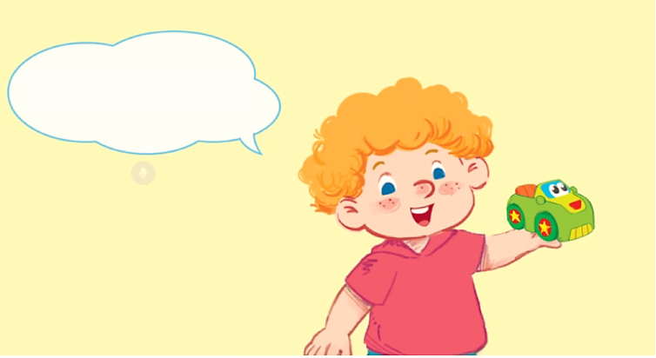

I’m Bill.
I have a bag.

Slide 6


ball

Slide 7
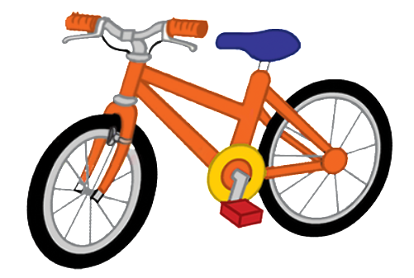
bike

Slide 8

book

Slide 9

car

Slide 10

cat

Slide 11

cup

Slide 12

cake

Slide 13

dog

Slide 14

duck

Slide 15

desk

Slide 16

door

Slide 17

hat

Slide 18

apple

Slide 19

can

Slide 20


Very Good!

Slide 21
02
Activity 1. Listen and tick.

Slide 22

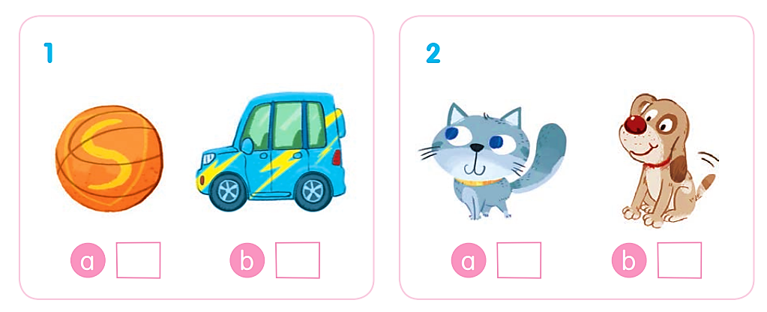
Listen and tick.

Slide 23
Listen and tick.
✓

Slide 24
Listen and tick.
✓

Slide 25
Listen and tick.
✓
✓

Slide 26
03
Activity 2. Listen and circle.

Slide 27
Listen and circle.
1 b d 2 a c
3 b c 4 c d

Slide 28
Listen and circle.
1 b d

Slide 29
Listen and circle.
2 a c

Slide 30
Listen and circle.
3 b c

Slide 31
Listen and circle.
4 c d

Slide 32
Listen and circle.
1 b d 2 a c
3 b c 4 c d

Slide 33
04
Activity 3.
Listen and tick or cross.

Slide 34
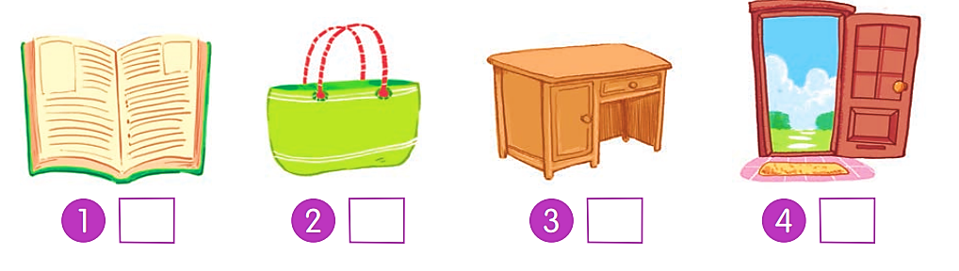
Listen and tick or cross.

Slide 35
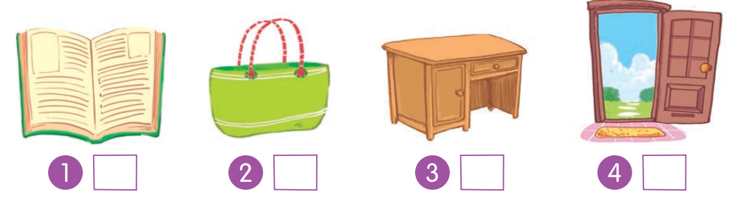
Listen and tick or cross.
✗

Slide 36
Listen and tick or cross.
✓

Slide 37
Listen and tick or cross.
✓

Slide 38
Listen and tick or cross.
✗

Slide 39
Listen and tick or cross.
✗
✓
✓
✗

Slide 40
05
Fun corner and Wrap-up

Slide 41
c
a
b
d

