Slide 1

REVIEW 2
UBND QUẬN DƯƠNG KINH
TRƯỜNG TIỂU HỌC ANH DŨNG
Period 1

Slide 2

Table of contents
01
02
Warm-up and Review
Activity 1.
Listen and repeat.
03
04
Activity 2.
Look and circle.
Fun corner and Wrap-up

Slide 3


01
Warm-up and Review

Slide 4


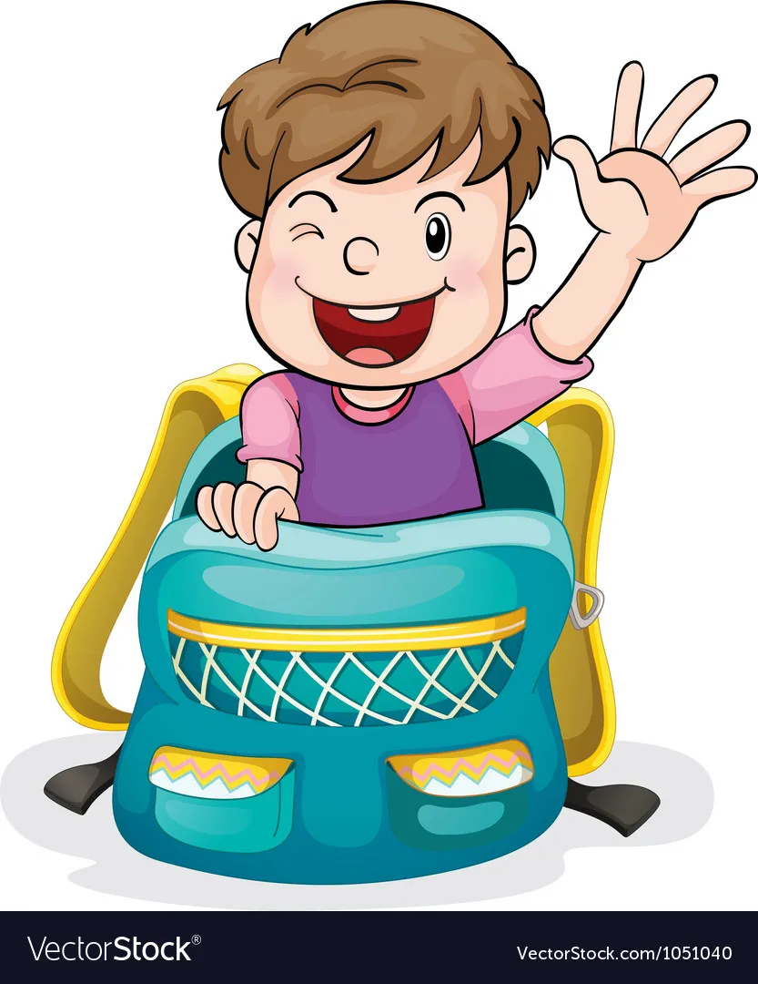

Slide 5


chips

Slide 6

fish

Slide 7

milk

Slide 8
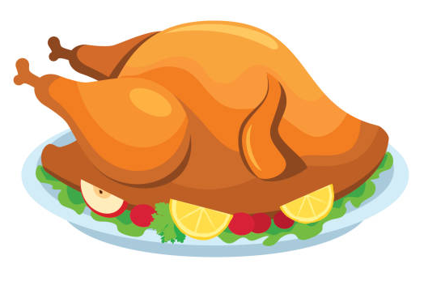
chicken

Slide 9

bell

Slide 10

pen

Slide 11

pencil

Slide 12

red

Slide 13
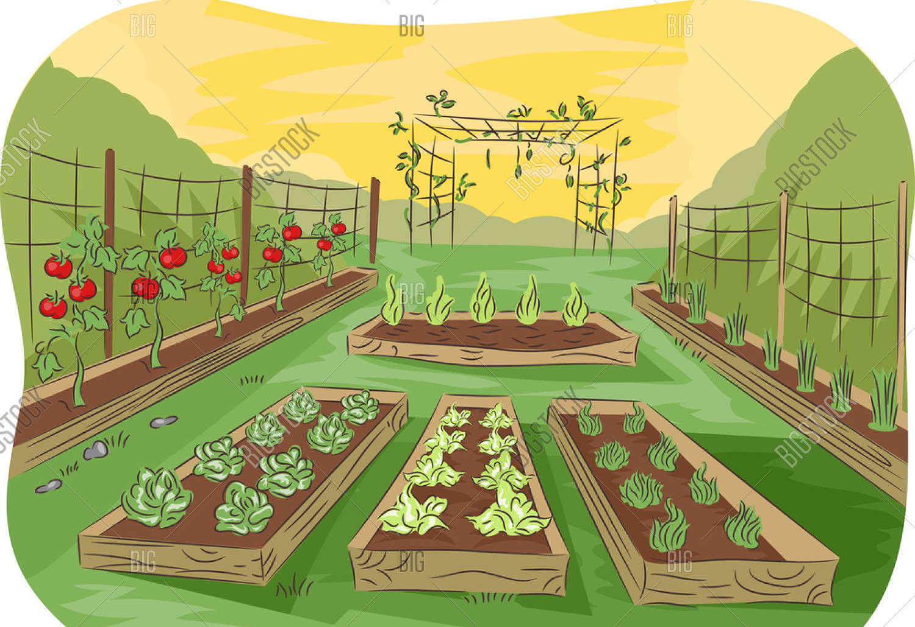
garden

Slide 14

gate

Slide 15
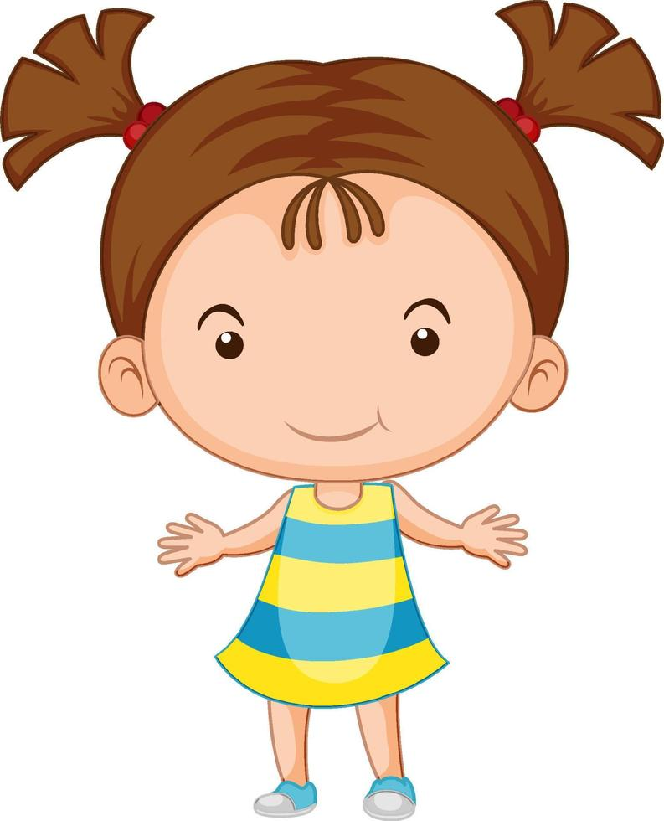
girl

Slide 16
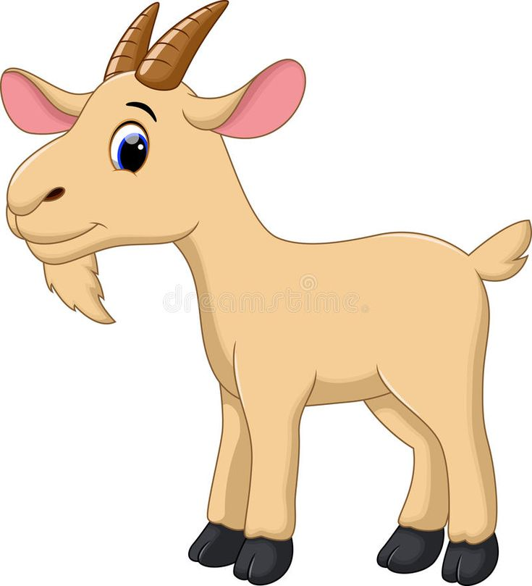
goat

Slide 17

hand

Slide 18

head

Slide 19
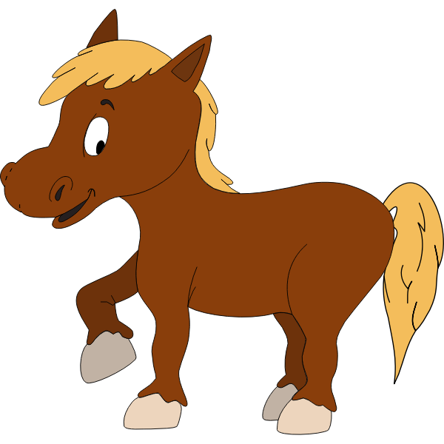
horse

Slide 20


Very Good!

Slide 21
02
Activity 1. Listen and repeat.

Slide 22

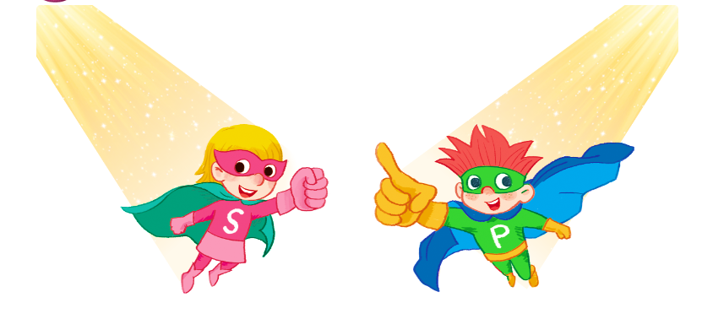
Listen and repeat.

Slide 23

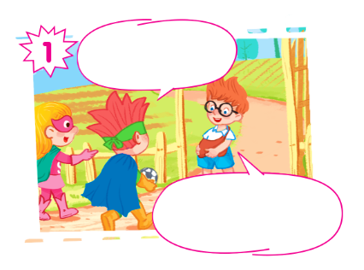
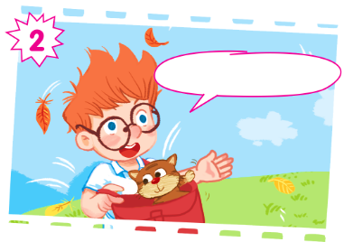
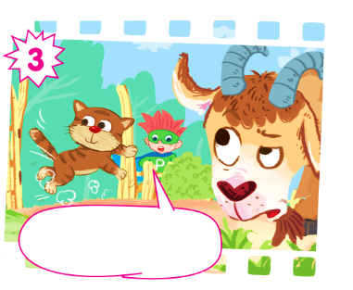
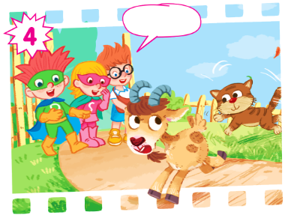

Slide 24
Listen and repeat.
Hi, Ben! I have a ball.
Hello, Sue and Phil! Look! I have a bag.

Slide 25
Listen and repeat.
And I have a cat.

Slide 26
Listen and repeat.
Look out, cat! There's a goat!

Slide 27
Listen and repeat.
Ha ha.

Slide 28
Listen and repeat.
Hi, Ben! I have a ball.
And I have a cat.
Hello, Sue and Phil! Look! I have a bag.
Ha ha.
Look out, cat! There's a goat!

Slide 29
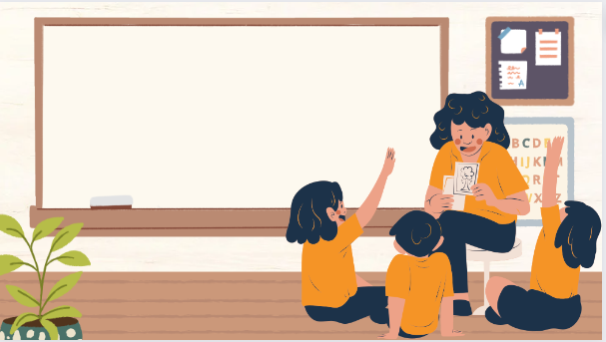
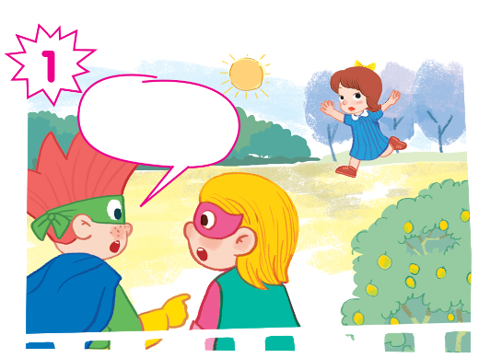
Play as a character

Slide 30
Hi, Ben! I have a ball.
And I have a cat.
Hello, Sue and Phil! Look! I have a bag.
Ha ha.
Look out, cat! There's a goat!

Slide 31
03
Activity 2. Look and circle.

Slide 32

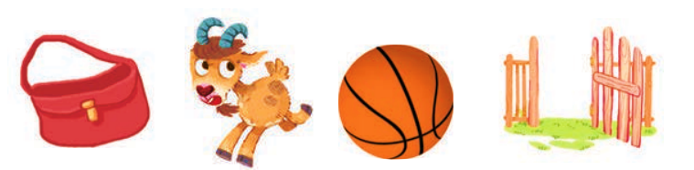
Look and circle.
cat gate girl goat hand head bag ball

Slide 33
Look and circle.
cat gate girl goat hand head bag ball

Slide 34
Look and circle.
cat gate girl goat hand head ball

Slide 35
Look and circle.
cat gate girl hand head ball

Slide 36
Look and circle.
cat gate girl hand head

Slide 37
Look and circle.
bag
goat
ball
gate

Slide 38
04
Fun corner and Wrap-up

Slide 39
