Slide 1

REVIEW 2
UBND QUẬN DƯƠNG KINH
TRƯỜNG TIỂU HỌC ANH DŨNG
Period 2

Slide 2

Table of contents
01
Warm-up and Review
02
Activity 1. Listen and tick.
03
Activity 2. Listen and circle.
04
Activity 3. Listen and tick or cross.
05
Fun corner and Wrap-up

Slide 3


01
Warm-up and Review

Slide 4
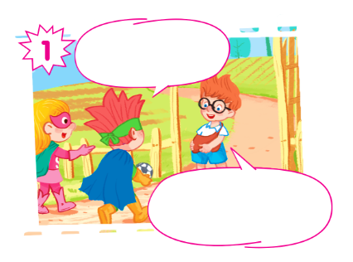
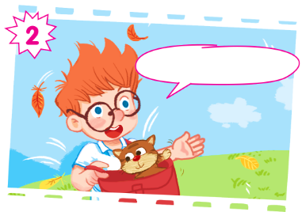
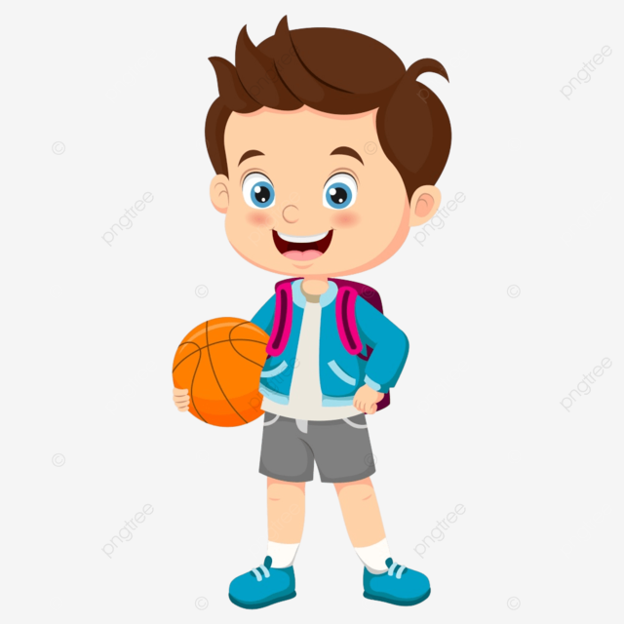

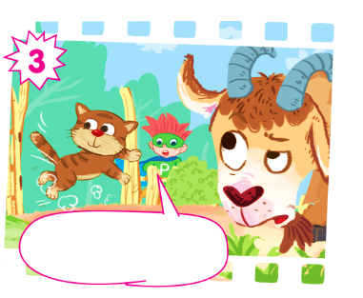
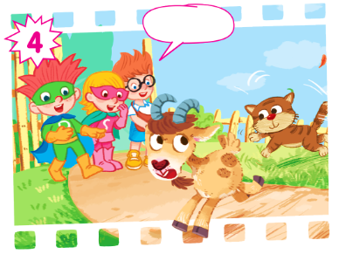
Play as a character.

Slide 5
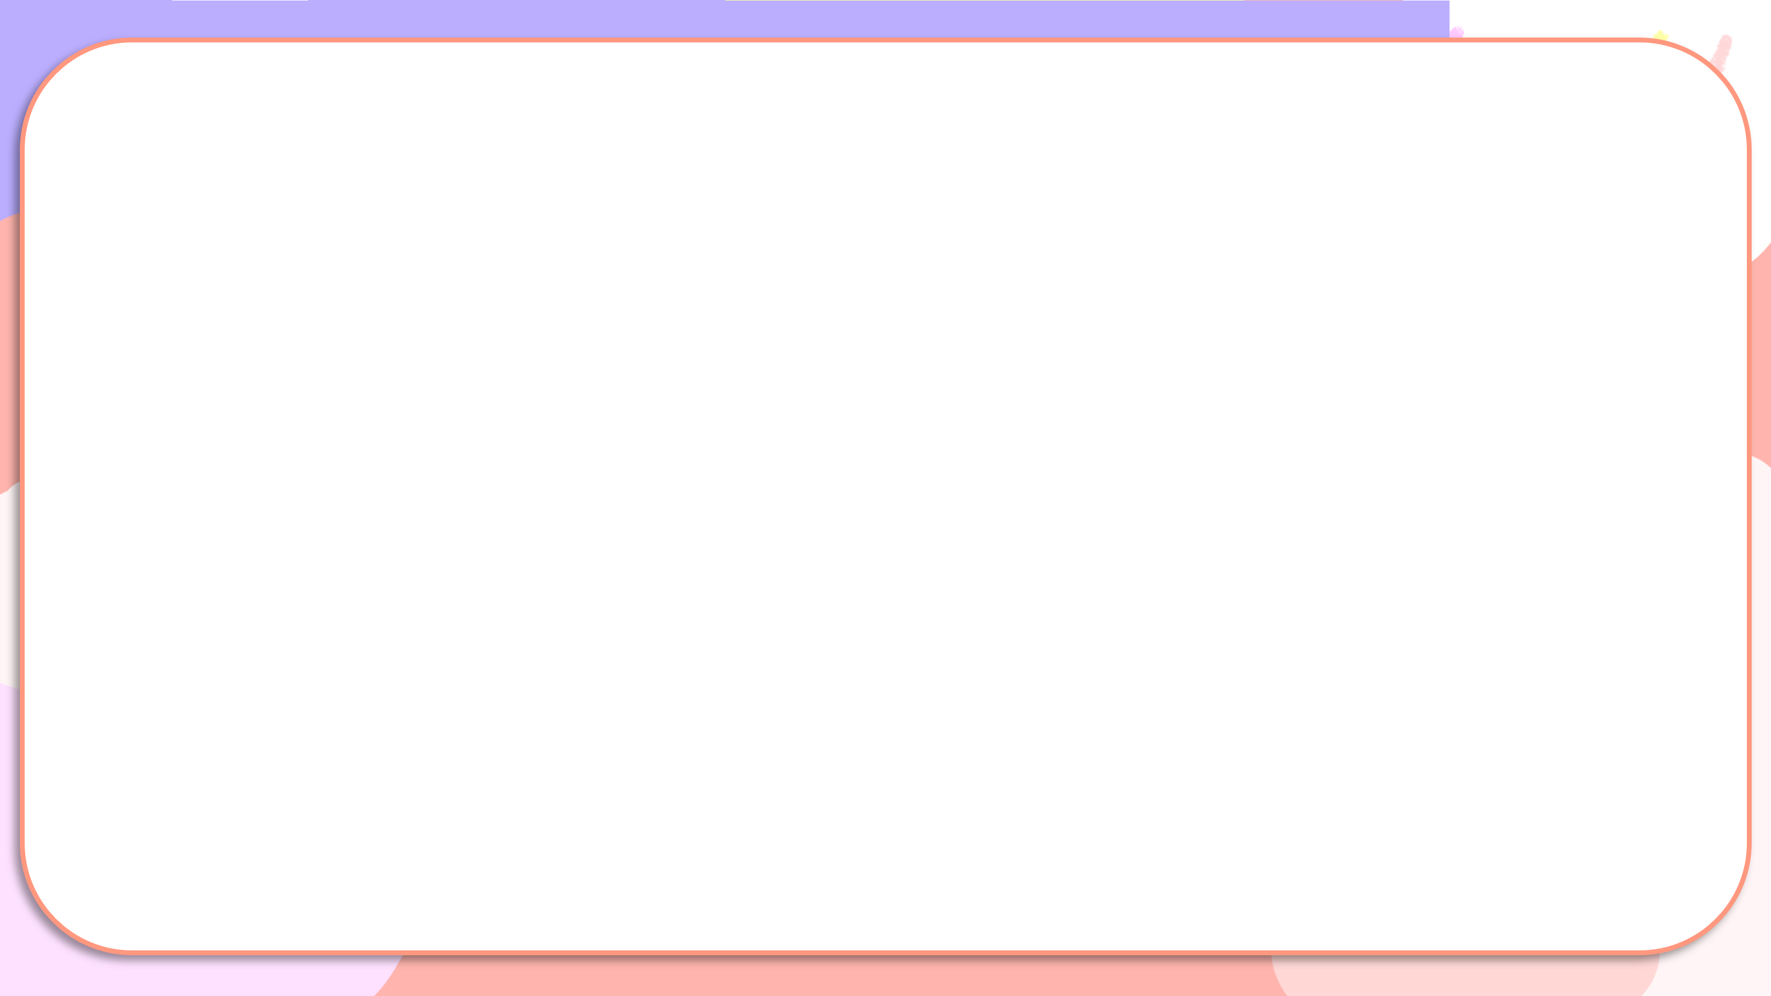
Hi, Ben! I have a ball.
Hello, Sue and Phil! Look! I have a bag.

Slide 6
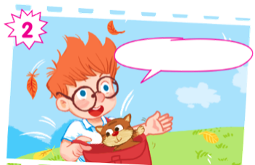
And I have a cat.

Slide 7
Look out, cat! There's a goat!

Slide 8
Ha ha.

Slide 9
02
Activity 1. Listen and tick.

Slide 10

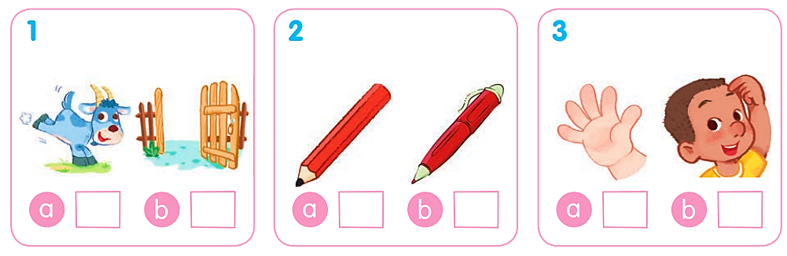
Listen and tick.

Slide 11
Listen and tick.
✓

Slide 12
Listen and tick.
✓

Slide 13
Listen and tick.
✓

Slide 14
Listen and tick.
✓
✓
✓

Slide 15
03
Activity 2. Listen and circle.

Slide 16

Listen and circle.
1 e i 2 e g
3 g h 4 h d

Slide 17
Listen and circle.
1 e i

Slide 18
Listen and circle.
2 e g

Slide 19
Listen and circle.
3 g h

Slide 20
Listen and circle.
4 h d

Slide 21
Listen and circle.
1 e i 2 e g
3 g h 4 h d

Slide 22
04
Activity 3.
Listen and tick or cross.

Slide 23
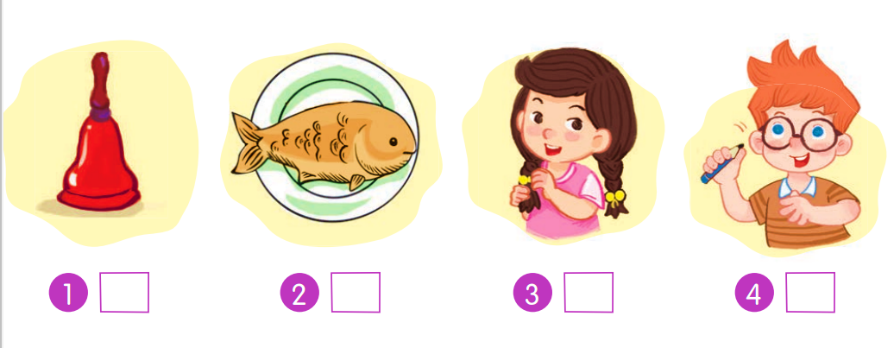
Listen and tick or cross.

Slide 24
Listen and tick or cross.
✓

Slide 25
Listen and tick or cross.
✗

Slide 26
Listen and tick or cross.
✓

Slide 27
Listen and tick or cross.
✗

Slide 28
Listen and tick or cross.
✓
✗
✓
✗

Slide 29
05
Fun corner and Wrap-up

Slide 30

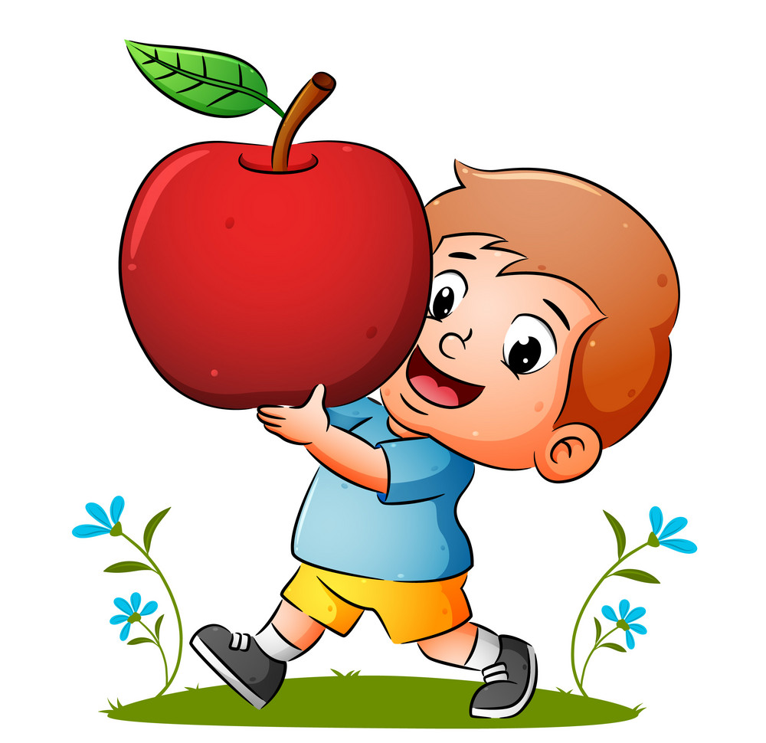
Choose the correct answer a, b or c.
I have a ___.
a. cup
b. apple
c. aple

Slide 31
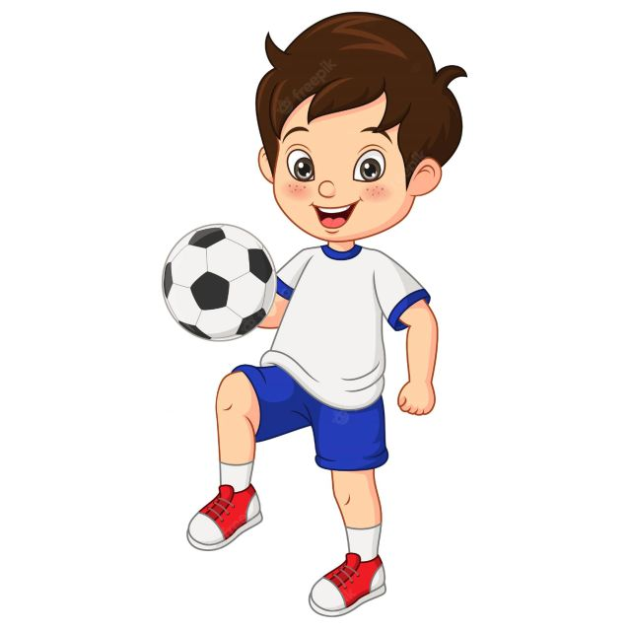
I have a ___.
a. book
b. ball
c. bike

Slide 32
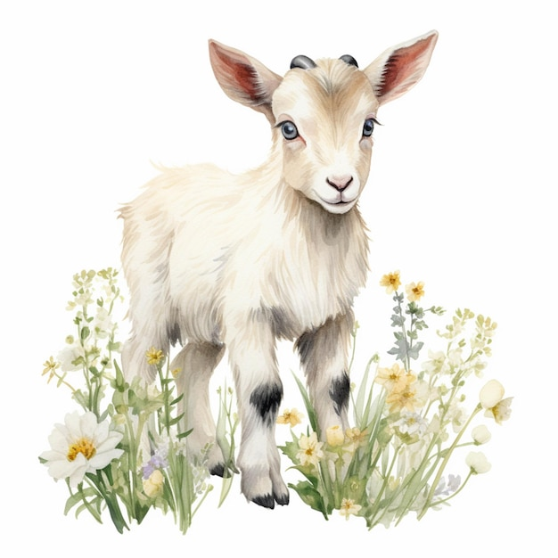
There’s a ___.
a. gate
b. girl
c. goat

Slide 33
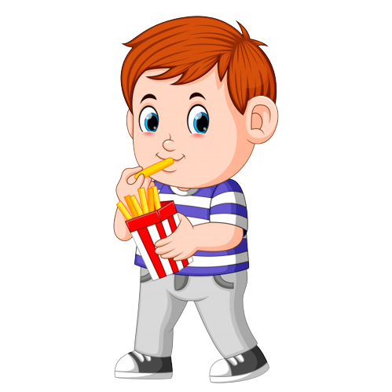
I like ____ .
a. fish
b. cake
c. chips

Slide 34
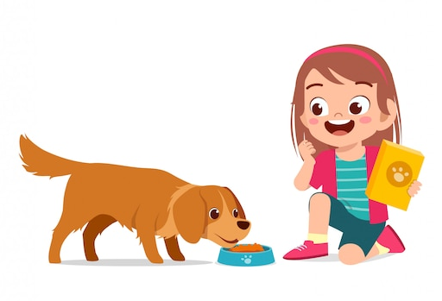
This is my ___.
a. dog
b. duck
c. cat

Slide 35


Very Good!

