Slide 1

REVIEW 3
Period 1

Slide 2

Table of contents
01
02
Warm-up and Review
Activity 1.
Listen and repeat.
03
04
Activity 2.
Look and circle.
Fun corner and Wrap-up

Slide 3


01
Warm-up and Review

Slide 4


Slide 5
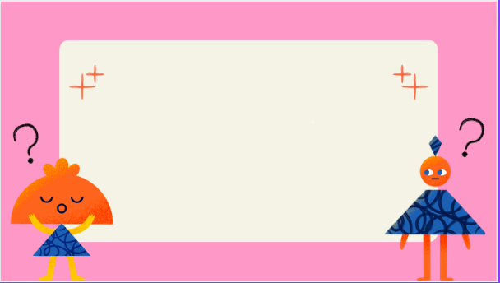

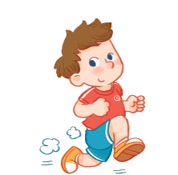

running

Slide 6

bus

Slide 7

Lucy

Slide 8

lake

Slide 9

sun

Slide 10

lemon

Slide 11

truck

Slide 12

leaf

Slide 13


Very Good!

Slide 14
02
Activity 1. Listen and repeat.

Slide 15

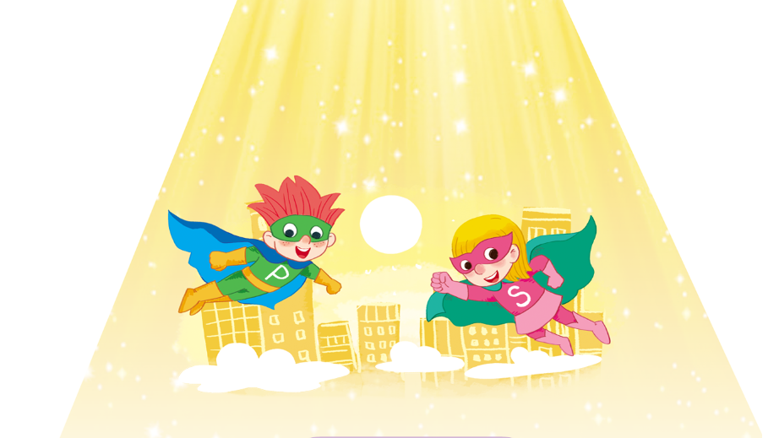
Listen and repeat.

Slide 16

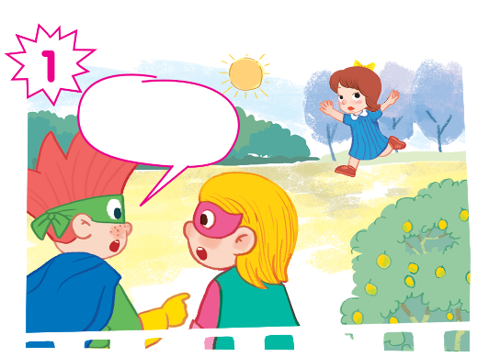
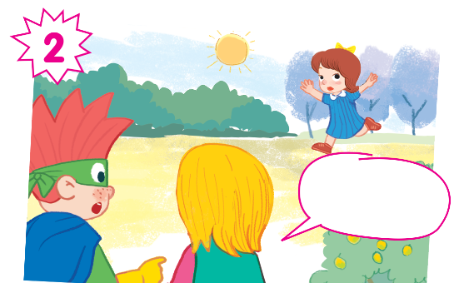
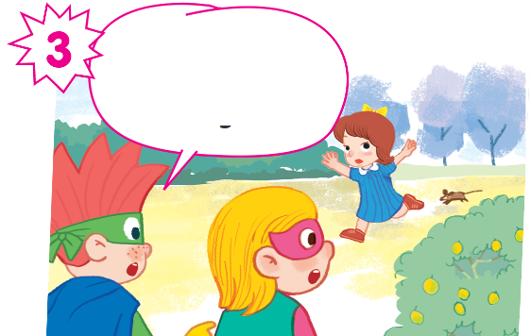
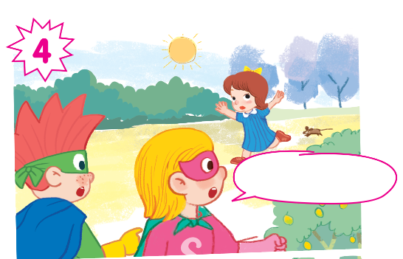

Slide 17

Listen and repeat.
Look at Mary!

Slide 18

Listen and repeat.
She’s running.

Slide 19

Listen and repeat.
And there’s a mouse. It’s running, too.

Slide 20

Listen and repeat.
Oh! Run, Phil!

Slide 21
Look at Mary!
She’s running.
And there’s a mouse. It’s running, too.
Oh! Run, Phil!

Slide 22
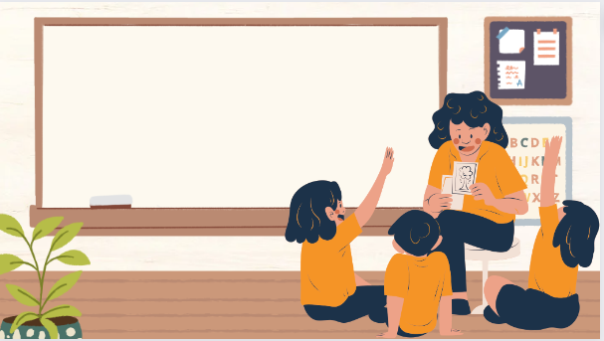
Play as a character

Slide 23
Look at Mary!
She’s running.
And there’s a mouse. It’s running, too.
Oh! Run, Phil!

Slide 24
03
Activity 2. Look and circle.

Slide 25
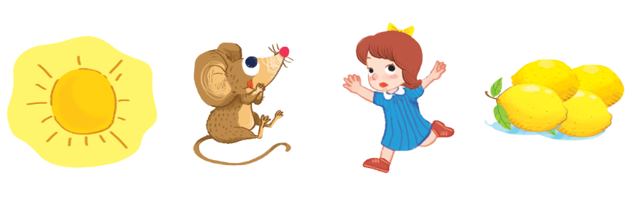
Look and circle.
bus lake locks lemons
monkey mouse running sun

Slide 26
Look and circle.
bus lake locks lemons
monkey mouse running sun

Slide 27



Look and circle.
bus lake locks lemons
monkey mouse running sun

Slide 28





Look and circle.
bus lake locks lemons
monkey mouse running sun

Slide 29



Look and circle.
bus lake locks lemons
monkey mouse running sun

Slide 30




sun
mouse
running
lemons

Slide 31
04
Fun corner and Wrap-up

Slide 32
Fill in the blanks.
Look at
______ Mary!

Slide 33
running
She’s ______.

Slide 34
And there’s a ______. It’s ______, too.
mouse
running

Slide 35
run
Oh! ____, Phil!

