Slide 1

REVIEW 3
Period 3

Slide 2

Table of contents
01
Warm-up and Review
02
Activity 4. Read and tick.
03
Activity 5. Find the words.
04
Activity 6. Write the letters.
05
Fun corner and Wrap-up

Slide 3


01
Warm-up and Review

Slide 4



Slide 5


Slide 6


Slide 7








Review
pot
mop
clock
lock
lake
lemon
Lucy

Slide 8
02
Activity 4. Read and tick.

Slide 9

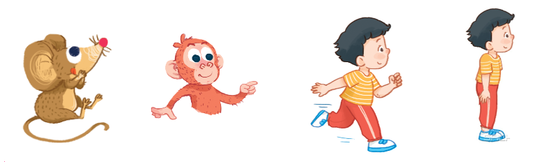

Read and tick.
a
b
a
b
a
b

Slide 10

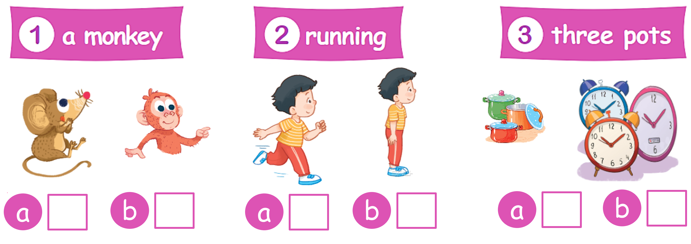
Read and tick.
✓

Slide 11
Read and tick.
✓

Slide 12
Read and tick.
✓

Slide 13
Read and tick.
✓
✓
✓
b
a
b
a
b
a

Slide 14
03
Activity 5. Find the words.

Slide 15
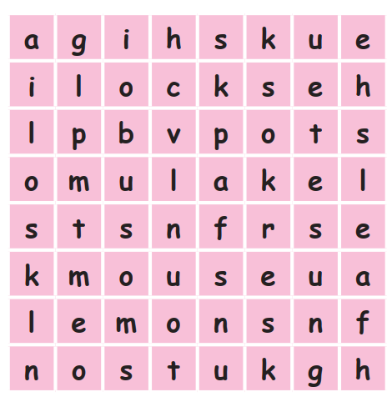
Find the words.
bus
locks
lake
mouse
leaf
pots
lemons
sun
Notes:
Nháy vào khung chữ từ để khoang tròn từ trong bảng.

Slide 16
Read.
bus
locks
lake
mouse
leaf
pots
lemons
sun
Notes:
Nháy vào khung chữ từ ở để khoang tròn từ trong bảng.

Slide 17
04
Activity 6.
Write the letters.

Slide 18
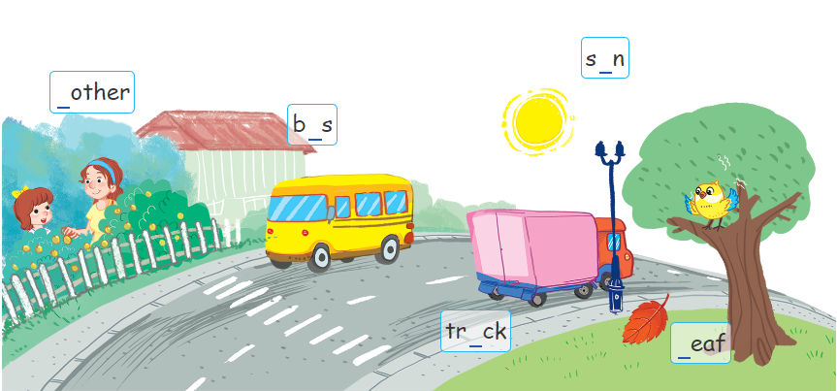
Write the letters.

Slide 19

Magical
balloons
Game

Slide 20

Choose to fill in the blanks.
__rother
b
b
d
h
f
Notes:
Nháy chuột vào quả bóng để chọn đáp án đúng.

Slide 21
b__s
u
a
e
i
u

Slide 22
tr__ck
u
i
e
o
u

Slide 23
__eaf
l
m
b
h
l

Slide 24
s__n
u
a
e
o
u

Slide 25

Very Good!

Slide 26

Write the letters.
u
b
u
u
l

Slide 27
05
Fun corner and Wrap-up

Slide 28


Slide 29

Let’s chant.
B, b, bus.
T, t, truck.
D, d, duck.
Look at the bus.
Look at the truck.
Look at the ducks.

