Slide 1
UBND QUẬN DƯƠNG KINH
TRƯỜNG TIỂU HỌC ANH DŨNG
WELCOME TO OUR CLASS

Slide 2
UNIT 1
IN THE SCHOOL PLAYGROUND

Slide 3

WELCOME TO OUR CLASS

Slide 4
B b
/b/

Slide 5
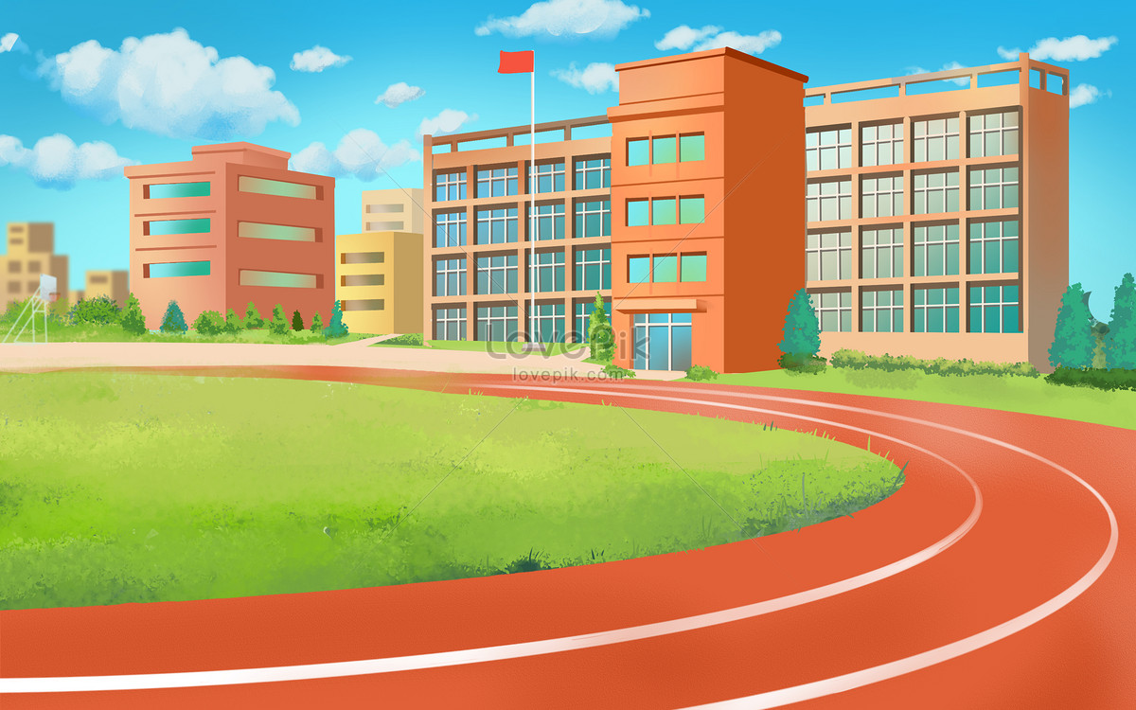

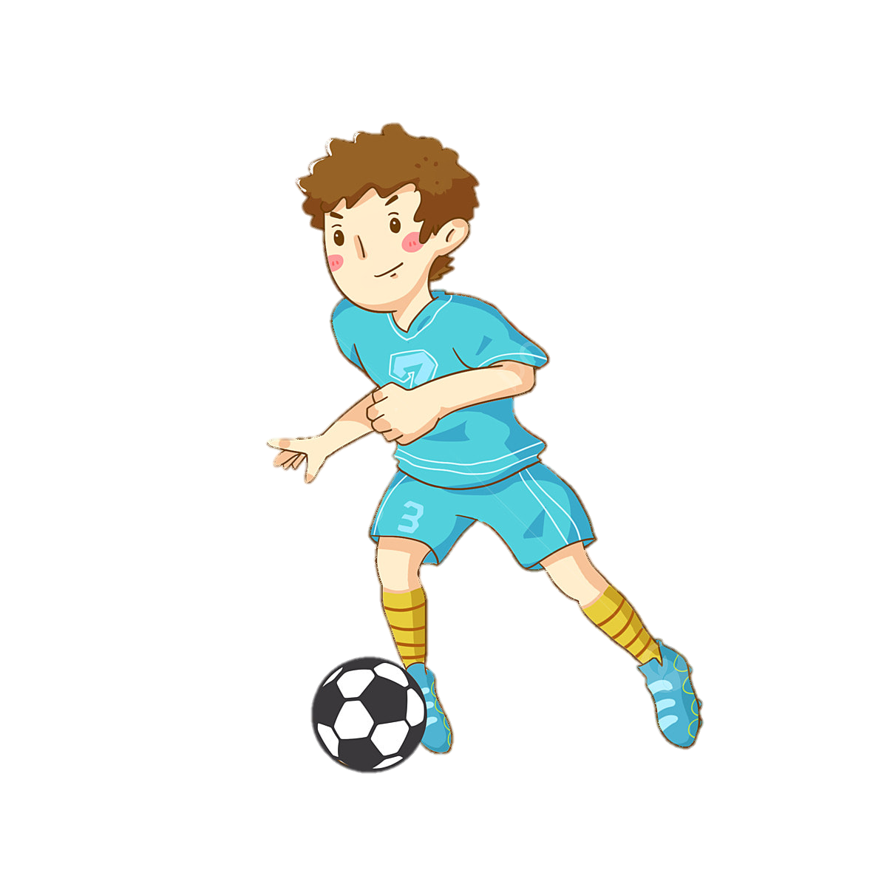
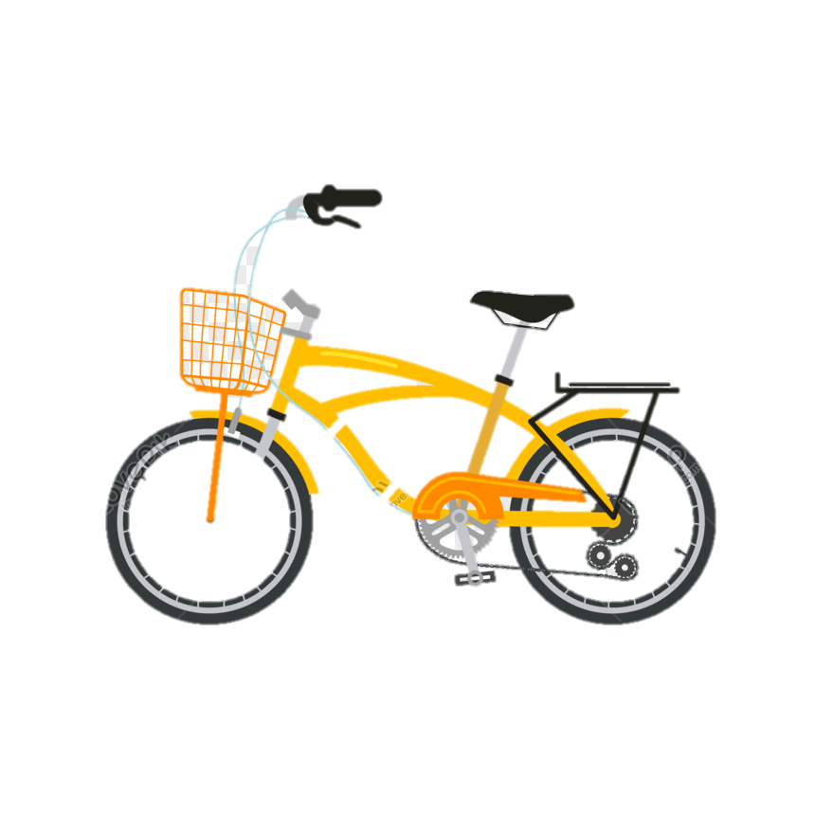

Bill
bike
book
ball

Slide 6



Slide 7


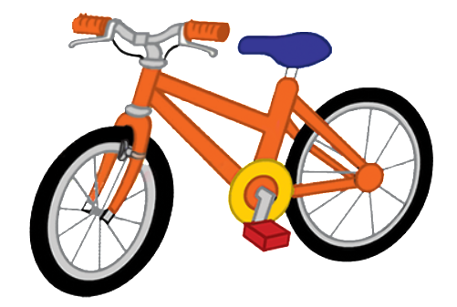

Notes:
Step 3
Listen and repeat
Goal:
- Pupils will be able to listen and repeat the unit keywords ball and bike; listen and repeat the sound b.
- Recognize and say the words with flashcards.
Time: 3-4 minutes.
Introduce the unit keywords ball and bike with flashcards.
Hold up the flashcard for ball and have pupils say the word. Stick the flashcard on the board.
Continue with the flashcard for bike.
On the board, there are two flashcards for ball and bike. The flashcard for ball is above the flashcard for bike.
Point to the ball, say the word and have pupils repeat the word. Do the TPR action which saying the word.
Do the same with bike.
Have pupils guess the word and repeat by pointing to bike or ball. Hold your hand up or down to the position of the flashcard.
Turn over the cards, have pupils guess the card and say the word.
Swap the cards and have pupils guess.
Play the game with all four 4 flashcards for Bill, ball, bike, book.
Ask pupils what is similar at the beginning of each word.
Point to the sound B/b, point to the first letter of each word and say. Have pupils listen and repeat.

Slide 8
Notes:
Step 3
Listen and repeat
Goal:
- Pupils will be able to listen and repeat the unit keywords ball and bike; listen and repeat the sound b.
- Recognize and say the words with flashcards.
Time: 3-4 minutes.
Introduce the unit keywords ball and bike with flashcards.
Hold up the flashcard for ball and have pupils say the word. Stick the flashcard on the board.
Continue with the flashcard for bike.
On the board, there are two flashcards for ball and bike. The flashcard for ball is above the flashcard for bike.
Point to the ball, say the word and have pupils repeat the word. Do the TPR action which saying the word.
Do the same with bike.
Have pupils guess the word and repeat by pointing to bike or ball. Hold your hand up or down to the position of the flashcard.
Turn over the cards, have pupils guess the card and say the word.
Swap the cards and have pupils guess.
Play the game with all four 4 flashcards for Bill, ball, bike, book.
Ask pupils what is similar at the beginning of each word.
Point to the sound B/b, point to the first letter of each word and say. Have pupils listen and repeat.

Slide 9

Mini Game
Notes:
What’s missing?
Goal: Pupils will be able to recognize the unit words’ pictures, sounds and their meaning.
Time: 5 minutes
Show the flashcards for Bill, ball, book and bike.
Hide one flashcard and have the pupils guess what is missing.
Play with the whole class first then teams to get stars.

Slide 10

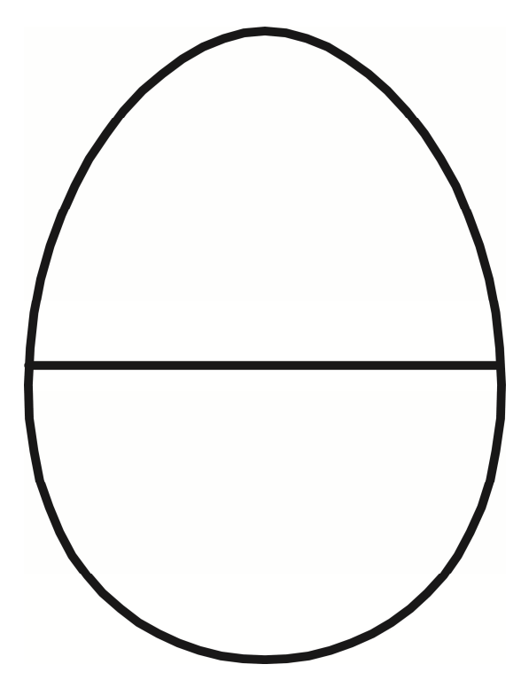





Notes:
What is missing?

Slide 11
Ball
Notes:
What is missing?

Slide 12
Bike
Notes:
What is missing?

Slide 13
Book
Notes:
What is missing?

Slide 14
Bill
Notes:
What is missing?

Slide 15

?
?
?
?
L
L
A
B
Notes:
Goodbye
Time: 2 minutes
Teacher and pupils say goodbye to the words.

Slide 16

?
?
?
?
K
I
E
B
Notes:
Goodbye
Time: 2 minutes
Teacher and pupils say goodbye to the words.

Slide 17
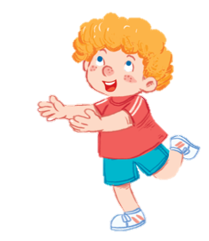
?
?
?
?
B
L
I
L
Notes:
Goodbye
Time: 2 minutes
Teacher and pupils say goodbye to the words.

Slide 18

?
?
?
?
B
O
O
K
Notes:
Goodbye
Time: 2 minutes
Teacher and pupils say goodbye to the words.

Slide 19
THANK YOU FOR LISTENING

