Slide 1
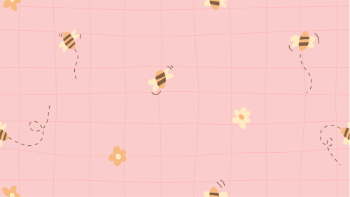

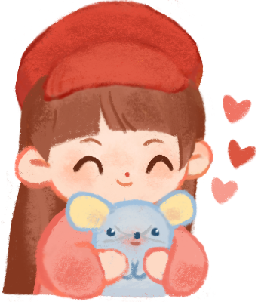
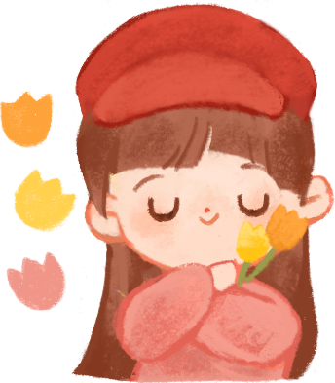
UNIT 1 - LESSON 2
IN THE SCHOOL PLAYGROUND

Slide 2
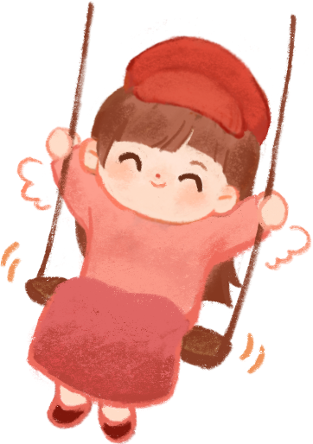

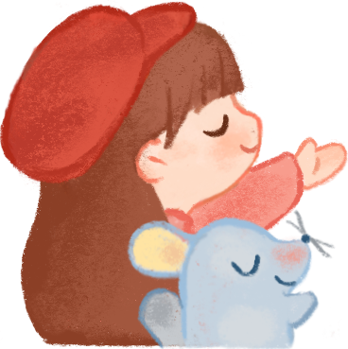
Hello and Welcome To My English Class

Slide 3


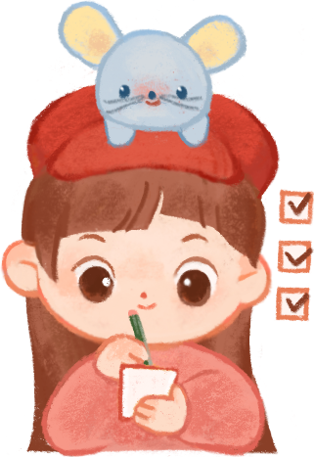
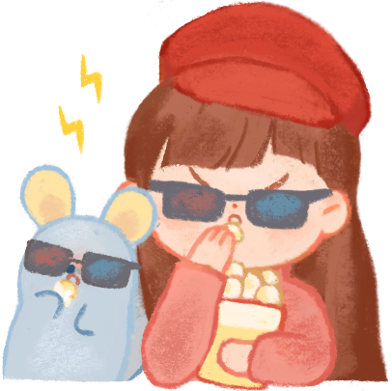


Guess the picture
1
2
3
4
3
Ball

Slide 4
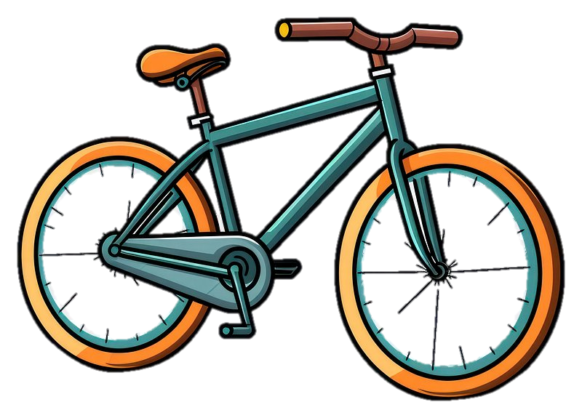


Guess the picture
1
2
3
4
Bike

Slide 5

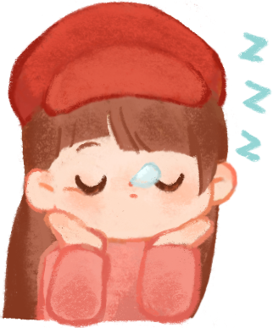

Guess the picture
1
2
3
4
Book

Slide 6
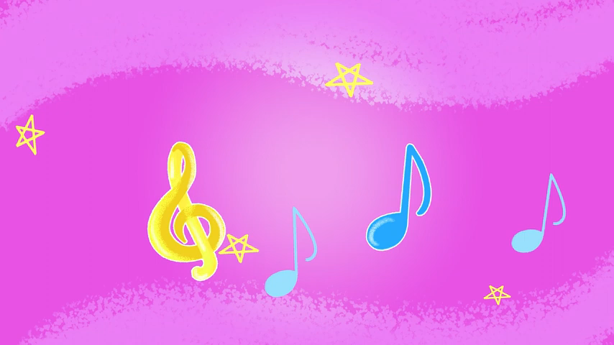
Let’s chant.

Slide 7
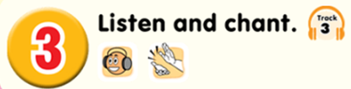
B, b, ball.
B, b, book.
A ball, a ball.
A book, a book.
B, b, a ball.
B, b, a book.
B, b, bike.
A bike, a bike.
B, b, a bike.
Notes:
Click to see each line
Click each line to hear the sound
Click the speaker to hear the whole chant

Slide 8


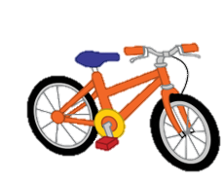
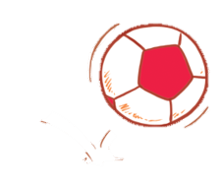


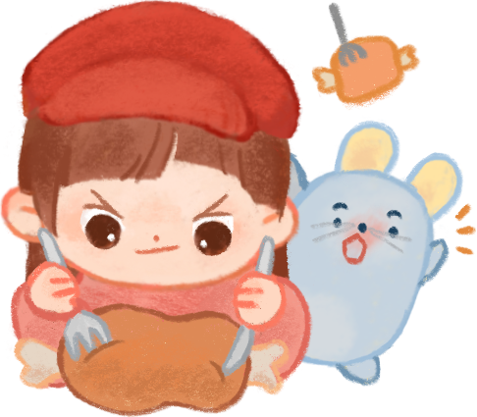
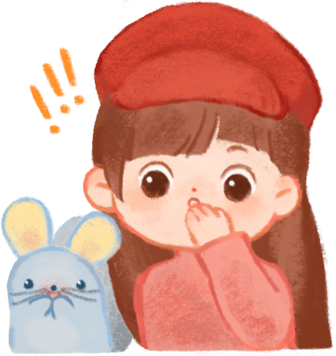
1.
Listen and tick
2.
a
b
a
b

Slide 9
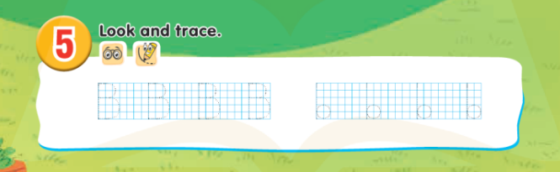
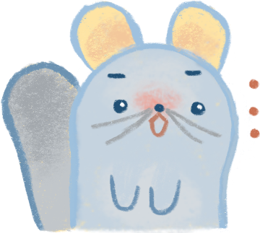
Look and write

Slide 10
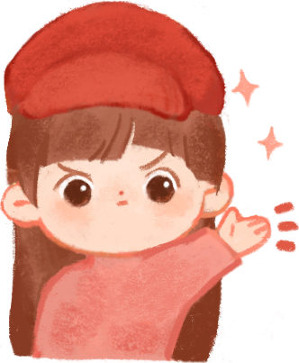
Thank You for listening

