Slide 1




UBND QUẬN DƯƠNG KINH
TRƯỜNG TIỂU HỌC ANH DŨNG
HELLO AND WELCOME TO MY ENGLISH CLASS

Slide 2
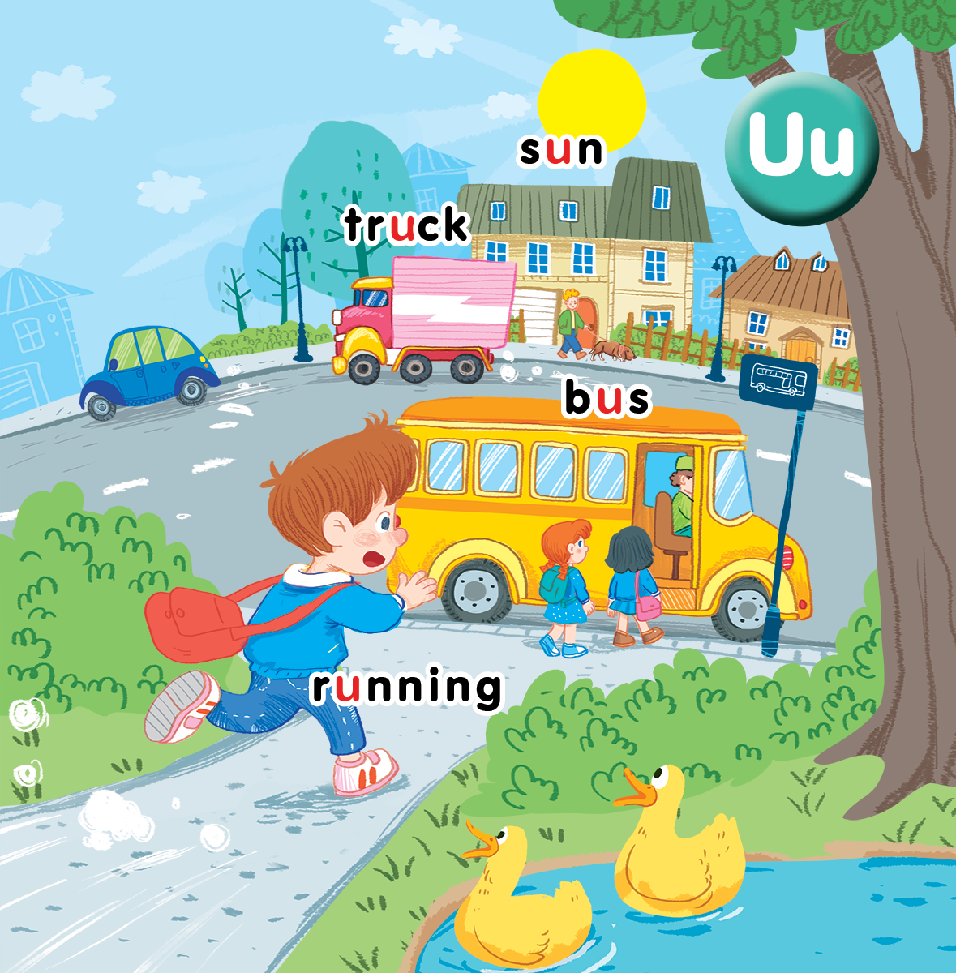
Unit 11 At the bus stop Lesson 3

Slide 3

Warm-up
Notes:
Goal: Warm up and revise the chant.
Time: 3 minutes
Play the chant.
Have pupils listen and chant 2-3 times.

Slide 4

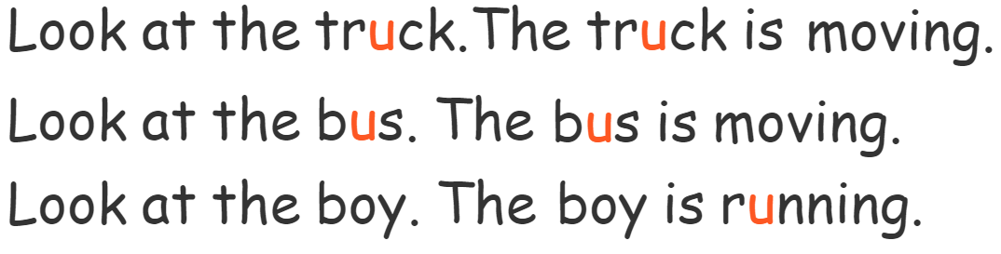

Let’s chant!

Slide 5


Listen and repeat

Slide 6
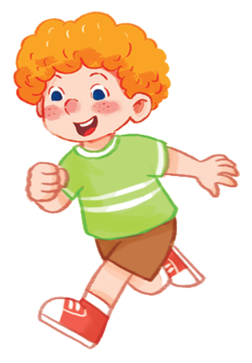
He’s running.

Slide 7

She’s running.

Slide 8
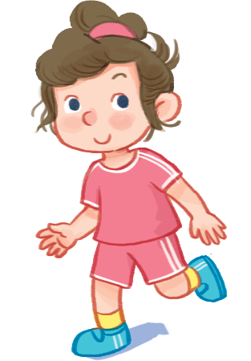
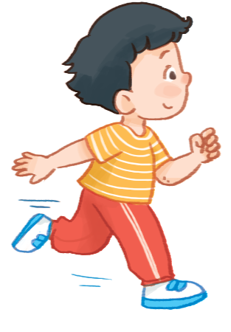
………….’s running.

Slide 9

Let’s talk

Slide 10
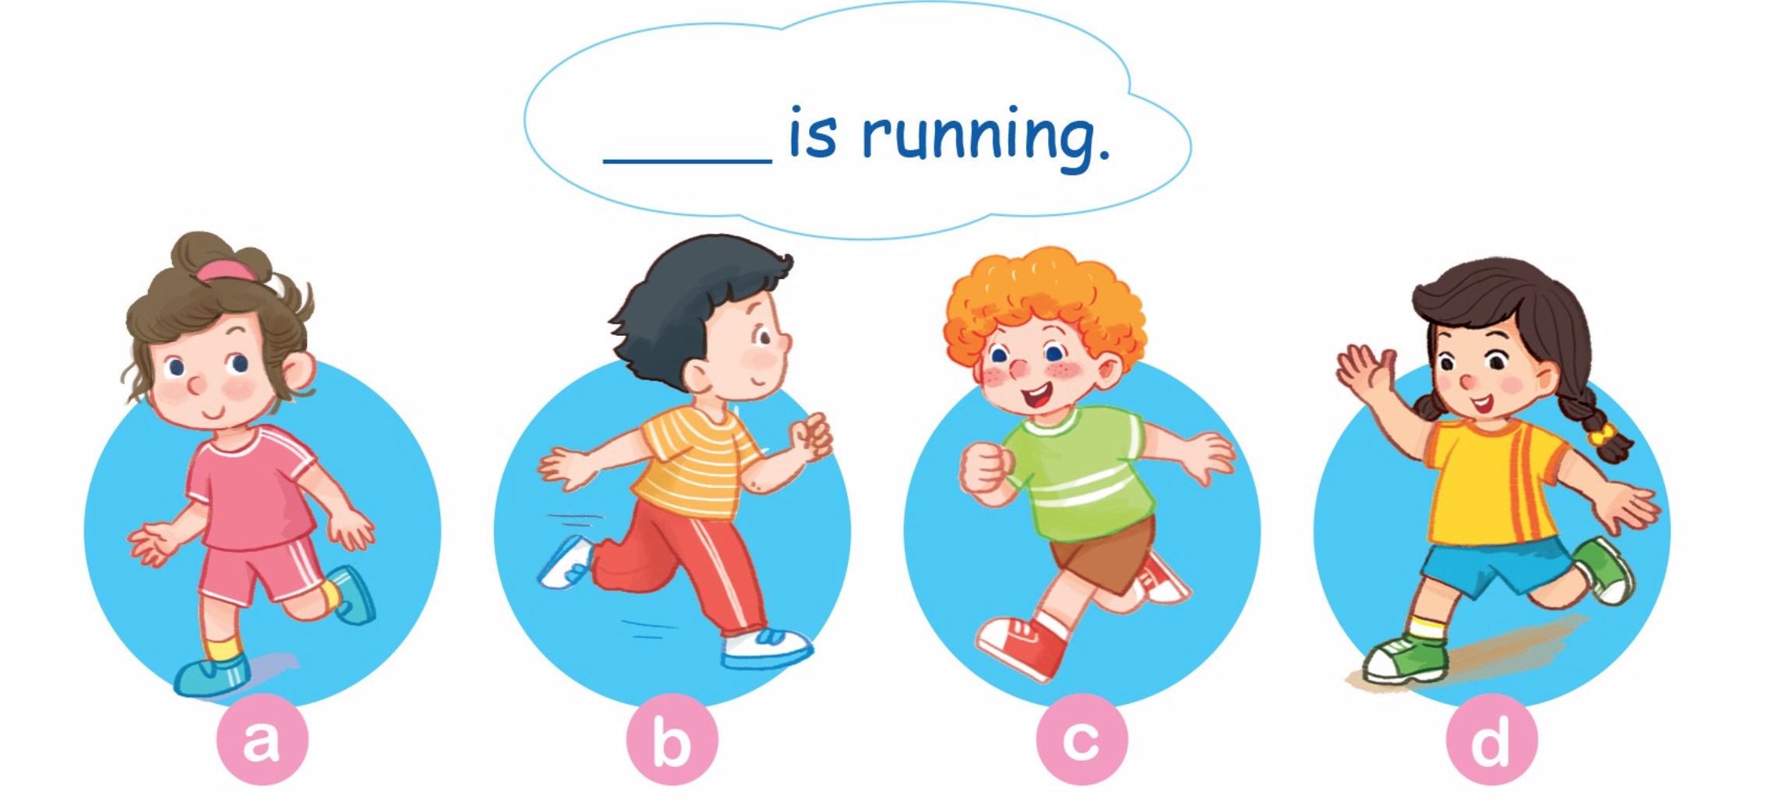
Let’s talk

Slide 11


Let’s sing

Slide 12
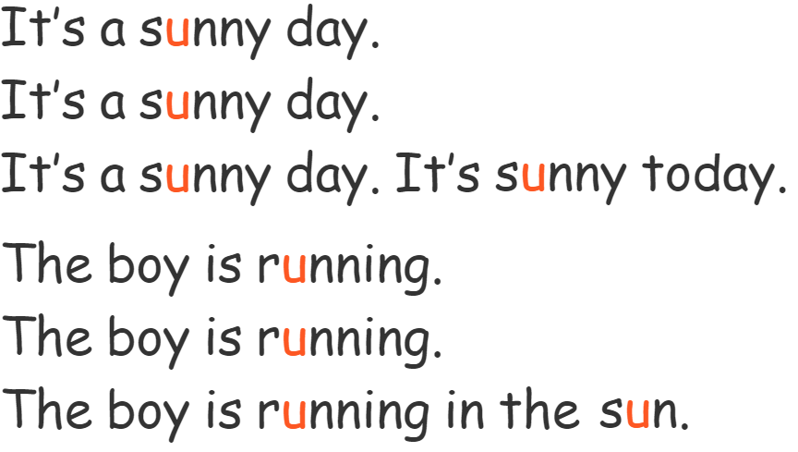
Let’s sing!

Slide 13
Game
Notes:
Goal: Review the unit keywords, the song and the chant.
Time: 5 minutes
Revise the words and play the game.
Have pupils play the game in 4 groups.
Choose the card one by one in each group and each member has to do with TPR action and the representative will say “_____’s running”. “That’s a____”.
The team with the highest points is the winner.

Slide 14
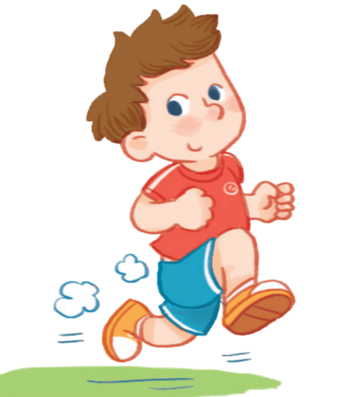

Slide 15


Slide 16


Slide 17


Slide 18
Goodbye
Notes:
Repeat the words with rhythm and say goodbye.

Slide 19

Goodbye

Slide 20
Goodbye

Slide 21
Goodbye

