Slide 1




UBND QUẬN DƯƠNG KINH
TRƯỜNG TIỂU HỌC ANH DŨNG
HELLO AND WELCOME TO MY ENGLISH CLASS

Slide 2
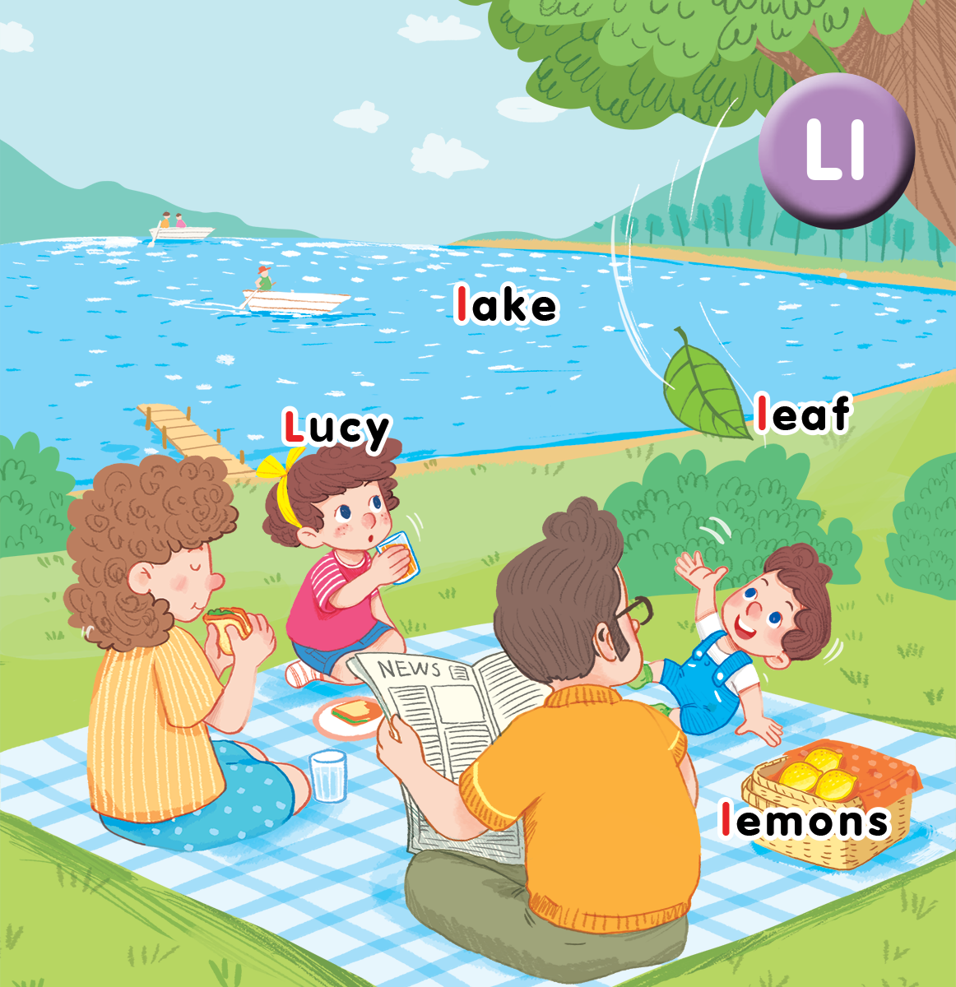
Unit 12 At the lake Lesson 2

Slide 3

Who’s faster?
Notes:
Game: Who’s faster
Goal: Warm up and revise the unit keywords.
Time: 5 minutes
- Give each group a set of words (from recent lessons).
- Say Find words with letter L
- Encourage pupils to find words having letter L and stick them on the board.
- The fastest is the winner.
- Have pupils say all the correct words found.

Slide 4


Listen and chant

Slide 5

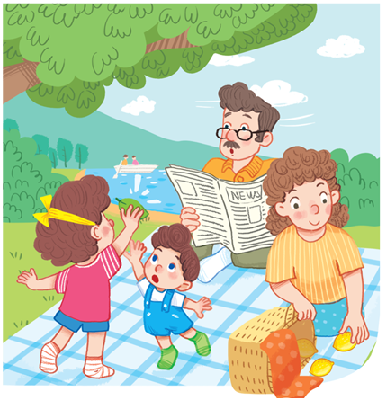
Let’s chant!
L, l, Lucy.
L, l, lake.
L, l, lemons.
Look at Lucy.
Look at the lake.
Look at the lemons.

Slide 6

Listen and tick

Slide 7
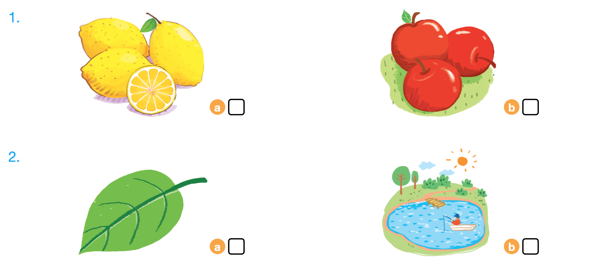

Listen and tick

Slide 8



Look, trace and write
Notes:
Goal: Pupils will be able to trace the letter.
Time: 5 minutes
Have pupils write the word by air tracing and say the word.
Demonstrate how to trace the word and have pupils do the task.

Slide 9
Game

Slide 10

Slap the slide

Slide 11





Slide 12
Goodbye
Notes:
Say goodbye Lucy in chorus.

Slide 13
Goodbye
Notes:
Say goodbye lake in chorus.

Slide 14

Goodbye
Notes:
Say goodbye leaf in chorus.

Slide 15
Goodbye
Notes:
Say goodbye lemon in chorus.

