Slide 1




UBND QUẬN DƯƠNG KINH
TRƯỜNG TIỂU HỌC ANH DŨNG
HELLO AND WELCOME TO MY ENGLISH CLASS

Slide 2
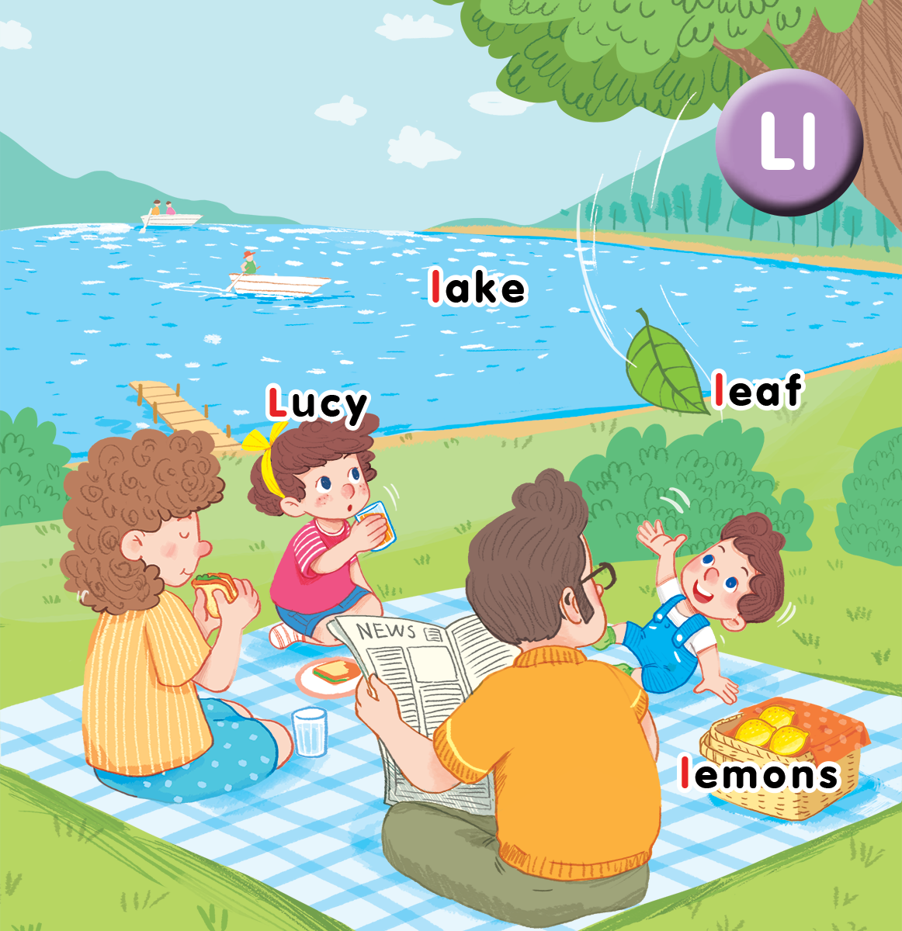
Unit 12
At the lake
Lesson 3

Slide 3

Warm-up

Slide 4

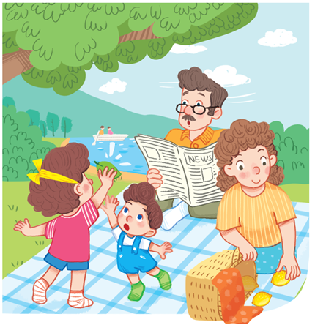
Let’s chant!
L, l, Lucy.
L, l, lake.
L, l, lemons.
Look at Lucy.
Look at the lake.
Look at the lemons.

Slide 5


Listen and repeat

Slide 6
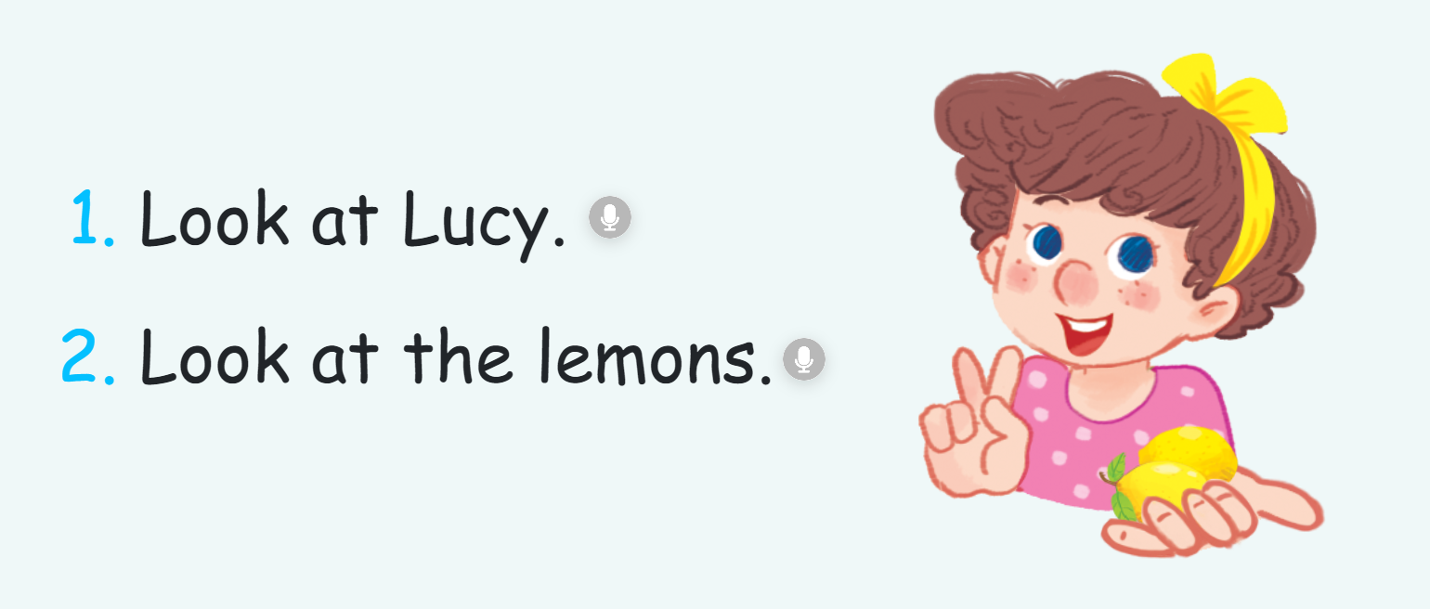

Slide 7


Let’s talk

Slide 8
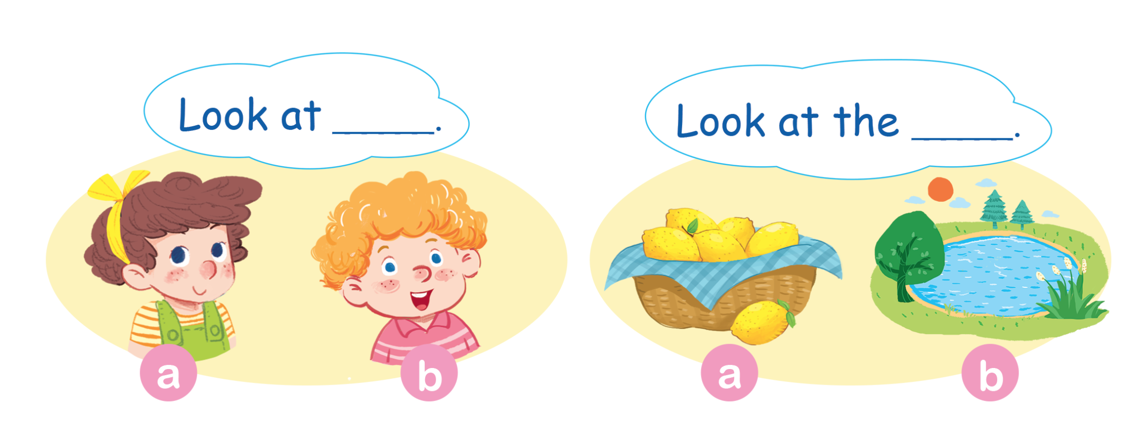
Let’s talk.

Slide 9


Let’s sing

Slide 10
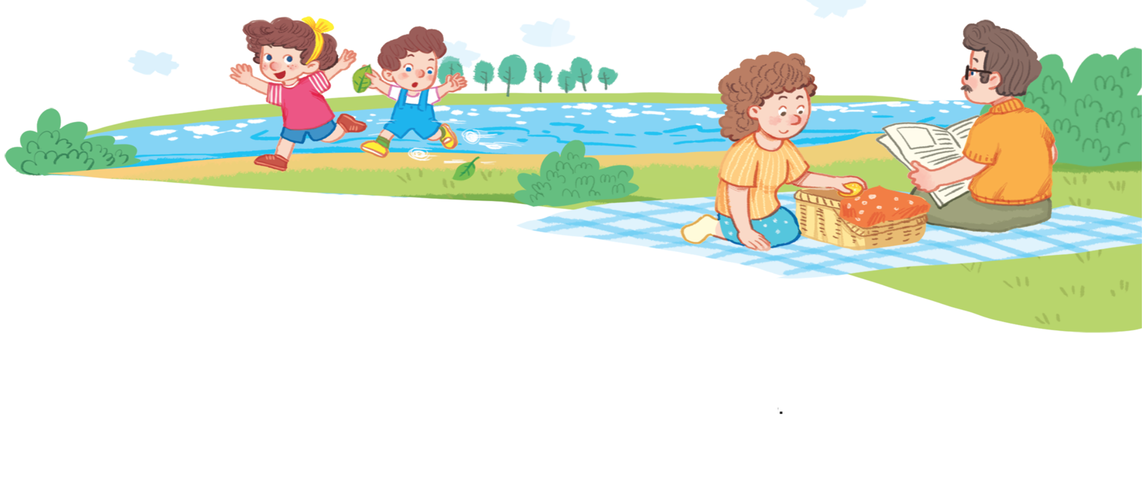
Let’s sing!
Look at Lucy. Look at Lucy.
Look at Lucy. She’s running round the lake.
Look at the leaf. Look at the leaf.
Look at the leaf. It’s falling to the ground.

Slide 11
Game
Notes:
Chair Game
- Have pupils play the game in groups. Each group sends 1 representative.
- Put one flashcard on each chair.
- Say 1 word.
- Pupils have to find the flashcard and sit on the chair that has that flashcard. Then hold the flashcard and say Look at____.
- The group has 1 point if their representative is the fastest and says the correct sentence.

Slide 12

Chair game

Slide 13

Goodbye
Notes:
Say goodbye Lucy in chorus.

Slide 14

Goodbye
Notes:
Say goodbye lake in chorus.

Slide 15

Goodbye
Notes:
Say goodbye leaf in chorus.

Slide 16

Goodbye
Notes:
Say goodbye lemon in chorus.

