Slide 1


UBND QUẬN DƯƠNG KINH
TRƯỜNG TIỂU HỌC ANH DŨNG
WELCOME
To Our Class

Slide 2
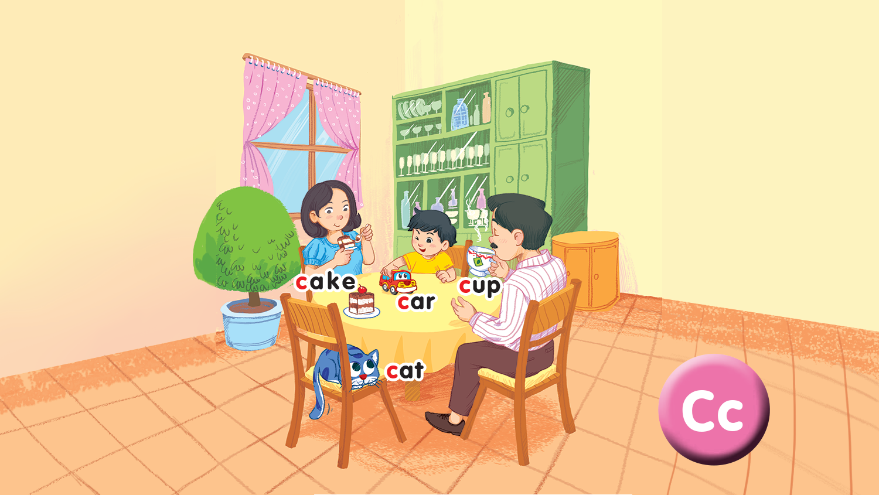
Unit 2 - Lesson 2 In the dining room
Notes:
Goals:
Pupils will be able to say the sound of the letter C/c and the words cake, car, cup, cat in a chant.
Pupils will be able to listen, recognize the words and tick the correct boxes.
Pupils will be able to trace the letter C/c (upper case and lower case).

Slide 3

Warm-up
Notes:
Goal: Warm up and revise the unit keywords.
Time: 3 minutes
Spinning Wheel
Have pupils play the game spinning wheel in groups. When the wheel stops, say the picture. For example, c, c (cup)
Click on Start/Stop to turn on and off the wheel.

Slide 4

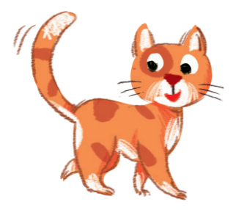




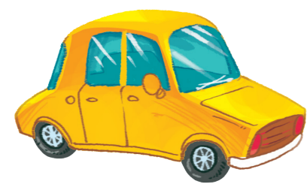
START/STOP

Slide 5


Listen and chant
Notes:
Listen and chant is divided into 3 steps.
Step 1
Goal: Pupils will be able to say the sound of the letter C/c and the words in the chant
Time: 5 minutes.
Have pupils listen and repeat the sound and the words of the chant, sentence by sentence

Slide 6






Slide 7
Listen and chant
C, c, a cup.
C, c, a cake.
A cup and a cake.
C, c, a cat.
C, c, a car.
A cat and a car.
Notes:
Step 2
Goal: Pupils will be able to chant and clap along.
Time: 3 minutes
Play the recording, have pupils listen and clap along.
Play the recording, have pupils listen, clap and chant along
+ Round 1. Have pupils listen and clap along.
+ Round 2. Have pupils listen and do the TPR actions with teacher.
+ Round 3. Have pupils listen and do the actions and chant along.
+ Repeat round 3 several times.
+ Revise the letter C/c by writing in the air.
Step 3
Goal: Pupils will be able to chant and clap along in pairs.
Time: 3 minutes
Have pupils chant along in pairs.

Slide 8

Listen and tick
Notes:
Listen and tick is divided into 2 steps.
Step 1
Goal: Pupils will be able to listen and choose the correct pictures.
Time: 5 minutes
Do the TPR action to help the pupils understand the meaning of Listen and tick activity.
Play the recording and have pupils listen and choose the correct picture. Demonstrate an example.
Play the recording and have pupils listen and repeat.
Play the recording and have pupils do the task.
Step 2
Goal: Quick check
Time: 4 minutes
Stick the flashcards on the board.
Have pupils listen again and check the answer.
Ask pupils to repeat the answer.

Slide 9
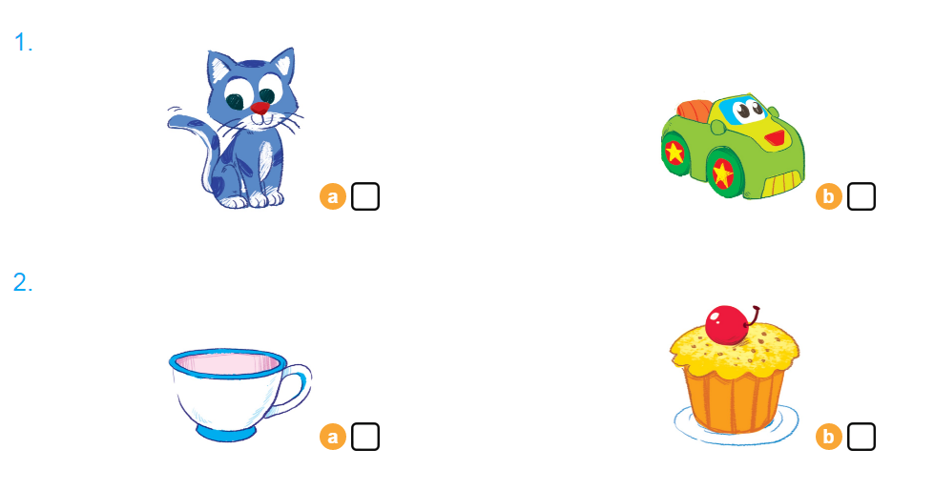

Listen and tick

Slide 10


Look and trace
Notes:
Goal: Pupils will be able to trace the letter.
Time: 5 minutes
Have pupils say the word.
Demonstrate how to trace the word in the air.
Have pupils write the word by air tracing.
Have pupils do the task in the book with pencils .

Slide 11
Game
Notes:
Goal: Revise the words and chant.
Time: 5 minutes
Spinning Wheel
Have pupils play the game spinning wheel in groups.
When the wheel stops, say the picture. For example, c, c (cup).

Slide 12
START/STOP

Slide 13
Goodbye
Notes:
Goodbye
Time: 2 minutes
Repeat the words with TPR actions. Goodbye to the words.

Slide 14
Goodbye

Slide 15
Goodbye

Slide 16

Goodbye
cup

