Slide 1





UBND QUẬN DƯƠNG KINH
TRƯỜNG TIỂU HỌC ANH DŨNG
HELLO AND WELCOME TO MY ENGLISH CLASS

Slide 2
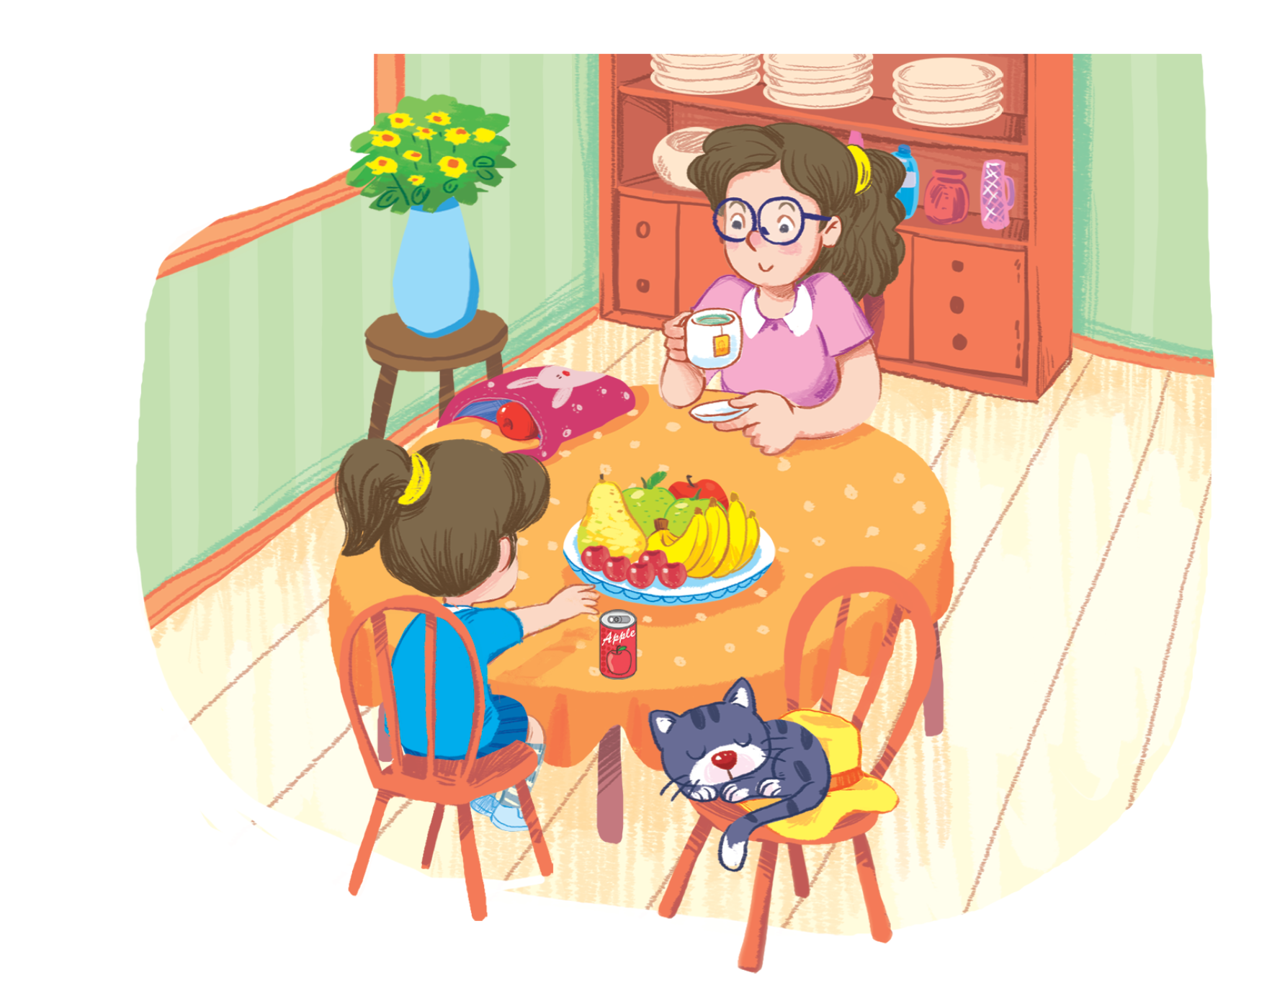
Unit 3 - Lesson 2
At the street market
Notes:
Goals:
Pupils will be able to say the sound of the letter A/a and the words apple, hat, can and bag in a chant.
Pupils will be able to listen, recognize the words and tick the correct boxes.
Pupils will be able to trace the letter A/a (upper case and lower case).

Slide 3

Warm-up
Notes:
Goal: Warm up and revise the unit keywords.
Time: 3 minutes
Look and say
Slide show the picture and words, have pupils say the words aloud with TPR actions.
Repeat the activity two or three times.

Slide 4


apple
hat

Slide 5


can
bag

Slide 6


Listen and chant
Notes:
Listen and chant is divided into 3 steps.
Step 1
Goal: Pupils will be able to say the sound of the letter A/a and the words in the chant.
Time: 5 minutes.
Have pupils listen and repeat the sound and the words of the chant, sentence by sentence.

Slide 7

Listen and chant
A, a, apple.
A, a, bag.
There’s an apple.
In the bag.
A, a, cat.
A, a, hat.
There’s a cat.
On the hat.
Notes:
Step 2
Goal: Pupils will be able to chant and clap along.
Time: 3 minutes
Play the recording, have pupils listen and clap along.
Play the recording, have pupils listen, clap and chant along
+ Round 1. Have pupils listen and clap along.
+ Round 2. Have pupils listen and do TPR actions with teacher.
+ Round 3. Have pupils listen and do the actions and chant along.
Repeat round 3 several times.
Revise the letter a by writing in the air.
Suggested TPR actions
A (clap), a (clap), apple (roll your hands to make an apple)
A (clap), a (clap), bag (use your hands to draw a bag in the air)
There’s (clap) an apple (roll your hands to make an apple).
In (clap) the bag (spread your hands forward)
A (clap), a (clap), cat (use your hands to draw cat whiskers)
A (clap), a (clap), hat (use your hands to make a hat over your head)
There’s (clap) a cat (use your hands to draw cat whiskers)
on (clap) the hat (spread your hands forward).
Step 3
Goal: Pupils will be able to chant and clap along in pairs.
Time: 3 minutes
Have pupils chant along in pairs.

Slide 8

Listen and tick
Notes:
Listen and tick is divided into 2 steps.
Step 1
Goal: Pupils will be able to listen and choose the correct pictures.
Time: 5 minutes
Do the TPR action to help pupils understand the meaning of Listen and tick activity.
Play the recording and have pupils listen and choose the correct picture. Demonstrate an example.
Play the recording and have pupils listen and repeat.
Play the recording and have pupils do the task.
Step 2
Goal: Quick check
Time: 4 minutes
Stick the flashcards on the board.
Have pupils listen again and check the answer.
Ask pupils repeat the answer.

Slide 9
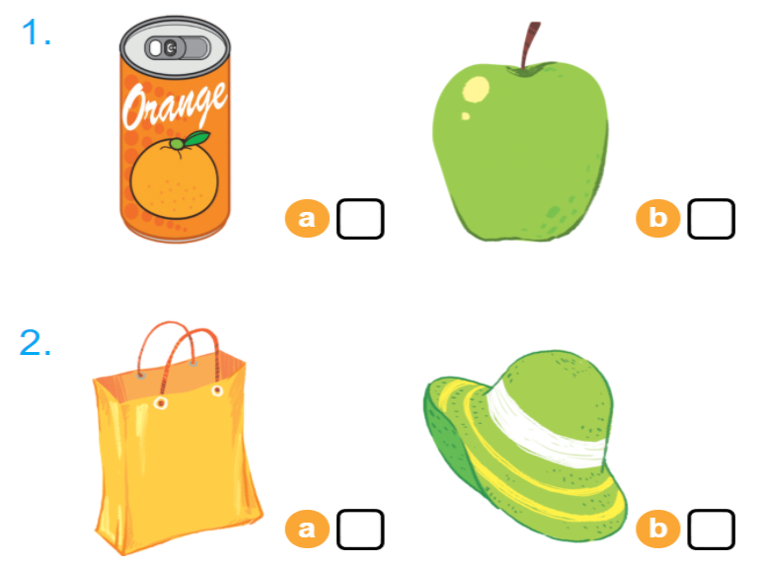

Listen and tick

Slide 10


Look and trace
Notes:
Goal: Pupils will be able to trace the letter.
Time: 5 minutes
Have pupils say the word.
Demonstrate how to trace the word in the air.
Have pupils write the word by air tracing.
Have pupils do the task in the book with pencil.

Slide 11
Game
Notes:
Goal: Revise the words and chant.
Time: 5 minutes
Spinning Wheel
Have pupils play the game spinning wheel in groups.
When the wheel stops, say the picture. For example, a, a apple.

Slide 12

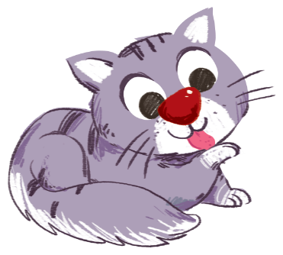





START/STOP
Notes:
Press start/stop to start the wheel.
Press start/stop to the stop the wheel.

Slide 13

It’s time to say goodbye
Notes:
Goodbye
Time: 2 minutes
Teacher and pupils say goodbye to the words.

Slide 14

Goodbye
hat

Slide 15
Goodbye
apple

Slide 16
Goodbye
bag

Slide 17

Goodbye
can

