Slide 1
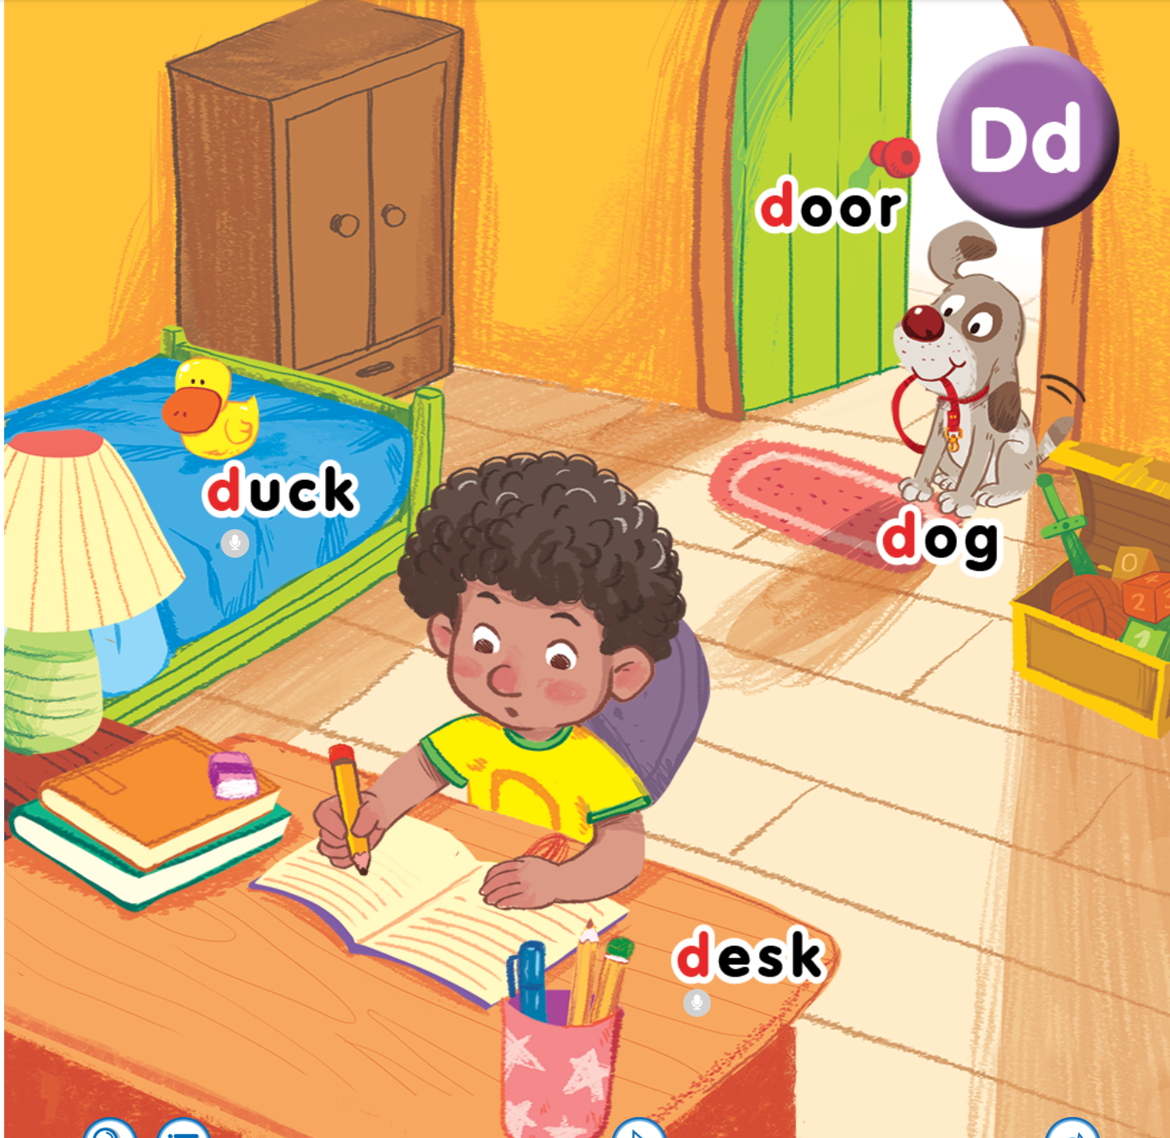
Unit 4
Lesson 3
In the bedroom
Notes:
Goals: By the end of the lesson, pupils will be able to:
listen and repeat the sentence This is a _______.
introduce something, using This is a _______.
sing a song with the structure This is a _______.

Slide 2

Warm-up
Notes:
Goal: Warm up and revise the unit keywords.
Time: 3 minutes
Listen and do
Say the actions and have pupils do the actions with you.
Stand up.
Sit nicely.
Clap your hands.
Stand up. Clap your hands,
Turn around.
Sit nicely.
Stand up.
Open the door.
Hi, dog.
Fist bump.
Open the door.
Hi, duck.
Fist bump.
Sit down.
Revise the words in lessons 1 and 2 (replace words).

Slide 3



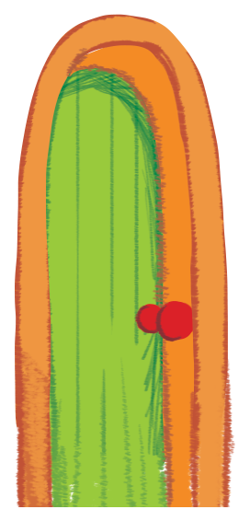

door
duck
desk

Slide 4


Listen and repeat
Notes:
Listen and repeat is divided in to 2 steps.
Step 1
Goal: Pupils will be able to listen to the structure This is a…. and understand the meaning.
Time: 7 minutes.
Introduce the structure and have pupils listen and repeat.
Hold up a flashcard dog and say I have a dog.
Stick the flashcard for dog on the board.
Do the same with other words.
Play the recording, and have pupils listen and repeat.
Step 2
Goal: Pupils will be able to recognize and repeat the structure This is a…
Time: 3 minutes.
Have pupils open the book, listen and repeat.

Slide 6
duck

Slide 7

hat

Slide 8
desk

Slide 9
door
Notes:
Tranh trong sách mềm chưa cập nhật

Slide 10

apple

Slide 11

bag

Slide 12

can
Notes:
Tranh trong sách mềm chưa cập nhật

Slide 13
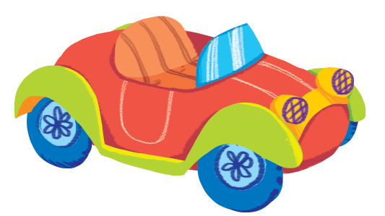
Notes:
Sách mềm chưa cập nhật

Slide 14


Slide 15
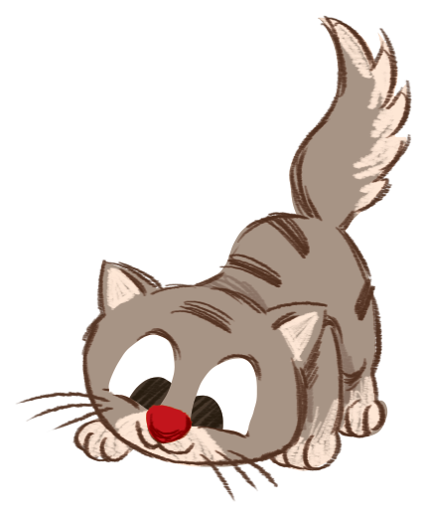

Slide 16


Let’s talk
Notes:
Let’s talk is divided into 2 steps.

Slide 17
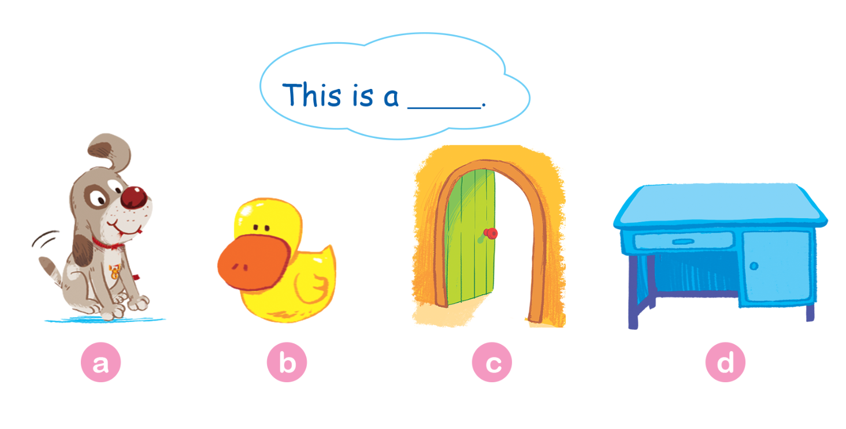
Let’s talk.
Notes:
Step 1
Goal: Pupils will be able to say a sentence with This is a….
Time: 3 minutes
Have pupils do the task in the textbook in chorus, pairs then individuals

Slide 18
This is a duck.
Notes:
Step 2
Goal: Pupils will be able to use the new structure to say in different situation
Put some flashcards or things in a box/ a bag. Have pupils choose one card, hold up and say the sentence This is a…
After that, ask the whole class if it is Yes or No. Have pupils answer with the TPR actions.
Have the whole class repeat that sentence in chorus.
Choose 10-12 flashcards from unit 1 to unit 4. Give each pupil a card.
Pupils stand up and say This is a…..

Slide 19
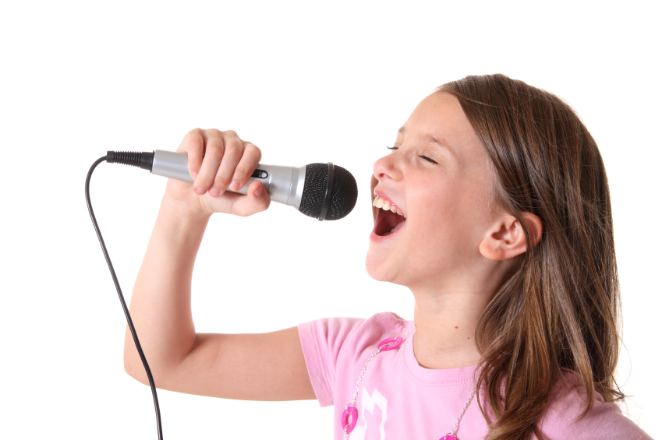

Let’s sing
Notes:
Let’s sing is divided into 2 steps.
Step 1
Goal: Pupils will be able to read the lyrics of the song.
Time: 3 minutes
Have pupils read the lyrics of the song, sentence by sentence.
Introduce window by showing the picture of the window.
Then say the song’s lyrics again with TPR actions.
Suggested TPR actions.
This is a duck. (do a TPR action for duck)
It on the desk. (clap)
This this a dog. (do a TPR action for dog)
It’s near the door. (clap)
And this is a desk. (clap)
It’s near the window. (clap)
Finish the song with the TRP for High five and fist bump.
Have pupils sing along two or three times.
Step 2
Goal: Pupils will be able to listen and sing the song.
Time: 5 minutes
Have pupils listen to the song and sing with TPR in chorus then groups

Slide 20

window
Notes:
Introduce window

Slide 21

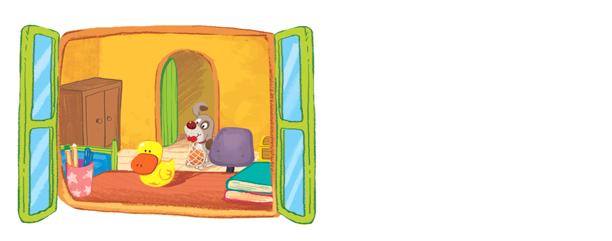
Let’s sing!
This is a duck.
It on the desk.
This is a dog.
It’s near the door.
And this is a desk.
It’s near the window.

Slide 22
Game
Notes:
Goal: Review the unit keywords, the song and the chant.
Time: 5 minutes
What’s this?
Revise the words and play the game.
Each team has 6 chance to guess what it is by opening parts of the box.

Slide 23





1
2
3
4
5
6

Slide 24

1
2
3
4
5
6

Slide 25

1
2
3
4
5
6

Slide 26

1
2
3
4
5
6

Slide 27
1
2
3
4
5
6

Slide 28
1
2
3
4
5
6

Slide 29
1
2
3
4
5
6

Slide 30
1
2
3
4
5
6

Slide 31
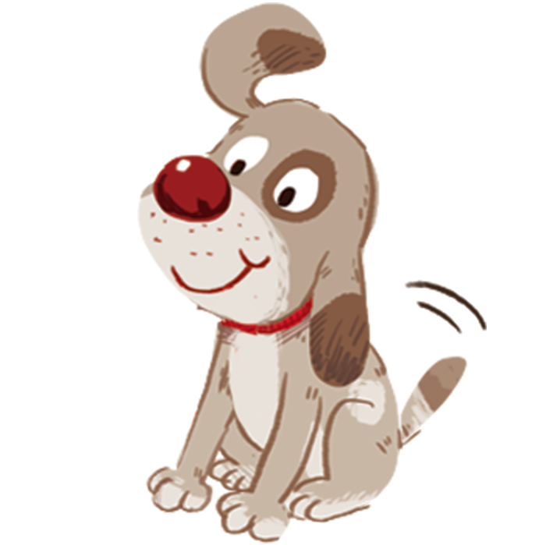
Goodbye
dog
Notes:
Goodbye
Time: 2 minutes
Teacher and pupils say goodbye to the words with TPR actions.

Slide 32
Goodbye
desk

Slide 33
Goodbye
door

Slide 34
Goodbye
duck

