Slide 1




UBND QUẬN DƯƠNG KINH
TRƯỜNG TIỂU HỌC ANH DŨNG
Hello and Welcome To My English Class

Slide 2

Unit 8 – Lesson 1 In the park
Notes:
By the end of the unit, pupils will be able to:
- pronounce the sound of the letter H/h in isolation and in the words hair, hand, head and horse correctly.
- say the sound of the letter H/h and the words hair, hands, head in a chant.
- recognize the words in different situations when listening.
- use Touch your_______ to express a command.
- trace the letter H/h.
- sing a song with the structure Touch your_______.
Lesson 1
By the end of the lesson, pupils will be able to:
pronounce the sound of the letter H/h in isolation and in the words hair, hand, head and horse correctly.
point to the letter H/h, the animal and parts of the body in the picture and say the sound of the letter H/h and the words hair, hand, head, horse.

Slide 3

Warm-up
Notes:
Game: Quick spelling
Goals:
- Help pupils feel happy at the beginning of the lesson.
- Review vocabulary of previous lesson (Unit 7)
Time limit: 5 mins
- Teacher sticks flashcards on the board. Pupils read the words again.
- Teacher spells a word, pupils touch the matching picture.

Slide 4



Notes:
Goal:
- Pupils will be able to pronounce the sound of the letter H/h in isolation and in the words hair, hand, head and horse correctly.
Step 1: Lead-in
Time limit: 3 mins
Objective: Pupils are able to identify and pronounce sound /h/
- Teacher shows letter “h” on slide and asks pupils What letter is this? and What sound does this make?
- Teacher pronounces sound /h/. Pupils listen and repeat. (as a class/ teams)
- Teacher says Today we are going to learn 4 words that have the sound /h/.

Slide 5

h

Slide 6
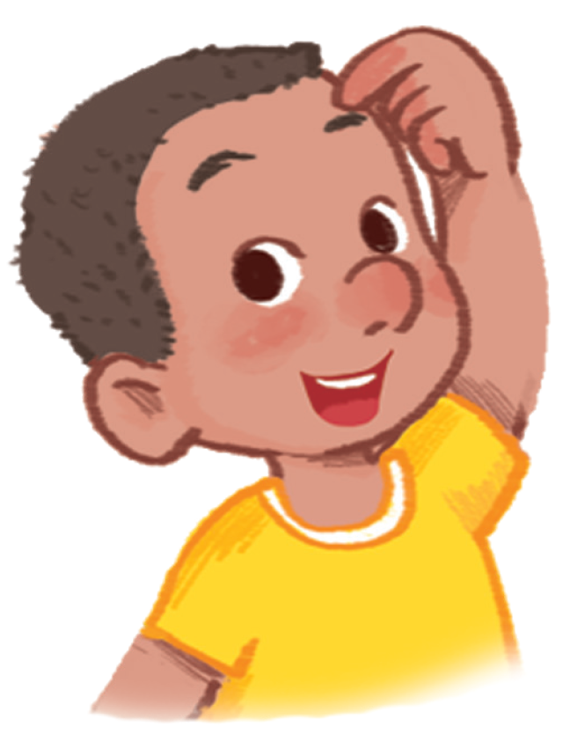
head
Notes:
Step 2: Listen and repeat vocabulary
Time limit: 5 mins
Objectives: Pupils are able to identify and pronounce 4 words: hair, hand, head and horse
- Teacher shows pictures on slide and says the words. (Teacher may pronounce each sound of the word separately, for example h – h – head).
- Pupils listen to teacher and repeat.

Slide 7
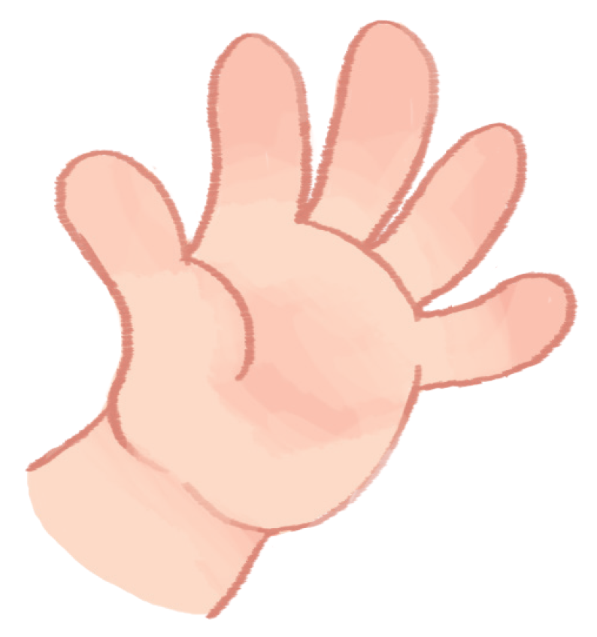
hand

Slide 8
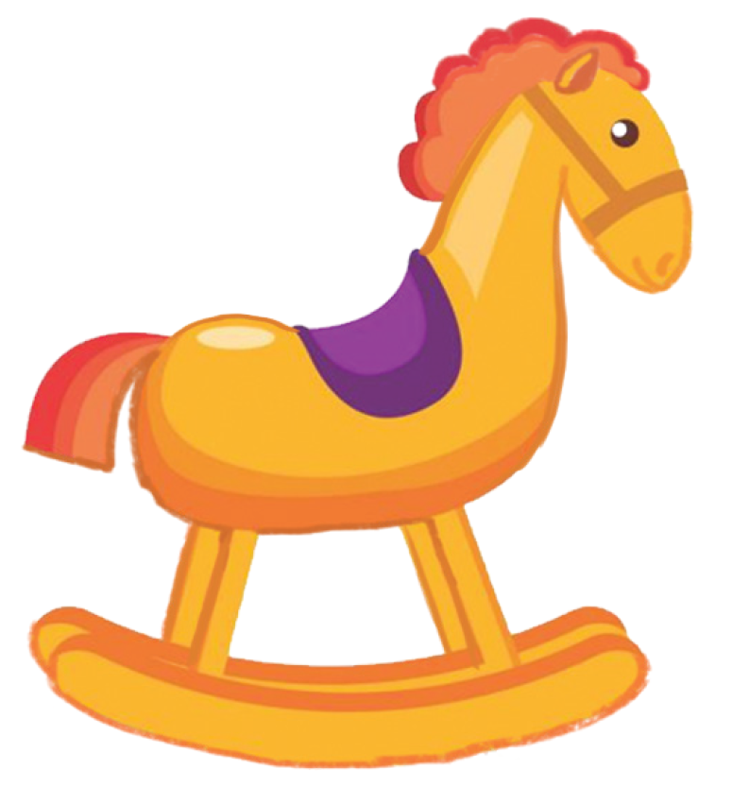
horse

Slide 9
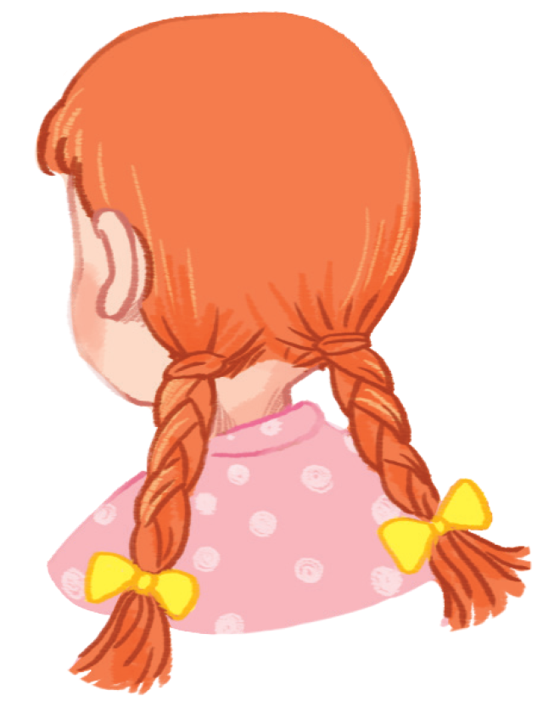
hair
Notes:
Step 3: Quick check
Time limit: 4 mins
- Teacher checks pronunciation (as teams).
- Teacher sticks flashcards and word cards on the board randomly. Teacher has Pupils go to the board and put word cards under the matching flashcards.
- Teacher checks pronunciation individually. Teacher points to a picture and has a pupil say the word.

Slide 10



Notes:
Goal:
- Pupils will be able to point to the letter H/h, the animal and parts of the body in the picture and say the sound of the letter H/h and the words hair, hand, head, horse. Step 1: Listen, point and say
Objective: Pupils are able to point to the correct picture and pronounce the words.
Time limit: 3 mins
- Teacher plays the audio, pupils listen and point only.
- Then pupils point and say the words.
- Pupils repeat the words as a class and teams.
Step 2: Point and say (in pairs)
Time limit: 3 mins
Pupils work in pairs: 1 pupil points, 1 pupil say the words.
Teacher goes around the class and gives feedback on pupils’ pronunciation
Step 3: Quick check
Time limit: 5 mins
- Teacher gives each team a set of 4 word cards: hair, hand, head, horse
- Teacher says a word, pupils choose the matching word card and stick it under the picture on the board.
- Pupils take turn to play. (When pupils in the first table row finish their turn, they pass the word cards to the next table.)

Slide 11
GAME
Notes:
Game: What’s this?
Time limit: 6 mins
- Teacher shows on slide a picture disappearing quickly in a few seconds.
- Pupils look and guess the word.

Slide 12
head

Slide 13
hand

Slide 14
head

Slide 15
hand

Slide 16
horse

Slide 17
hair

Slide 18
hair

Slide 19
horse

Slide 20
Goodbye
Notes:
- Teacher shows the vocabulary of the lesson on slide.
- Pupils say goodbye.

Slide 21
Goodbye

Slide 22

Goodbye

Slide 23

Goodbye

