Slide 1




UBND QUẬN DƯƠNG KINH
TRƯỜNG TIỂU HỌC ANH DŨNG
HELLO AND WELCOME TO MY ENGLISH CLASS

Slide 2






Unit 13:
In the maths class
Lesson 3

Slide 3

Warm-up and Review.

Slide 4









Game
MISSING LETTERS

Slide 5




What are missing letters?
F
O
_
_
T
E
E
N
I
R
A
R
U
R

Slide 6
What are missing letters?
_
_
F
T
E
E
N
F
I
T
I
S
I

Slide 7
What are missing letters?
T
_
_
R
T
E
E
N
K
I
H
I
R
I

Slide 8
What are missing letters?
E
L
E
V
_
_
E
L
E
M
E
N

Slide 9
THANK YOU
FOR
PLAYING!

Slide 10

Listen and repeat.

Slide 11

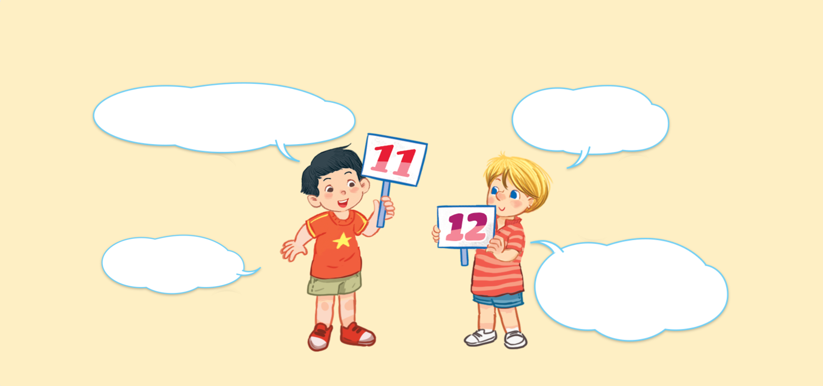


Look and say.
What number is it?
What number is it?
What number is it?
What number is it?
It’s eleven.
It’s eleven.
It’s eleven.
It’s eleven.
It’s twelve.
It’s twelve.
It’s twelve.
It’s twelve.
What number is it?
What number is it?
What number is it?
What number is it?

Slide 12

6. Listen and repeat.
What number is it?
What number is it?
What number is it?
What number is it?
It’s eleven.
It’s eleven.
It’s eleven.
It’s eleven.
It’s twelve.
It’s twelve.
It’s twelve.
It’s twelve.
What number is it?
What number is it?
What number is it?
What number is it?

Slide 13

Let’s talk.

Slide 14








Look and say
What number ______?
.
______.
a
b
c
d

Slide 15
7. Let’s talk.
What number ______?
.
______.
a
b
c
d

Slide 16
Work in pairs.
What number ______?
.
______.
a
b
c
d

Slide 17

Let’s sing.

Slide 18

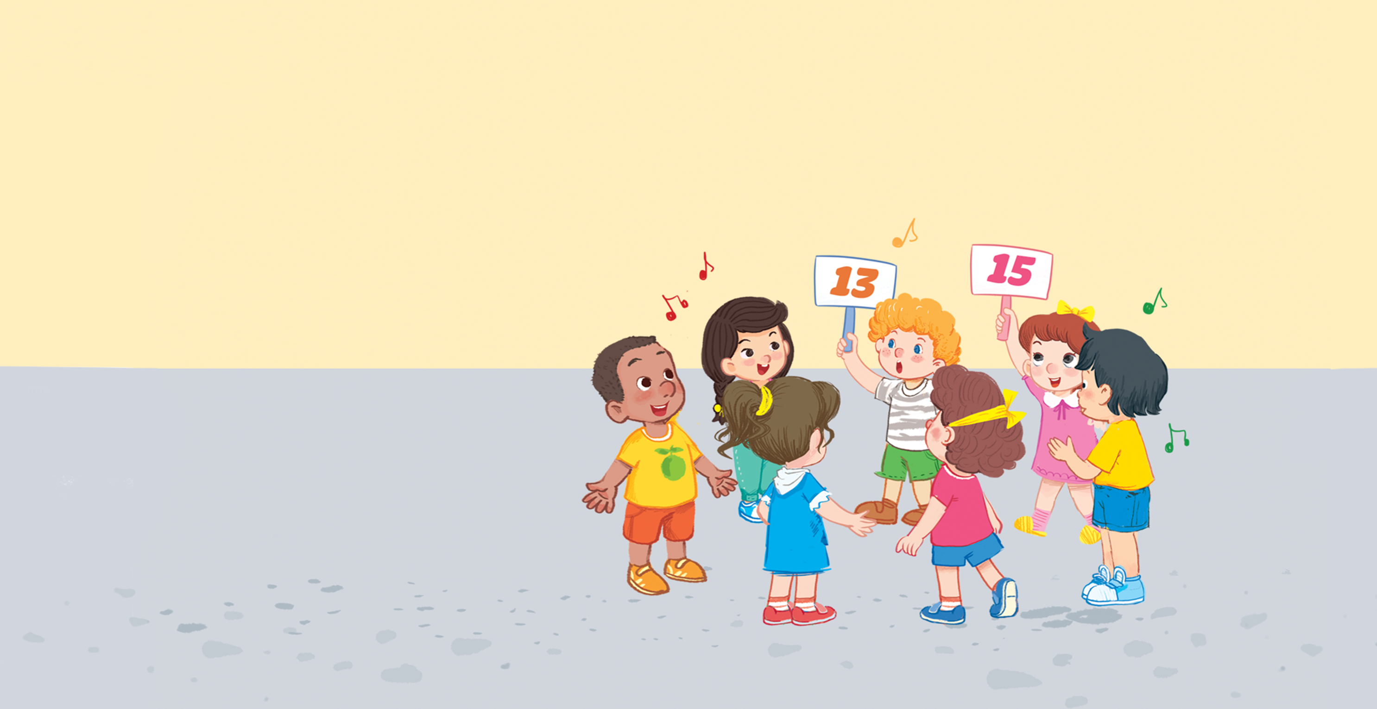


Look and say.

Slide 19

Watch a video song.
Notes:
Step 2: Play the recording of the song to familiarise pupils with the rhythm and melody (say “Listen.”).

Slide 20
8. Let’s sing.
What number is it?
What number is it?
What number is it?
What number is it?
Eleven, twelve or thirteen.
Eleven, twelve or thirteen.
Eleven, twelve or thirteen.
Eleven, twelve or thirteen.
It’s thirteen.
It’s thirteen.
It’s thirteen.
It’s thirteen.
What number is it?
What number is it?
What number is it?
What number is it?
Thirteen, fourteen or fifteen.
Thirteen, fourteen or fifteen.
Thirteen, fourteen or fifteen.
Thirteen, fourteen or fifteen.
It’s fifteen.
It’s fifteen.
It’s fifteen.
It’s fifteen.

Slide 21
Work in groups.
What number is it?
Eleven, twelve or thirteen.
It’s thirteen.
What number is it?
Thirteen, fourteen or fifteen.
It’s fifteen.
Notes:
Step 5: Have pupils work in groups to make up actions for the song. Invite a few groups to perform the song for the class.

Slide 22

Fun corner and wrap-up.

Slide 23




PLAY TIME
Bingo

Slide 24



B
I
N
G
O
11
1
7
✗
13
15
8
9
10
4

Slide 25

Thank You
For Playing!

