Slide 1


UBND QUẬN DƯƠNG KINH
TRƯỜNG TIỂU HỌC ANH DŨNG
Fun Time 4
Period 2

Slide 2


Activity 1
Warm-up
and review.

Slide 3




Let’s Play
Number Matching

Slide 4






nineteen

Slide 5



twenty

Slide 6



seventeen

Slide 7

fifteen

Slide 8
thirteen

Slide 9
sixteen

Slide 10

Well Done!

Slide 11
Activity 2
Look, read
and answer.

Slide 12





READ and ANSWER.
What number is it?
It’s twenty.

Slide 13
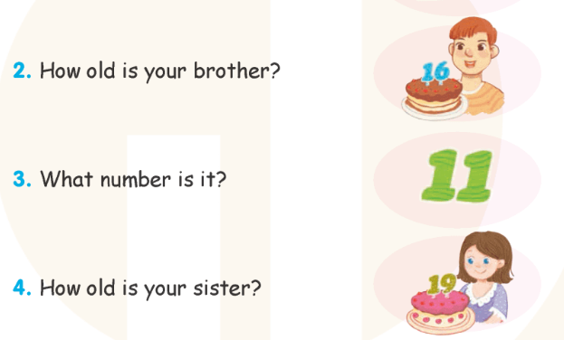
READ and ANSWER.

Slide 14







Let’s check.
Work in pairs.

Slide 15

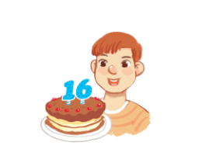
Let’s CHECK.
How old is your brother?
He’s sixteen.

Slide 16


Let’s CHECK.
What number is it?
It’s eleven.

Slide 17

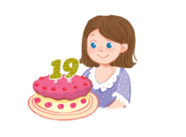
Let’s CHECK.
How old is your sister?
She’s nineteen.

Slide 18

Good
job!
Keep moving!

Slide 19
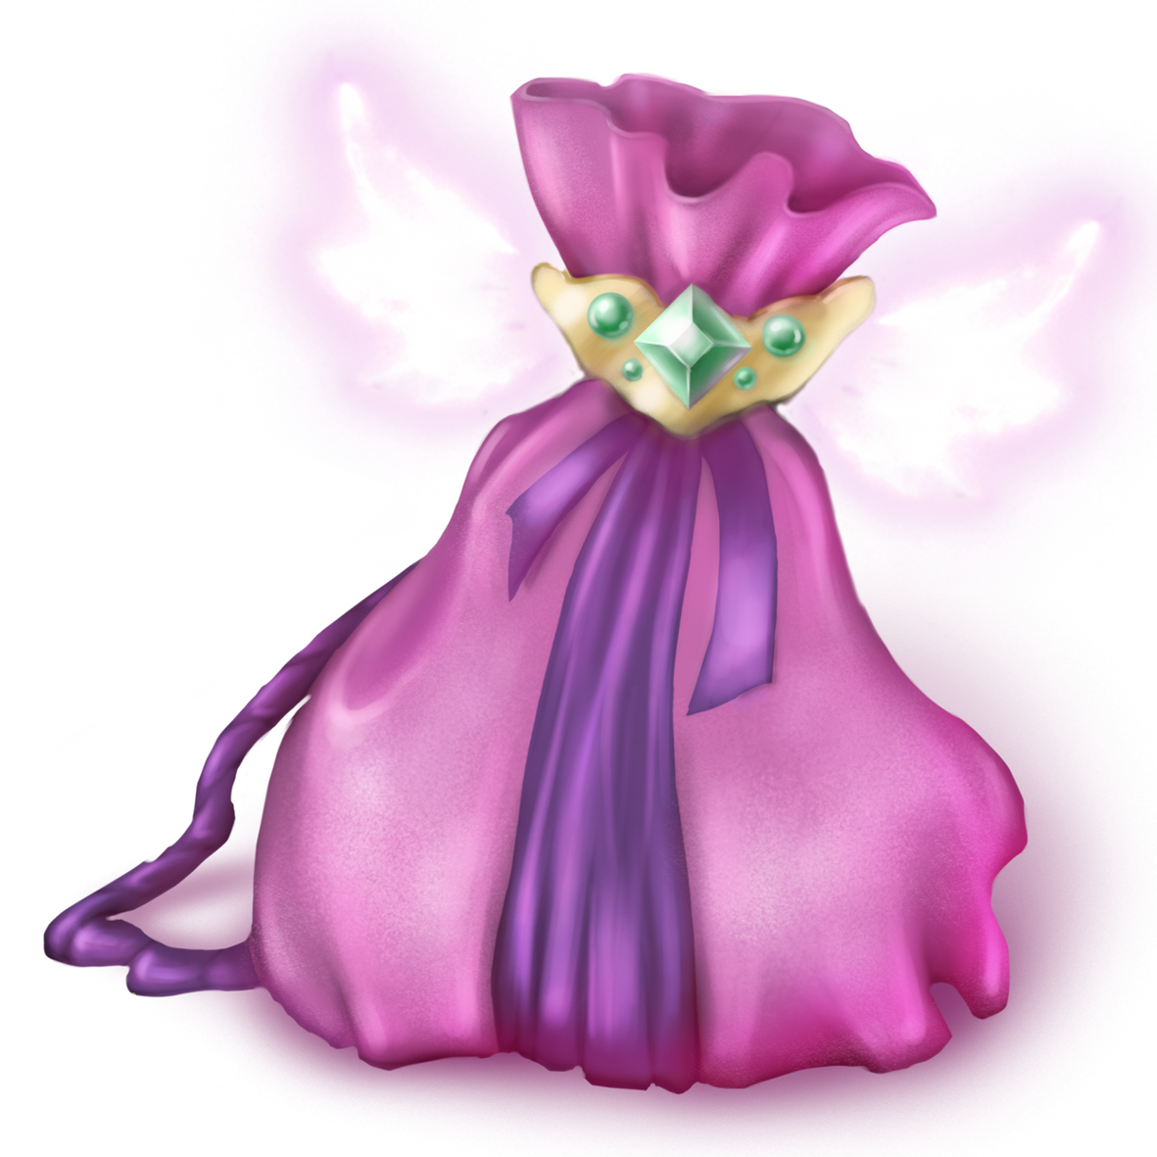
Activity 3
Let’s play.
MYSTERY BAG

Slide 20

Game: MYSTERY BAG
n
eleven
Notes:
Click the mystery bag to show the letter or letter combination card.
Click Next to show the answer example.

Slide 21
Game: MYSTERY BAG
er
Notes:
Click the mystery bag to show the letter or letter combination card.

Slide 22
Game: MYSTERY BAG
n
Notes:
Click the mystery bag to show the letter or letter combination card.

Slide 23
Game: MYSTERY BAG
er
Notes:
Click the mystery bag to show the letter or letter combination card.

Slide 24
Game: MYSTERY BAG
er
Notes:
Click the mystery bag to show the letter or letter combination card.

Slide 25
Game: MYSTERY BAG
n
Notes:
Click the mystery bag to show the letter or letter combination card.

Slide 26
Game: MYSTERY BAG
n
Notes:
Click the mystery bag to show the letter or letter combination card.

Slide 27
Game: MYSTERY BAG
er
Notes:
Click the mystery bag to show the letter or letter combination card.

Slide 28
Good
job!
Keep moving!

Slide 29
Activity 4
Fun corner
and wrap-up.

Slide 30





Game
SECRET WINDOWS

Slide 31








Which one is number nineteen?

Slide 32

Window 3 is number nineteen.

Slide 33
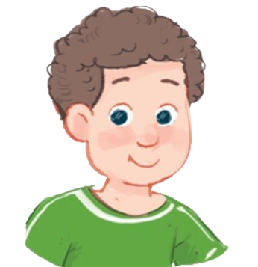

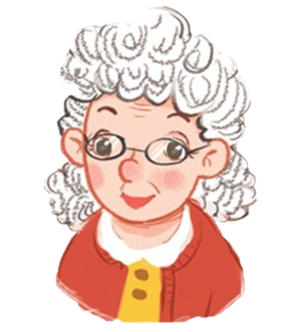
Which one is “brother”?

Slide 34

Window 1 is “brother”.

Slide 35



Which one is number fifteen?

Slide 36
Window 2 is number fifteen.

Slide 37
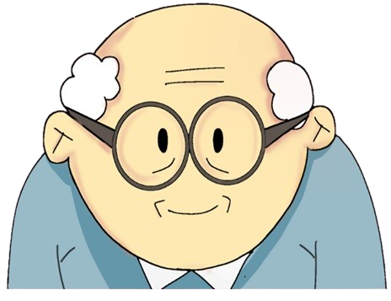

Which one is “grandfather”?

Slide 38
Window 3 is “grandfather”.

Slide 39




Thank
You!

