Slide 1






UBND QUẬN DƯƠNG KINH
TRƯỜNG TIỂU HỌC ANH DŨNG
REVIEW 4
Period 2 – Self-check

Slide 2


TABLE OF CONTENTS
1.
Warm-up and review.
2.
Listen and tick or cross.
3.
Listen and circle.
4.
Write and say.
5.
Fun corner and wrap-up.

Slide 3


Warm-up
and review.
1

Slide 4




Guess
the Word

Slide 5




Are you ready?

Slide 6


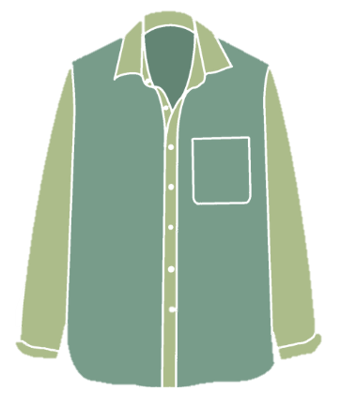
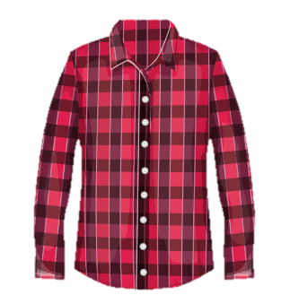
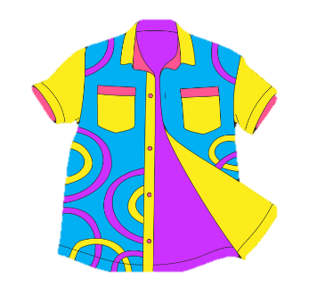

Look AND SAY.
(clue: 6 letters)
shirts

Slide 7
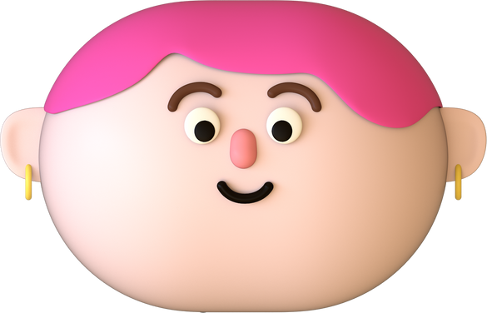

Listen and write.
(clue: 6 letters)
shorts

Slide 8





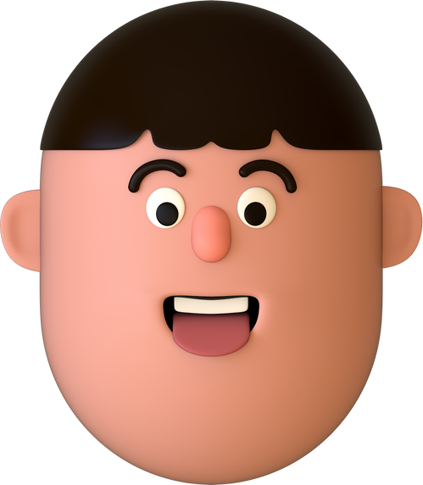
Look AND SAY.
(clue: 6 letters)
eleven

Slide 9
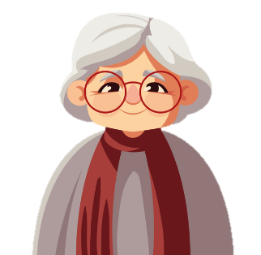
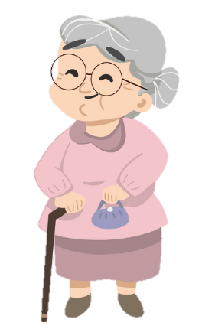
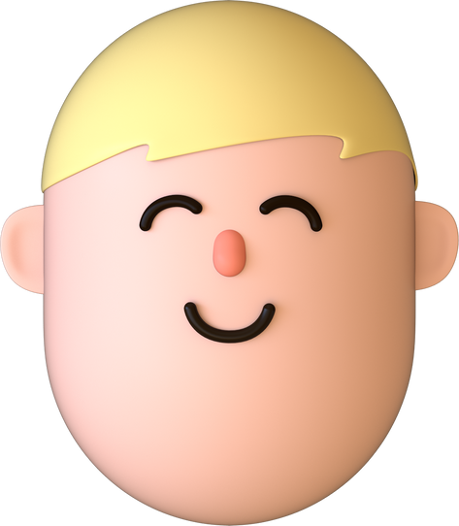
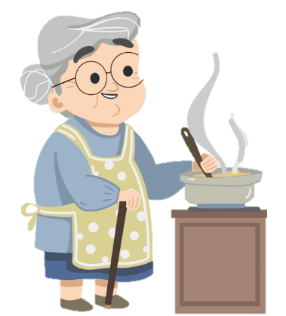
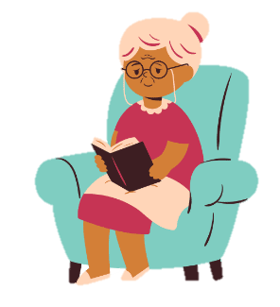
Look AND SAY.
(clue: 11 letters)
GRANDMOTHER

Slide 10
Listen and write.
(clue: 8 letters)
thirteen

Slide 11

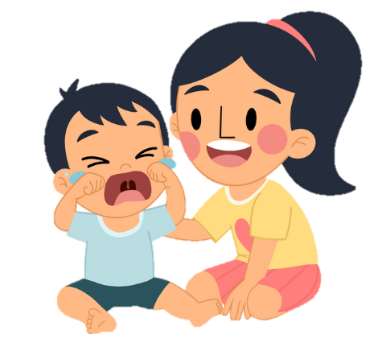


Look AND SAY.
(clue: 6 letters)
sister

Slide 12
Listen and write.
(clue: 7 letters)
brother

Slide 13




Look AND SAY.
(clue: 8 letters)
nineteen

Slide 14
Listen and write.
(clue: 5 letters)
shoes

Slide 15

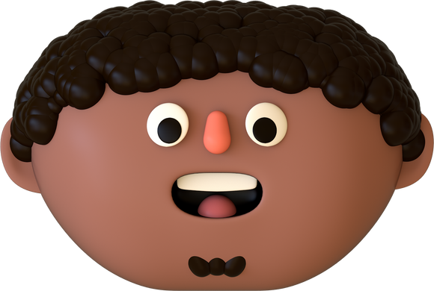
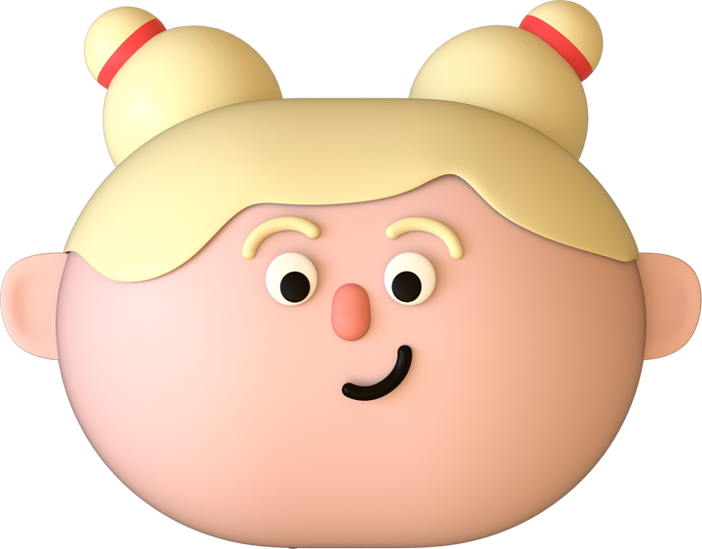
Thank you
for playing!

Slide 16

2
Listen and tick or cross.

Slide 17

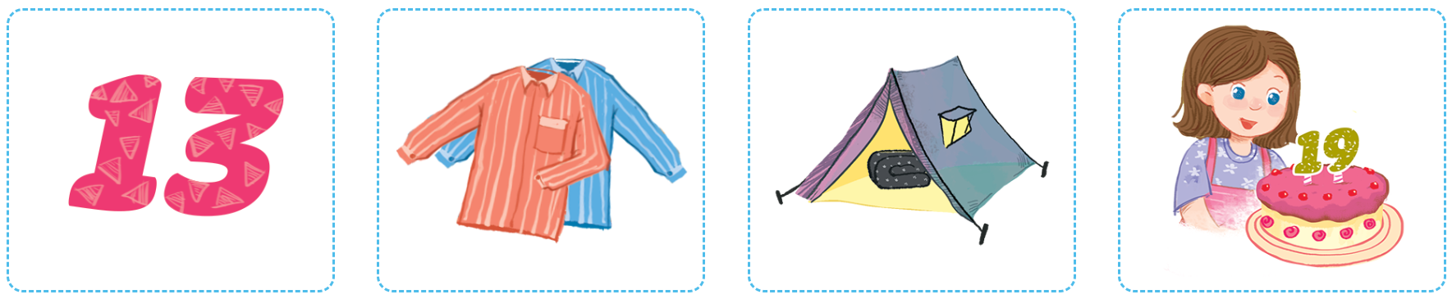


POINT and SAY.

Slide 18
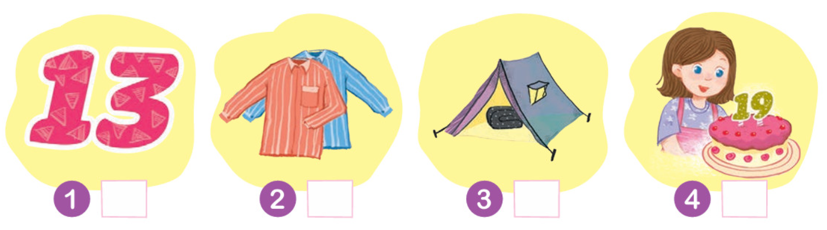
LISTEN and TICK or CROSS.

Slide 19
LISTEN again.

Slide 20







Let’s check.
Work in pairs.

Slide 21
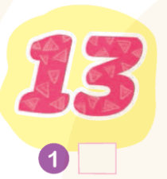
Let’s CHECK.
✓

Slide 22
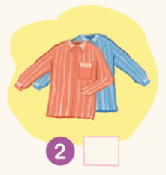
Let’s CHECK.
✗

Slide 23
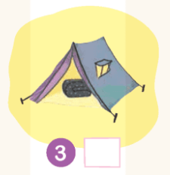
Let’s CHECK.
✓

Slide 24
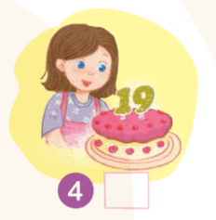
Let’s CHECK.
✗

Slide 25
Good Job!

Slide 26
3
Look
and circle.

Slide 27

Point and say.
n
er

Slide 28

Point and say.
sh
t

Slide 29

Point and say.
er
t

Slide 30

Point and say.
n
sh

Slide 31
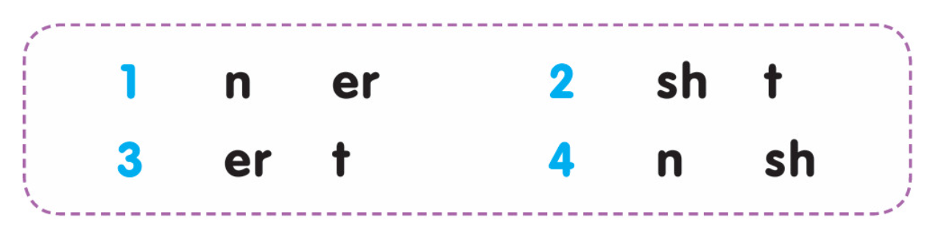
LISTEN and CIRCLE.

Slide 32
LISTEN again.

Slide 33
Let’s check.
Work in pairs.

Slide 34
Let’s CHECK.
n
er

Slide 35
Let’s CHECK.
sh
t

Slide 36
Let’s CHECK.
er
t

Slide 37
Let’s CHECK.
n
sh

Slide 38
Good Job!

Slide 39
4
Write
and say.

Slide 40
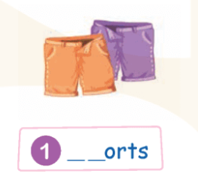
Point and say.

Slide 41
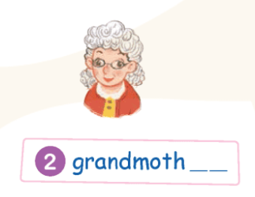
Point and say.

Slide 42
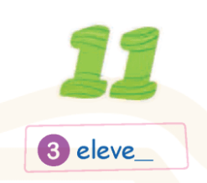
Point and say.

Slide 43

Point and say.

Slide 44
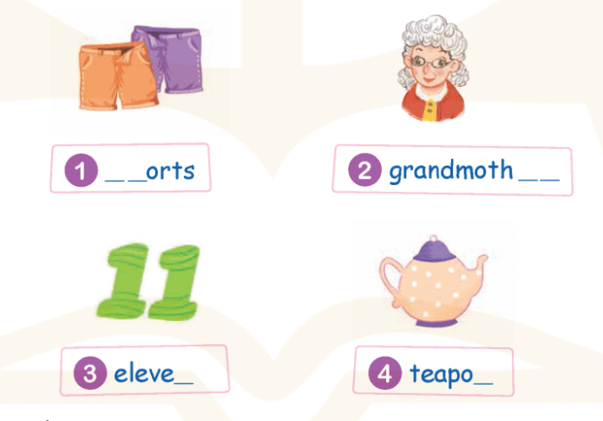
LOOK and WRITE.

Slide 45
Let’s check.
Work in pairs.

Slide 46
WRITE and SAY.
s
_ _orts
h

Slide 47
WRITE and SAY.
grandmoth_ _
e
r

Slide 48
WRITE and SAY.
n
eleve_

Slide 49
WRITE and SAY.
t
teapo_

Slide 50
Good Job!

Slide 51
5
Fun corner
and wrap-up.

Slide 52




Game
HAMSTER
Look, Read and Choose the correct sentence.

Slide 53


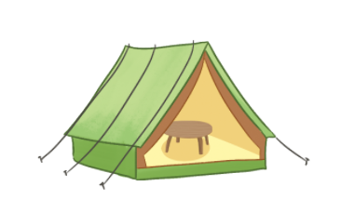



1
8
2
1. tent
5. sister
7
3
2. table
6. brother
6
4
3. thirteen
7. nineteen
5
4. grandmother
8. teapot

Slide 54
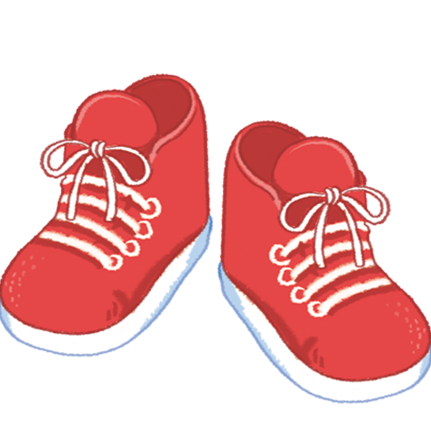
1
8
2
1. blanket
5. shoes
7
3
2. tent
6. teapot
6
4
3. thirteen
7. nineteen
5
4. sister
8. brother

Slide 55
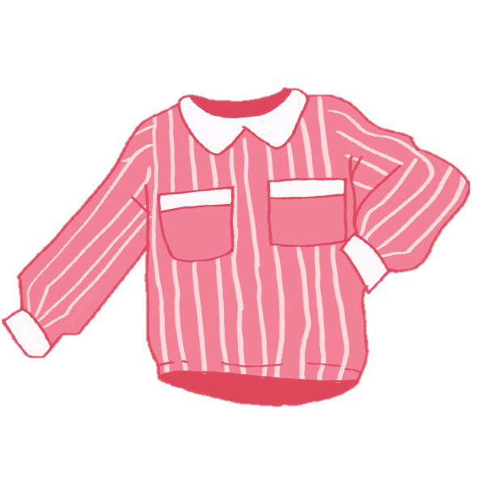
1
8
2
1. shoes
5. sister
7
3
2. shirts
6. brother
6
4
3. thirteen
7. nineteen
5
4. fifteen
8. teapot

Slide 56

1
8
2
1. blanket
5. sister
7
3
2. table
6. brother
6
4
3. thirteen
7. teapot
5
4. shirts
8. tent

Slide 57
1
8
2
1. tent
5. sister
7
3
2. table
6. brother
6
4
3. thirteen
7. thirteen
5
4. grandmother
8. nineteen

Slide 58
1
8
2
1. teapot
5. brother
7
3
2. table
6. sister
6
4
3. thirteen
7. nineteen
5
4. grandmother
8. tent

Slide 59
1
8
2
1. teapot
5. sister
7
3
2. nineteen
6. brother
6
4
3. thirteen
7. blanket
5
4. shoes
8. tent

Slide 60
1
8
2
1. table
5. nineteen
7
3
2. sister
6. blanket
6
4
3. brother
7. thirteen
5
4. grandmother
8. shoes

Slide 61
Good Job!

