Slide 1





UBND QUẬN DƯƠNG KINH
TRƯỜNG TIỂU HỌC ANH DŨNG
HELLO AND WELCOME TO MY ENGLISH CLASS

Slide 2










Unit 12:
At the café
Lesson 2

Slide 3












TABLE OF CONTENTS
Warm-up and review.
Listen and chant.
Listen and circle.
Write and say.
Fun corner and wrap-up.

Slide 4






Warm-up and Review.

Slide 5












Crossword Puzzle

Slide 6
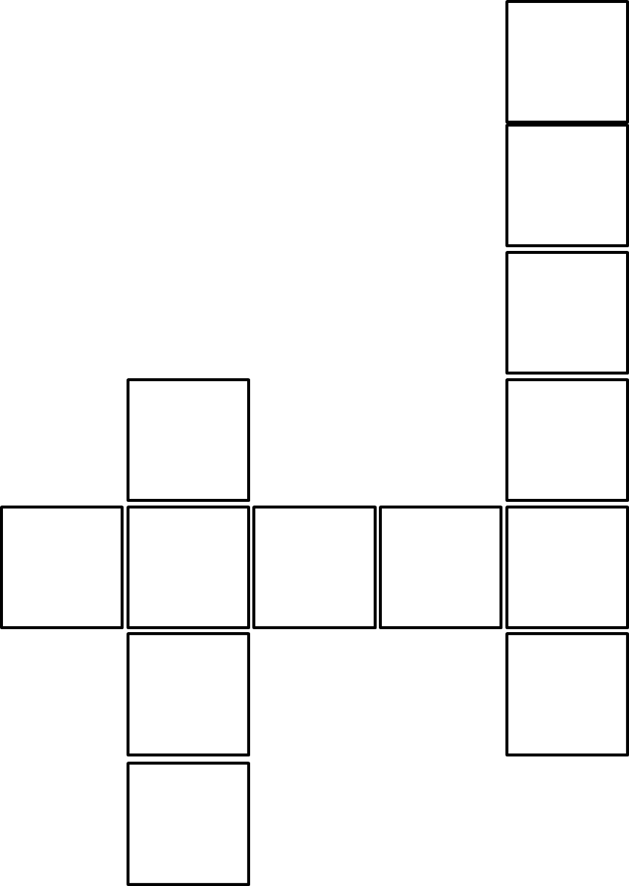


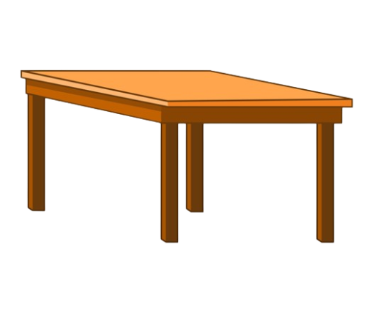
Crossword Puzzle
3
G
R
A
2
C
P
1
T
A
B
L
E
K
S
E
Notes:
Work in two teams.
Click number 1, 2, 3 to show the answers

Slide 7

THANK YOU
FOR
PLAYING!

Slide 8
Listen and chant.

Slide 9
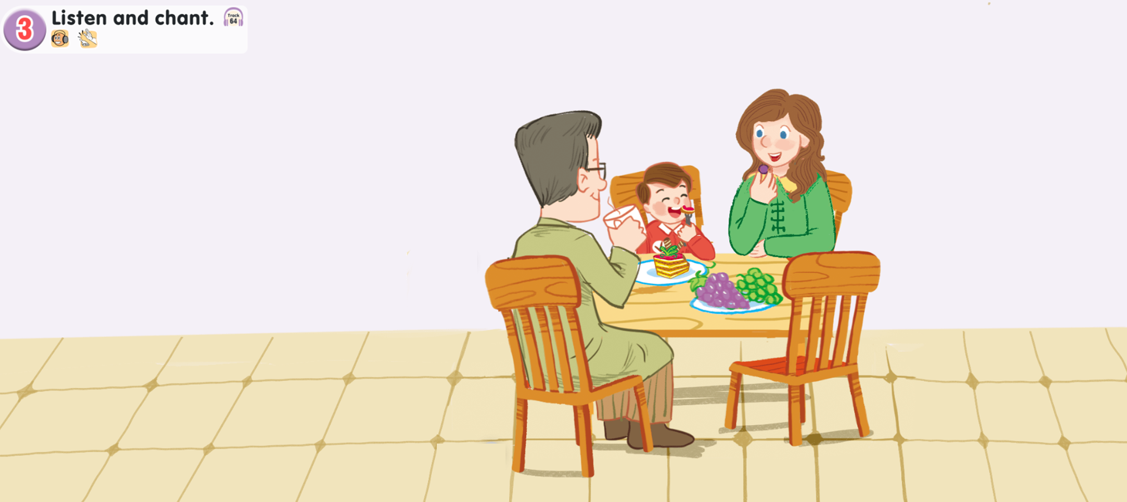
Look and say.

Slide 10

Watch a video.

Slide 11

3. Listen and chant.
A, a, cake.
A, a, cake.
A, a, cake.
A, a, cake.
A, a, cake.
A, a, cake.
A, a, cake.
A, a, cake.
He’s having a cake.
He’s having a cake.
He’s having a cake.
He’s having a cake.
A, a, grapes.
A, a, grapes.
A, a, grapes.
A, a, grapes.
A, a, grapes.
A, a, grapes.
A, a, grapes.
A, a, grapes.
She’s having grapes.
She’s having grapes.
She’s having grapes.
She’s having grapes.

Slide 12
It’s time to chant together.
A, a, cake.
A, a, cake.
A, a, cake.
A, a, cake.
A, a, cake.
A, a, cake.
A, a, cake.
A, a, cake.
He’s having a cake.
He’s having a cake.
He’s having a cake.
He’s having a cake.
A, a, grapes.
A, a, grapes.
A, a, grapes.
A, a, grapes.
A, a, grapes.
A, a, grapes.
A, a, grapes.
A, a, grapes.
She’s having grapes.
She’s having grapes.
She’s having grapes.
She’s having grapes.

Slide 13
Listen and circle.

Slide 14

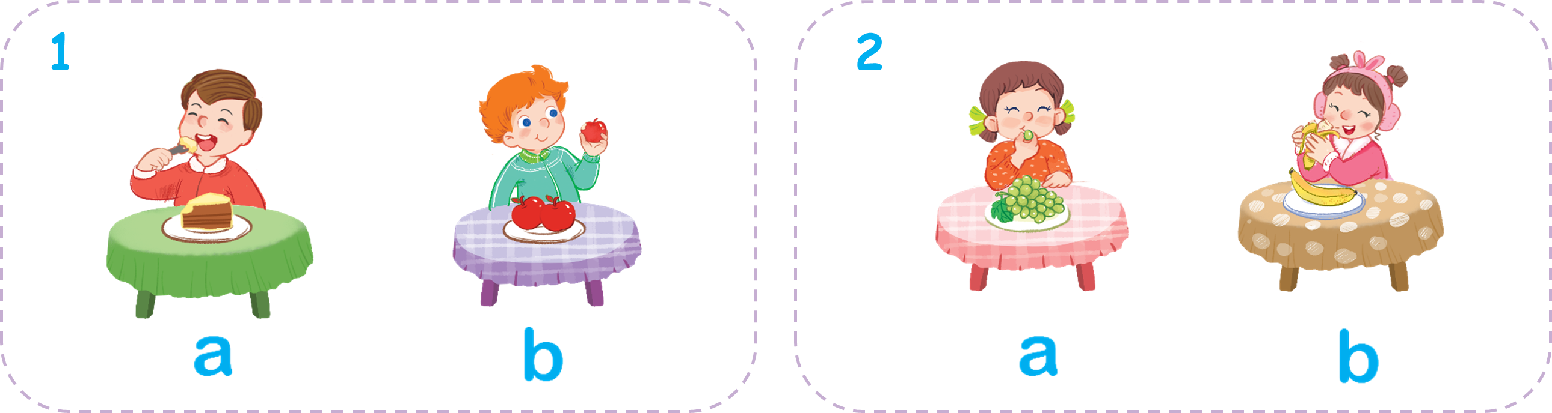

Look and say.

Slide 15
4. Listen and circle.

Slide 16
Check the answers.

Slide 17
Check the answers.

Slide 18
Write and say.

Slide 19

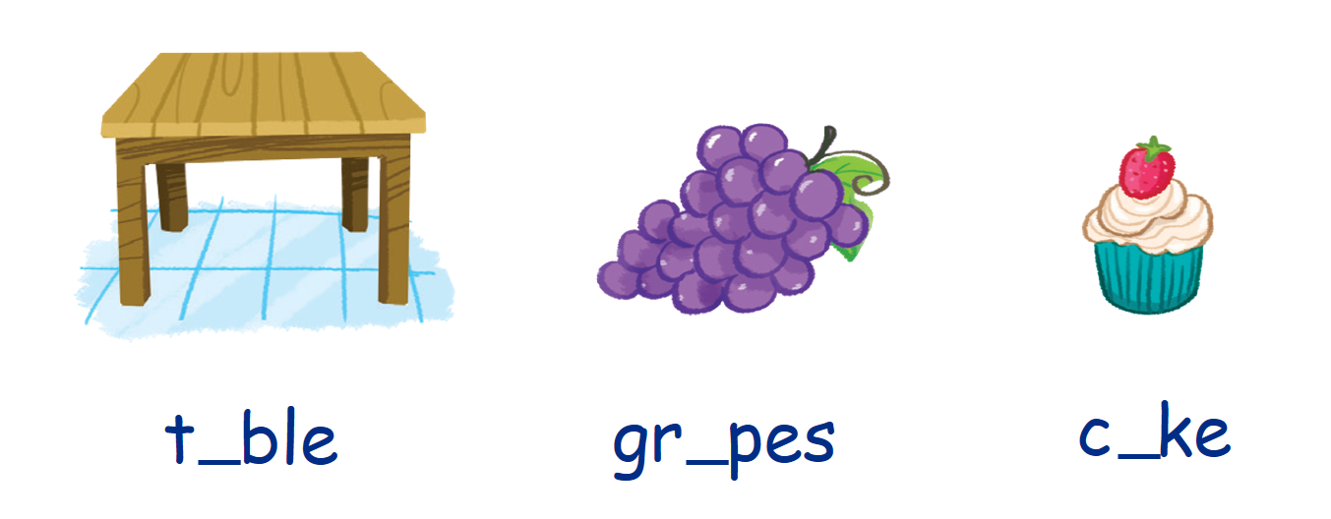

Look and say.

Slide 20
5. Write and say.

Slide 21
Check the answers.
a
a
a

Slide 22
Say the words.
a
a
a

Slide 23
Fun corner and wrap-up.

Slide 24


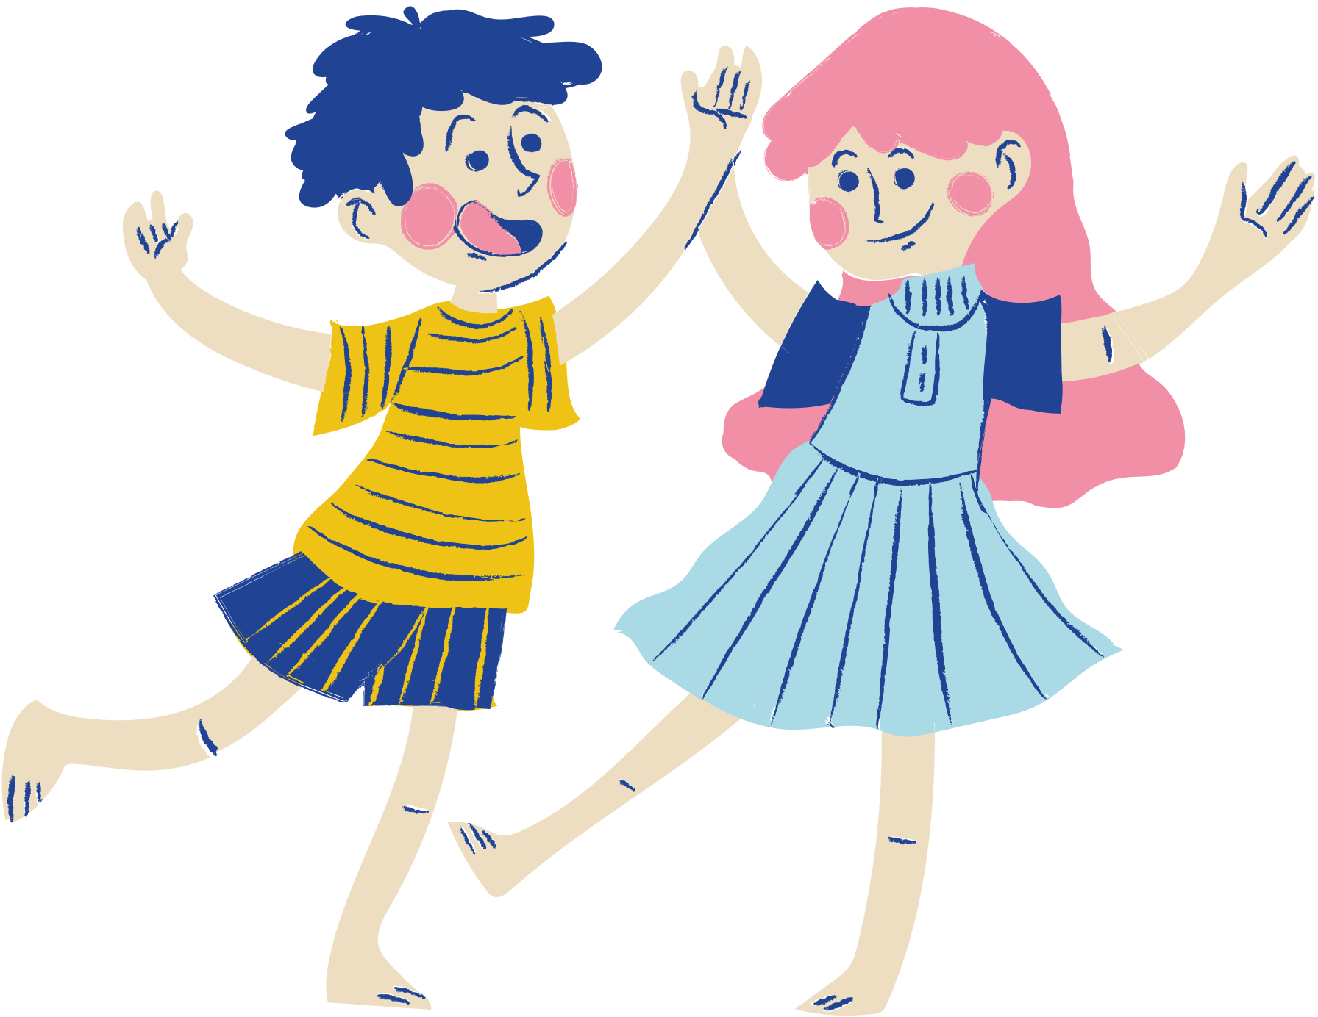
Apple Passing Game

