Slide 1




UBND QUẬN DƯƠNG KINH
TRƯỜNG TIỂU HỌC ANH DŨNG
HELLO AND WELCOME TO MY ENGLISH CLASS

Slide 2


Unit 7
In the kitchen
Lesson 3 - Period 3

Slide 3
TABLE OF CONTENTS
1
Warm-up and Review
2
Activity 6: Listen and repeat.
3
Activity 7: Let’s talk.
4
Activity 8: Let’s sing.
5
Fun corner and Wrap-up

Slide 4
01
Warm-up and Review

Slide 5



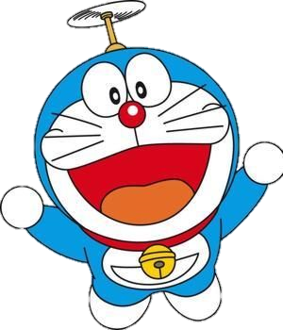
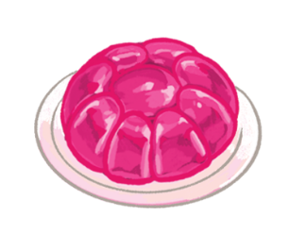
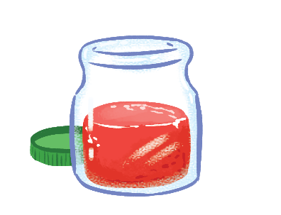


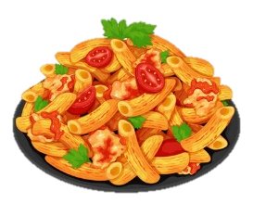





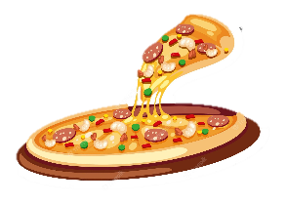











I like …
You are given 3 points
You are given 8 points
You are given 10 points
You are given 5 points
You are given 4 points
You are given 2 points

Slide 6
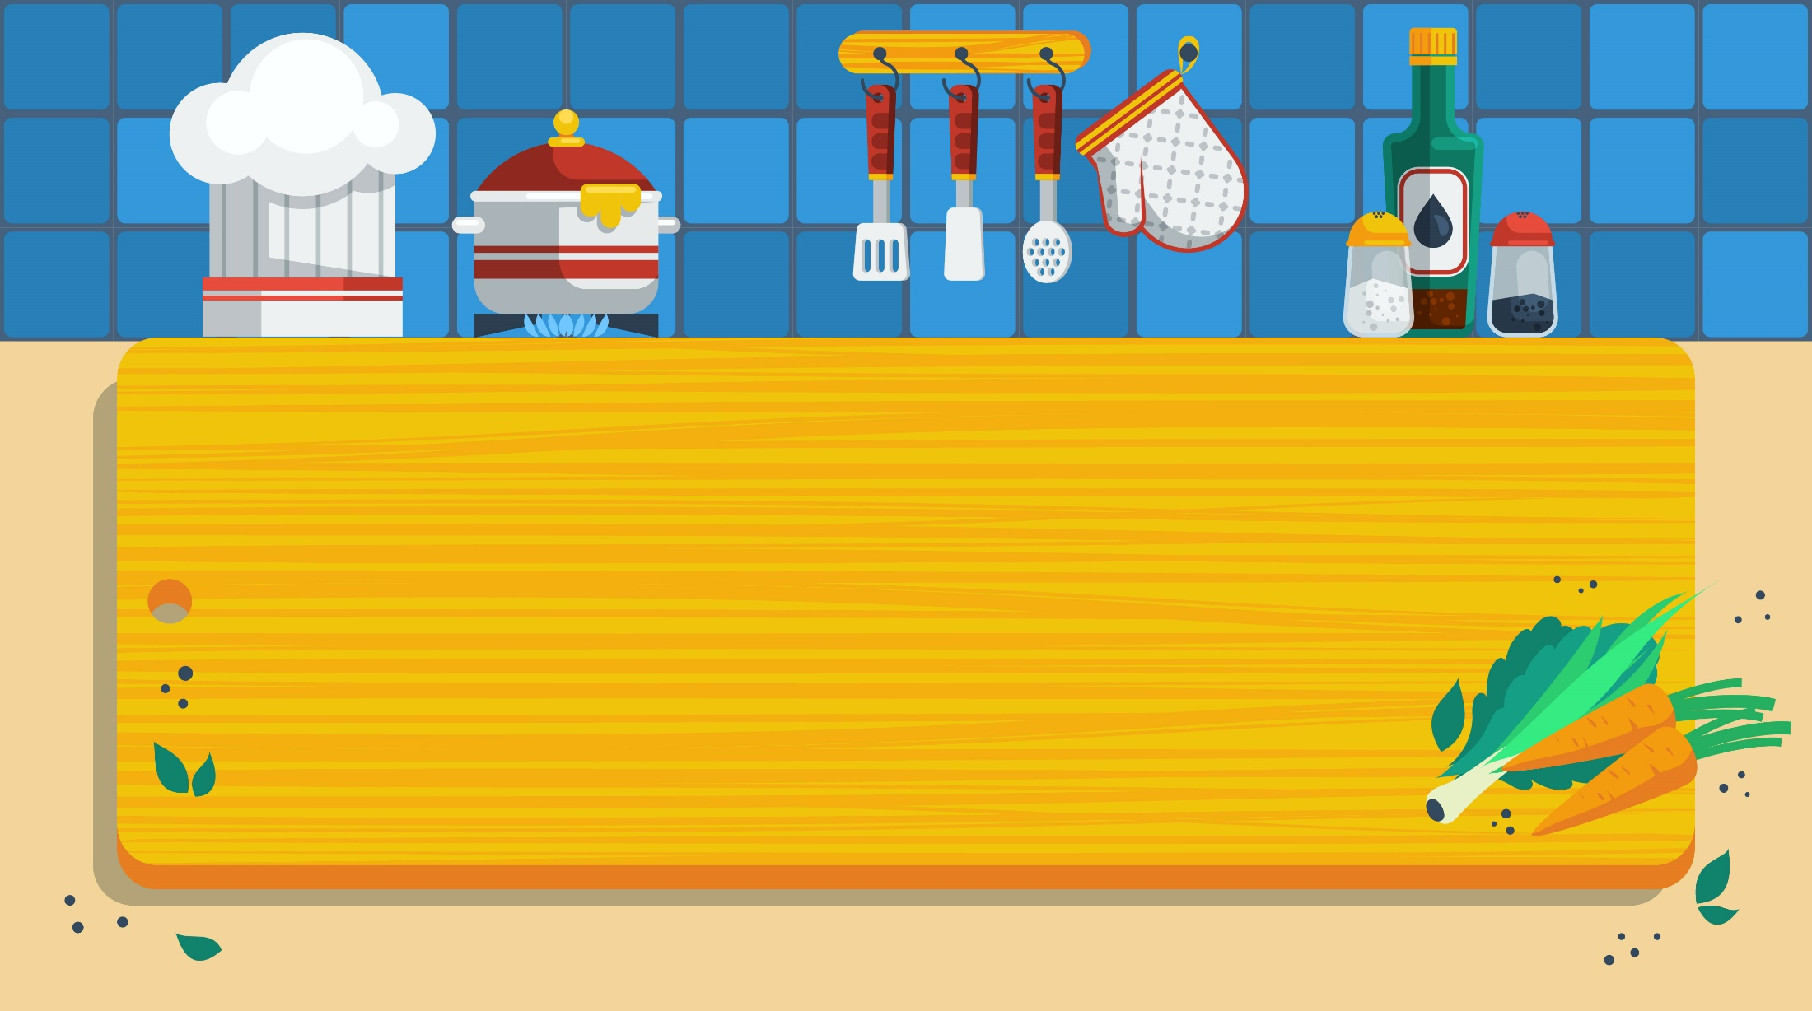
02
Activity 6
Listen and repeat.

Slide 7
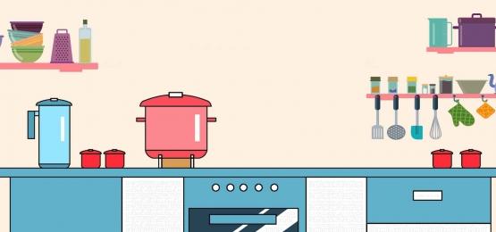




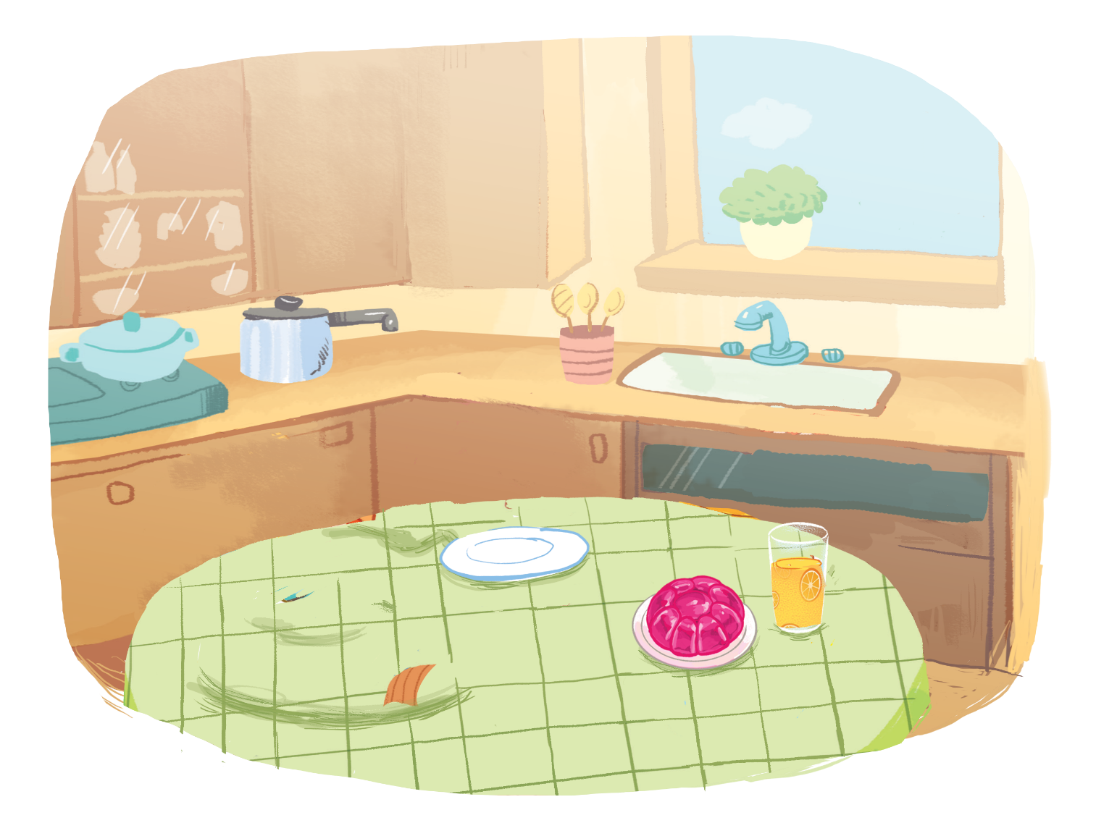
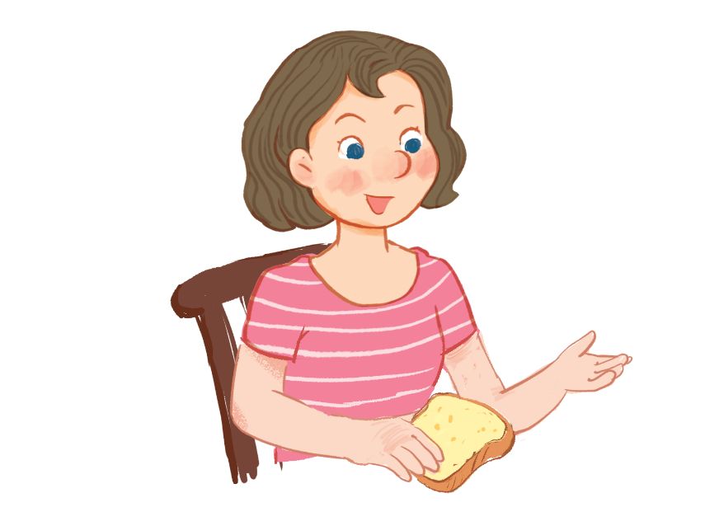
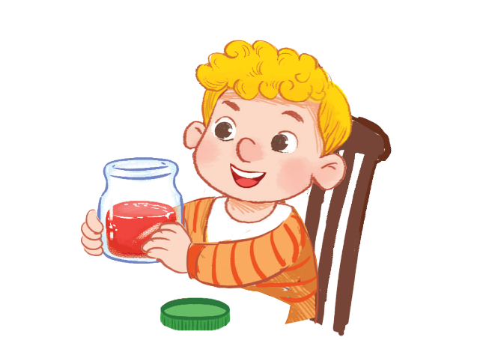

Listen and repeat.
Pass me the jam, please.
Pass me the jam, please.
Pass me the jam, please.
Pass me the jam, please.
Here you are.
Here you are.
Here you are.
Here you are.

Slide 8
03
Activity 7
Let’s talk.

Slide 9





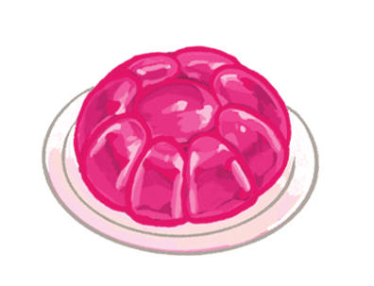
Let’s talk.
, please.
Here .
a
b
c

Slide 10
, please.
Here .
a

Slide 11
, please.
Here .
b

Slide 12
, please.
Here .
c

Slide 13
04
Activity 8
Let’s sing!

Slide 14


Let’s sing!
Jam, juice, jelly.
Jam, juice, jelly.
Jam, juice, jelly.
Jam, juice, jelly.
Pass me the jam.
Pass me the jam.
Pass me the jam.
Pass me the jam.
Pass me the juice.
Pass me the juice.
Pass me the juice.
Pass me the juice.
Pass me the jelly.
Pass me the jelly.
Pass me the jelly.
Pass me the jelly.
Here you are.
Here you are.
Here you are.
Here you are.
Here you are.
Here you are.
Here you are.
Here you are.
Here you are.
Here you are.
Here you are.
Here you are.

Slide 15
05
Fun corner
and
Wrap-up

Slide 16


Option 1
Option 2

Slide 17
Vocabulary race

Slide 18






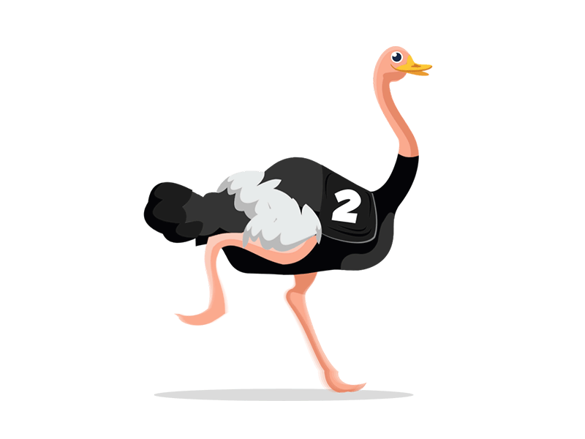

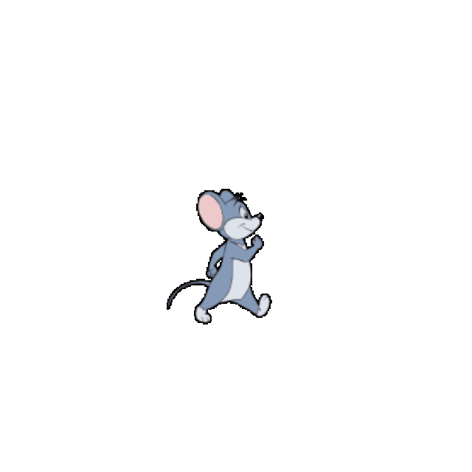
Vocabulary race
j a m
j u i c e
j e l l y
c a k e
p a s t a
____ ____ ____
___ ___ ___ ___ ___
____ ____ ____ ____ ____
___ ___ ____ ____
___ ___ ___ ___ ___
Notes:
- Sau khi bấm PLAY sẽ hiện hình ảnh đầu tiên, GV click vào biểu tượng các dấu gạch ( _ _ _ ) bên dưới tranh để hiện đáp án. Sau đó click tiếp vào màn hình để hiện đáp án và chuyển sang câu hỏi tiếp theo.

Slide 19


Slide 20
ROLE PLAY

Slide 21




Get the points
+3
+1
+4
+2
+5

Slide 22
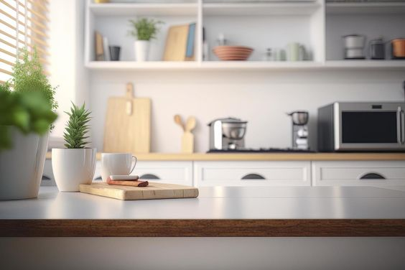



…………..,………..
…….……...

Slide 23
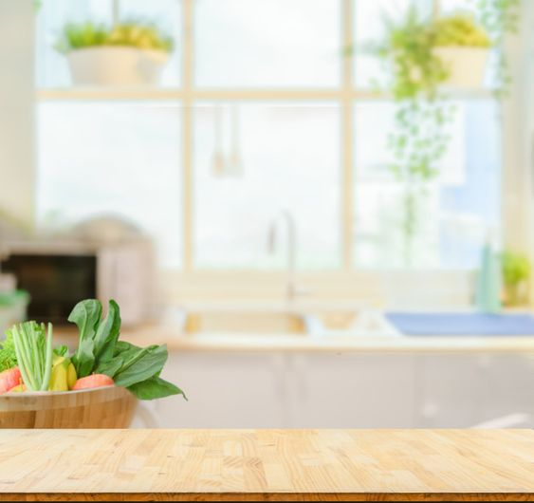



…………
………..…,……...

Slide 24



…………….…, ……..
…………

Slide 25


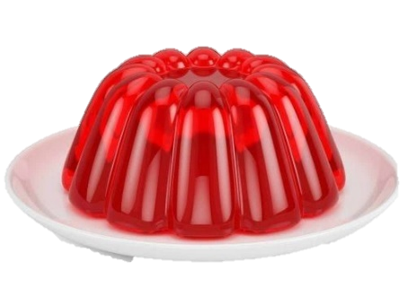
…………….…., ……..
…………...

Slide 26

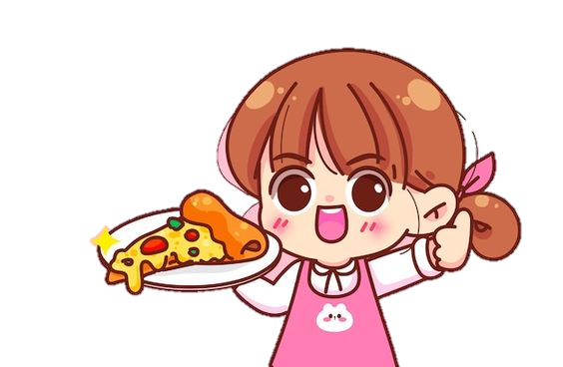
…………….…., ……..
…………...

Slide 28

Time to say goodbye!
j

