Slide 1




UBND QUẬN DƯƠNG KINH
TRƯỜNG TIỂU HỌC ANH DŨNG
ENGLISH - GRADE 5
UNIT 6: OUR SCHOOL ROOMS
LESSON 1 (1, 2, 3)

Slide 2

Our school rooms
Lesson 1 - Period 1

Slide 3

01
Warm-up & Review

Slide 4

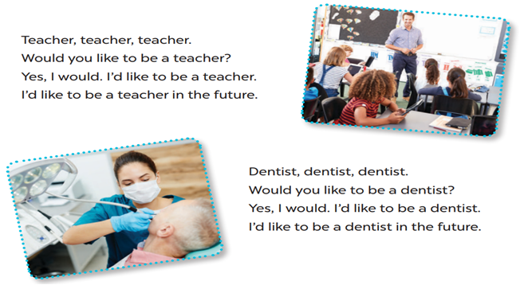


LET’S SING!
Teacher, teacher, teacher.
Would you like to be a teacher?
Yes, I would. I’d like to be a teacher.
I’d like to be a teacher in the future.
Dentist, dentist, dentist.
Would you like to be a dentist?
Yes, I would. I’d like to be a dentist.
I’d like to be a dentist in the future.

Slide 5
02
Look, listen and repeat.

Slide 6
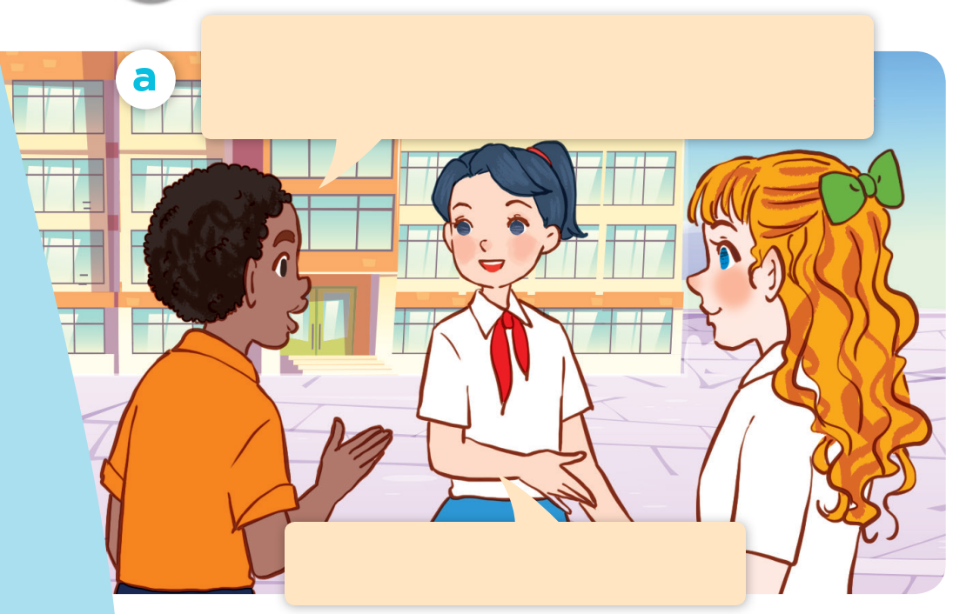
What are they doing?
Where are they?
Who are they?
Listen and repeat.
Good morning. Could you show us around your school?
Yes, of course. Let’s go!

Slide 7
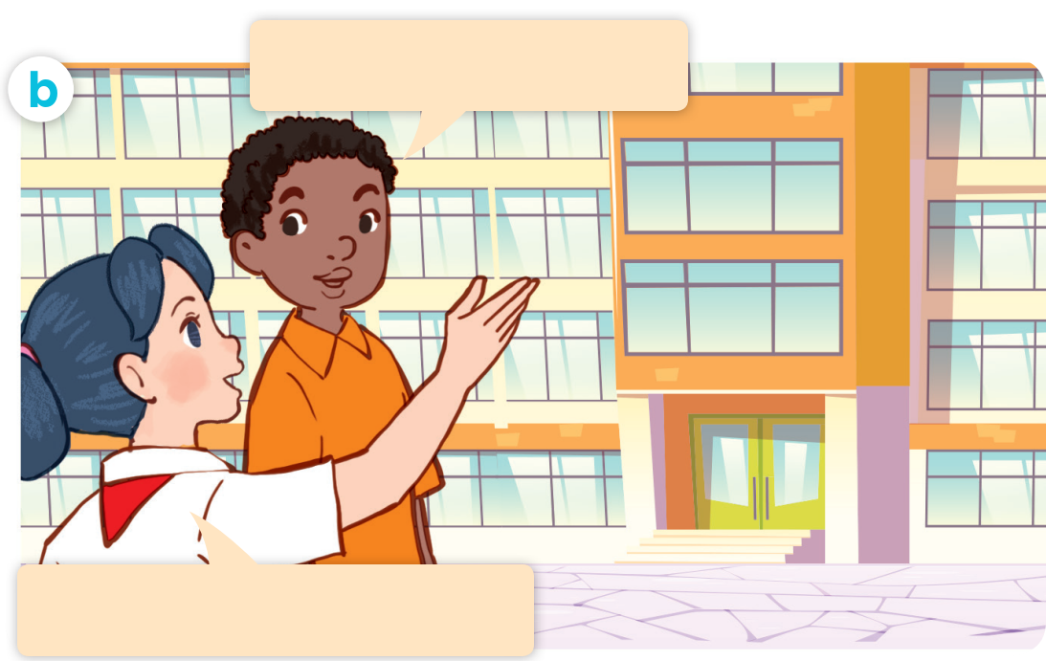
Listen and repeat.
Act it out.
Where’s the library?
It’s on the second floor.

Slide 8


Where’s the library?
It’s on the second floor.

Slide 9
03
Listen, point and say.

Slide 10
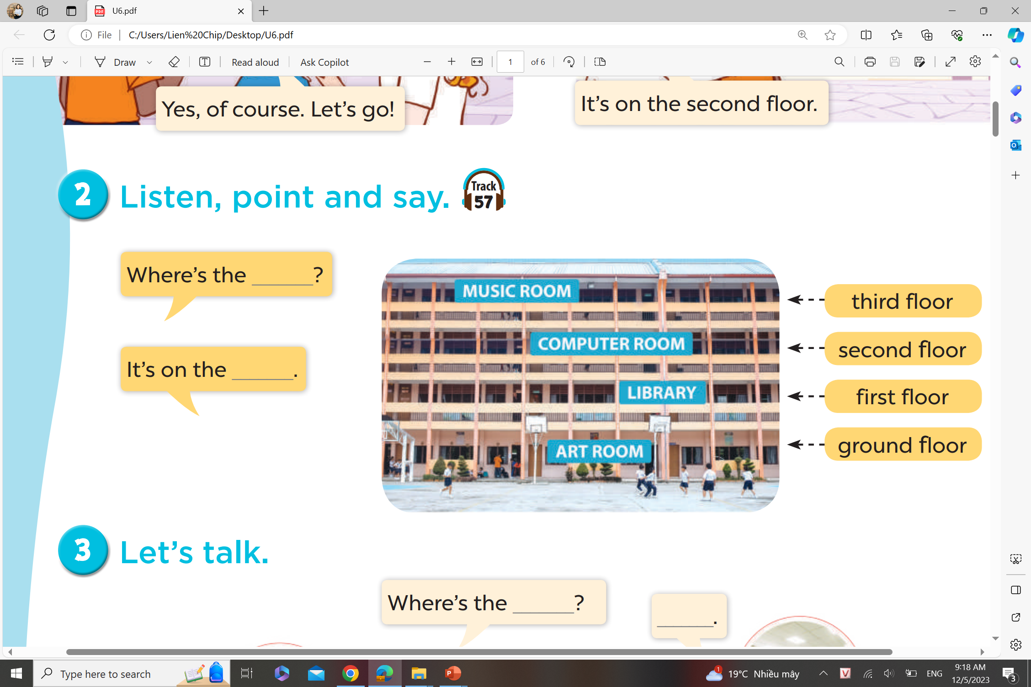
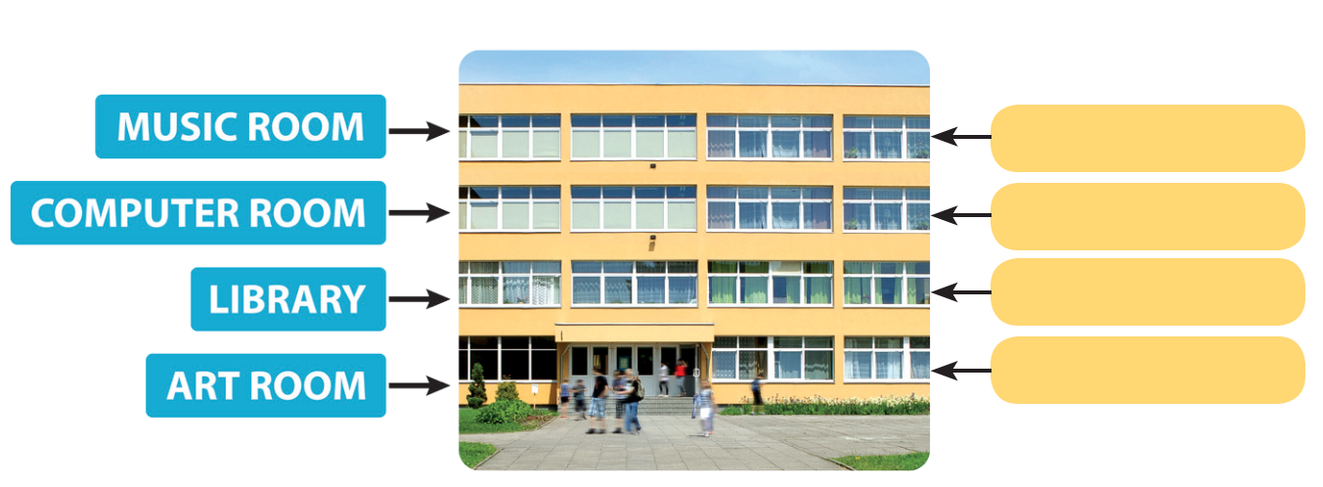
Listen, point and say.
Where’s the ____?
It’s on the ___.
third floor
second floor
first floor
ground floor

Slide 11
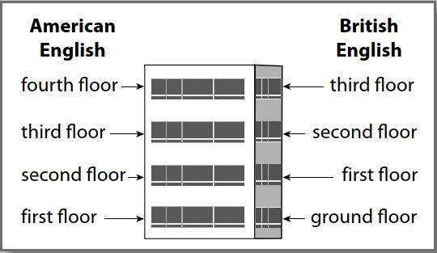
NOTE!

Slide 12
04
Let’s talk.

Slide 13
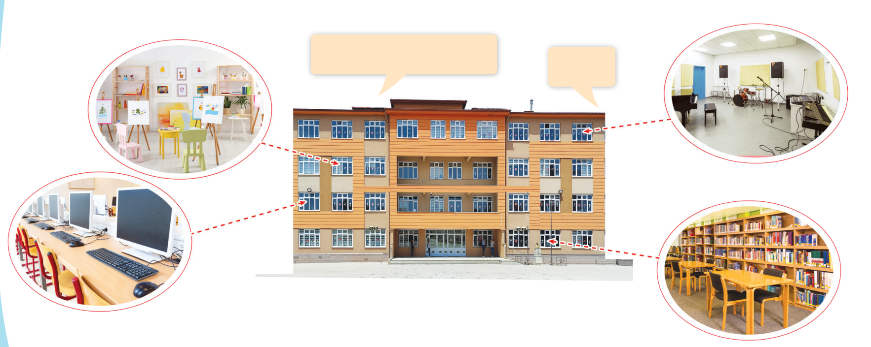
Let’s talk.
Where’s the _____?
_____.

