Slide 1




UBND QUẬN DƯƠNG KINH
TRƯỜNG TIỂU HỌC ANH DŨNG
ENGLISH - GRADE 5
UNIT 7: OUR FAVOURITE SCHOOL ACTIVITIES
LESSON 3 (1, 2, 3)

Slide 2
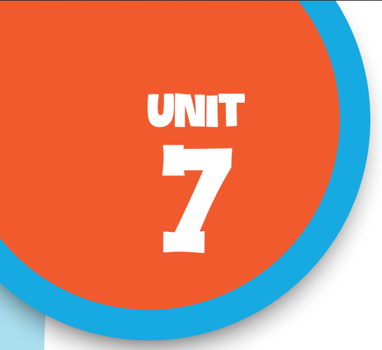

Our favourite
school activities
Lesson 3 - Period 5

Slide 3


01
Warm-up
& Review

Slide 4

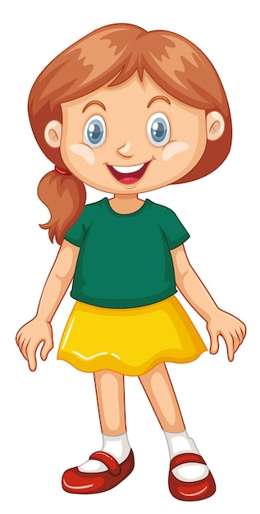
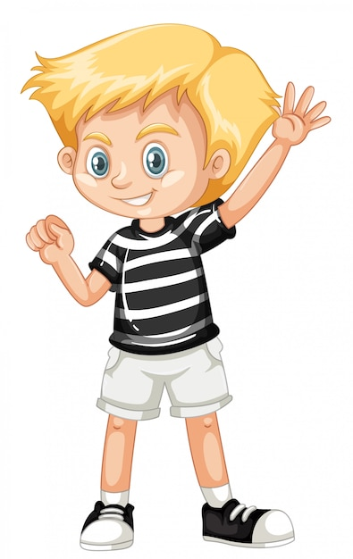
Interview
What school activity
do you like?
I like .

Slide 5
Interview
Why do you like it?
Because I think
it’s .

Slide 6
02
Listen
and repeat.

Slide 7

Listen and repeat.
'solving He likes 'solving maths problems.
'reading Her favourite school activity
is 'reading books.

Slide 8
03
Circle, listen and check.

Slide 9
Circle the word having different stress.
1.a.solving b.downstairs c.because
2.a.goodbye b.swimming c.enjoy
3.a.before b.guitar c.writing

Slide 10
Listen and check.
1.a.solving b.downstairs c.because
2.a.goodbye b.swimming c.enjoy
3.a.before b.guitar c.writing

Slide 11
04
Let’s chant.

Slide 12
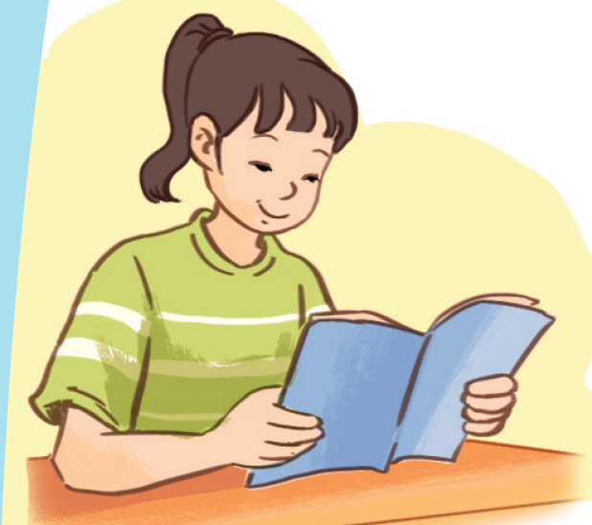
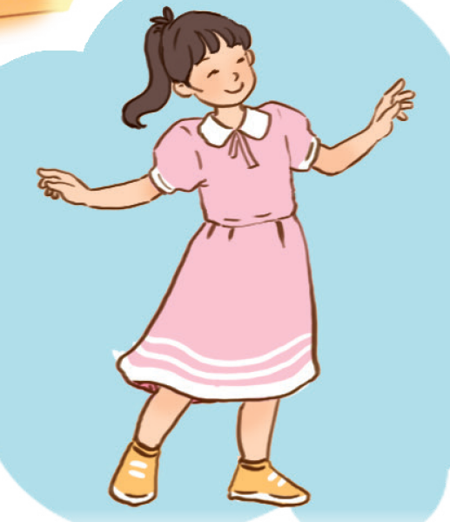
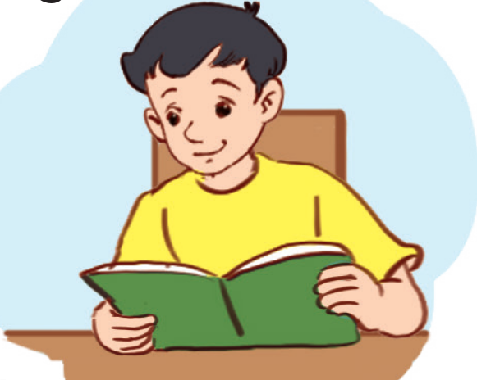
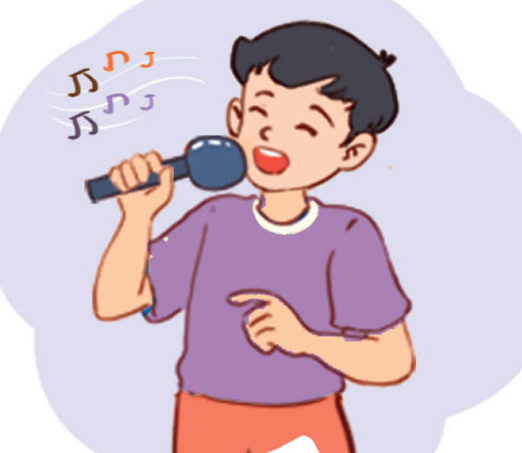
Name the school activities
reading
dancing
reading
singing

Slide 13
Look and read.
Clap and chant.
Listen and repeat.
What school activities does she like?
What school activities does she like?
She likes reading and dancing.
Does she like drawing and painting?
No, she doesn’t. She likes reading and dancing.
What school activities does he like?
He likes reading and singing.
Does he like drawing and swimming?
No, he doesn’t. He likes reading and singing.

Slide 14
Compose the chant.
What school activities does she like?
What school activities does she like?
She likes reading and dancing.
Does she like drawing and painting ?
No, she doesn’t. She likes reading and dancing.
What school activities does he like?
He likes reading and singing.
Does he like drawing and swimming?
No, he doesn’t. He likes reading and singing.

Slide 15
05
Fun corner & Wrap-up

Slide 16
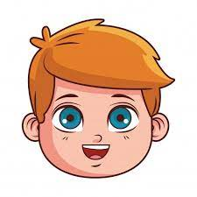
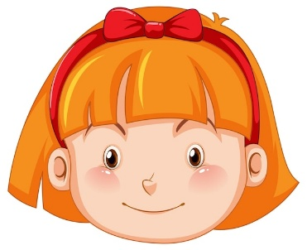
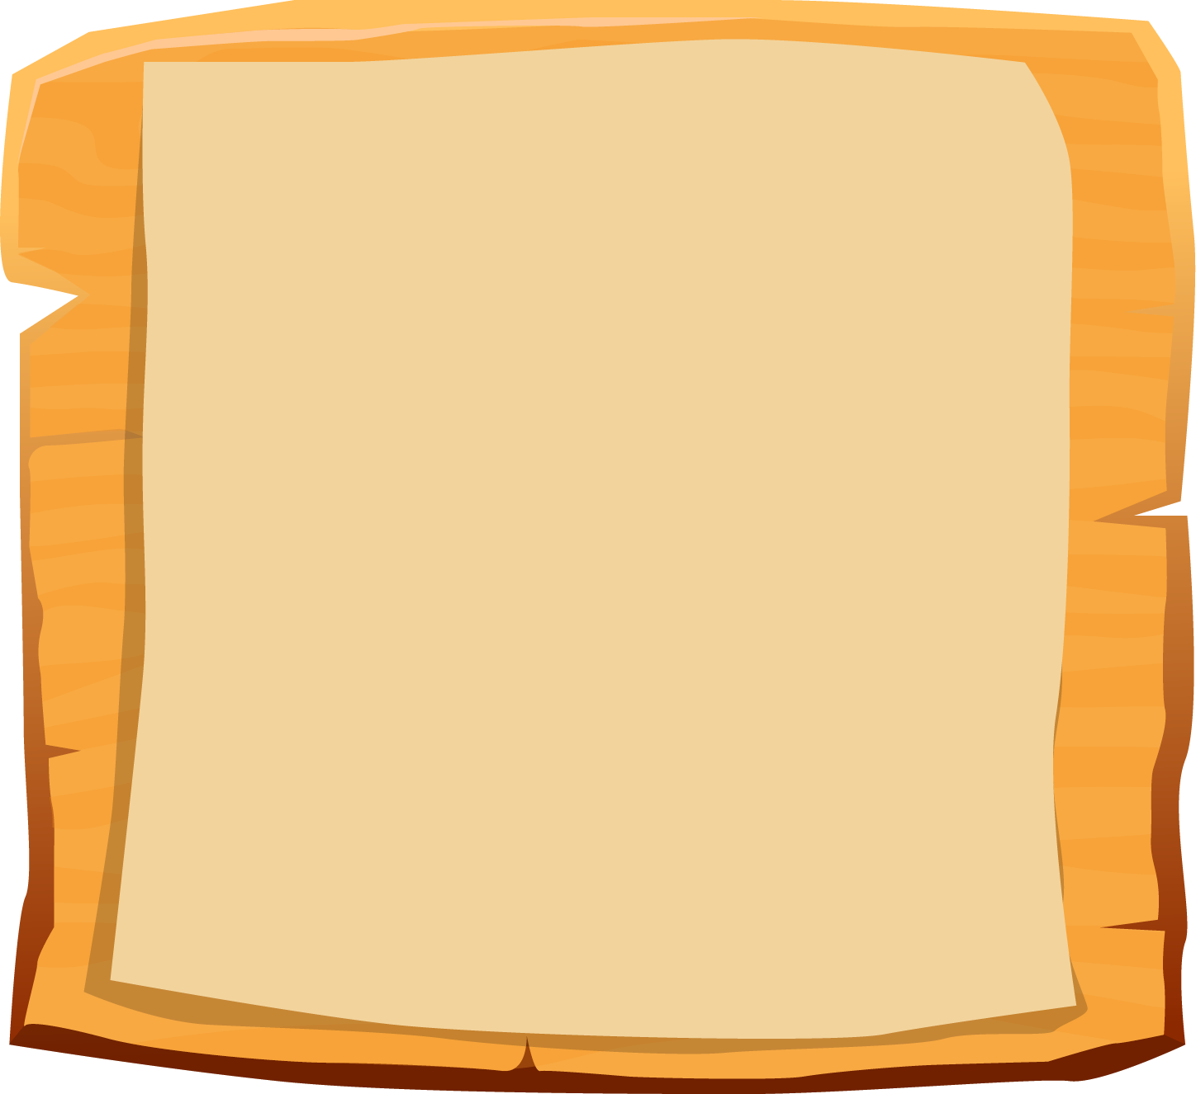






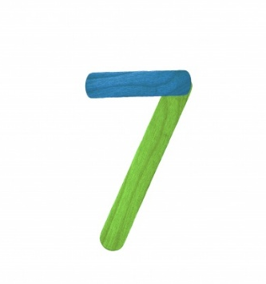


Slide 17


A: What school activity does he like?
“
He likes reading books.
B: __________________

Slide 18
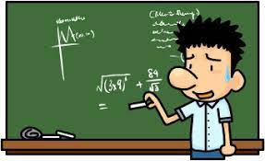
A: Do you like solving
maths problems?
No, I don’t.
B: ________

Slide 19
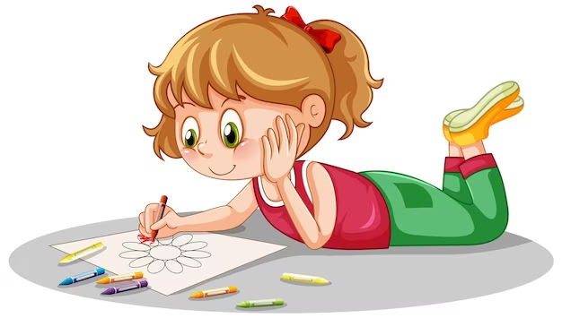
A: What school activity does she like?
She likes drawing.
B: ______________

Slide 20

swimming
A: Why does he like _______?
B: Because he thinks it’s fun.

Slide 21
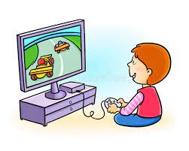
A: Does he like playing games?
Yes, he does.
B: __________

Slide 22
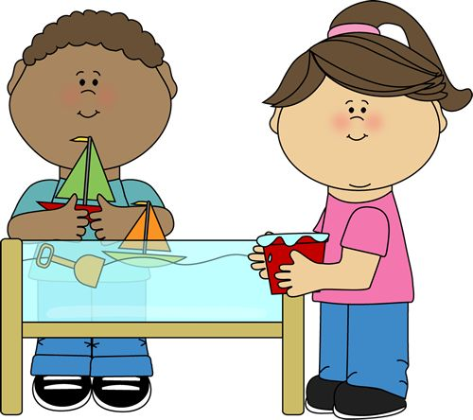
doing projects
A: Why do you like ___________?
B: Because I think
it’s good for
group work.

Slide 23
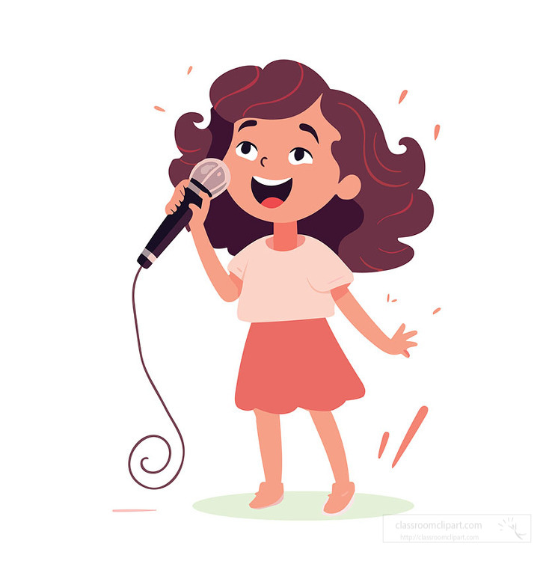
A: What school activity
do you like?
I like singing.
B: ___________

Slide 24
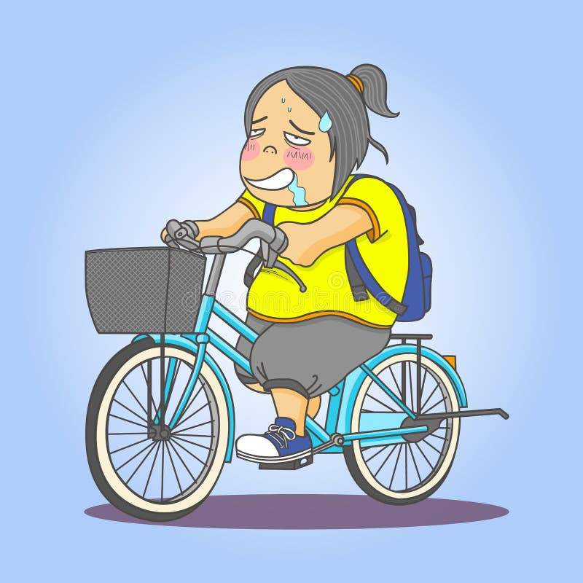
A: Why doesn’t she like
__________?
riding a bike
B: Because she thinks
it isn’t interesting.

