Slide 1




UBND QUẬN DƯƠNG KINH
TRƯỜNG TIỂU HỌC ANH DŨNG
ENGLISH - GRADE 5
UNIT 7: OUR FAVOURITE SCHOOL ACTIVITIES
LESSON 2 (1, 2, 3)

Slide 2
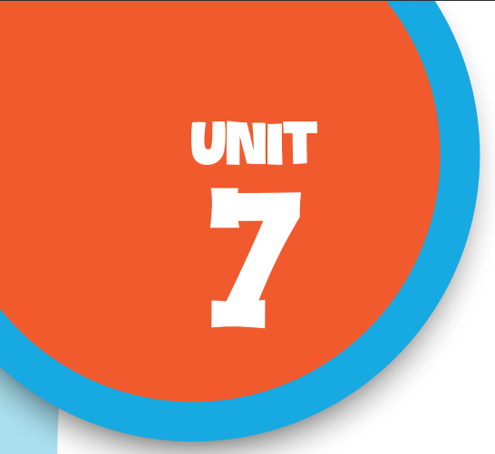

Our favourite
school activities
Lesson 3 - Period 6

Slide 3


01
Warm-up and Review

Slide 4



Nhạc nền
ROCK, PAPER, SCISSORS

Slide 5
How to play
There are 8 questions. Use rock, paper, scissors signs to answer each question.

Slide 6



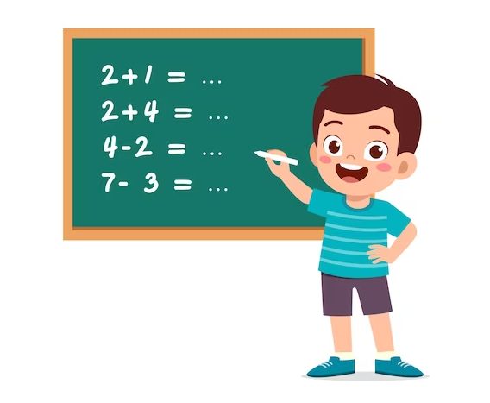


Q1
I like ________.
playing games
Âm thanh kiểm tra đáp án
solving maths problems
reading stories

Slide 7
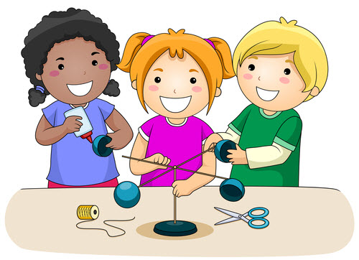
Q2
I like __________.
doing projects
Âm thanh kiểm tra đáp án
do projects
studying maths

Slide 8
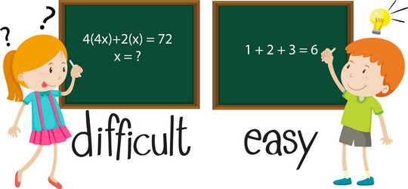
She thinks it’s ______.
Q3
interesting
Âm thanh kiểm tra đáp án
easy
difficult
Notes:
We can say “math” or “maths”.

Slide 9
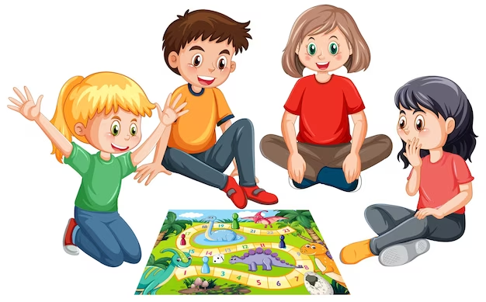
Playing games is ____.
Q4
fun
Âm thanh kiểm tra đáp án
useful
good for group work

Slide 10

He thinks doing projects is ________.
Q5
useful
Âm thanh kiểm tra đáp án
good for group work
interesting

Slide 11

My brother ____ reading books. He thinks it isn't interesting.
Q6
doesn't like
Âm thanh kiểm tra đáp án
don't like
likes

Slide 12
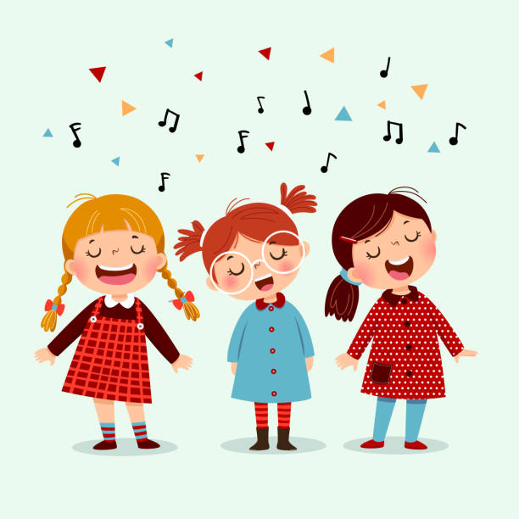
My friend likes ___________
because she wants to be a singer.
Q7
studying maths
Âm thanh kiểm tra đáp án
playing chess
singing

Slide 13

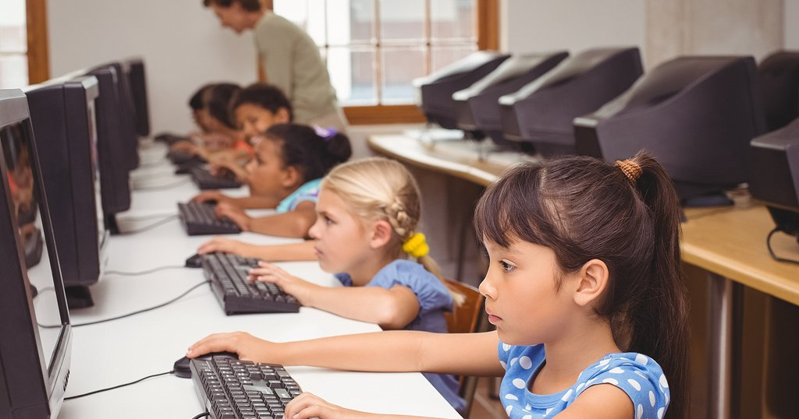
A: _____ do they like studying IT?
B: Because they think it's useful.
Q8
What
Âm thanh kiểm tra đáp án
Why
How
Notes:
We can say “ICT” or “computer science”

Slide 14
02
Read and circle.

Slide 15



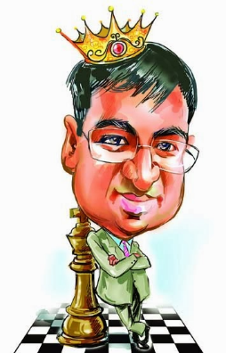
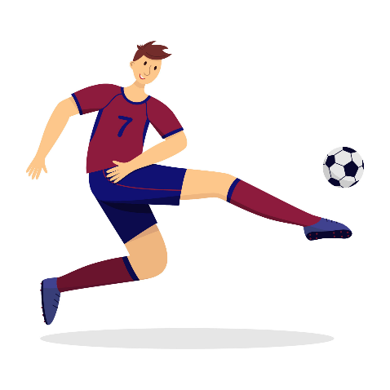

Linh, Minh, Lucy and Bill are close friends. They study at the same school. They have different favourite activities. Linh likes singing because she wants to be a singer in the future. Minh likes studying science because he wants to be a scientist. Lucy likes playing chess because she wants to be a world chess champion. And Bill loves playing football because he wants to be a famous footballer.
singer
scientist
chess champion
footballer

Slide 16
Linh, Minh, Lucy and Bill are close friends. They study at the same school. They have different favourite activities. Linh likes singing because she wants to be a singer in the future. Minh likes studying science because he wants to be a scientist. Lucy likes playing chess because she wants to be a world chess champion. And Bill loves playing football because he wants to be a famous footballer.
1. ________ likes singing.
a. Minh b. Lucy c. Linh

Slide 17
Linh, Minh, Lucy and Bill are close friends. They study at the same school. They have different favourite activities. Linh likes singing because she wants to be a singer in the future. Minh likes studying science because he wants to be a scientist. Lucy likes playing chess because she wants to be a world chess champion. And Bill loves playing football because he wants to be a famous footballer.
2. Minh wants to be a ________.
a. teacher b. scientist c. singer

Slide 18
Linh, Minh, Lucy and Bill are close friends. They study at the same school. They have different favourite activities. Linh likes singing because she wants to be a singer in the future. Minh likes studying science because he wants to be a scientist. Lucy likes playing chess because she wants to be a world chess champion. And Bill loves playing football because he wants to be a famous footballer.
3. Lucy’s favourite activity is ________.
a. playing chess b. doing projects c. singing songs

Slide 19
Linh, Minh, Lucy and Bill are close friends. They study at the same school. They have different favourite activities. Linh likes singing because she wants to be a singer in the future. Minh likes studying science because he wants to be a scientist. Lucy likes playing chess because she wants to be a world chess champion. And Bill loves playing football because he wants to be a famous footballer.
4. Bill wants to be a famous ________ player.
a. baseball b. volleyball c. football

Slide 20
03
Let's write.

Slide 21
Favourite school activities
School activity | Reason
He / She likes
Because it's ...
solving maths problems
useful
reading stories
good for group work
doing projects
interesting
playing games
fun

Slide 22

Favourite school activities
__________________’s favourite school activity
is _____________. He / She likes ___________
because he / she thinks ___________________.
He / She doesn’t like ______________________
because he / she thinks it’s ________________.

Slide 23
04
Project

Slide 24
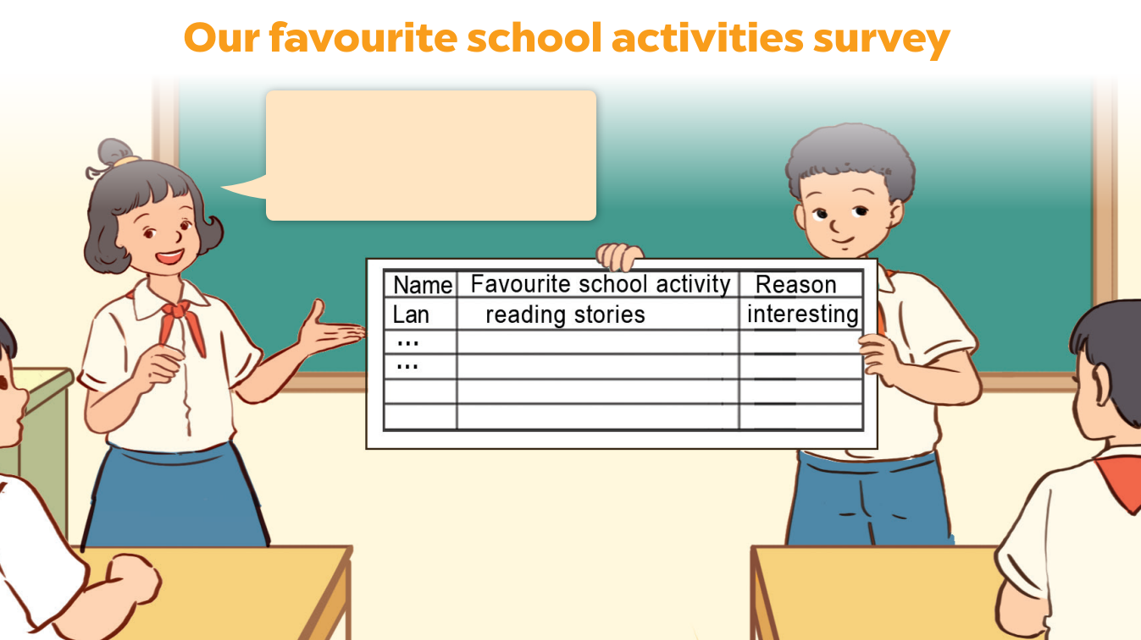
Lan likes reading stories because she thinks it’s interesting.

Slide 25
05
Fun corner
& Wrap-up

Slide 26
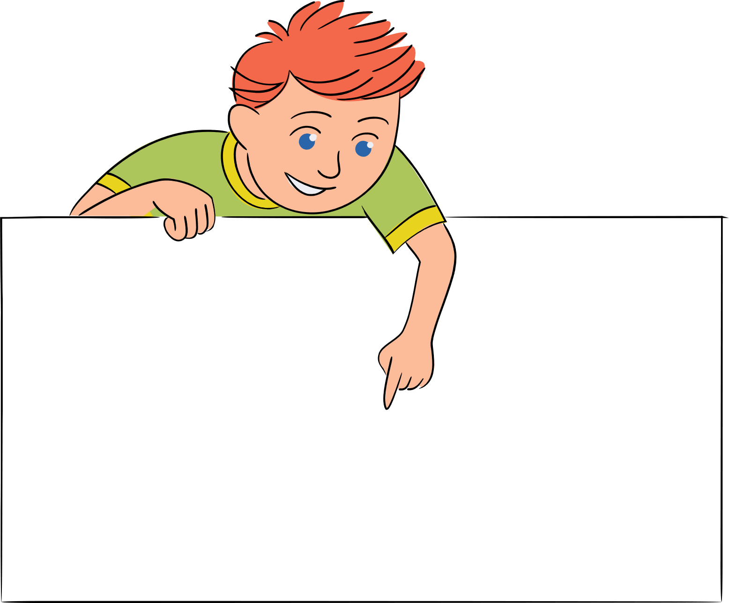









Choose and answer.
Team A
Team B
Notes:
- T clicks on the number to open each question.
- T writes the score (equivalent to the number of stars) in the box for each team after each question.

Slide 27

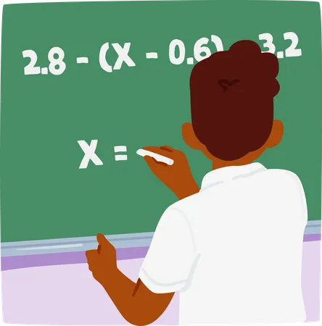

What's your brother's favourite school activity?
My brother's favourite activity is solving maths problems.
Notes:
T clicks on the Arrow icon to go back to the game's home page.

Slide 28
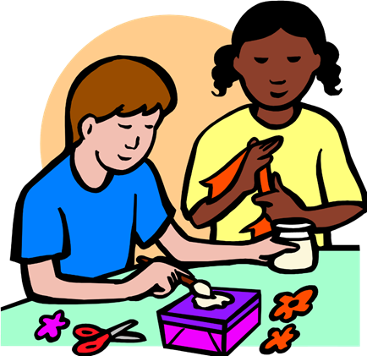

What school activity does your friend like?
He likes doing projects.
Notes:
T clicks on the Arrow icon to go back to the game's home page.

Slide 29
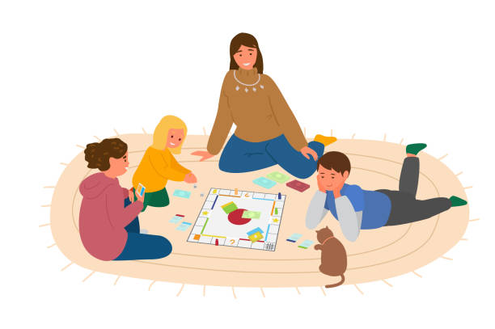

Why does she like playing games?
Because she thinks it's fun.
Notes:
T clicks on the Arrow icon to go back to the game's home page.

Slide 30


Why doesn't he like reading books?
Because he thinks
it isn't interesting.
Notes:
T clicks on the Arrow icon to go back to the game's home page.

Slide 31
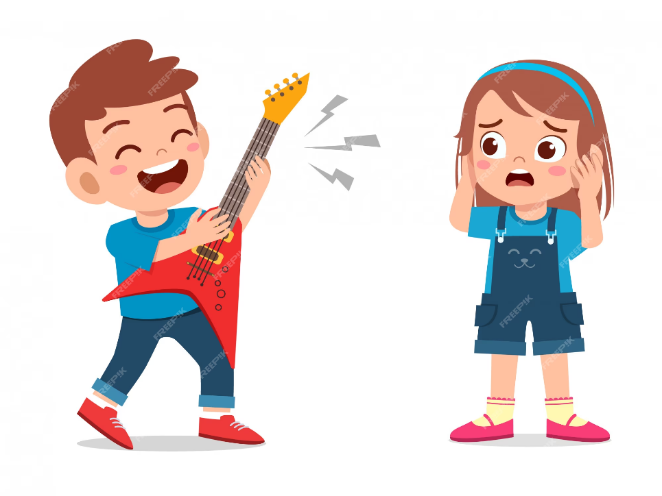

What school activity doesn't she like?
She doesn't like playing the guitar.
Notes:
T clicks on the Arrow icon to go back to the game's home page.

Slide 32
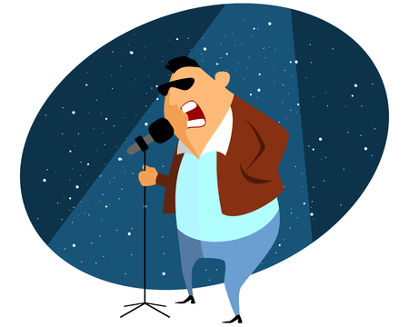

Why does he like singing?
Because he wants to be a singer in the future.
Notes:
T clicks on the Arrow icon to go back to the game's home page.

Slide 33
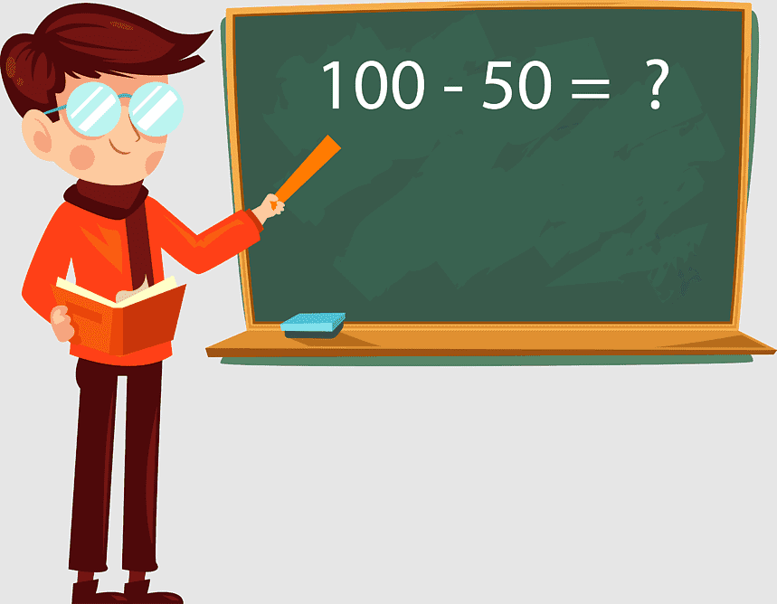

Why does he like studying maths?
Because he wants to be a maths teacher in the future.
Notes:
T clicks on the Arrow icon to go back to the game's home page.

Slide 34
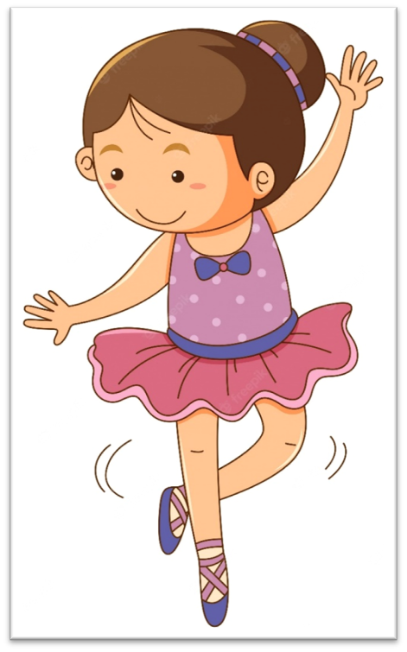

What's your sister's favourite school activity?
She likes dancing.
Notes:
T clicks on the Arrow icon to go back to the game's home page.

