Slide 1



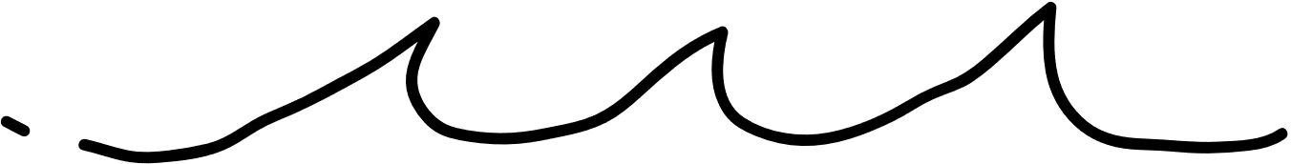
UBND QUẬN DƯƠNG KINH
TRƯỜNG TIỂU HỌC ANH DŨNG
ENGLISH - GRADE 5
UNIT 8: IN OUR CLASSROOM
LESSON 1 (1, 2, 3)

Slide 2







Unit 8
IN OUR CLASSROOM
Lesson 1 – Period 2

Slide 3




02
Listen and tick or cross.

Slide 4




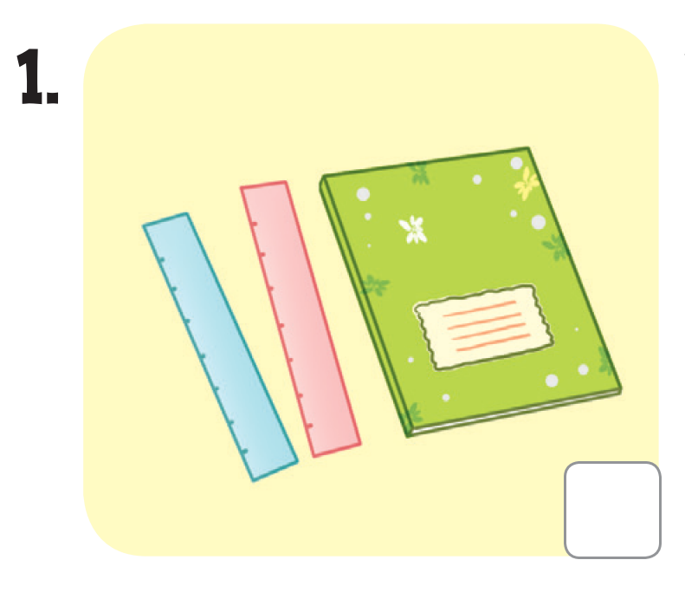
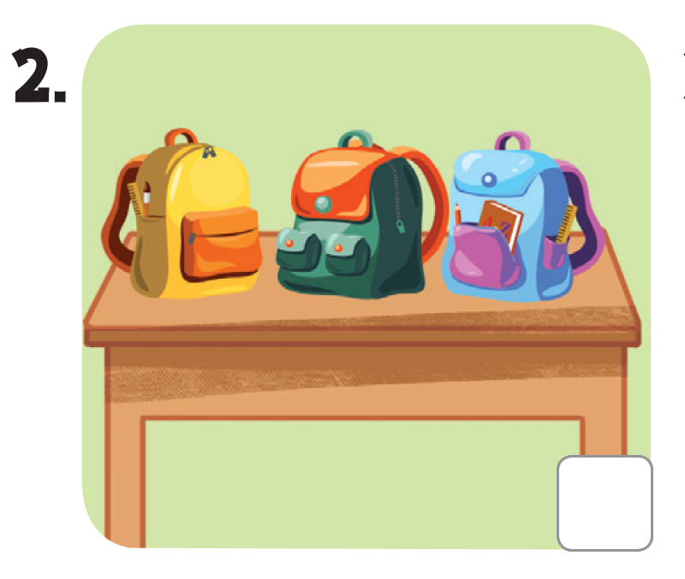
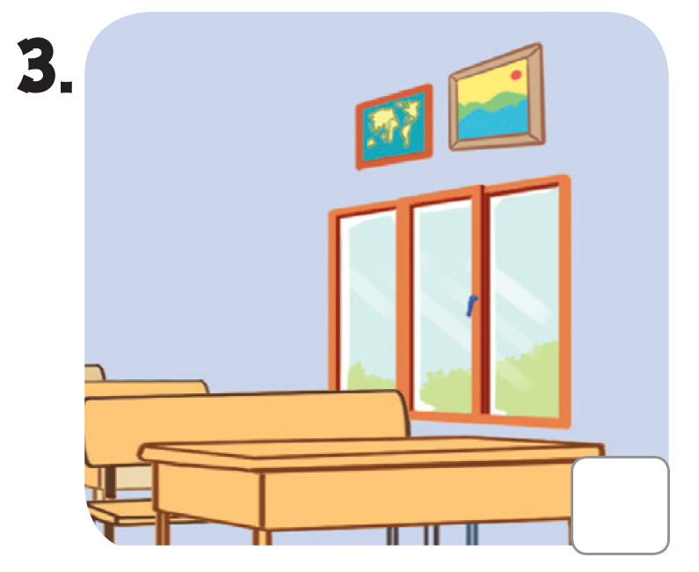
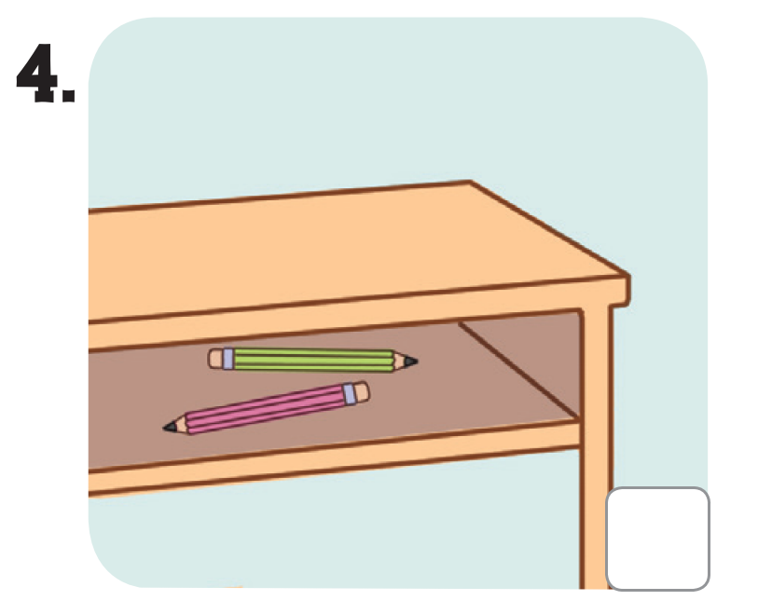



LISTEN AND TICK OR CROSS.

Slide 5

LET’S CHECK!

Slide 6
03
Read and complete.

Slide 7





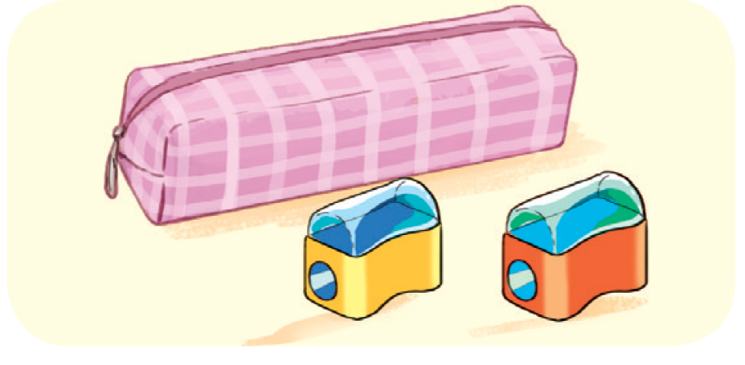
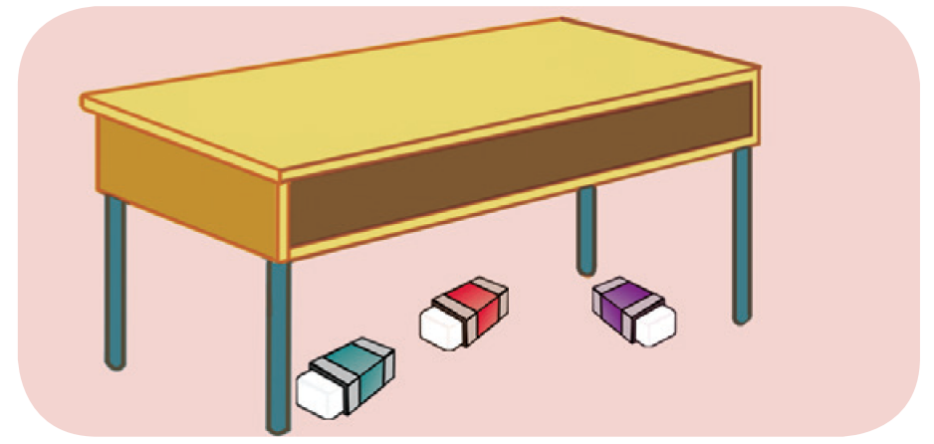

LOOK AND SAY

Slide 8
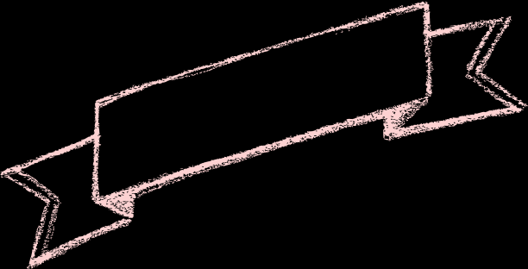



LOOK AND GUESS.
A: Where are the pens?
B: They’re _________ the notebook.

Slide 9

LOOK AND GUESS.
2. A: Where ___ the pencil sharpeners?
B: They’re in front of _____.

Slide 10
LOOK AND GUESS.
3. A: Are the ______ on the desk?
B: No, they aren’t.
A: Where are they?
B: They are __________ the desk.

Slide 11
LOOK AND GUESS.
4. A: ___________ are the pictures?
B: They’re _________ the bookcase.
A: Thank you.

Slide 12
READ AND COMPLETE.
A: Where are the pens?
B: They’re _______ the notebook.
beside

Slide 13

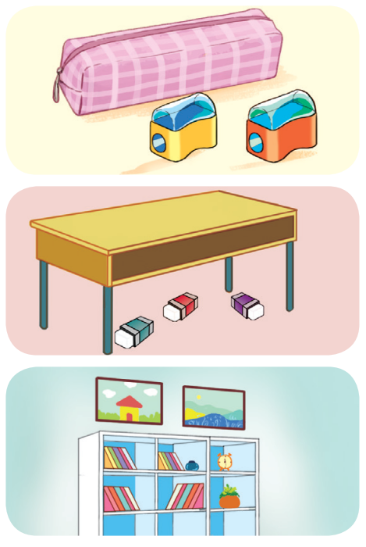
READ AND COMPLETE.
2. A: Where _____ the pencil sharpeners?
B: They’re in front of _________.
3. A: Are the __________ on the desk?
B: No, they aren’t.
A: Where are they?
B: They are __________ the desk.
4. A: ___________ are the pictures?
B: They’re _________ the bookcase.
A: Thank you.

Slide 14





SWAP YOUR BOOKS!

Slide 15
LET’S CHECK!
2. A: Where ____ the pencil sharpeners?
B: They’re in front of _______________.
are
the pencil case

Slide 16
LET’S CHECK!
3. A: Are the _______ on the desk?
B: No, they aren’t.
A: Where are they?
B: They are ______ the desk.
erasers
under

Slide 17
LOOK AND GUESS.
4. A: _______ are the pictures?
B: They’re _______ the bookcase.
A: Thank you.
Where
above

Slide 18




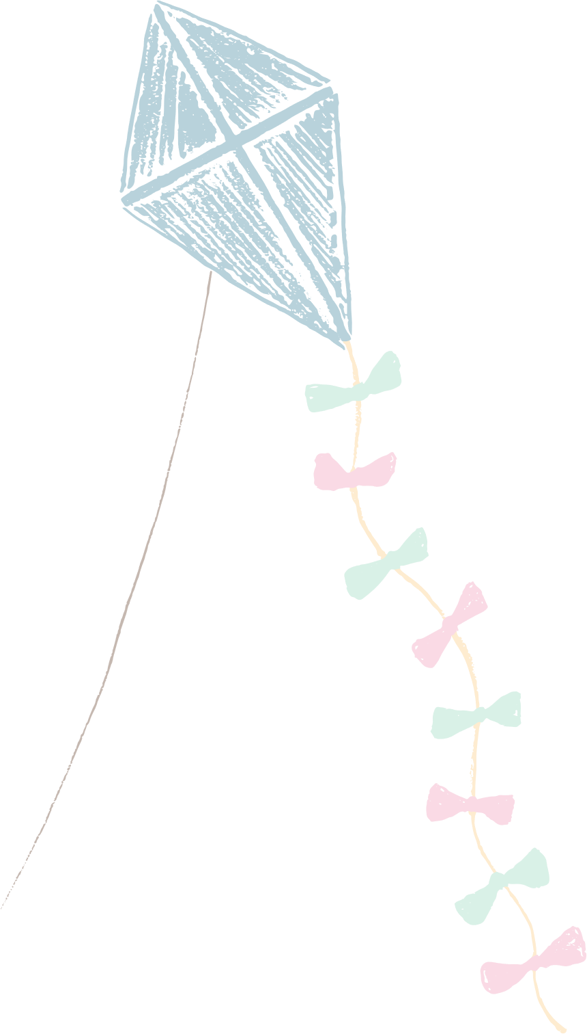






Slide 19
04
Let’s sing.

Slide 20


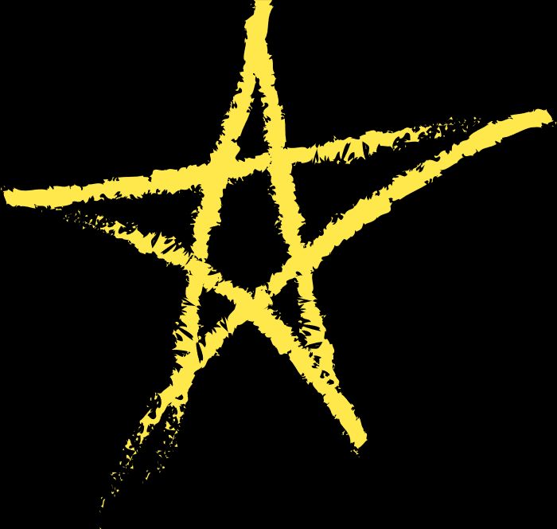
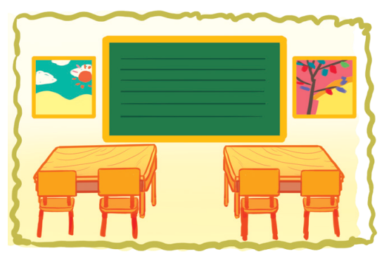
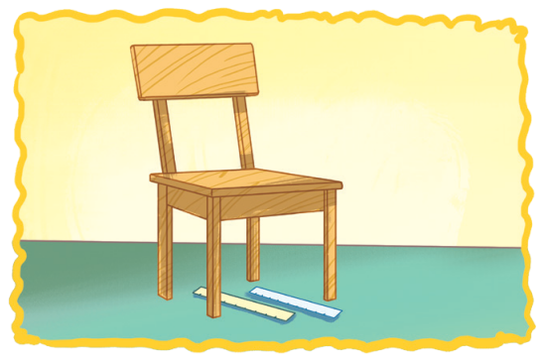

LOOK AND POINT.
WHERE ARE THEY?
Pictures, pictures, pictures.
Where are the pictures?
Beside the board.
Beside the board.
They’re beside the board.
Rulers, rulers, rulers.
Where are the rulers?
Under the chair.
Under the chair.
They’re under the chair.

Slide 21


LISTEN AND POINT.
WHERE ARE THEY?
Pictures, pictures, pictures.
Where are the pictures?
Beside the board.
Beside the board.
They’re beside the board.

Slide 22
LISTEN AND POINT.
WHERE ARE THEY?
Rulers, rulers, rulers.
Where are the rulers?
Under the chair.
Under the chair.
They’re under the chair.

