Slide 1




UBND QUẬN DƯƠNG KINH
TRƯỜNG TIỂU HỌC ANH DŨNG
ENGLISH - GRADE 5
UNIT 8: IN OUR CLASSROOM
LESSON 2 (1, 2, 3)

Slide 2







Unit 8
IN OUR CLASSROOM
Lesson 2 – Period 3

Slide 3




01
Warm-up & Review

Slide 4



Game
SENTENCE BUILDING
Where
the
are
?
pictures

Slide 5
Game
SENTENCE BUILDING
Where
are
the
pictures
?

Slide 6
Game
SENTENCE BUILDING
are
above
bookcase
the
pictures
The
.

Slide 7
Game
SENTENCE BUILDING
The
pictures
are
above
the
bookcase
.

Slide 8
Game
SENTENCE BUILDING
The
books
are
in front of
.
the
clock

Slide 9
Game
SENTENCE BUILDING
under
are
chair
the
The
.
rulers

Slide 10
Game
SENTENCE BUILDING
The
rulers
are
under
the
chair
.

Slide 11
02
Look, listen and repeat.

Slide 12




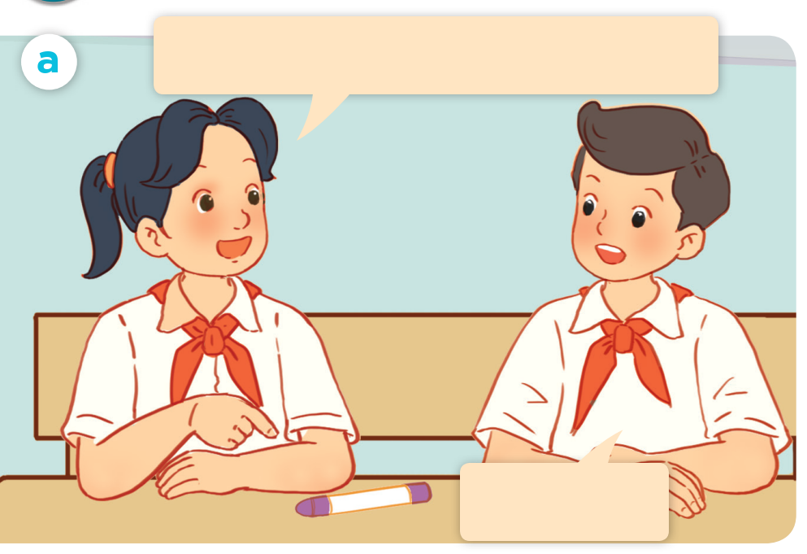


LISTEN and REPEAT.
Excuse me, is this your crayon?
No, it isn’t.

Slide 13
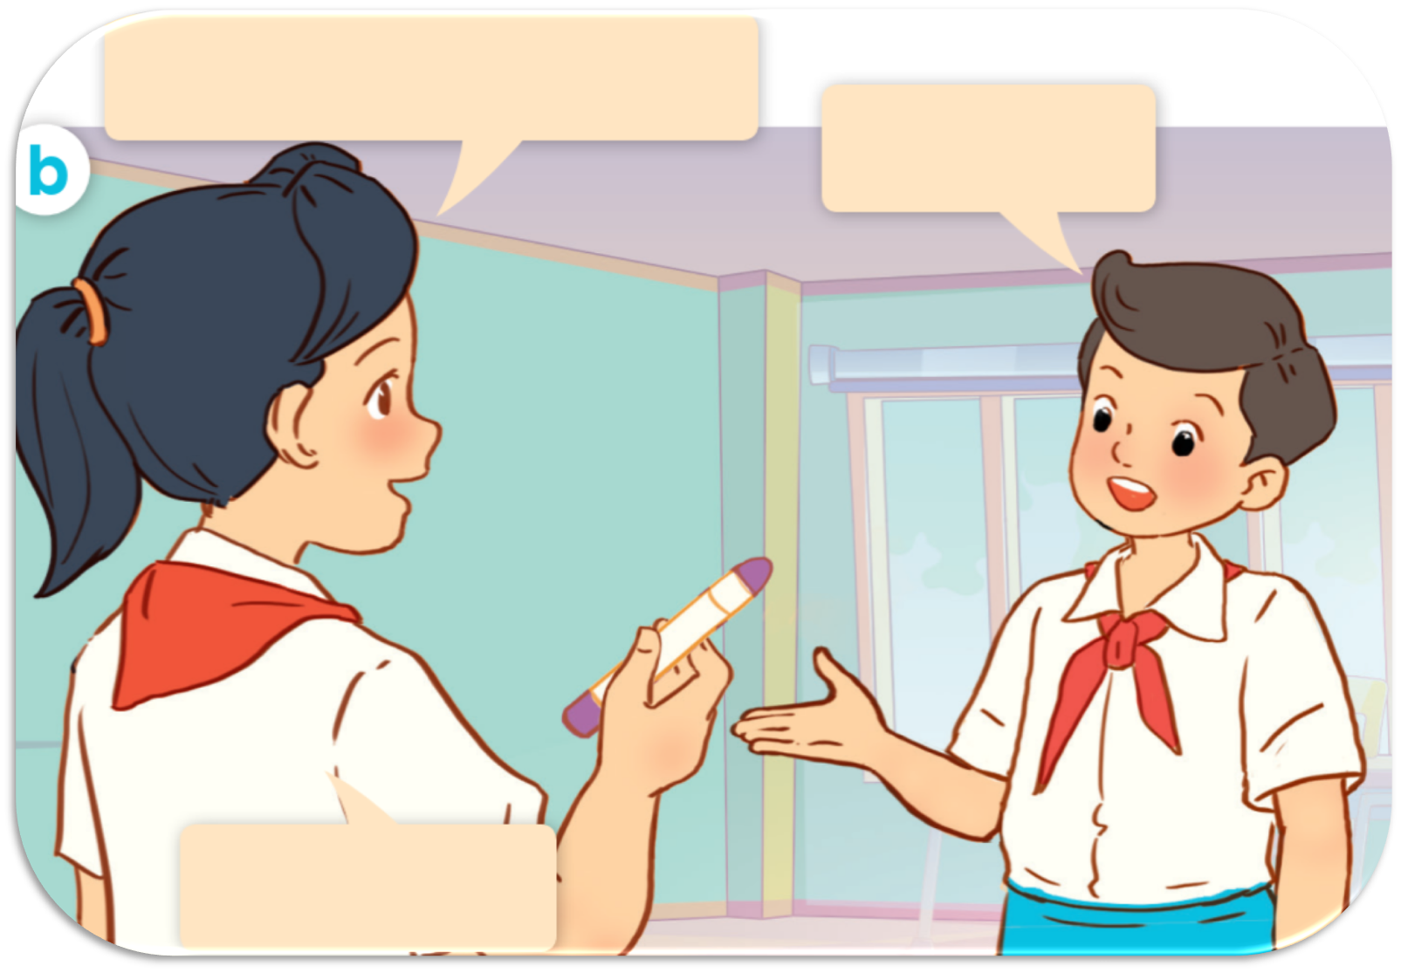
LISTEN and REPEAT.
Whose crayon
is this?
It’s Linh.
Thank you.

Slide 14
LISTEN and REPEAT.
Whose crayon is this?
Excuse me, is this your crayon?
It’s Linh.
No, it isn’t.
Thank you.

Slide 15
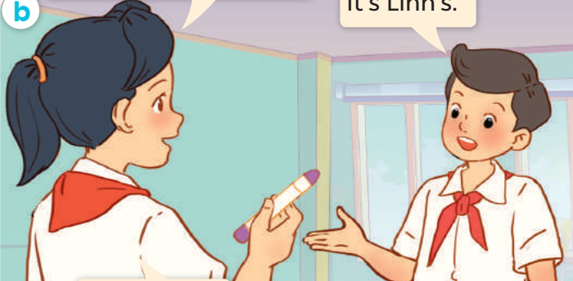
LISTEN and REPEAT.
It’s Linh’s.
Whose crayon is this?

Slide 16
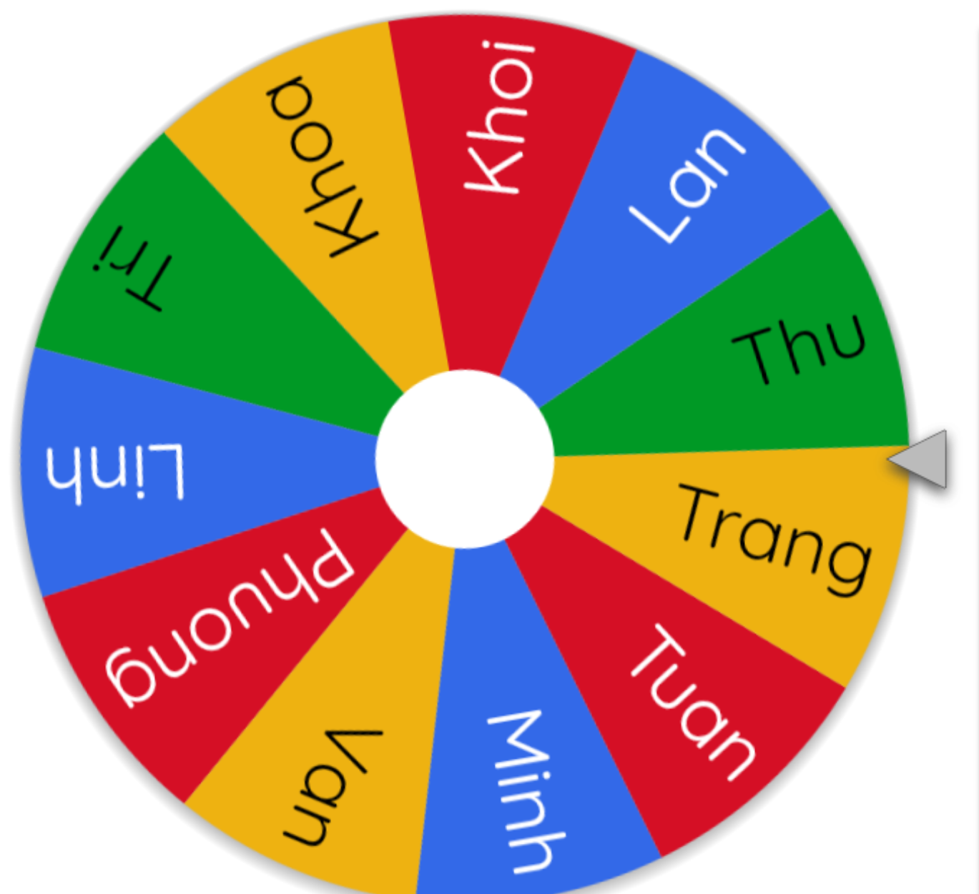
ASK and ANSWER.
Whose crayon is this?
Excuse me, is this your crayon?
It’s Linh.
No, it isn’t.
Thank you.

Slide 17
03
Listen, point and say.

Slide 18




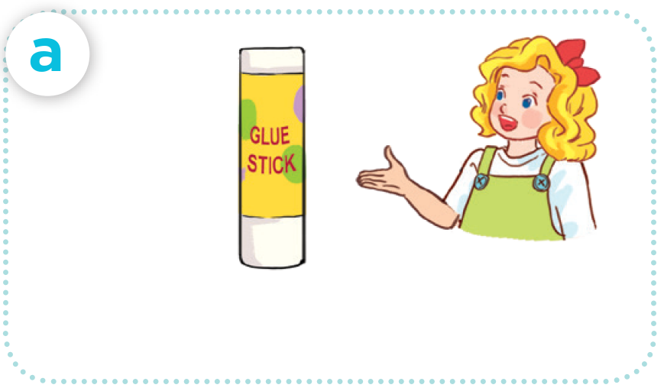

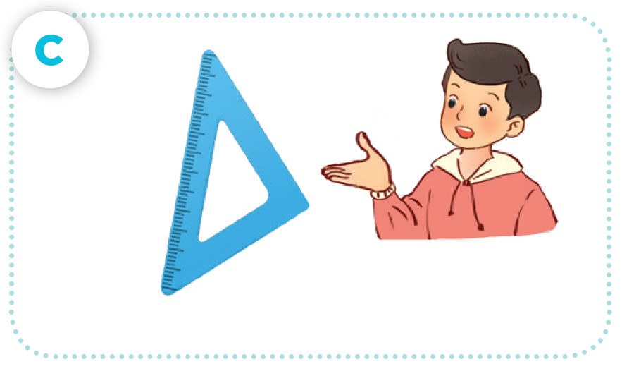
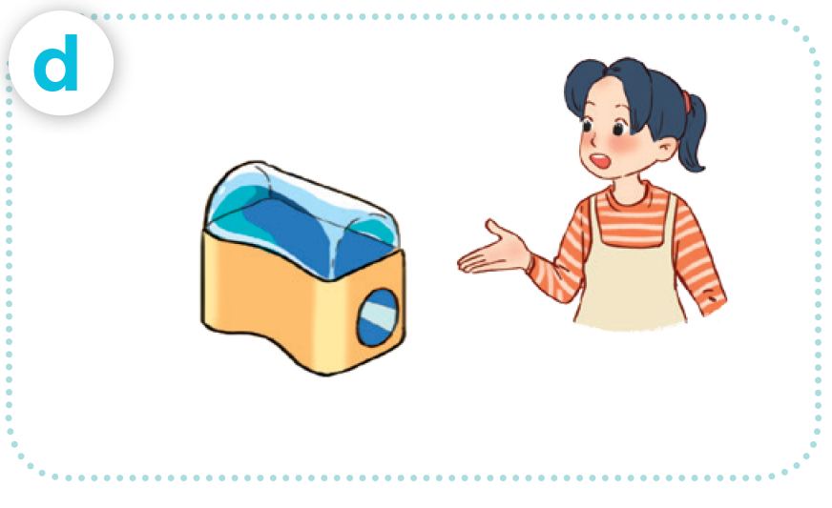
LOOK AND SAY
glue stick / Mary’s
crayon / Bill’s
set square / Nam’s
pencil sharpener / Mai’s

Slide 19




LISTEN AND REPEAT.
glue stick / Mary’s

Slide 20

LISTEN AND REPEAT.
crayon / Bill’s

Slide 21
LISTEN AND REPEAT.
set square / Nam’s

Slide 22
LISTEN AND REPEAT.
pencil sharpener / Mai’s

Slide 23
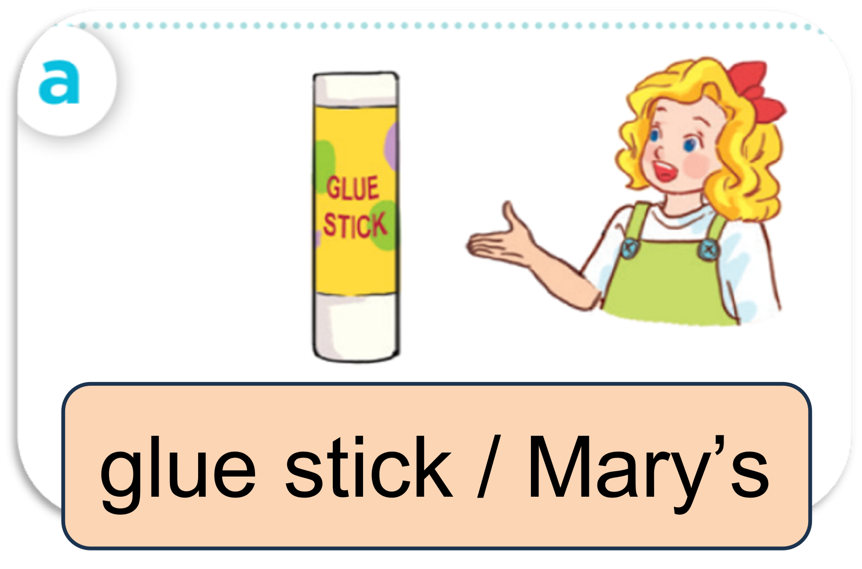
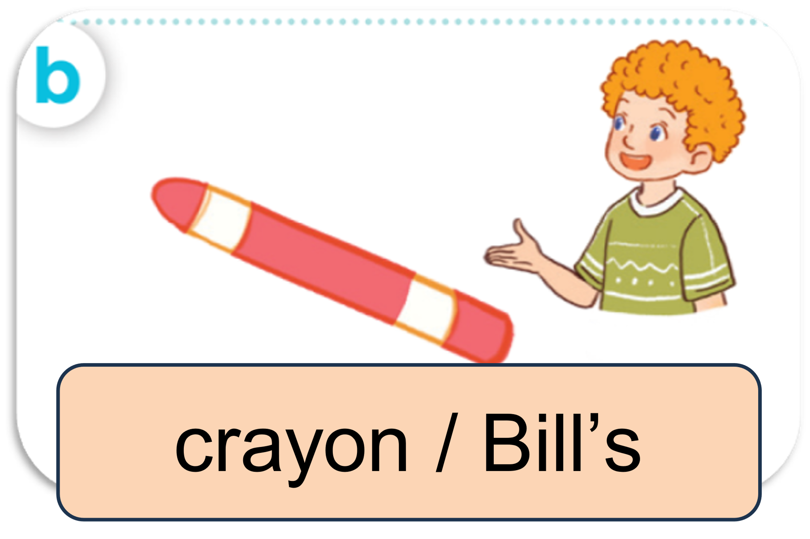
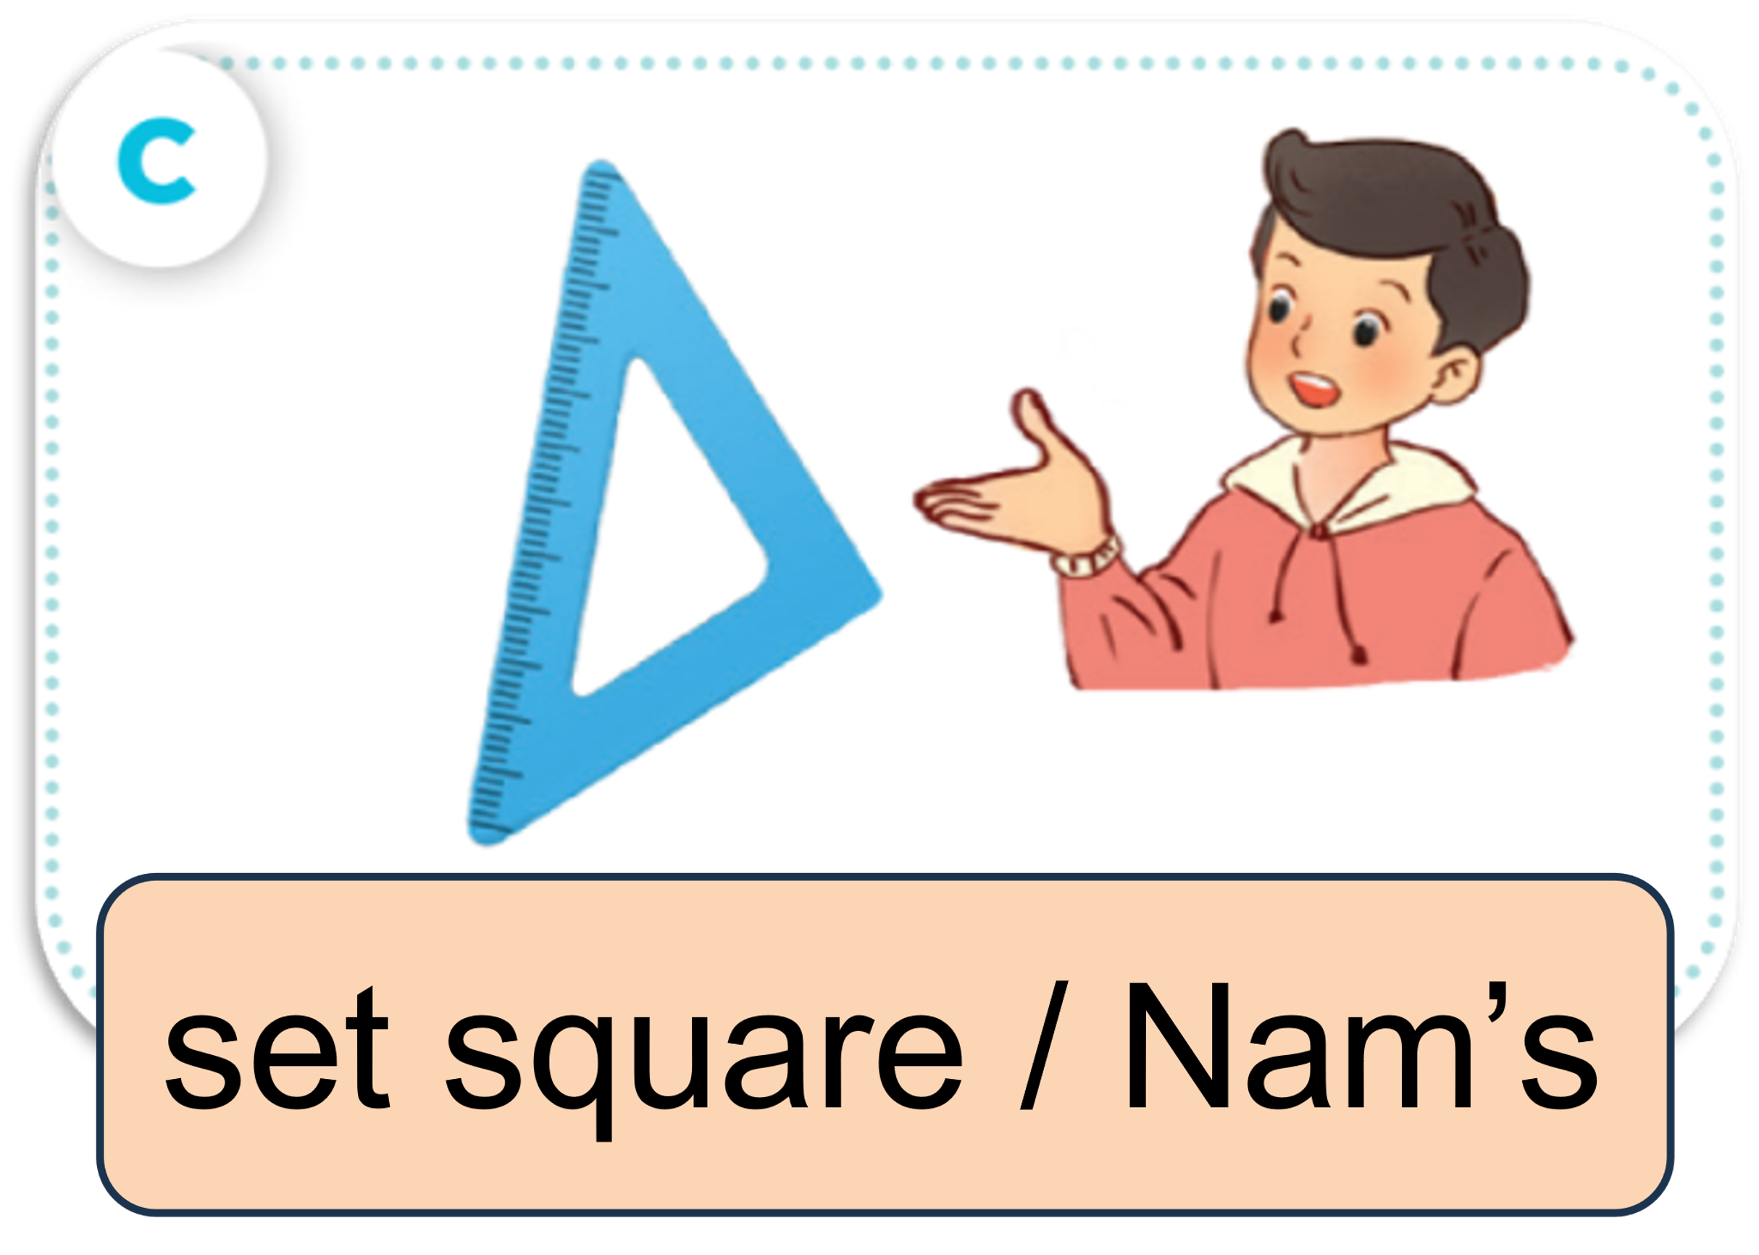
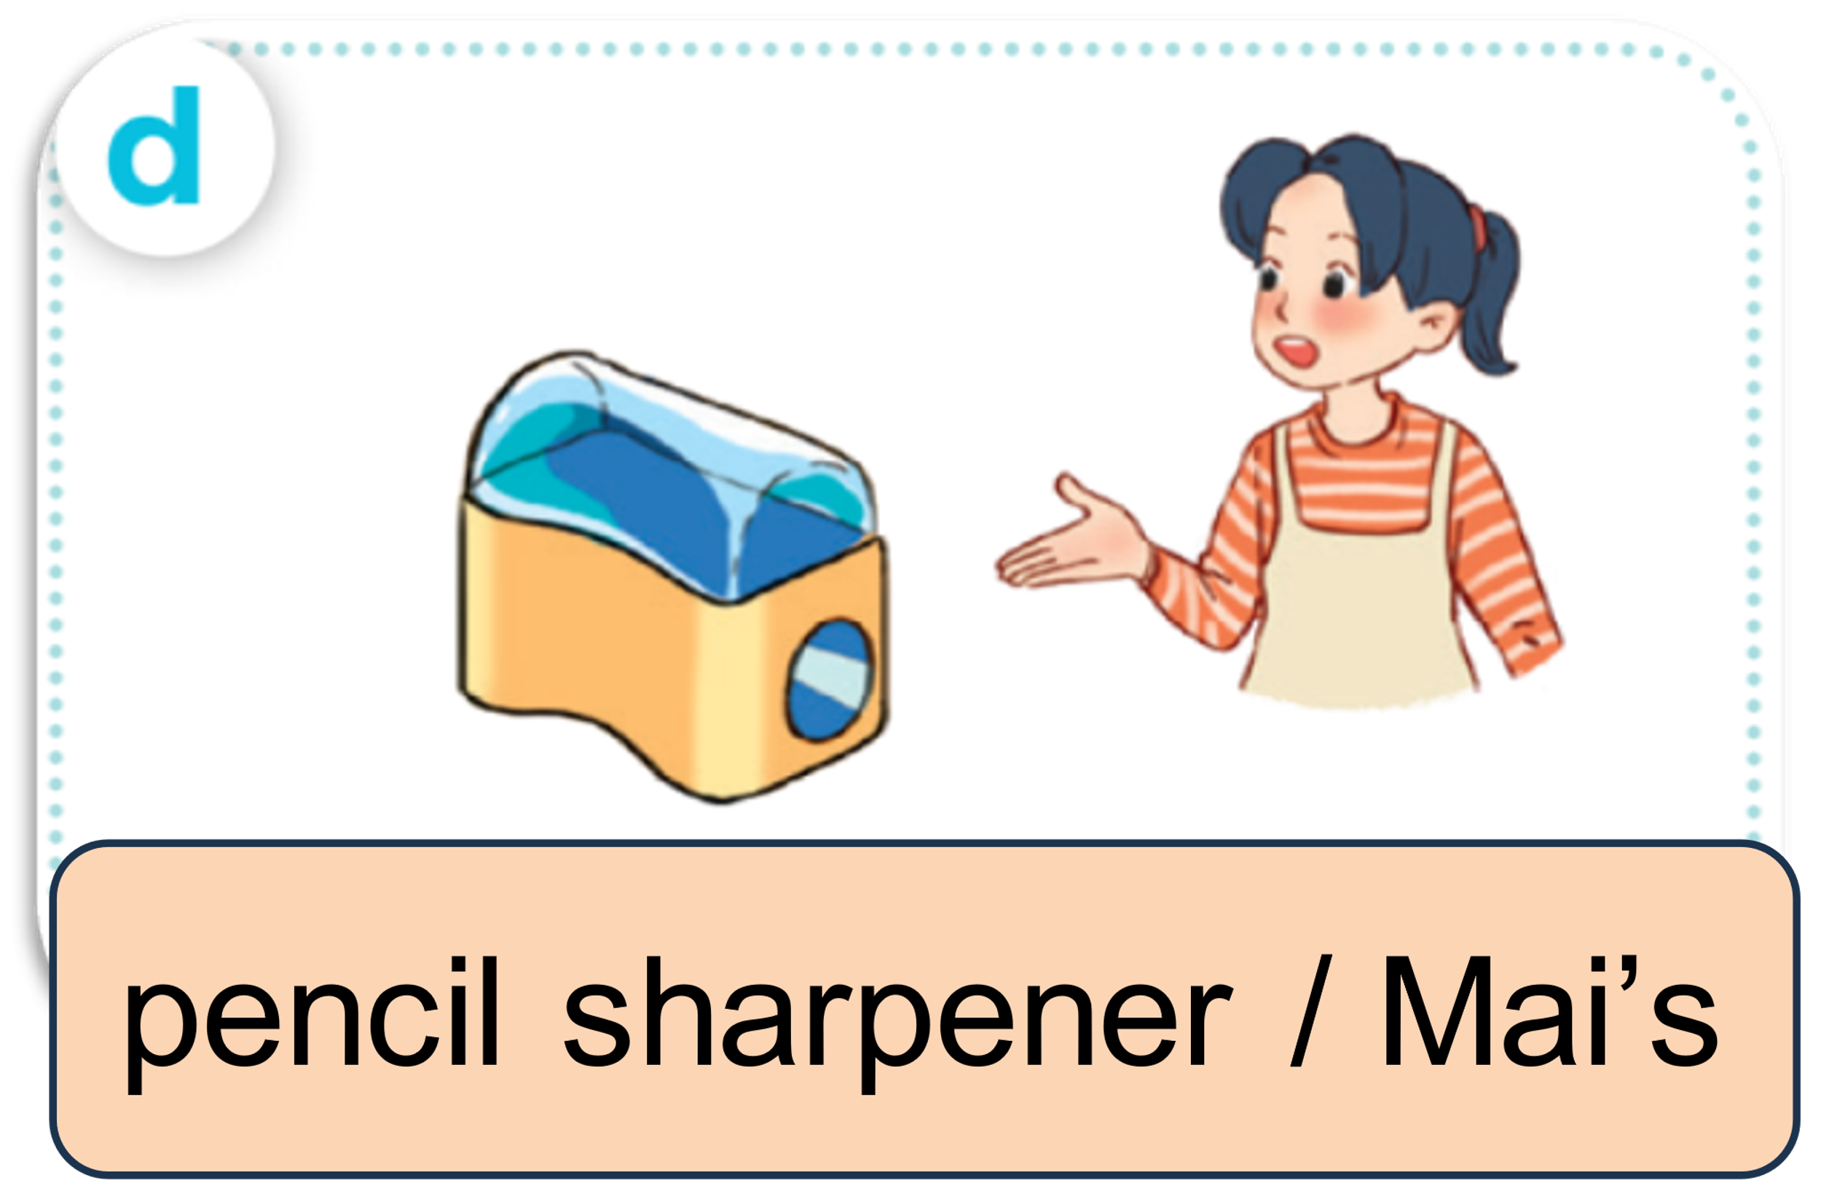


ASK AND ANSWER.

Slide 24
04
Let’s talk.

Slide 25





LOOK AND SAY.
It this your ___?
____.
Whose ___ is this?
____.

Slide 26

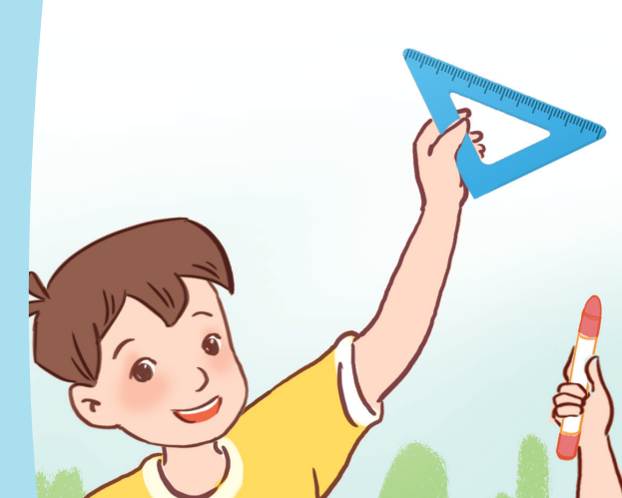
ASK AND ANSWER.
Whose set square is this?
It’s Minh’s.

Slide 27
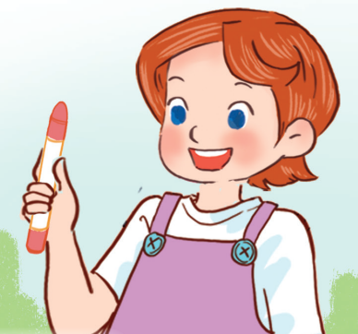
ASK AND ANSWER.
Whose crayon is this?
It’s Lucy’s.

Slide 28

ASK AND ANSWER.
Whose pencil sharpener
is this?
It’s Linh’s.

Slide 29
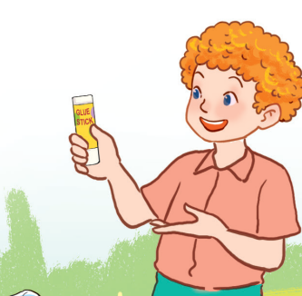
ASK AND ANSWER.
Whose glue stick is this?
It’s Bill’s.

Slide 30










WORK in PAIRS.
Ask and answer.

Slide 31









