Slide 1




UBND QUẬN DƯƠNG KINH
TRƯỜNG TIỂU HỌC ANH DŨNG
ENGLISH - GRADE 5
UNIT 8: IN OUR CLASSROOM
LESSON 2 (4, 5, 6)

Slide 2







Unit 8
IN OUR CLASSROOM
Lesson 2 – Period 4

Slide 3




01
Warm-up & Review

Slide 4
02
Listen and tick.

Slide 5





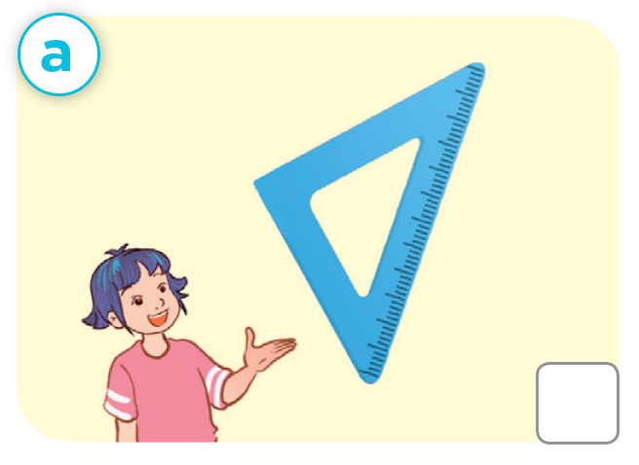
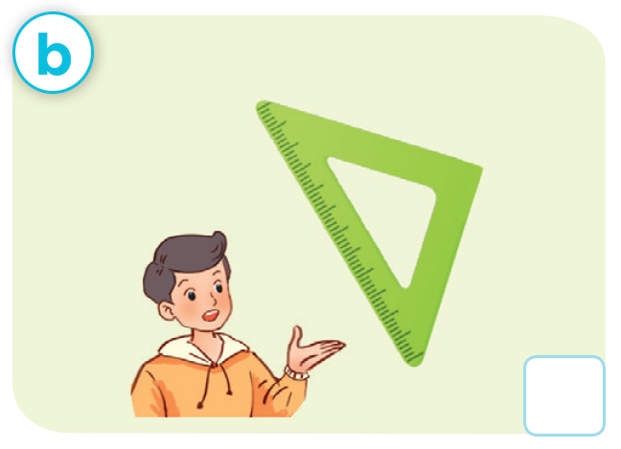
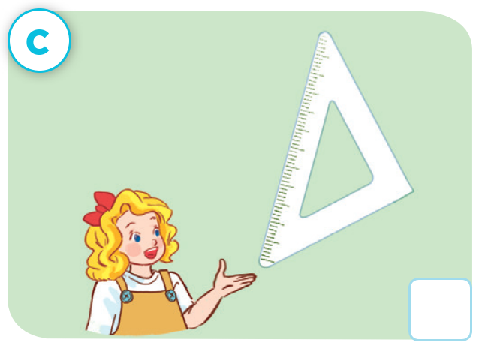


Let’s check!
✓

Slide 6
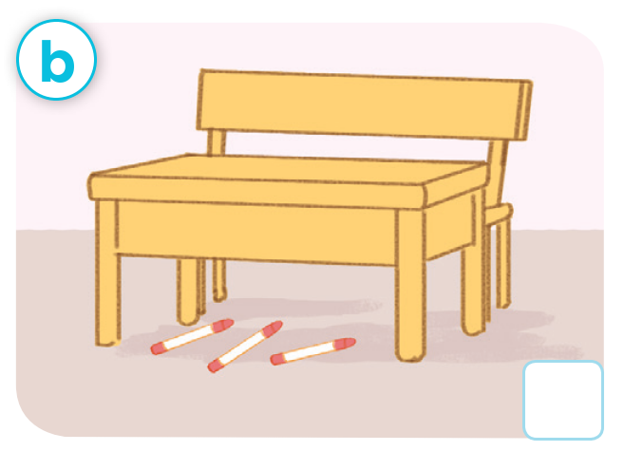


Make a new conversation.

Slide 7
Make a new conversation.

Slide 8











Slide 9
03
Read and complete.

Slide 10




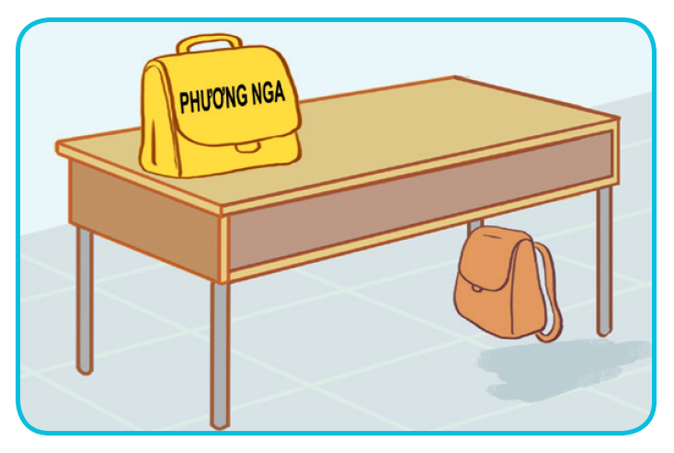
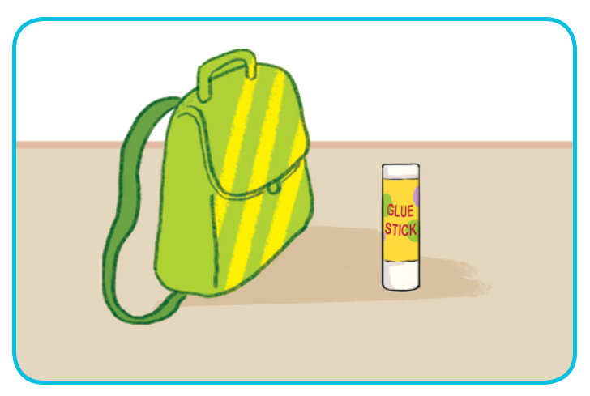
Look and say

Slide 11



Read and complete.
1. A: Excuse me, whose school bag is this?
  B: ____ Phuong Nga’s.
A: And where’s my school bag?
B: Look! It’s there, ______ the desk.
A: Thank you.
It’s
under

Slide 12
Read and complete.
2. A: Is this your glue stick?
B: No, it isn’t.
A: ________ glue stick is this?
B: It’s Tom’s.
A: ______ my glue stick?
B: It’s there, beside the ___________.

Slide 13
Let’s check!
2. A: Is this your glue stick?
B: No, it isn’t.
A: ________ glue stick is this?
B: It’s Tom’s.
A: _________ my glue stick?
B: It’s there, beside the ____________.
Whose
Where’s
school bag

Slide 14
04
Let’s play.

Slide 15
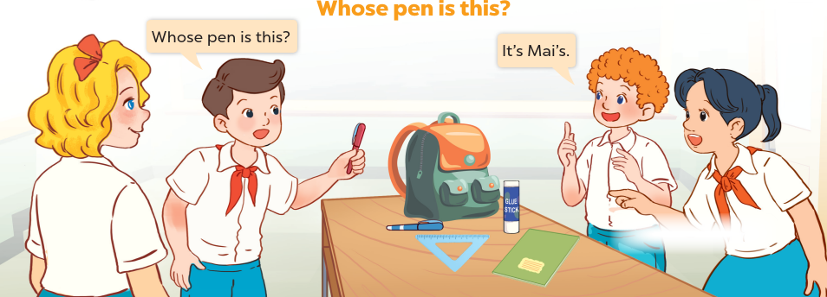
Whose pen is this??
Whose pen is this?
It’s Mai.

Slide 16





Let’s play!
WHOSE PEN IS THIS?
Group A
Group B

