Slide 1




UBND QUẬN DƯƠNG KINH
TRƯỜNG TIỂU HỌC ANH DŨNG
ENGLISH - GRADE 5
UNIT 8: IN OUR CLASSROOM
LESSON 3 (4, 5, 6)

Slide 2







Unit 8
IN OUR CLASSROOM
Lesson 3 – Period 6

Slide 3




01
Warm-up & Review

Slide 4
02
Read and answer.

Slide 5



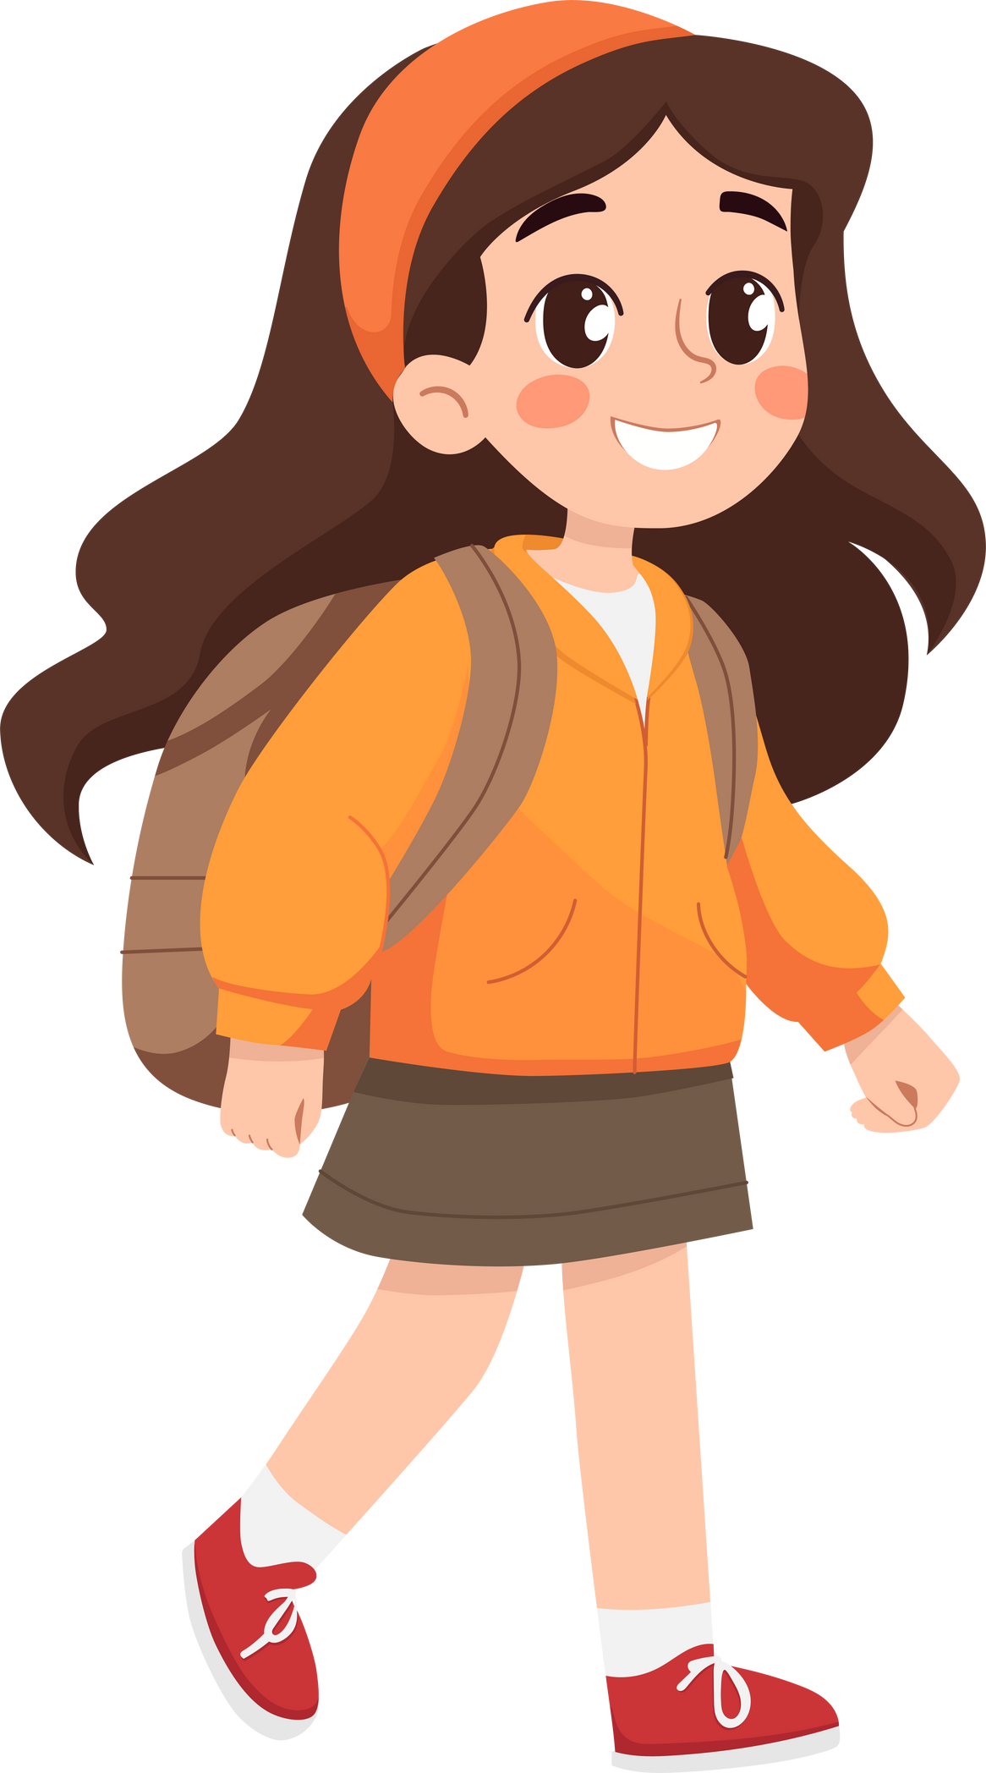

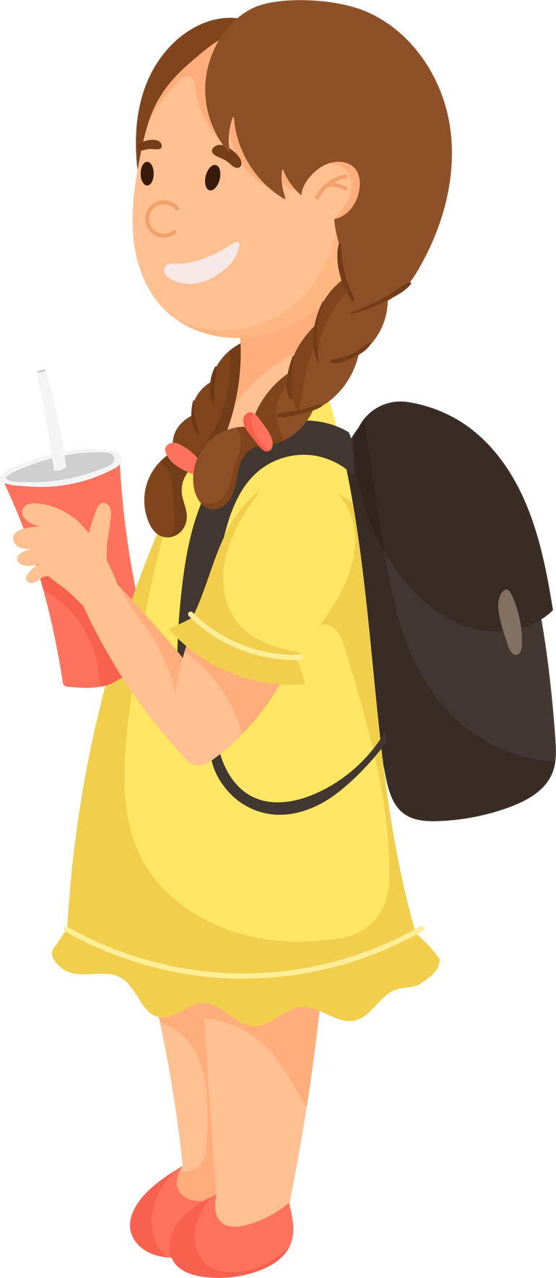


Listen and read.
Trang
Lan
Hung

Slide 6
Listen and Read.
Trang, Hung and Lan are in Class 5A. They’re very tidy! Trang’s set square is on her desk, beside her pencil case. Hung’s pencils are on his desk, in front of his pencil sharpener. Lan’s school bag is under her desk.
Trang has a new storybook. It’s in her school bag. Hung’s storybook is beside his notebook. Lan’s storybook is in the desk. They want to read together after the lesson. They love stories, especially fairy tales for children.

Slide 7

Read and Answer.
1. Whose set square is on her desk?
Whose set square
Trang, Hung and Lan are in Class 5A. They’re very tidy! Trang’s set square is on her desk, beside her pencil case. Hung’s pencils are on his desk, in front of his pencil sharpener. Lan’s school bag is under her desk.

Slide 8
Read and Answer.
2. Where are Hung’s pencils?
3. Whose storybook is in her school bag?
4. Where is Lan’s storybook?

Slide 9





SWAP YOUR BOOKS!

Slide 10

Let’s check!
Where
Hung’s pencils
2. Where are Hung’s pencils?
Trang, Hung and Lan are in Class 5A. They’re very tidy! Trang’s set square is on her desk, beside her pencil case. Hung’s pencils are on his desk, in front of his pencil sharpener. Lan’s school bag is under her desk.

Slide 11
Let’s check!
3. Whose storybook is in her school bag?
Trang has a new storybook. It’s in her school bag. Hung’s storybook is beside his notebook. Lan’s storybook is in the desk. They want to read together after the lesson. They love stories, especially fairy tales for children.

Slide 12

Let’s check!
Where
Lan’s storybook
4. Where is Lan’s storybook?
Trang has a new storybook. It’s in her school bag. Hung’s storybook is beside his notebook. Lan’s storybook is in the desk. They want to read together after the lesson. They love stories, especially fairy tales for children.

Slide 13
03
Look and write.

Slide 14




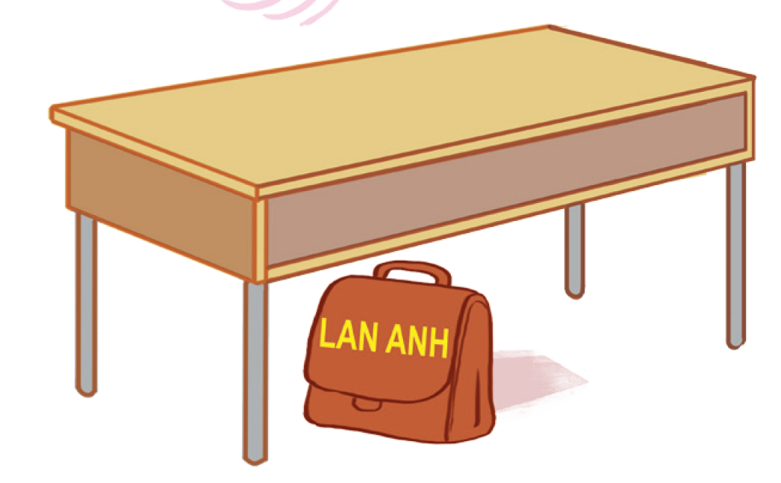
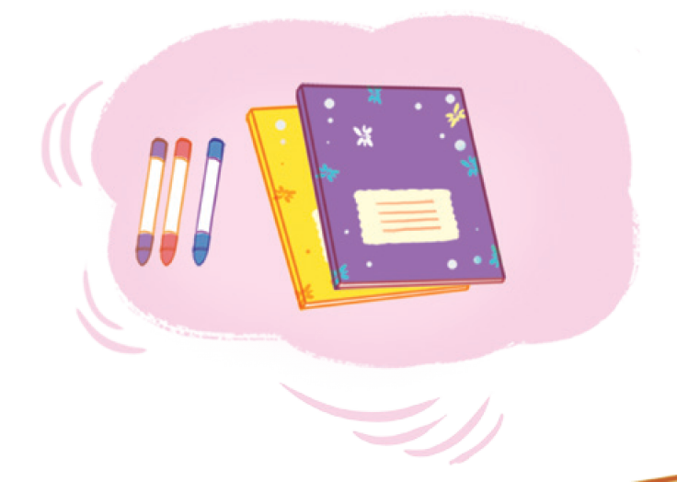
Look and say!

Slide 15




Read and guess.
I have some new __________________.
The crayons are _______ the notebooks.
Lan Anh has a new ________________ .
Lan Anh’s __________ is ___________ .

Slide 16
Look and write.
crayons
I have some new _________ .
The crayons are _______ the notebooks.
Lan Anh has a new _________ .
Lan Anh’s _______ is _________ .

Slide 17
SWAP YOUR BOOKS!

Slide 18
Let’s check!
crayons
I have some new ________.
beside
The crayons are _______ the notebooks.
school bag
Lan Anh has a new ___________.
school bag
under the desk
Lan Anh’s __________ is ______________.

Slide 19




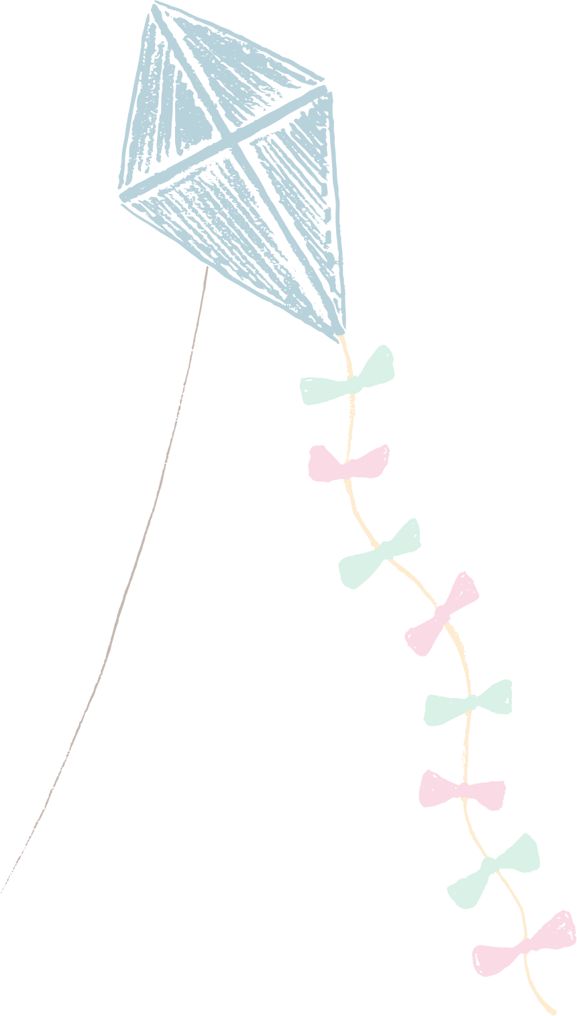






Slide 20
04
Project

Slide 21


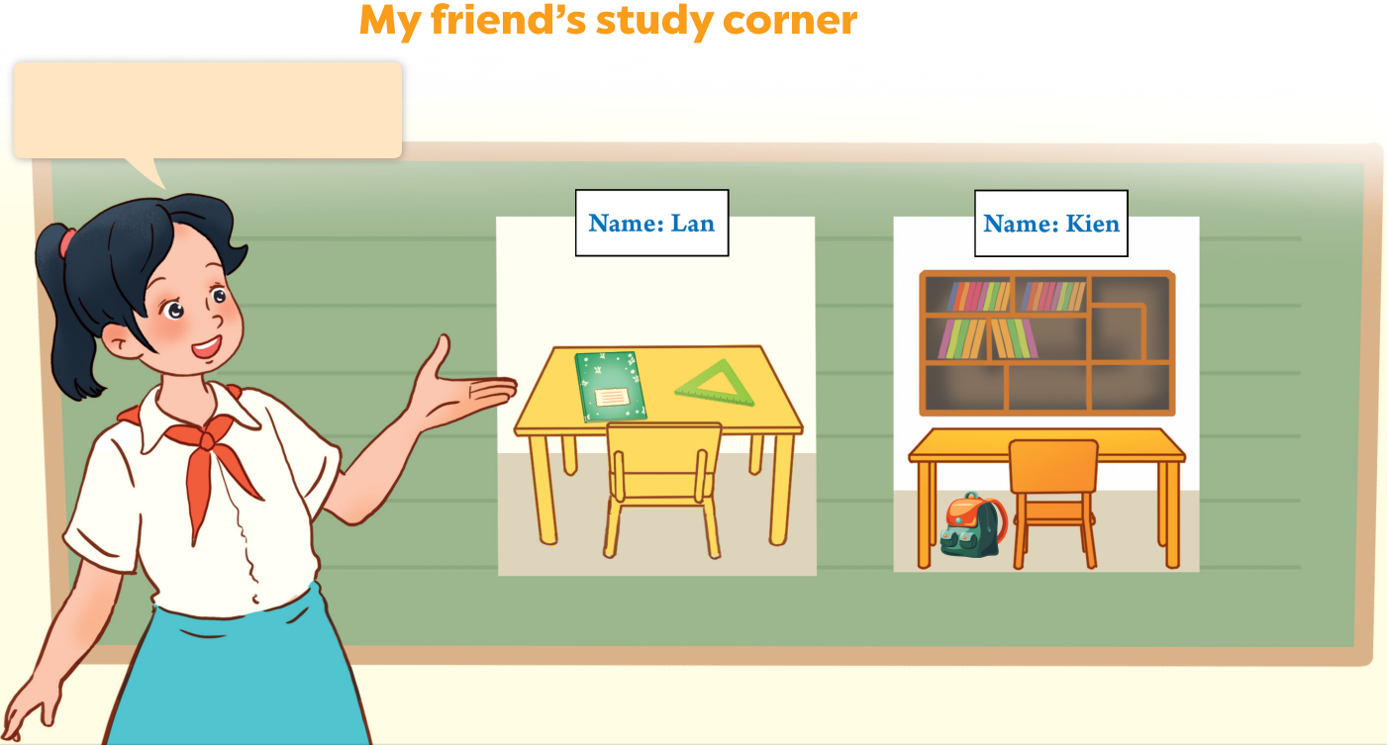


Look at your groups’ pictures!

Slide 22


Work in groups.
Study
Corner
Study
Corner
Study
Corner

Slide 23
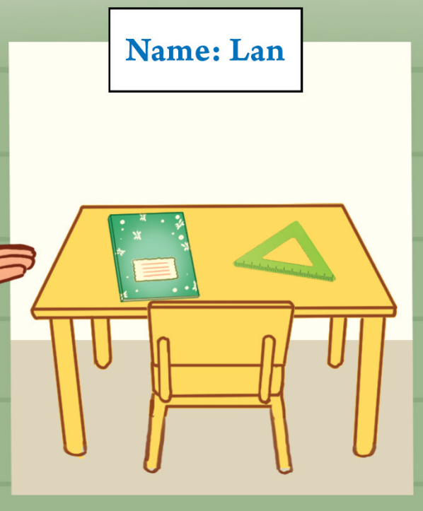
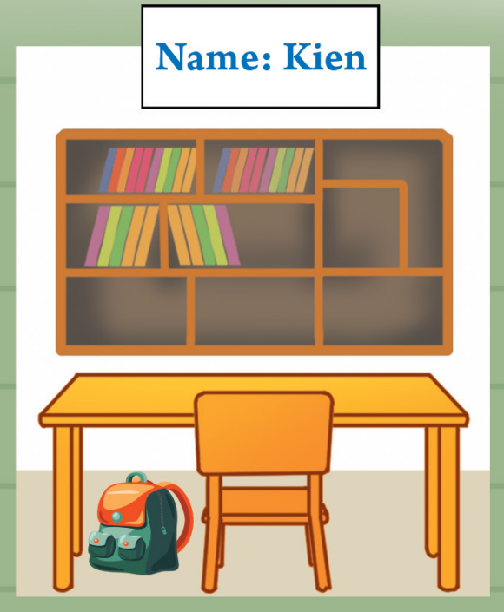
Present your group’s picture.

