Slide 1




UBND QUẬN DƯƠNG KINH
TRƯỜNG TIỂU HỌC ANH DŨNG
ENGLISH - GRADE 5
UNIT 10: OUR SCHOOL TRIP
LESSON 3 (4, 5, 6)

Slide 2

Unit 10
Our school trip
Lesson 3 - Period 6

Slide 3


01
Warm-up and Review

Slide 4

GAME

Slide 5

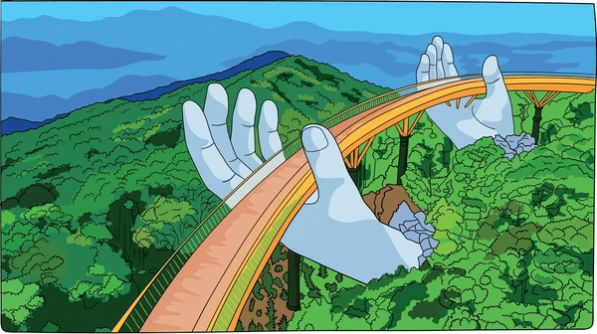

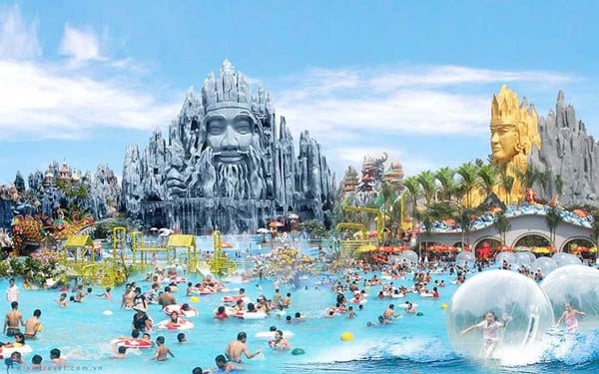
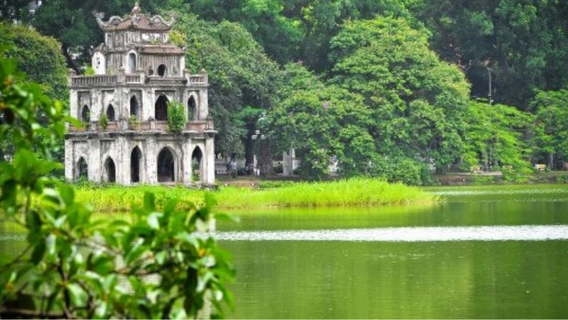
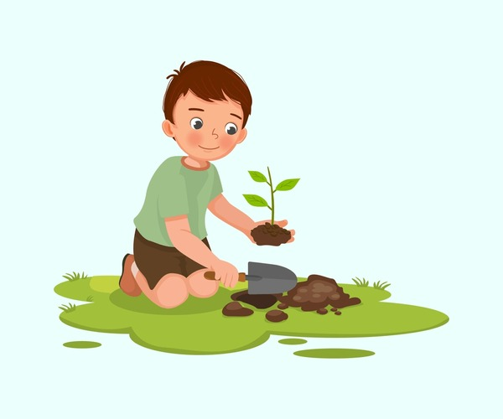
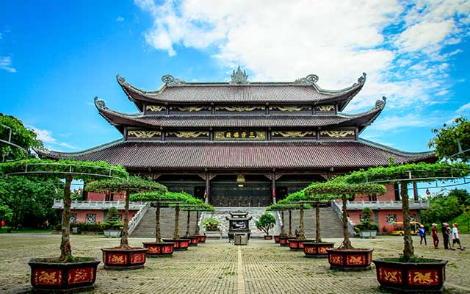
Ba Na Hills
play games
Suoi Tien Theme Park
Hoan Kiem Lake
plant trees
Bai Dinh Pagoda

Slide 6
02
Activity 1. Read and circle.

Slide 7

Read
Minh’s class went on an eco-tour last Sunday. They visited a farm near their school. They started their trip early and arrived there at 9 a.m. In the morning, they walked around the lake. Then they planted trees with the farmers. That was fun! In the afternoon, they watched a film about the farm. After that, they played some games and danced together. They went back to school late in the afternoon. What a great trip!

Slide 8


GUESSING
GAME

Slide 9
Complete
Minh’s class went on an eco-tour last Sunday. They visited a farm near their school. They started their trip early and arrived there at 9 a.m. In the morning, they walked around the lake. Then they planted trees with the farmers. That was fun! In the afternoon, they watched a film about the farm. After that, they played some games and danced together. They went back to school late in the afternoon. What a great trip!
1. They visited a farm near their school last _______.
a. Saturday b. Friday c. Sunday
Notes:
Nháy vào bức thư nhỏ ở góc để xuất hiện bức thư và nhấn vào bức thư để làm biến mất nó

Slide 10
Complete
Minh’s class went on an eco-tour last Sunday. They visited a farm near their school. They started their trip early and arrived there at 9 a.m. In the morning, they walked around the lake. Then they planted trees with the farmers. That was fun! In the afternoon, they watched a film about the farm. After that, they played some games and danced together. They went back to school late in the afternoon. What a great trip!
2. They _______ trees with the farmers.
a. planted b. looked at c. watered
Notes:
Nháy vào bức thư nhỏ ở góc để xuất hiện bức thư và nhấn vào bức thư để làm biến mất nó

Slide 11
Complete
Minh’s class went on an eco-tour last Sunday. They visited a farm near their school. They started their trip early and arrived there at 9 a.m. In the morning, they walked around the lake. Then they planted trees with the farmers. That was fun! In the afternoon, they watched a film about the farm. After that, they played some games and danced together. They went back to school late in the afternoon. What a great trip!
3. They watched a film about the _______.
a. flowers b. farm c. animals
Notes:
Nháy vào bức thư nhỏ ở góc để xuất hiện bức thư và nhấn vào bức thư để làm biến mất nó

Slide 12
Complete
Minh’s class went on an eco-tour last Sunday. They visited a farm near their school. They started their trip early and arrived there at 9 a.m. In the morning, they walked around the lake. Then they planted trees with the farmers. That was fun! In the afternoon, they watched a film about the farm. After that, they played some games and danced together. They went back to school late in the afternoon. What a great trip!
4. They played _______ and danced together.
a. football b. badminton c. some games
Notes:
Nháy vào bức thư nhỏ ở góc để xuất hiện bức thư và nhấn vào bức thư để làm biến mất nó

Slide 13


Very Good!

Slide 14
Complete
1. They visited a farm near their school last _______.
a. Saturday b. Friday c. Sunday
2. They _______ trees with the farmers.
a. planted b. looked at c. watered
3. They watched a film about the _______.
a. flowers b. farm c. animals
4. They played _______ and danced together.
a. football b. badminton c. some games
Notes:
Nháy vào bức thư nhỏ ở góc để xuất hiện bức thư và nhấn vào bức thư để làm biến mất nó

Slide 15
03
Activity 2. Let’s write.

Slide 16

Let’s write.
Mai’s last school trip
On Mai’s last school trip, they went to _________. They ___
_______________________
_______________________ _______________________.
– Where did Mai’s class go on their last school trip?
– What did they do in the morning / afternoon / evening?

Slide 17
Let’s write.
Suggestion:
Mai’s last school trip
On Mai’s last school trip, they went to Ba Na Hills. In the morning, they visited the old buildings. In the afternoon, they walked along the Golden Bridge and took photos of the flowers. In the evening, they listened to music and watched the dances. They had a lot of fun.

Slide 18
Let’s write.
Mai’s last school trip
On Mai’s last school trip, they went to _________. They ___
_______________________
_______________________ _______________________.
– Where did Mai’s class go on their last school trip?
– What did they do in the morning / afternoon / evening?

Slide 19

_________________________________________________________________________________________________________

Slide 20
04
Activity 3. Project

Slide 21
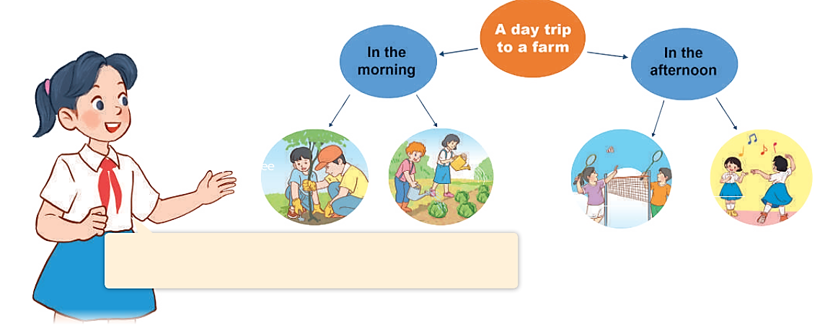
Project.
A mind map of your trip
A day trip to a farm
In the morning
In the afternoon
Our class went on a day trip to a farm yesterday. In the morning, we planted trees. We ______.

Slide 22
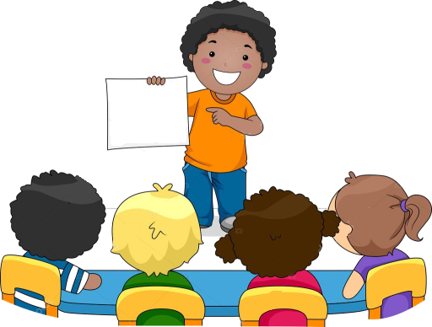
Our class went on a day trip to a farm yesterday. In the morning, we planted trees. We ______.

Slide 23
05
Fun corner and Wrap-up

Slide 24
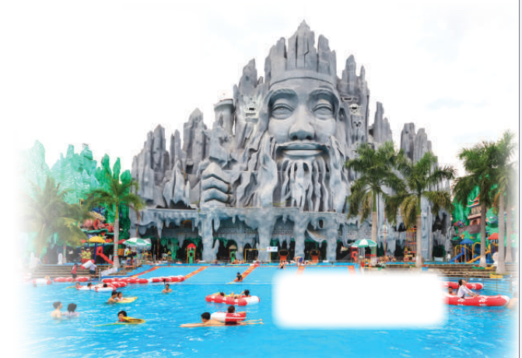
Let’s sing.
Did they go to Suoi Tien Theme Park?
Did they go to Suoi Tien Theme Park? Yes, they did. Yes, they did. Did they watch a film there? No, they didn’t. No, they didn’t. Did they swim in the swimming pool ? Yes, they did. Yes, they did. Did they play badminton there? No, they didn’t. No, they didn’t.

Slide 25

Let’s sing.
Did they go to Suoi Tien Theme Park?

