Slide 1




UBND QUẬN DƯƠNG KINH
TRƯỜNG TIỂU HỌC ANH DŨNG
ENGLISH - GRADE 5
UNIT 12: OUR TET HOLIDAY
LESSON 2 (1, 2, 3)

Slide 2



Unit 12 Our Tet holiday
Lesson 2 - Period 4

Slide 3
1
Review

Slide 4
2
Listen and number.
Activity 4

Slide 5
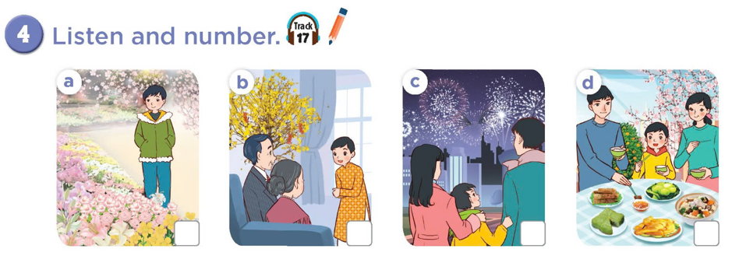

2
1
4
3

Slide 6
2
1
4
3
2
1
4
3

Slide 7
3
Read and complete.

Slide 8
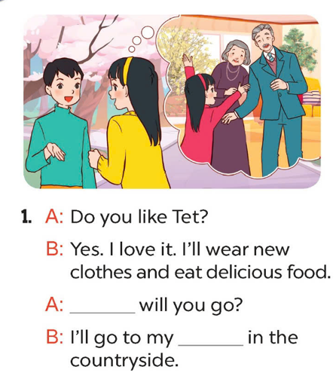
Where
grandparents’
house

Slide 9
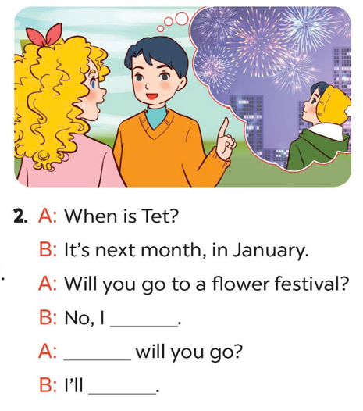
won’t
Where
go to the fireworks show

Slide 10
4
Let’s play.
Activity 5

Slide 11
