Slide 1




UBND QUẬN DƯƠNG KINH
TRƯỜNG TIỂU HỌC ANH DŨNG
ENGLISH - GRADE 5
UNIT 14: STAYING HEALTHY
LESSON 1 (1, 2, 3)

Slide 2








Unit 14: STAYING HEALTHY
Lesson 1 - Period 1

Slide 3




01
Warm-up and Review

Slide 4












Healthy and
unhealthy food

Slide 5

Healthy food is food that gives you all the nutrients you need to stay healthy, feel well and have plenty of energy.
What's
healthy
food?

Slide 6

Unhealthy food is food that lack nutrients, vitamins and minerals. They are also high in energy, salts, sugars and fats.
What's
unhealthy
food?

Slide 7
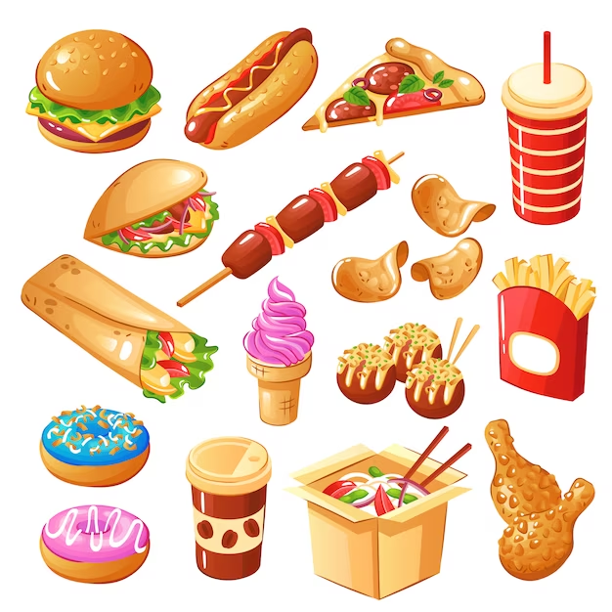

✓
healthy
unhealthy

Slide 8
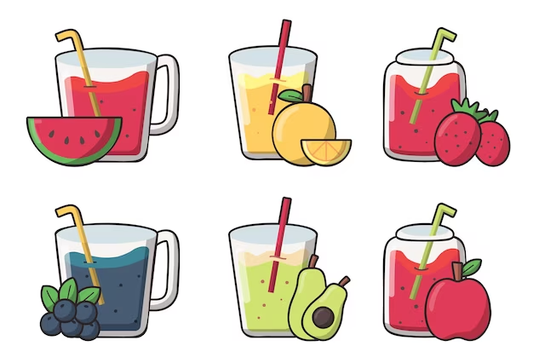
✓
healthy
unhealthy

Slide 9
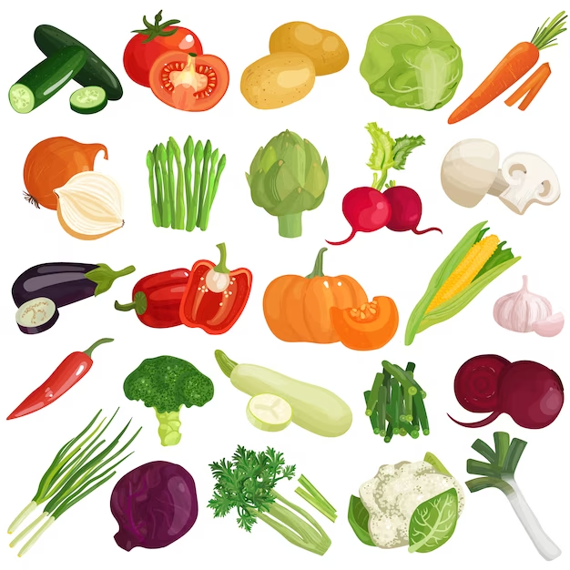

✓
healthy
unhealthy

Slide 10
02
Activity 1
Look, listen and repeat.

Slide 11


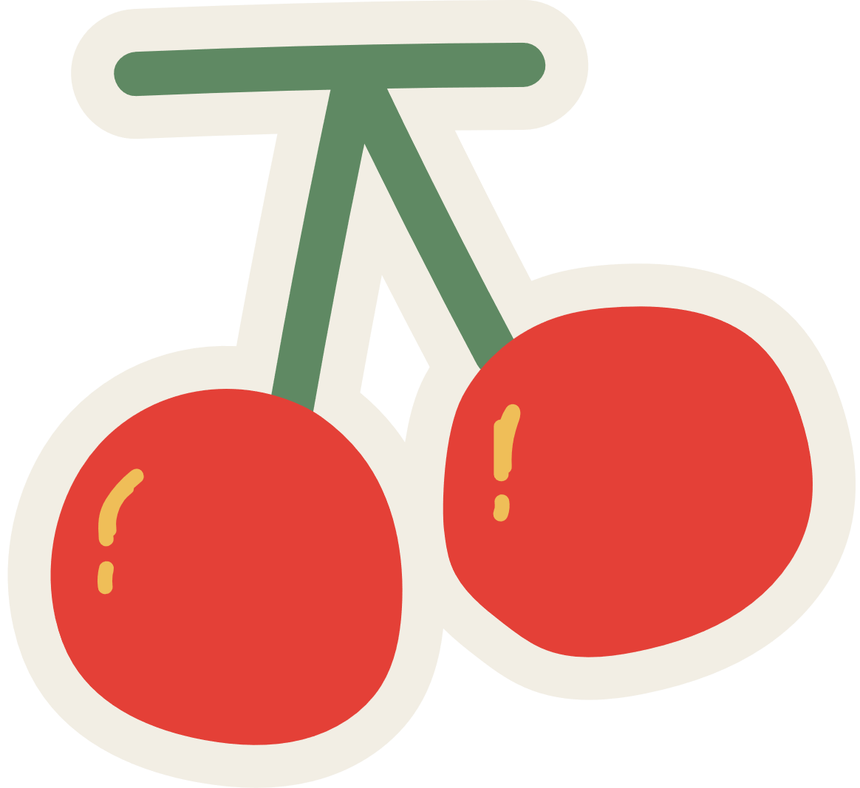
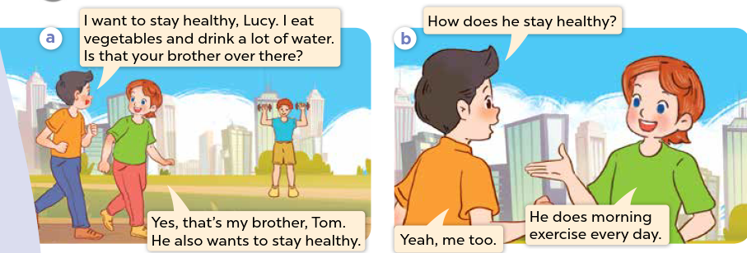


Look and say.
Notes:
Step 1: Ask pupils to look at Pictures a and b and identify the characters and say what they can see in the pictures.
Step 2: Have pupils look at Picture a and b and guess what the characters are talking about. Pupils can use Vietnamese, then repeat their responses in English.

Slide 12
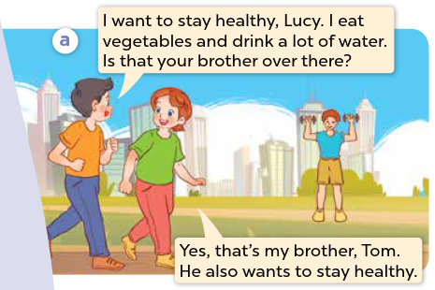

Look, listen and repeat.
Notes:
Step 3: Play the recording and encourage pupils to point at the characters while listening.

Slide 13
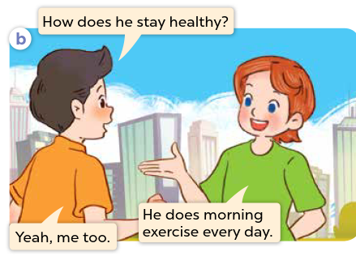
Look, listen and repeat.
Notes:
Step 3: Play the recording and encourage pupils to point at the characters while listening.

Slide 14
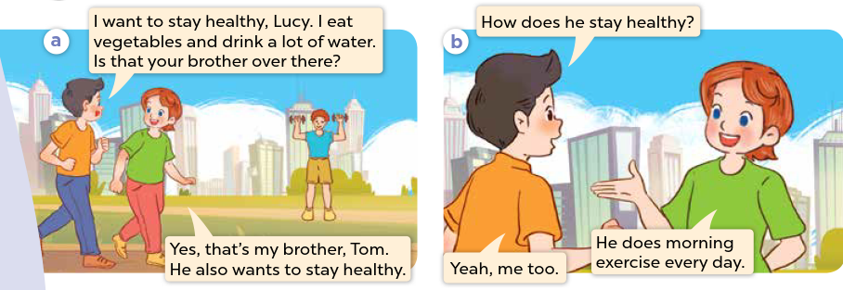
Look, listen and repeat.
Notes:
Step 4: Play the recording again, sentence by sentence, for pupils to listen, point to the sentences and repeat. Correct their pronunciation where necessary.
Step 5: Draw pupils’ attention to the question How does he stay healthy? and the answers He does morning exercise every day. Explain that they are used to talk about a someone’s lifestyle.

Slide 15
03
Activity 2
Listen, point and say.

Slide 16


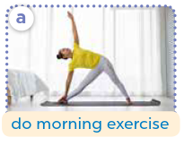





Listen, point and say.
Notes:
Step 1: Have pupils look at the pictures, say what they can see in the pictures and identify the activities the characters do.

Slide 17
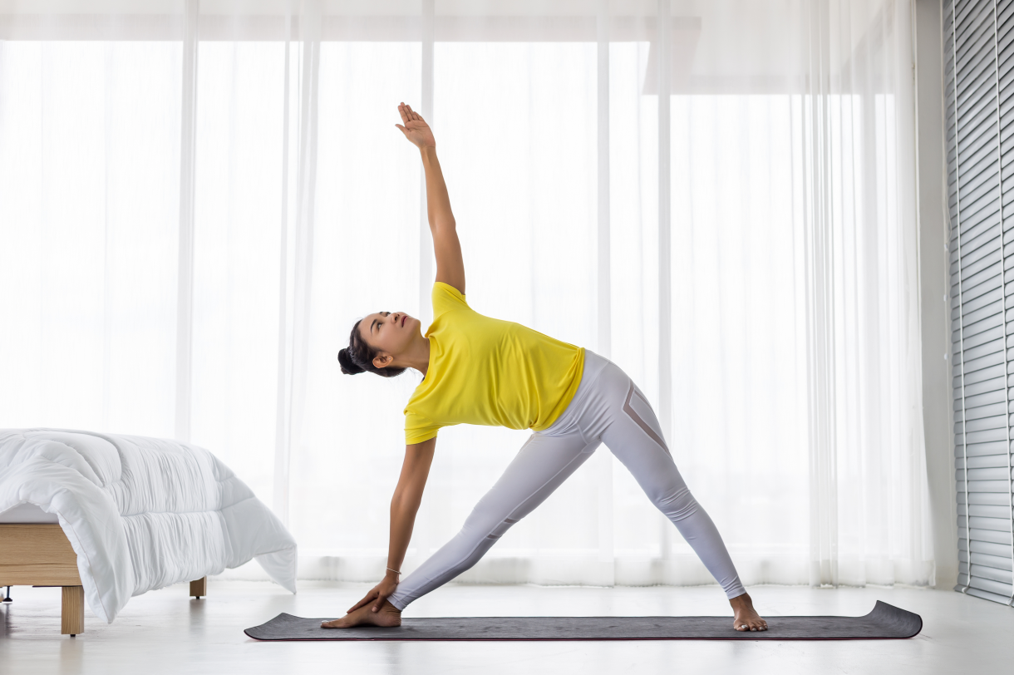
A
Listen, point and say.
a. do morning exercise
Notes:
Step 2: Play the first part of the recording for pupils to listen and repeat the phrases under the pictures in chorus and individually until they feel confident. Use the flashcards for do morning exercise, play sports, drink fresh juice and eat healthy food to practise the phrases.
Step 3: Have pupils point at Picture a. Draw pupils’ attention to the speech bubbles and elicit the missing words (How does she stay healthy? – She does morning exercise.) Play the next part of the recording a few times for pupils to repeat the sentences in both bubbles.

Slide 18

p
Listen, point and say.
b. play sports
Notes:
Step 4: Repeat Step 3 with Pictures b, c, and d. Then let pupils practise asking and answering questions in pairs. Go around the classroom to offer help if necessary.

Slide 19

Listen, point and say.
c. drink fresh juice
Notes:
Step 4: Repeat Step 3 with Pictures b, c, and d. Then let pupils practise asking and answering questions in pairs. Go around the classroom to offer help if necessary.

Slide 20

Listen, point and say.
d. eat healthy food
Notes:
Step 4: Repeat Step 3 with Pictures b, c, and d. Then let pupils practise asking and answering questions in pairs. Go around the classroom to offer help if necessary.

Slide 21



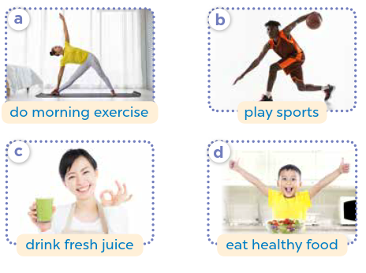



Work in pairs.
How does he / she stay healthy?
He / She _____.
Notes:
Step 5: Invite a few pairs to point at the pictures and ask and answer questions about a family member’s lifestyle.

Slide 22




Listen, point and say.
How does she stay healthy?
She does morning exercise.
a. do morning exercise
Notes:
Step 5: Invite a few pairs to point at the pictures and ask and answer questions about a family member’s lifestyle.

Slide 23
Listen, point and say.
How does he stay healthy?
He plays sports.
b. play sports
Notes:
Step 5: Invite a few pairs to point at the pictures and ask and answer questions about a family member’s lifestyle.

Slide 24
Listen, point and say.
How does she stay healthy?
She drinks fresh juice.
c. drink fresh juice
Notes:
Step 5: Invite a few pairs to point at the pictures and ask and answer questions about a family member’s lifestyle.

Slide 25
Listen, point and say.
How does he stay healthy?
He eats healthy food.
d. eat healthy food
Notes:
Step 5: Invite a few pairs to point at the pictures and ask and answer questions about a family member’s lifestyle.

Slide 26
04
Activity 3
Let’s talk.

Slide 27





Let’s talk.
How does your _____ stay healthy?
_____.
Notes:
Step 1: Draw pupils’ attention to the picture. Ask questions to help them identify the context (see Input).
Step 2: Point at the first character and elicit the question in the first speech bubble (e.g. How does your sister stay healthy?) and the answer in the second speech bubble (She does morning exercise.) as an example. Then write the sentences on the board. Get pupils to say the completed sentences. Repeat the same procedure with other pictures.

Slide 28
Work in pairs.
How does your _____ stay healthy?
_____.
Notes:
Step 3: Put pupils into pairs to ask and answer questions about how their mother, father, brother or sister stay healthy. Go around and offer support where necessary.

Slide 29
Let’s talk.
How does your ____ stay healthy?
_________.
Notes:
Step 4: Invite a few pairs to the front of the classroom to ask and answer questions about a family member’s lifestyle.

Slide 30
Let’s talk.
How does your ____ stay healthy?
_________.
Notes:
Step 4: Invite a few pairs to the front of the classroom to ask and answer questions about a family member’s lifestyle.

Slide 31
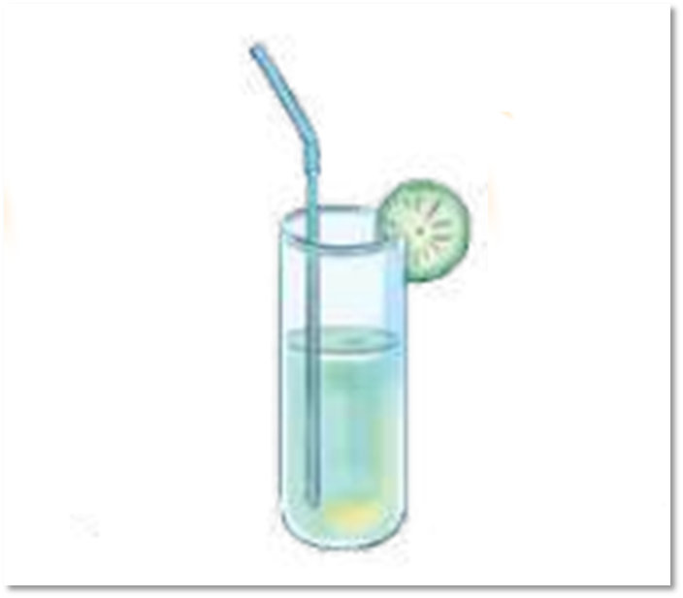
Let’s talk.
How does your ____ stay healthy?
_________.
Notes:
Step 4: Invite a few pairs to the front of the classroom to ask and answer questions about a family member’s lifestyle.

Slide 32
Let’s talk.
How does your ____ stay healthy?
_________.
Notes:
Step 4: Invite a few pairs to the front of the classroom to ask and answer questions about a family member’s lifestyle.

Slide 33
05
Fun corner and wrap-up.

Slide 34


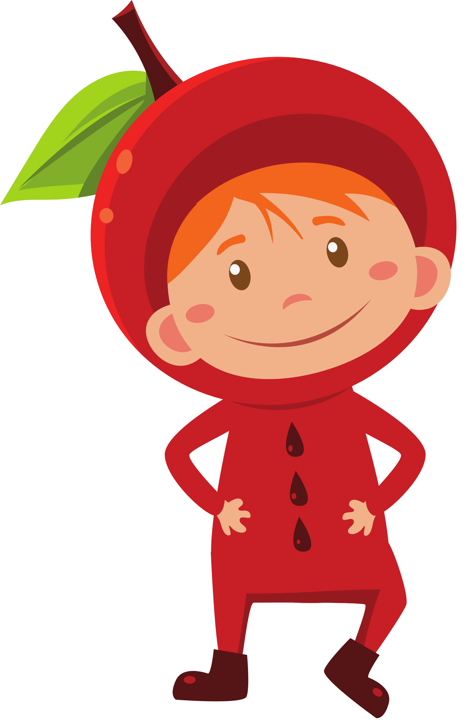
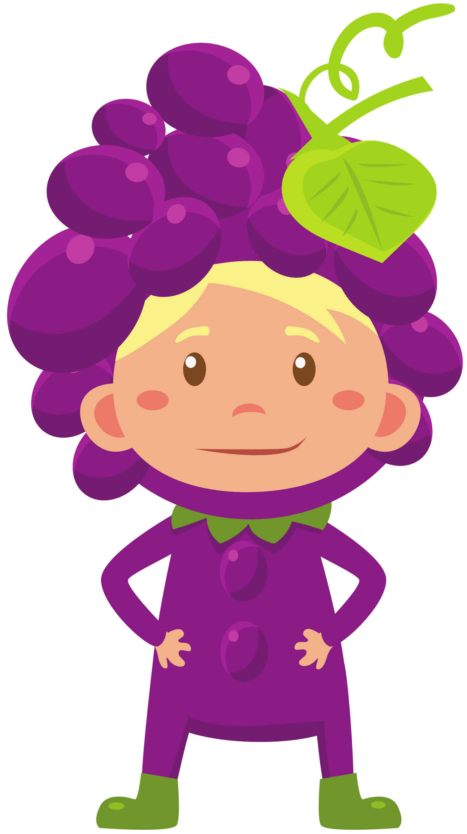
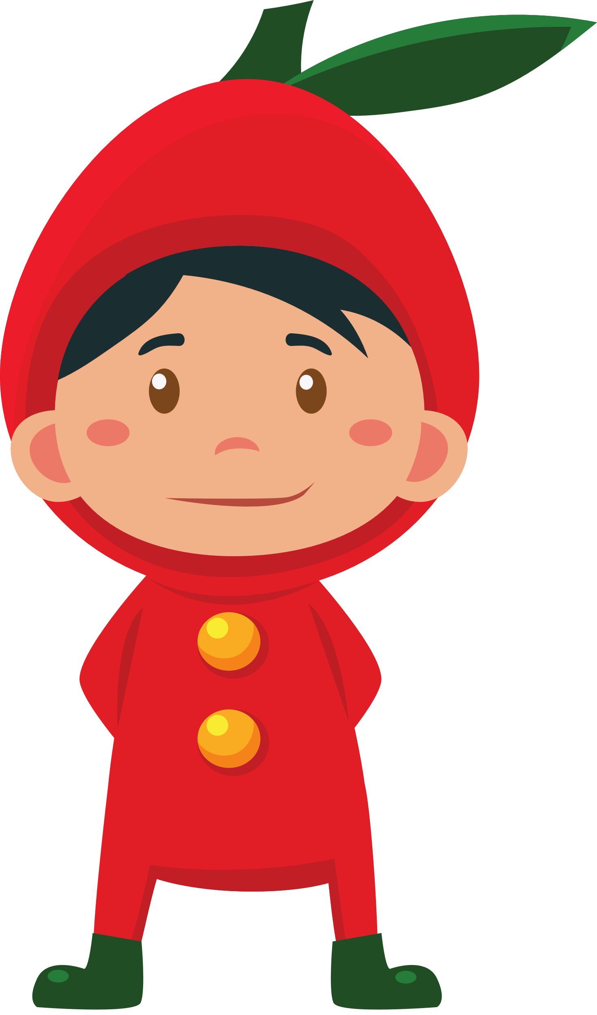
LET’S PLAY A GAME.

Slide 35






LUCKY FRUITS
Notes:
Click fruits to choose
After finishing, click LUCKY FRUITS to move the next slide

Slide 36

How does your sister stay healthy?
She _________.
Notes:
Click the fruit to GO BACK

Slide 37

Notes:
Click the fruit to GO BACK

Slide 38
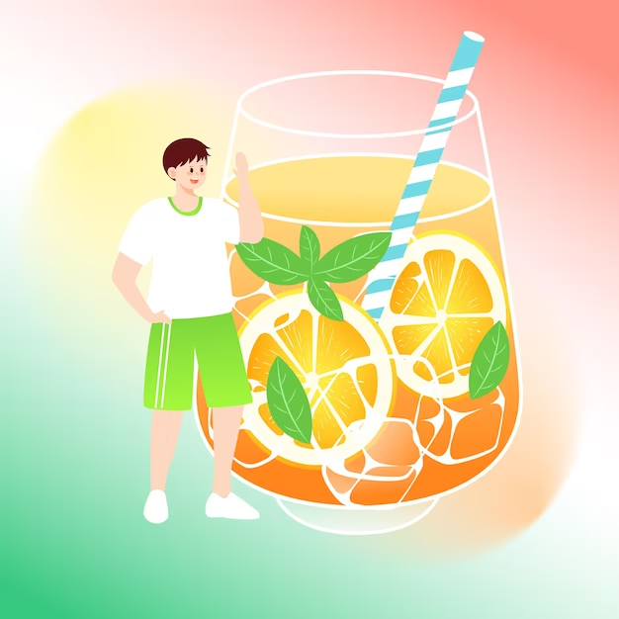
How does your brother stay healthy?
He _________.
Notes:
Click the fruit to GO BACK

Slide 39
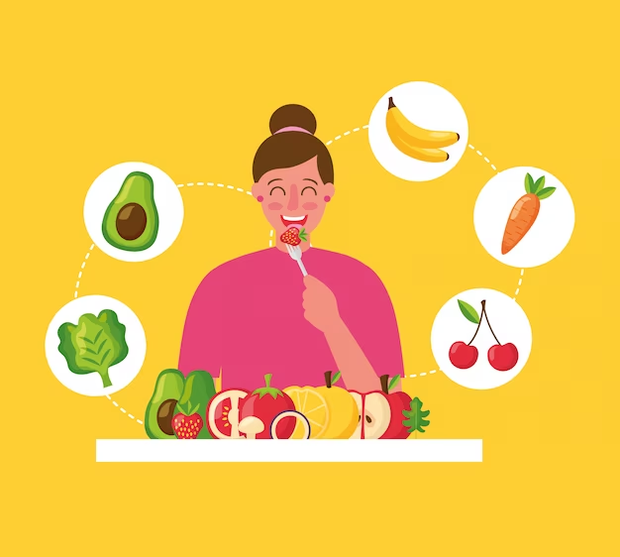
How does your sister stay healthy?
She _________.
Notes:
Click the fruit to GO BACK

Slide 40
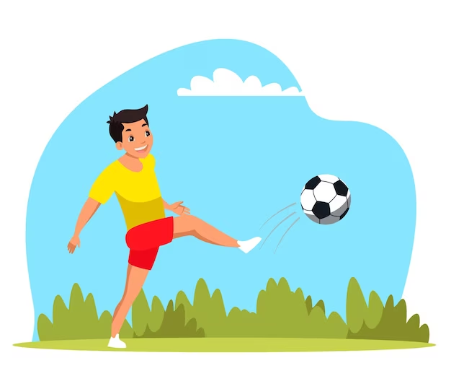
How does your brother stay healthy?
He _________.
Notes:
Click the fruit to GO BACK

Slide 42
THANK YOU FOR PLAYING!

