Slide 1




UBND QUẬN DƯƠNG KINH
TRƯỜNG TIỂU HỌC ANH DŨNG
ENGLISH - GRADE 5
UNIT 14: STAYING HEALTHY
LESSON 3 (1, 2, 3)

Slide 2








Unit 14: STAYING HEALTHY
Lesson 3 - Period 5

Slide 3




01
Warm-up and Review.

Slide 4




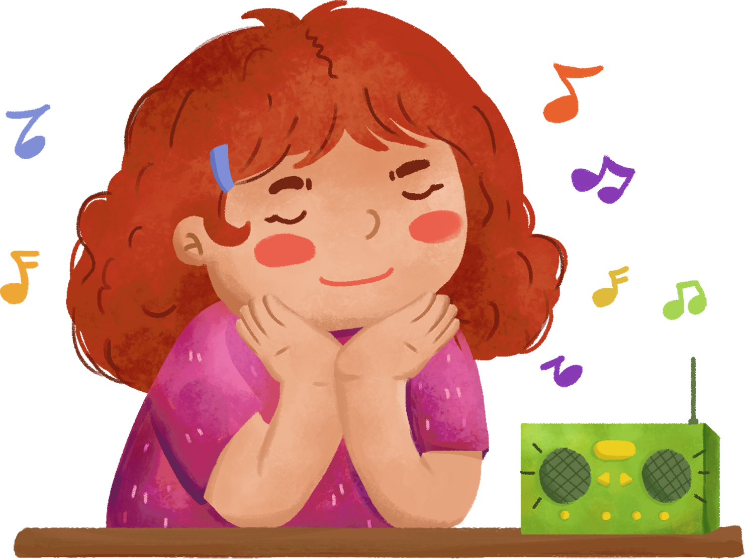
Let’s sing
Staying healthy
My sister wants to stay healthy.
She does morning exercise daily.
She eats healthy food,
And drinks fresh juice.
My brother wants to stay healthy.
He plays sport every day.
He eats healthy fruit,
And drinks fresh juice.

Slide 5
02
Activity 1
Listen and repeat.

Slide 6


Listen and repeat.
Does she 'eat ‘healthy 'fruit?
Notes:
Step 1: Have pupils look at the first question. Draw their attention to the stress on the words (e.g. eat, vegetables, every, day). Explain that they are the “content” (important) words in the question and need to be stressed. Check comprehension.
Step 2: Play the recording for pupils to listen to and repeat, in chorus and individually, until they feel confident. Correct their stress and pronunciation if necessary. Repeat Steps 1 and 2 with the second question.

Slide 7
Listen and repeat
Is your 'brother a 'strong 'swimmer?
Notes:
Step 1: Have pupils look at the first question. Draw their attention to the stress on the words (e.g. eat, vegetables, every, day). Explain that they are the “content” (important) words in the question and need to be stressed. Check comprehension.
Step 2: Play the recording for pupils to listen to and repeat, in chorus and individually, until they feel confident. Correct their stress and pronunciation if necessary. Repeat Steps 1 and 2 with the second question.

Slide 8


Work in pairs
Does she 'eat ‘healthy 'fruit?
Is your 'brother a 'strong 'swimmer?
Notes:
Step 3: Let pupils work in pairs or groups, saying questions with correct stressed words and pronunciation. Go around the classroom to offer help if necessary.
Step 4: Invite a few pupils to listen to and repeat the questions in front of the class. Praise them when their pronunciation is good.

Slide 9
03
Activity 2
Listen and underline one more stressed word. Then repeat.

Slide 10


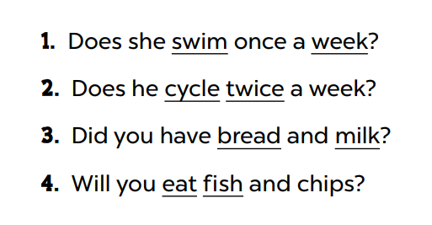


Look and say.
Notes:
Step 1: Draw pupils’ attention to the four sentences. Explain what pupils have to do. Check comprehension.

Slide 11
Listen and underline one more stressed word. Then repeat.
Notes:
Step 2: Play the recording for pupils to listen and underline one more stressed word in each question. Play the recording again for pupils to listen and check.

Slide 12

Swap your book.
Notes:
Step 3: Tell pupils to swap books with a partner, then check the answers as a class. Write the correct answers on the board.

Slide 13
Work in pairs.
Notes:
Step 4: Get pupils to work in pairs or groups, reading the Yes / No questions aloud with correct word stress. Go around the classroom and correct their pronunciation if necessary.
Step 5: Invite a few pupils to read aloud the questions in front of the class. Praise when they read the sentences correctly.

Slide 14
04
Activity 3
Let’s chant.

Slide 15



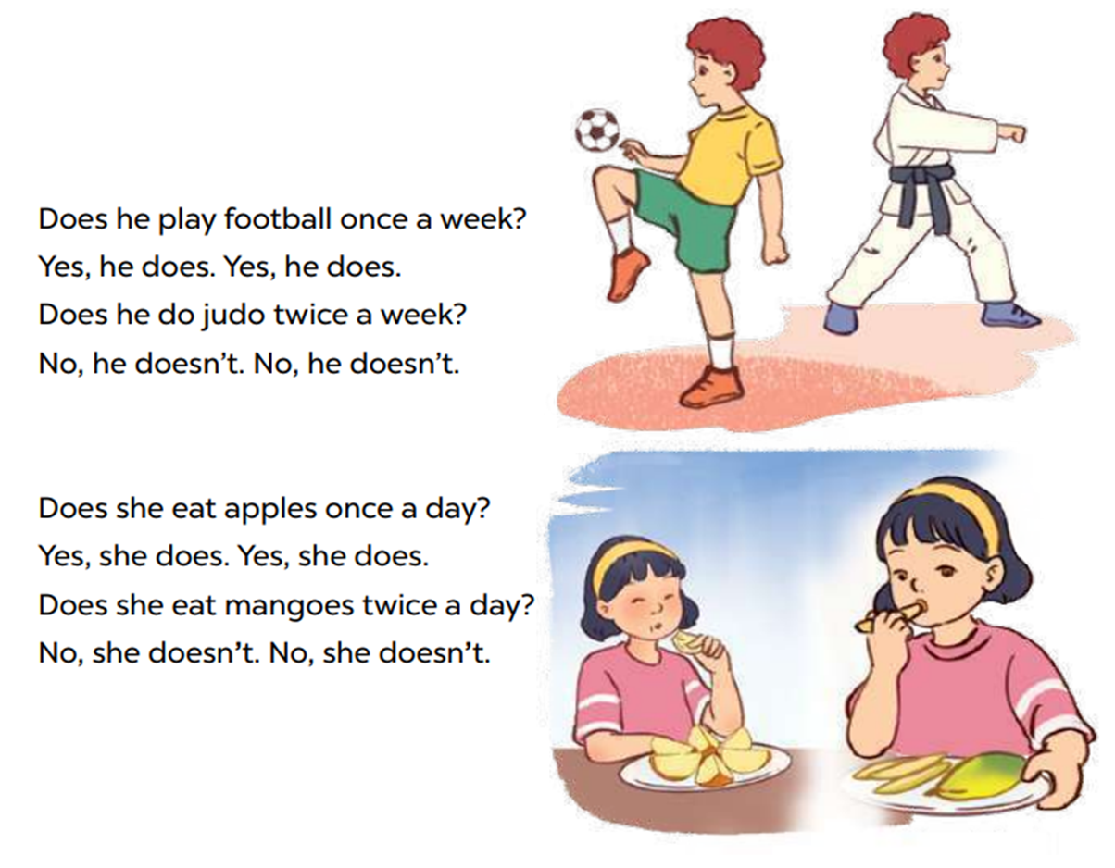


Look and read.
Notes:
Step 1: Have pupils read the lyrics of the chant. Then get them to look at the picture to reinforce their understanding. Check comprehension.

Slide 16
Listen and chant.
Notes:
Step 2: Play the recording all the way through for pupils to listen to the whole chant. Encourage them to listen carefully to the stressed words. Play it again line by line, for pupils to listen and repeat. Draw their attention to the pronunciation and rhythm. Encourage them to clap while chanting.

Slide 17
Chant and clap.
Notes:
Step 3: Divide the class into two groups to take turns listening to and repeating the chant, while the rest of the class claps along.

Slide 18
05
Wrap-up

Slide 19
















Share your activities to stay healthy with your partner!

Slide 20




















Slide 21















FOR PLAYING!

