Slide 1




UBND QUẬN DƯƠNG KINH
TRƯỜNG TIỂU HỌC ANH DŨNG
ENGLISH - GRADE 5
UNIT 15: OUR HEALTH
LESSON 2 (4, 5, 6)

Slide 2




Unit 15
OUR
HEALTH
Lesson 2 – Period 4

Slide 3


01
Warm-up and Review

Slide 4

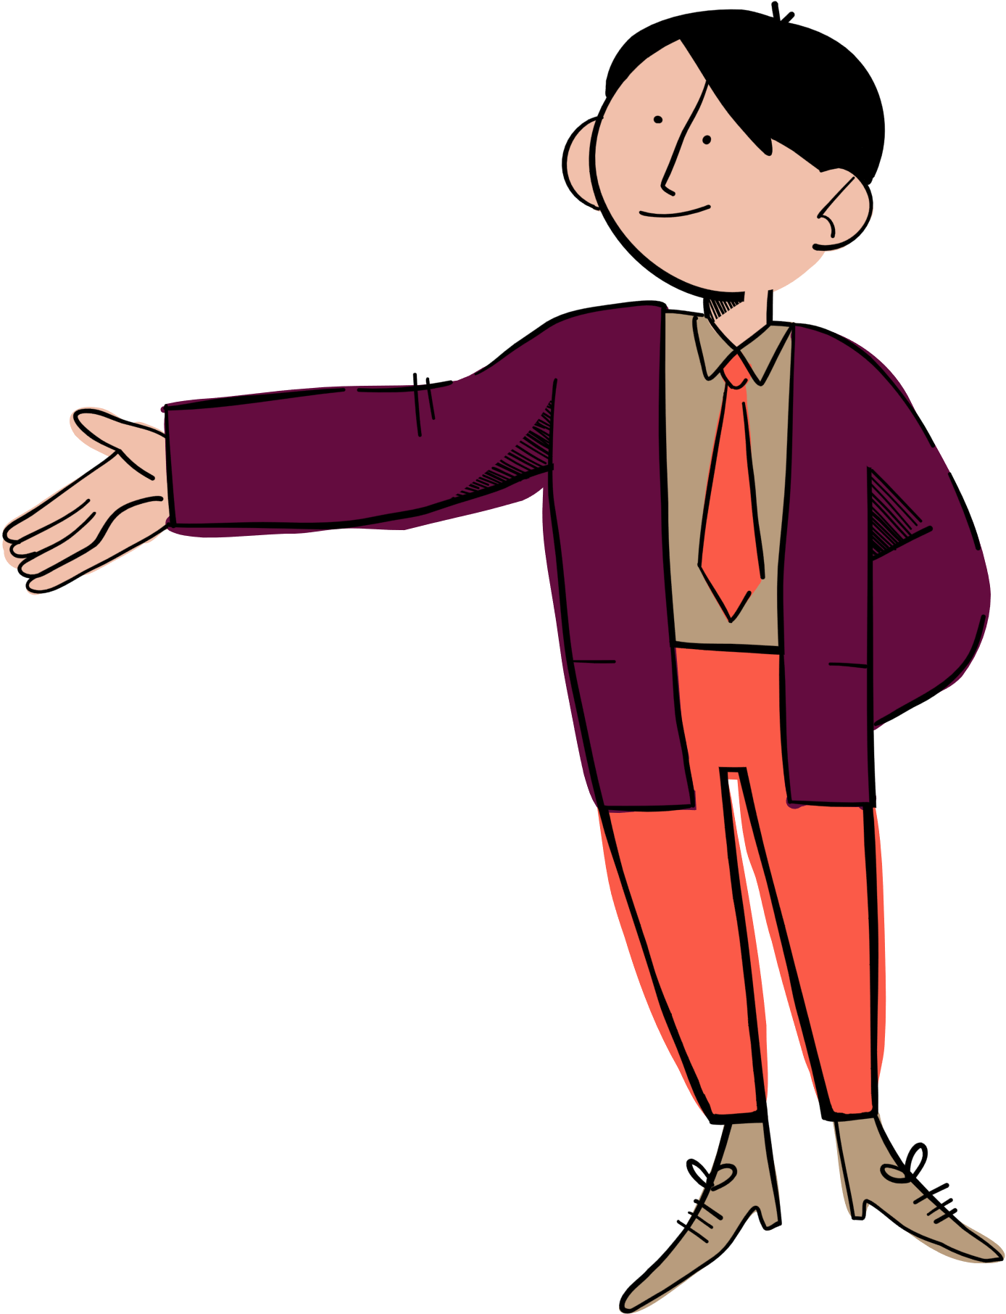


Let’s
spin the wheel!
10
30
Team 1
100
150
50
50
Team 2
200
10

Slide 5



Let’s choose a number.
1
2
3
4
5
6
7
Notes:
Click the number to link to the Question slide.
Click the red heart to end the game.

Slide 6

10
30
100
150
30
50
200
10
Notes:
Click the yellow flower to back to the Number slide.

Slide 7

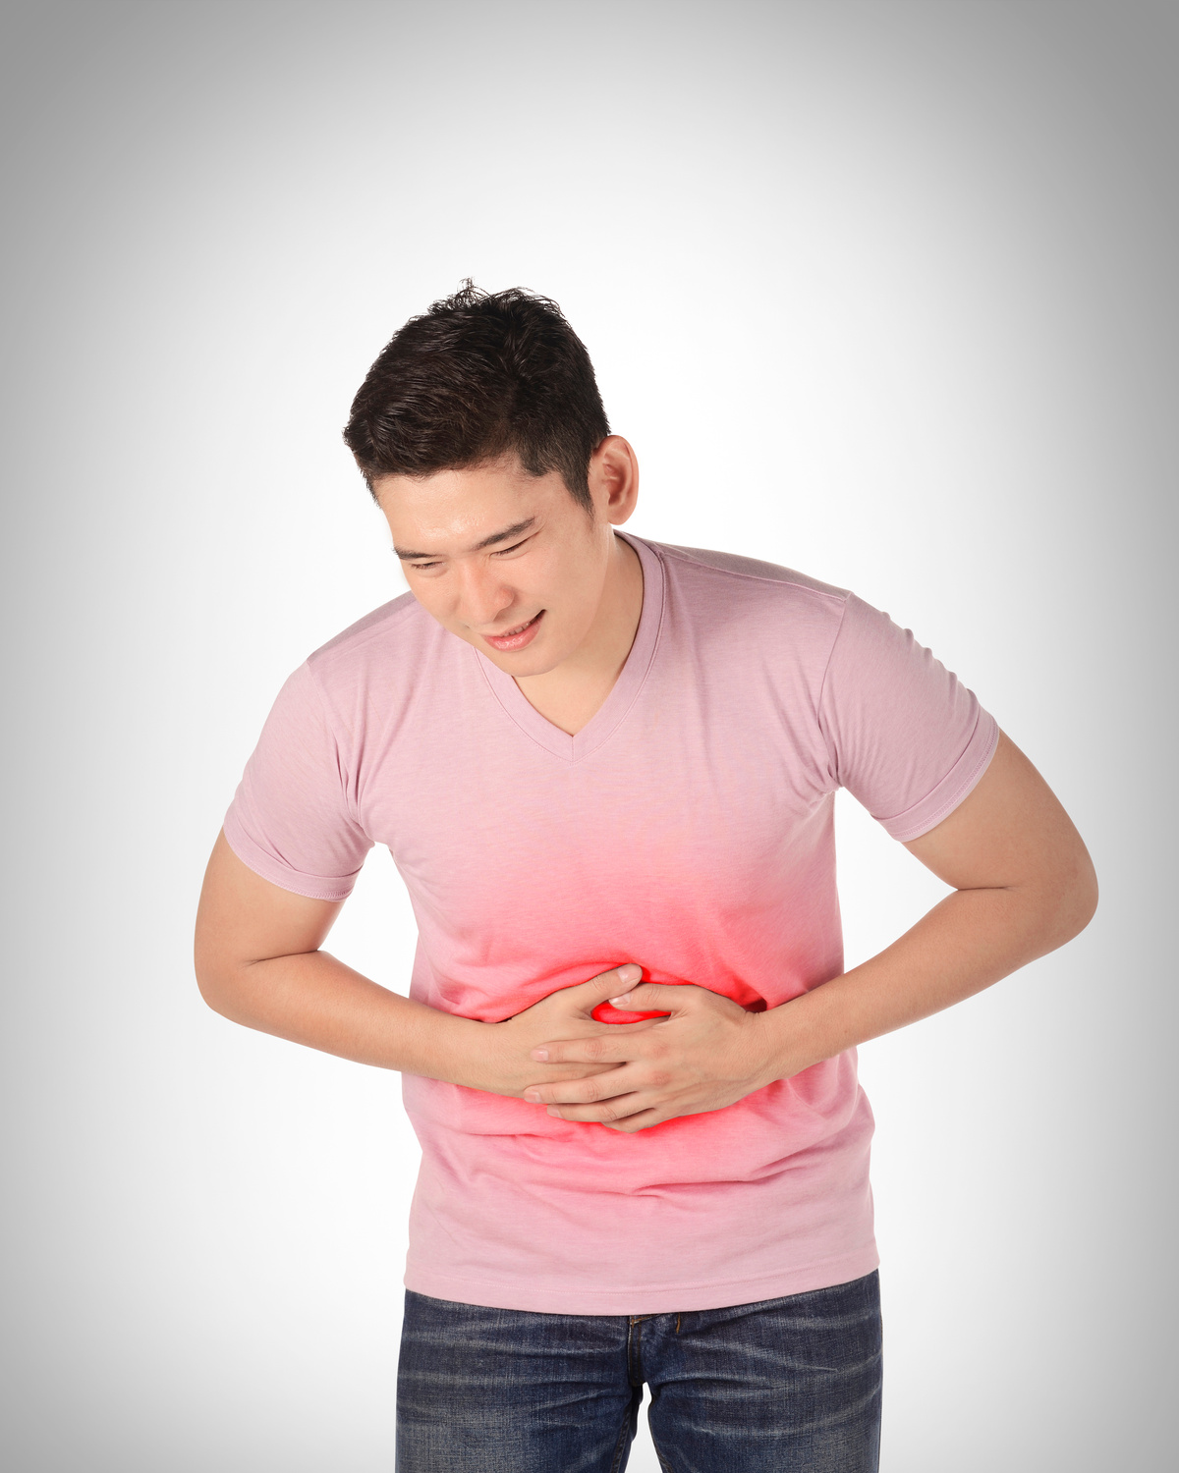
Ask and answer.
What’s the matter?
I have a stomach ache.
You should take some medicine.
Thanks for
your advice.
Notes:
Click the yellow flower to move to the Spin slide for getting points for groups.

Slide 8



You get a clap from everyone!!!
Notes:
Click the yellow flower to move to the Spin slide for getting points for groups.

Slide 9
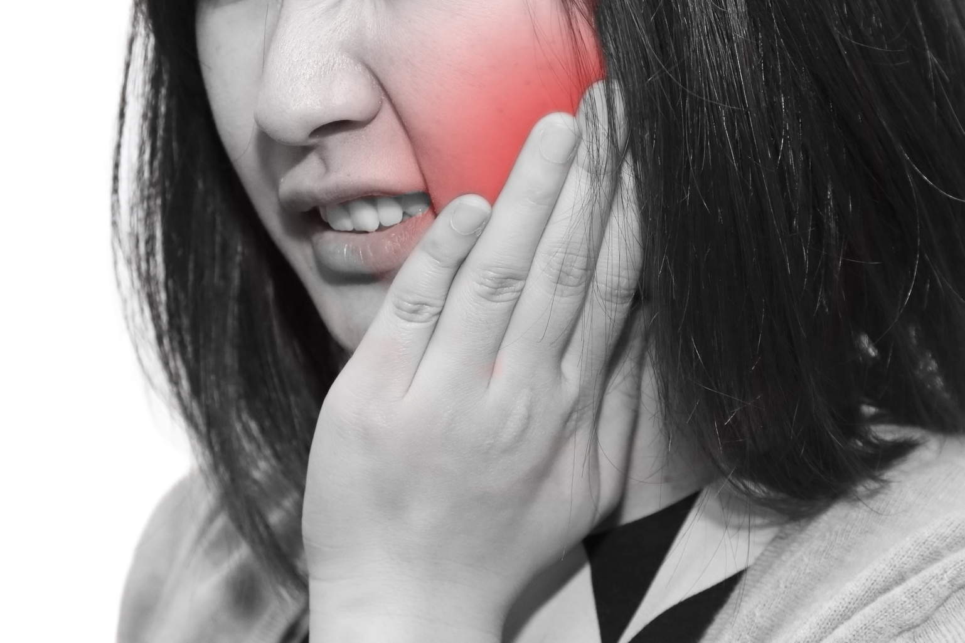
Ask and answer.
What’s the matter?
I have a toothache.
You should go to the dentist.
Thanks for
your advice.
Notes:
Click the yellow flower to move to the Spin slide for getting points for groups.

Slide 10
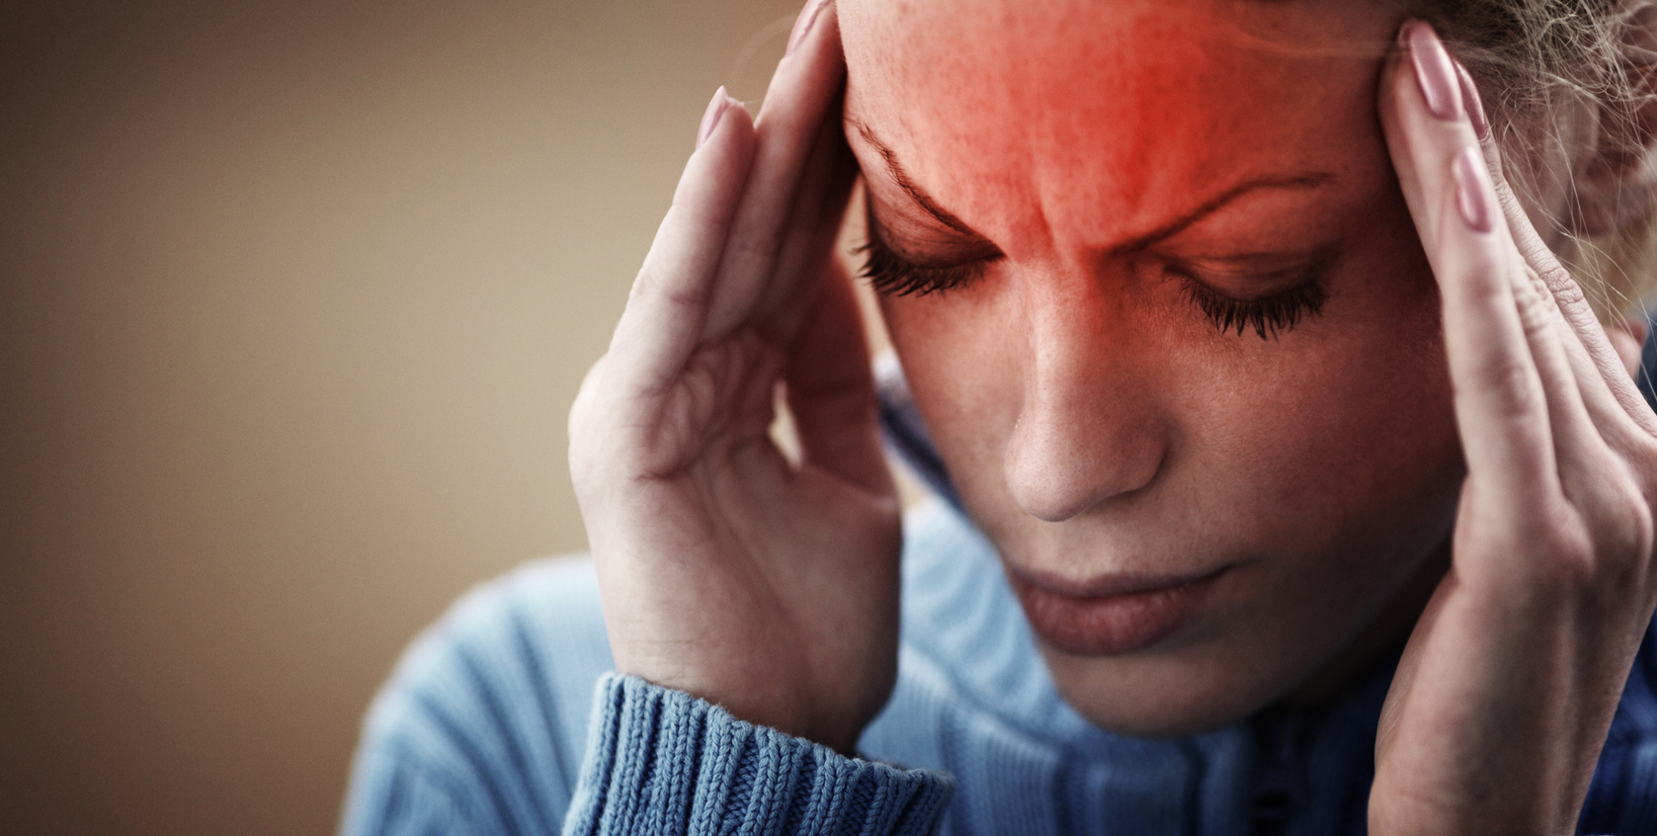
Ask and answer.
What’s the matter?
I have a headache.
You should have a rest.
Thanks for
your advice.
Notes:
Click the yellow flower to move to the Spin slide for getting points for groups.

Slide 11

You get a hug from the teacher!!!
Notes:
Click the yellow flower to move to the Spin slide for getting points for groups.

Slide 12
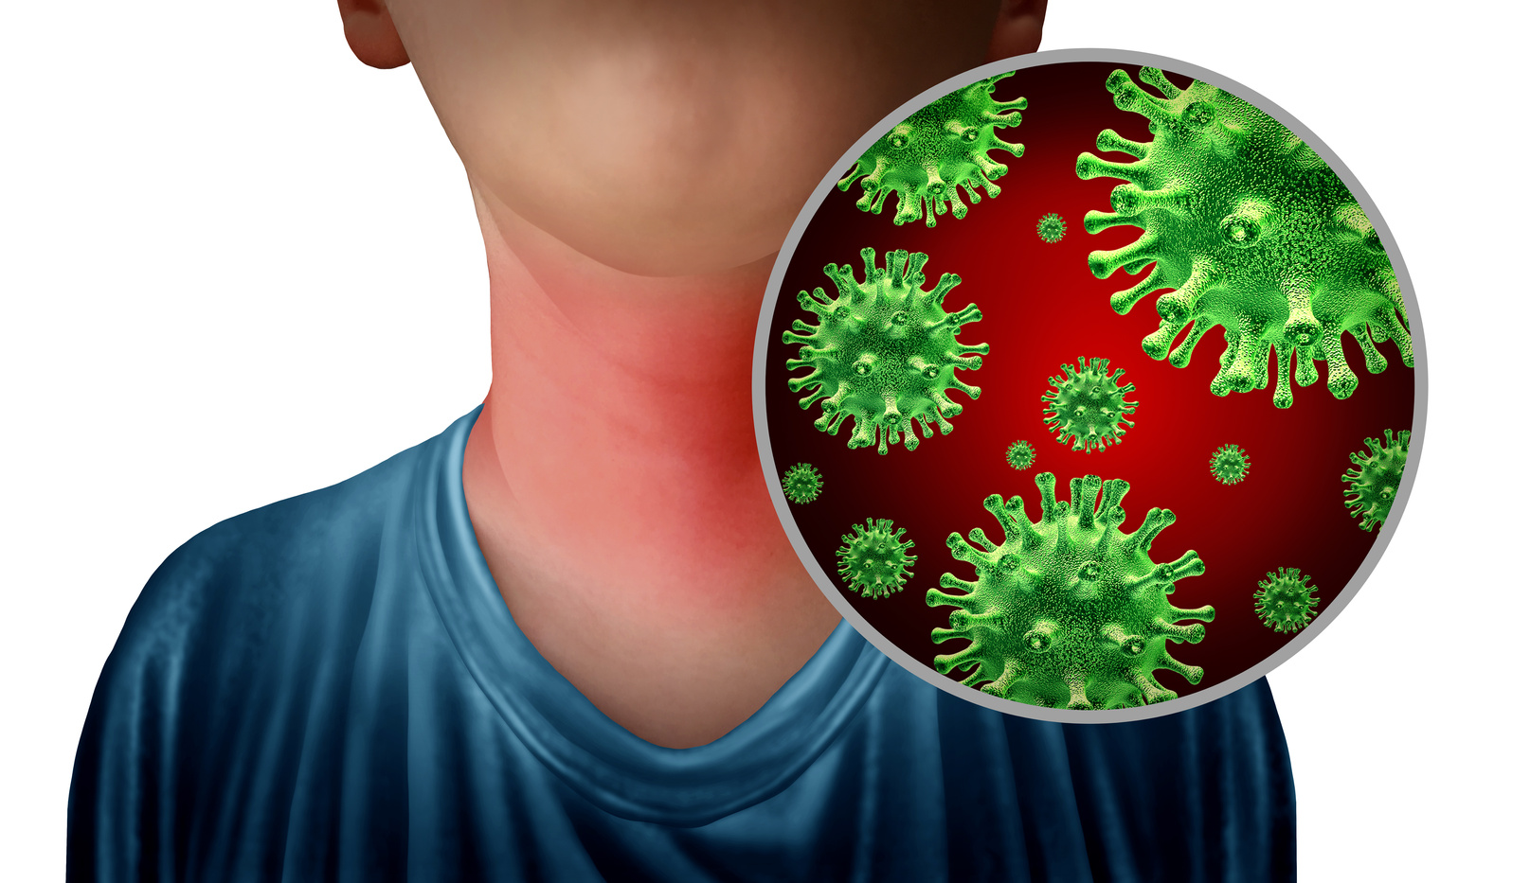
Ask and answer.
What’s the matter?
I have a sore throat.
You should drink warm water.
Thanks for
your advice.
Notes:
Click the yellow flower to move to the Spin slide for getting points for groups.

Slide 13

You get a gift from the teacher!!!
Notes:
Click the yellow flower to move to the Spin slide for getting points for groups.

Slide 14





Slide 15
02
Activity 4
Listen and tick.

Slide 16


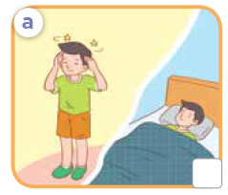
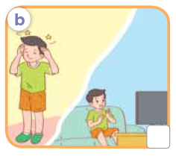
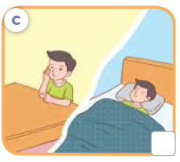

Listen and tick.
Notes:
Ask pupils to tick the correct picture that shows the boy’s health problem and the advice that the girl gives him.

Slide 17

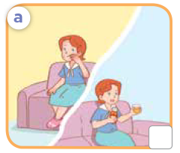
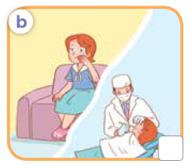
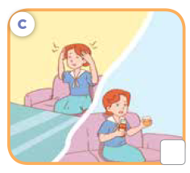
Listen and tick.
Notes:
Ask pupils to tick the correct picture that shows the boy’s health problem and the advice that the girl gives him.

Slide 18
Work in pairs. Listen and check.
✓
✓
Notes:
Step 4: Ask pupils to work in pairs for their peer-checks. Correct answers and give feedback.
*Key: 1. a, 2. b

Slide 19
03
Activity 5
Read and complete.

Slide 20

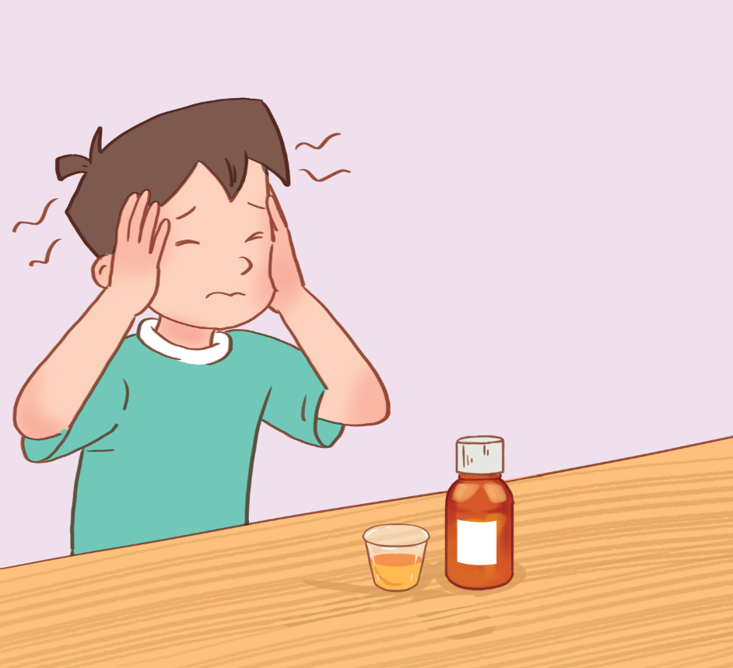
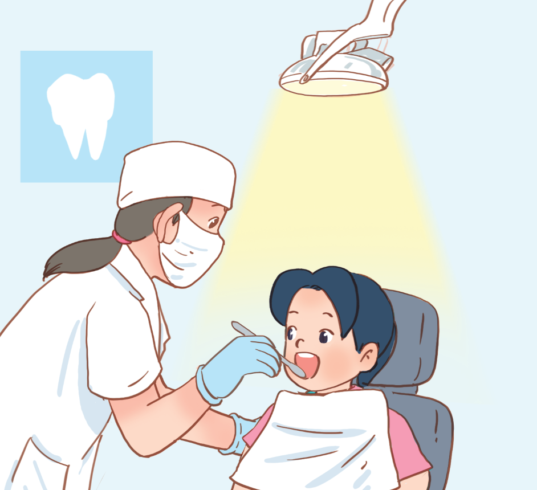
Look and say.
Notes:
Step 1: Ask pupils to look at the pictures and identify the health problems that the characters have.

Slide 21
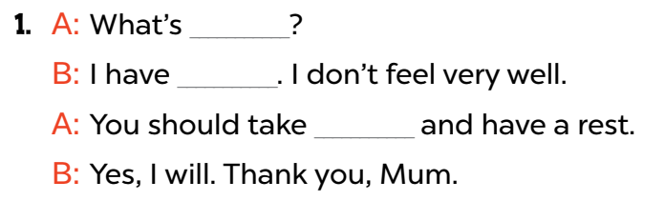
Read and complete.
Notes:
Step 2: Have pupils read Conversation 1. Ask them what are missing from the gaps. Have them complete the gaps by finding the clues from the context and the picture. Repeat the same procedure with Conversation 2.

Slide 22
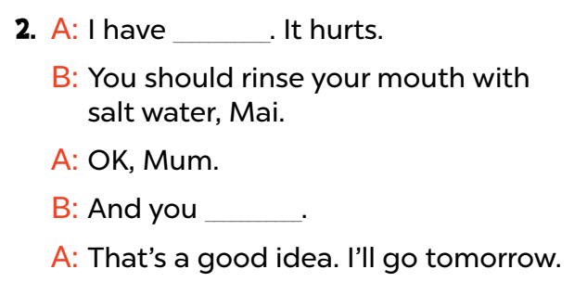
Read and complete.
Notes:
Step 2: Have pupils read Conversation 1. Ask them what are missing from the gaps. Have them complete the gaps by finding the clues from the context and the picture. Repeat the same procedure with Conversation 2.

Slide 23
Read and complete.
Notes:
Step 3: Get pupils to complete the conversations individually.

Slide 24
Read and complete.
1. A: What’s _______________?
B: I have _______________. I don’t feel very well.
A: You should take ________________________
and have a rest.
B: Yes, I will. Thank you, Mum.
the matter?
a headache
some medicine
Notes:
Then ask a few pairs to read them aloud. Check their answers, giving corrections and feedback where necessary.
Step 4: Ask two pupils and two pairs to read the sentences aloud. Give feedback and corrections if necessary.

Slide 25
Read and complete.
2. A: I have _______________ . It hurts.
B: You should rinse your mouth with salt water, Mai.
A: OK, Mum.
B: And you ______________________________ .
A: That’s a good idea. I’ll go tomorrow.
a toothache
should go to the dentist
Notes:
Then ask a few pairs to read them aloud. Check their answers, giving corrections and feedback where necessary.
Step 4: Ask two pupils and two pairs to read the sentences aloud. Give feedback and corrections if necessary.

Slide 27
04
Activity 6
Let’s play.

Slide 28

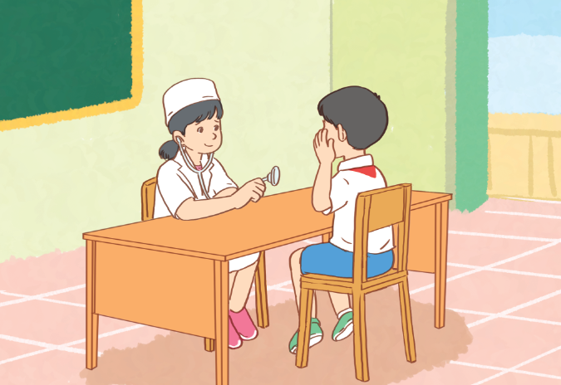
Look and say.
patient
doctor
Notes:
Pupils look at the picture and tell who the characters are.

Slide 29

Let’s role-play.
Notes:
Step 1: Tell pupils to role- play in pairs as a doctor and a patient within 3 minutes. Encourage them to ask and give advice about health problems. Go round the class and give support when necessary.

Slide 30
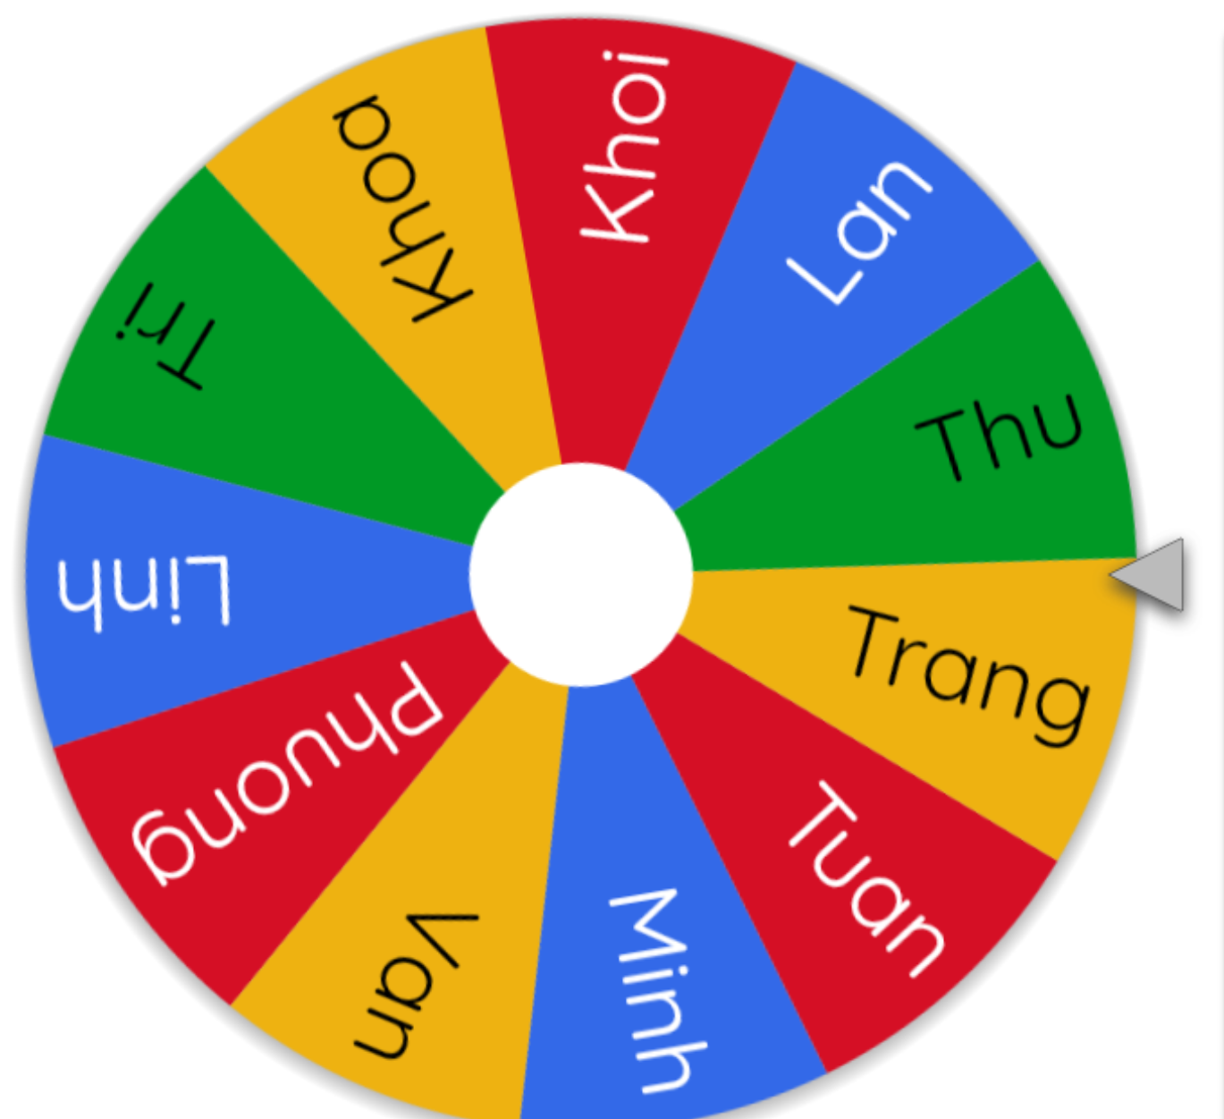
Let’s role-play.
Notes:
Step 2: When the time is up, ask 3 pairs to perform their roles in front of the class. Ask the class to vote for the best performance.
Step 3: Reward the pair with the most votes.
Use this link to choose two pupils for playing the game: https://wheelofnames.com/

Slide 31
Suggested answers.
What’s the matter?
I have a toothache.
You should rinse your mouth with salt water and take some medicine.
Yes, I will.
Thank you, doctor.
Notes:
Step 1: Tell pupils to role- play in pairs as a doctor and a patient within 3 minutes. Encourage them to ask and give advice about health problems. Go round the class and give support when necessary.

