Slide 1




UBND QUẬN DƯƠNG KINH
TRƯỜNG TIỂU HỌC ANH DŨNG
ENGLISH - GRADE 5
UNIT 15: OUR HEALTH
LESSON 3 (1, 2, 3)

Slide 2




Unit 15
OUR
HEALTH
Lesson 3 – Period 5

Slide 3


01
Warm-up and Review

Slide 4



ZOOM IT IN!
(HEALTH EDITION)

Slide 5



WELCOME!

Slide 6

GUESS
THE ZOOMED PICTURE

Slide 7
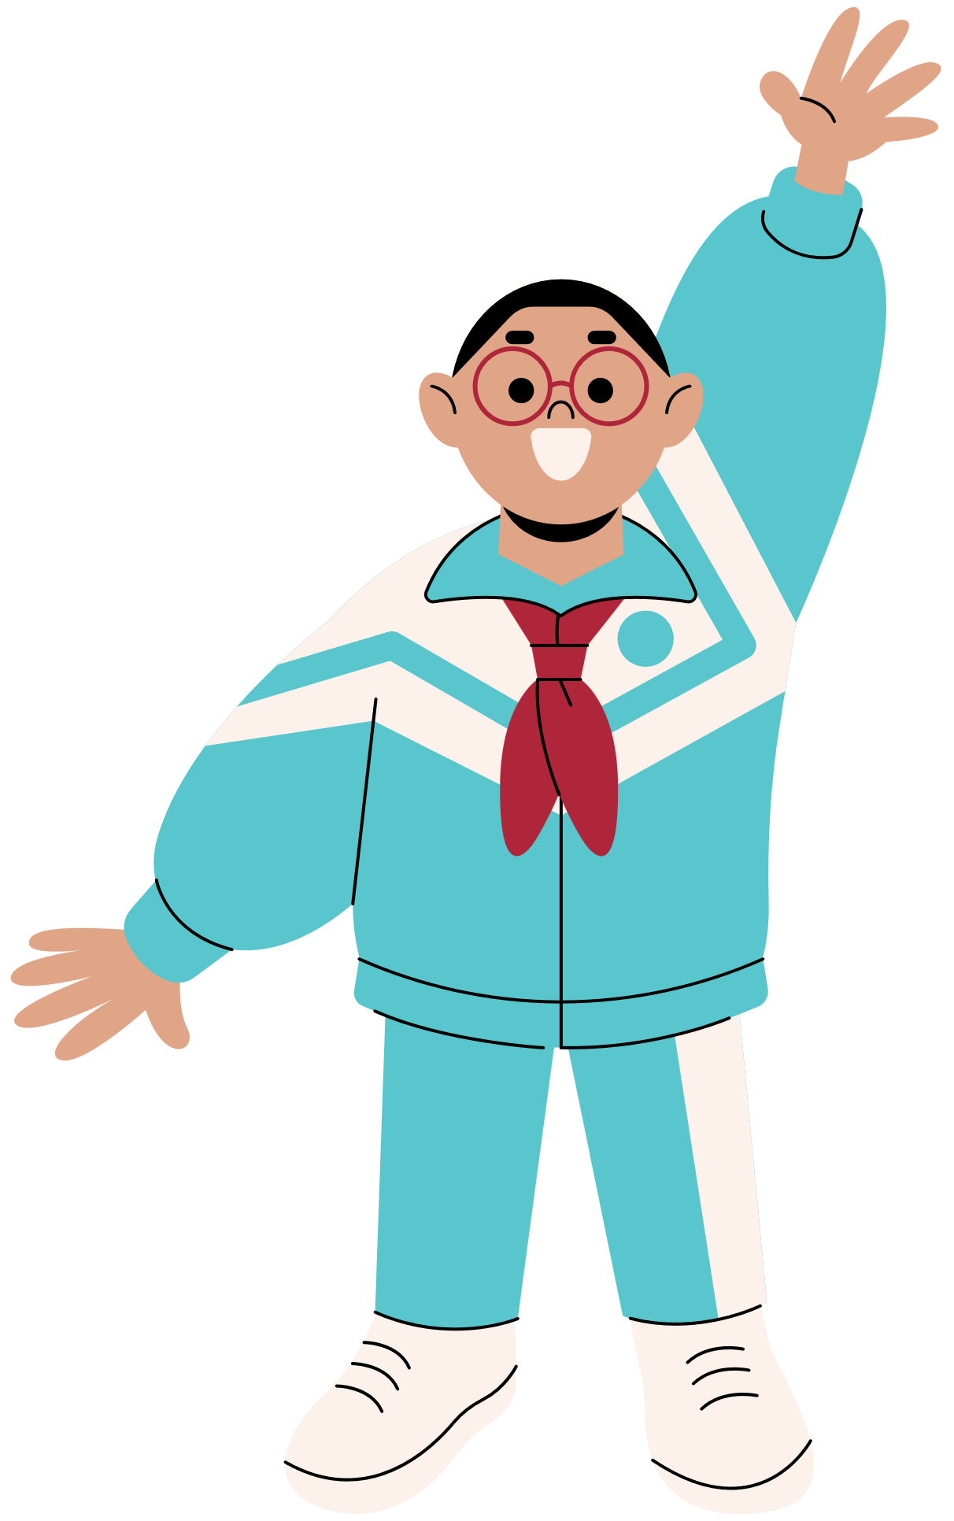
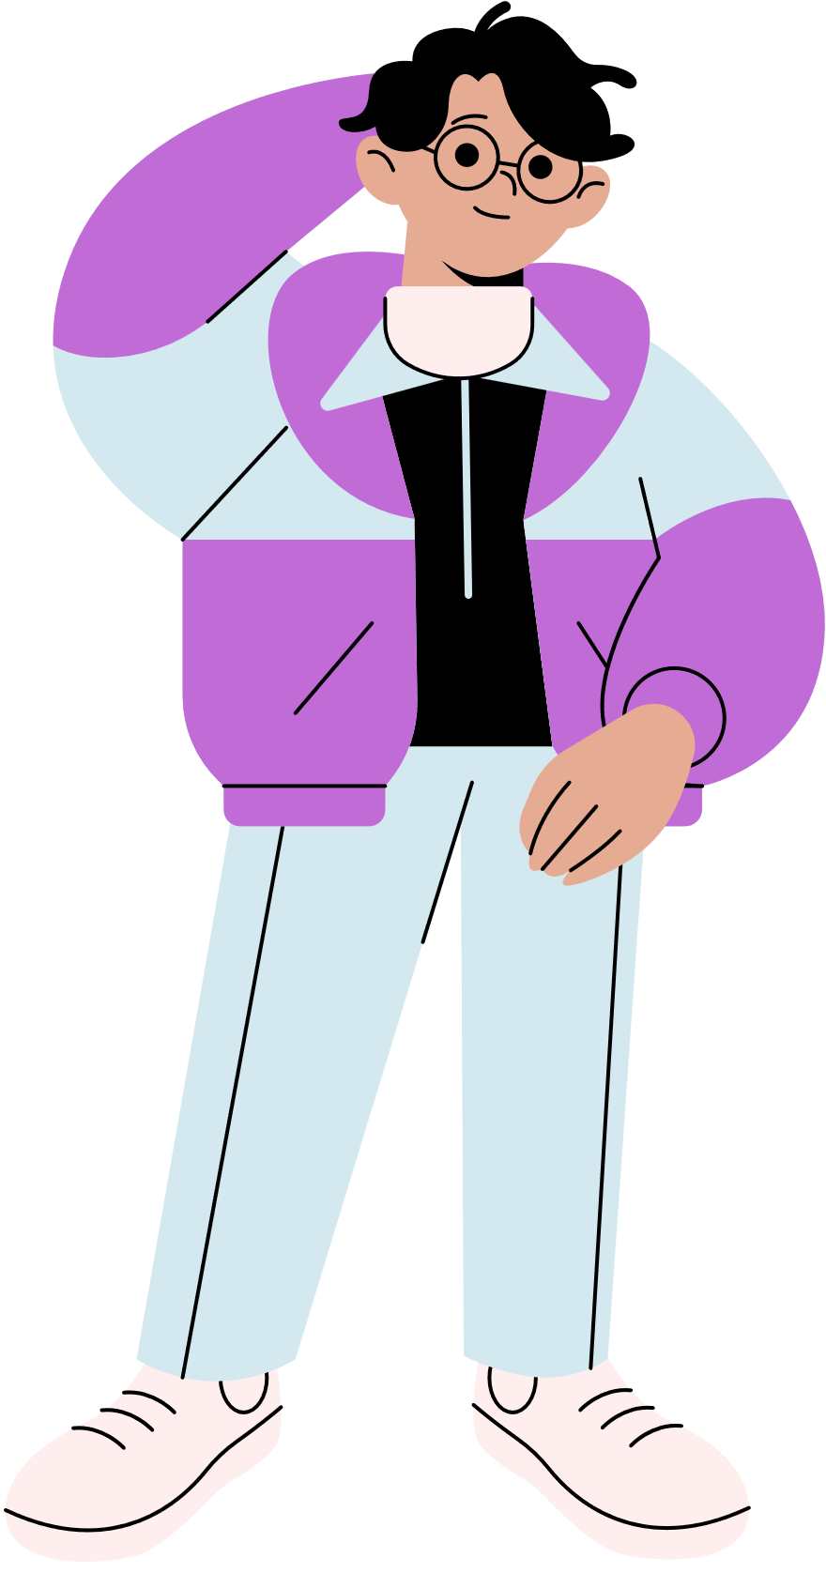
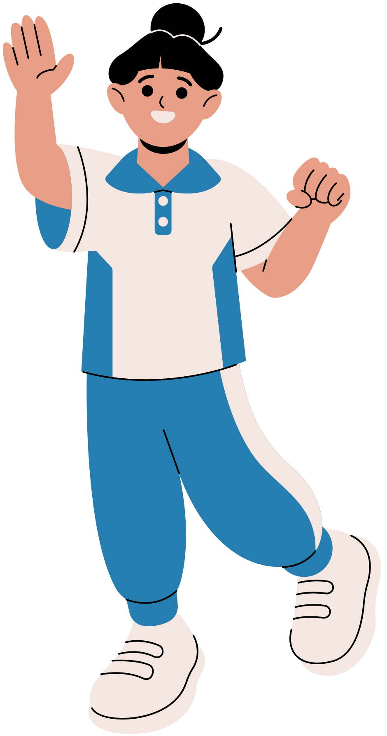
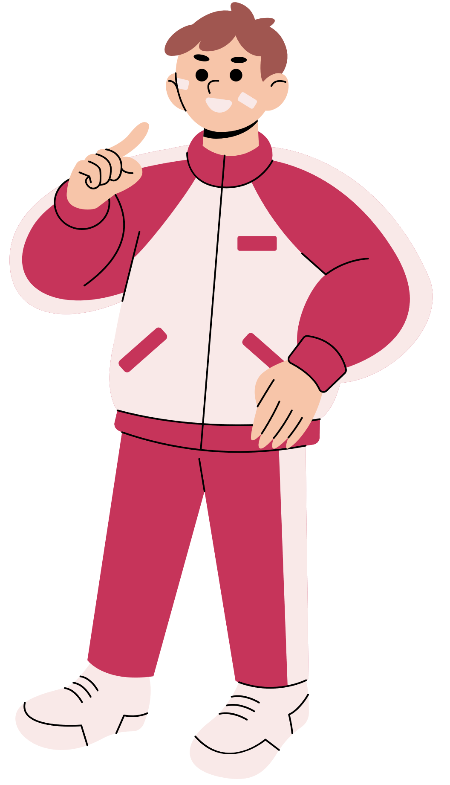
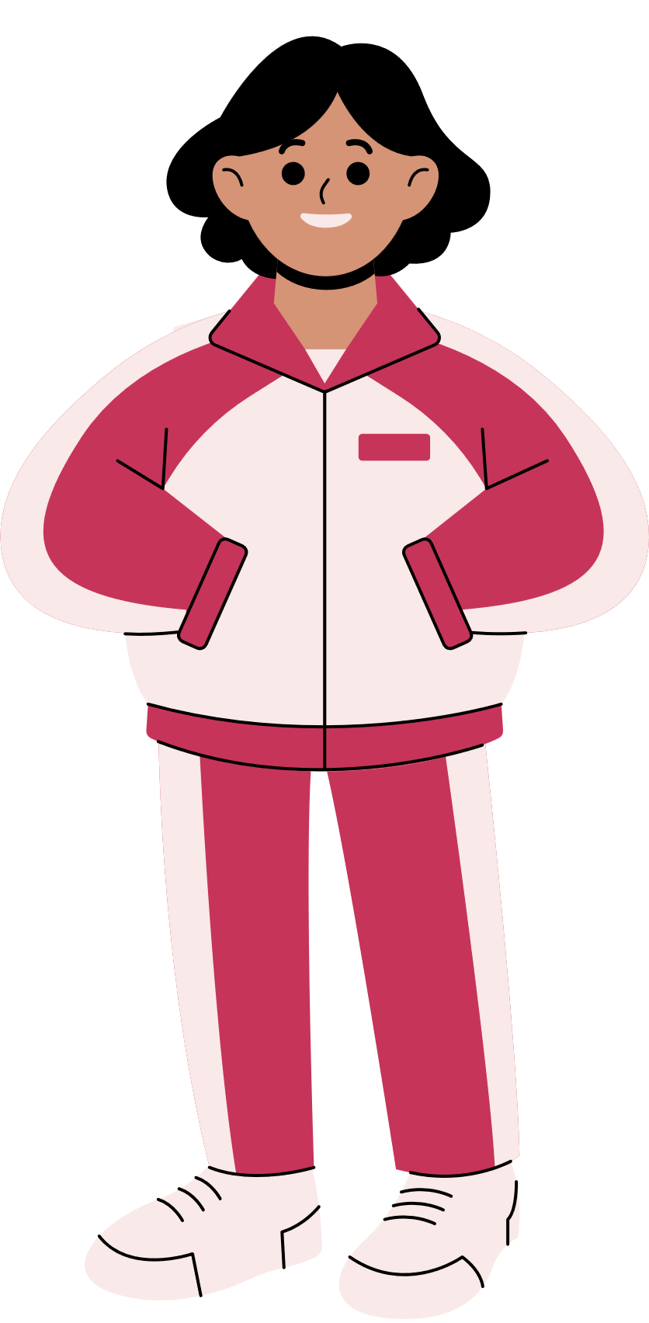
ARE YOU READY?

Slide 8
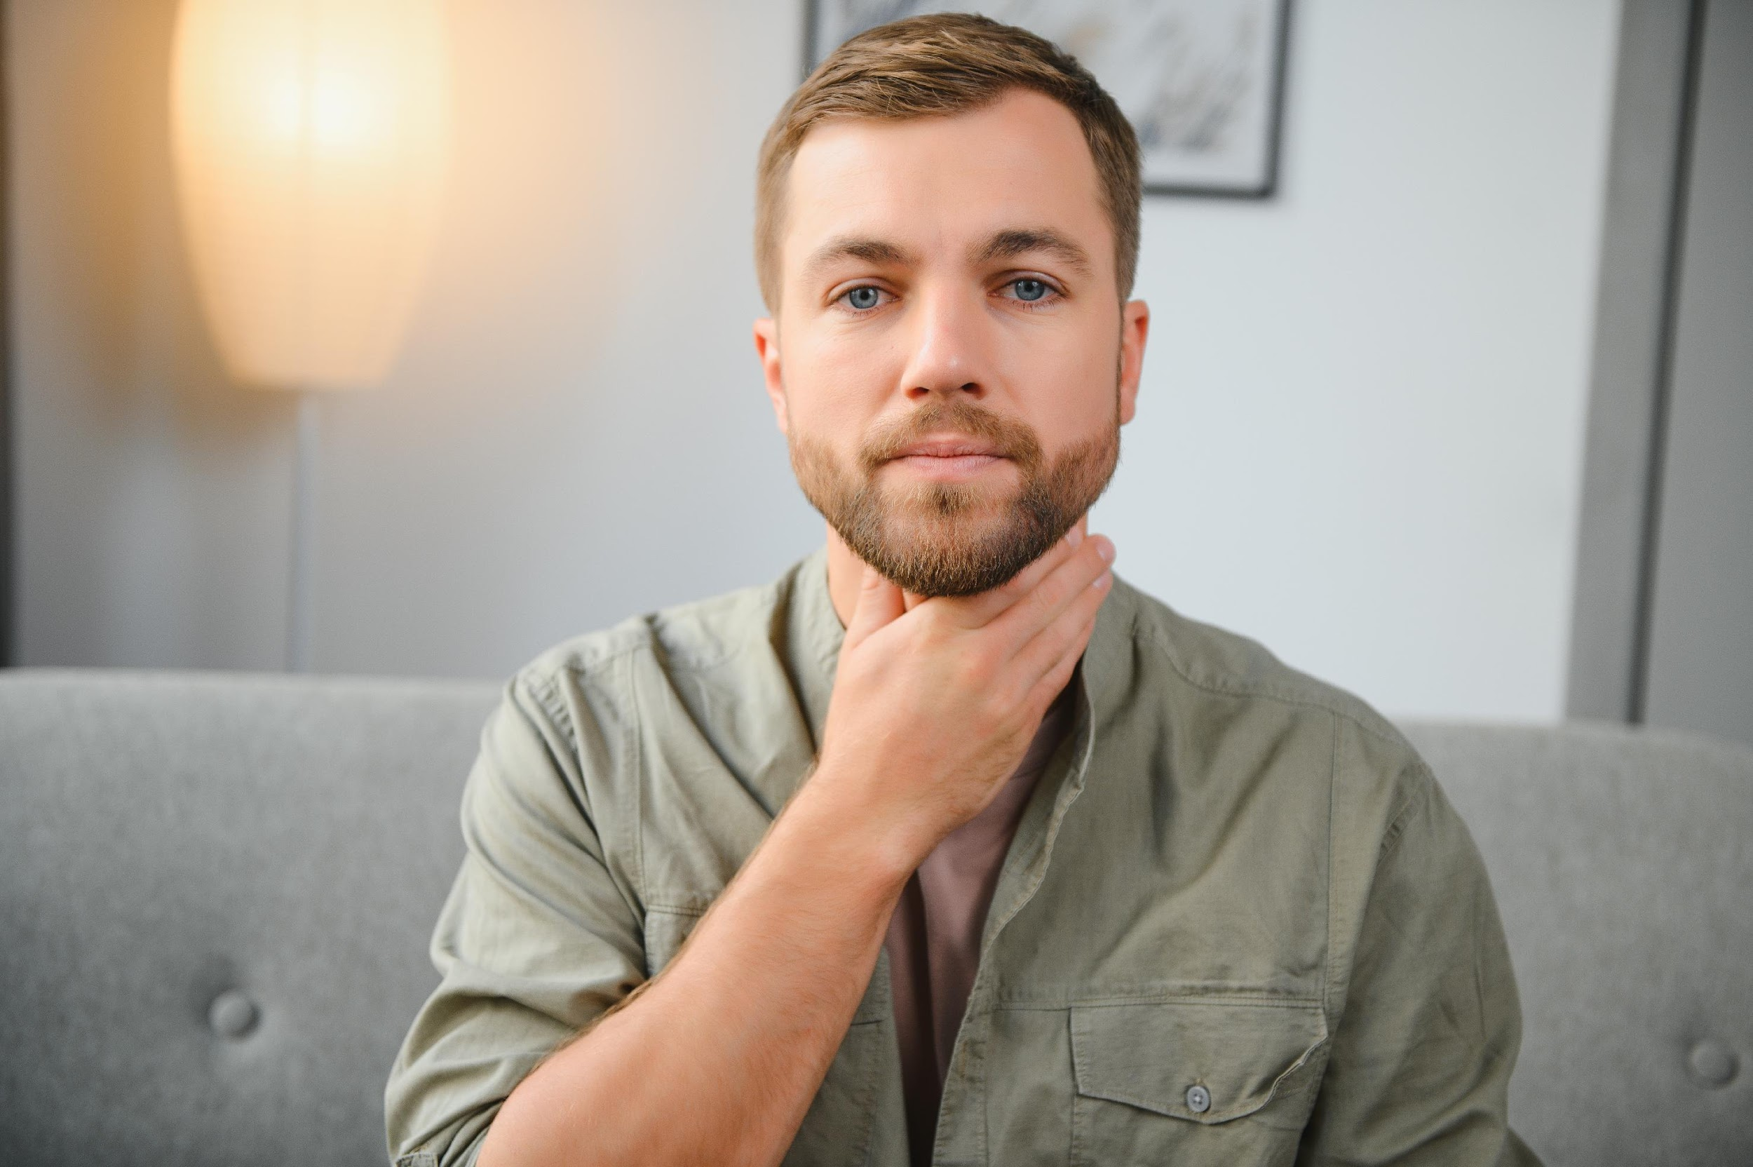


Slide 9


sore throat

Slide 10



Slide 11
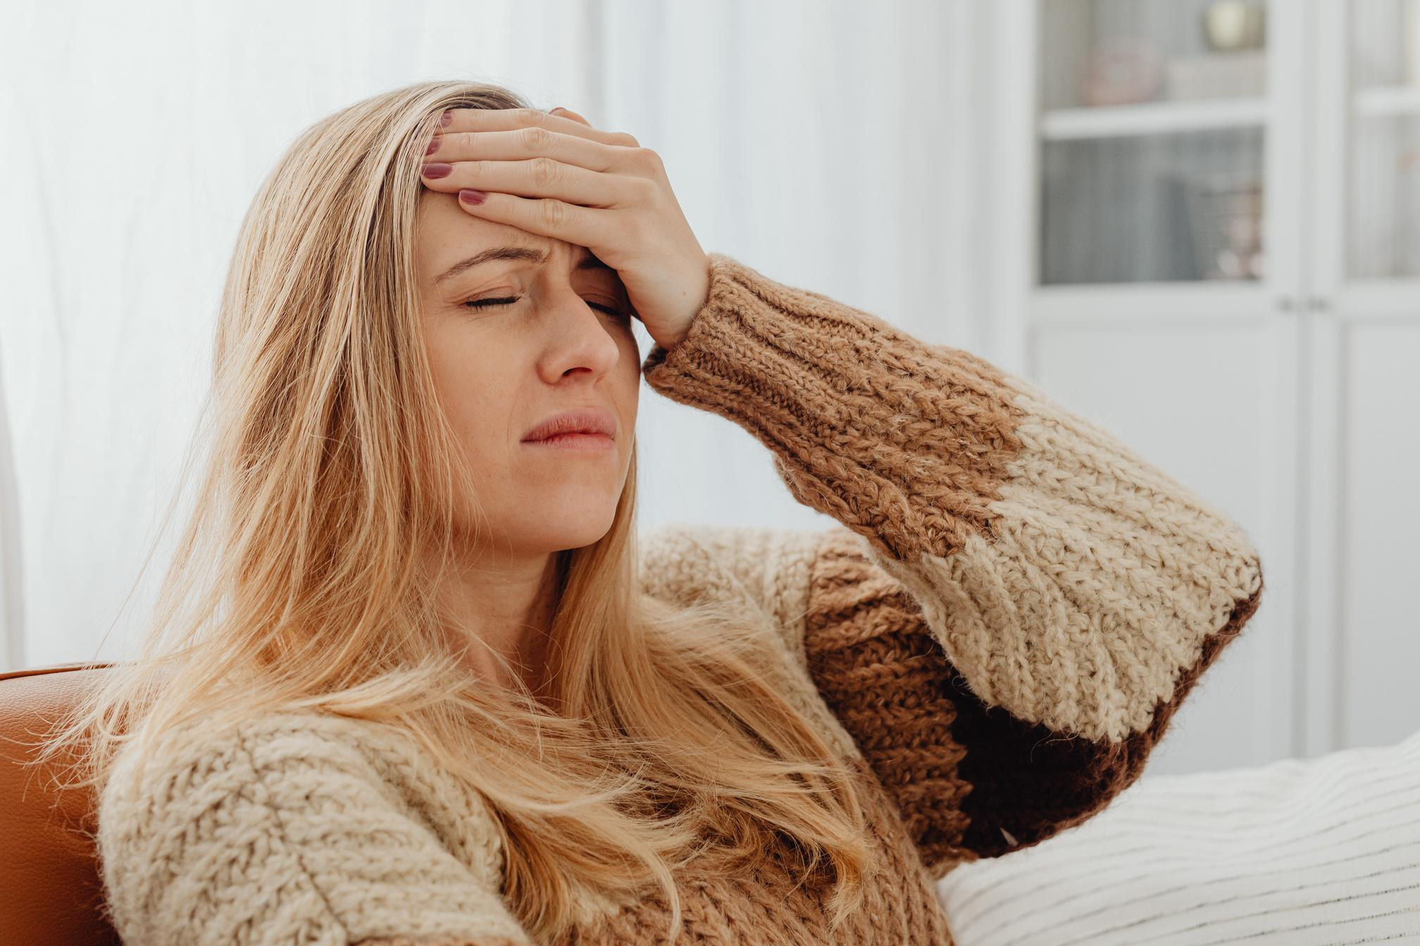
headache

Slide 12

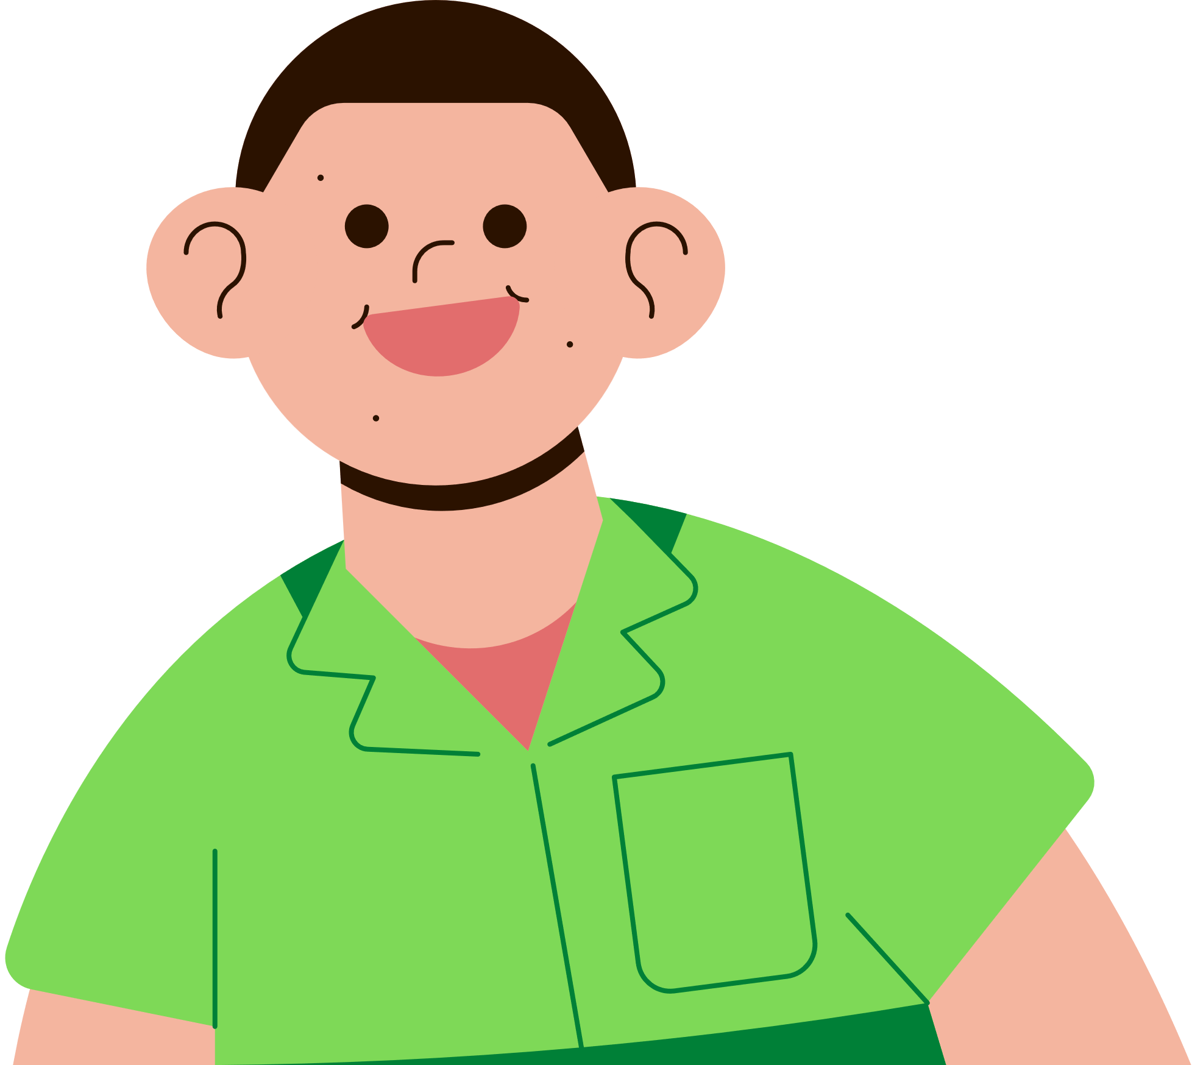

Slide 13

stomachache

Slide 14
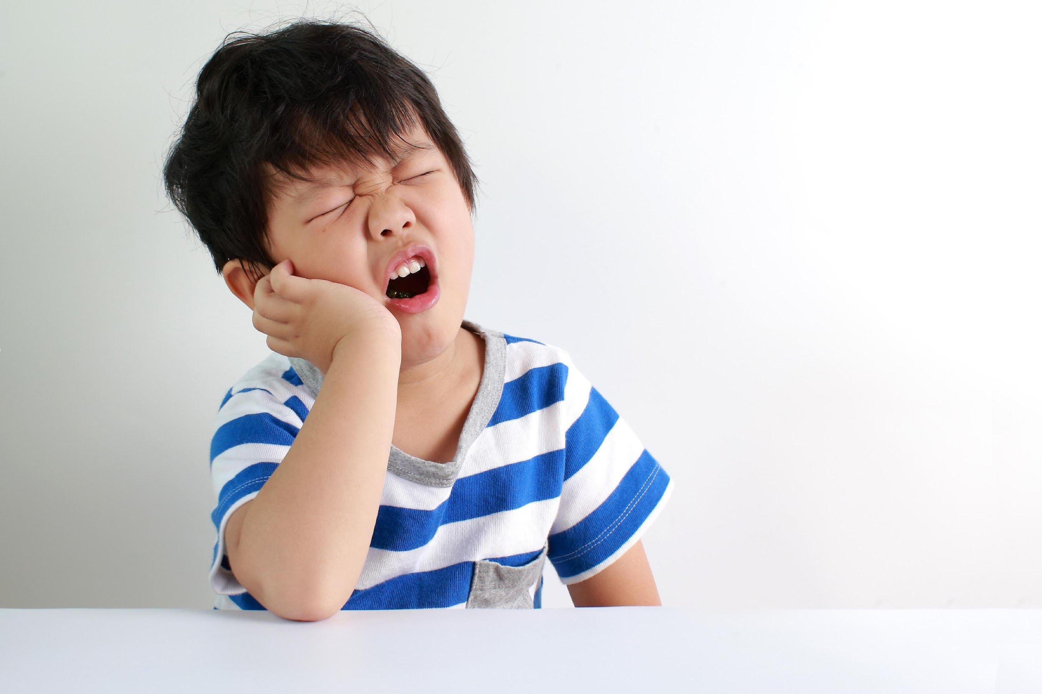

Slide 15
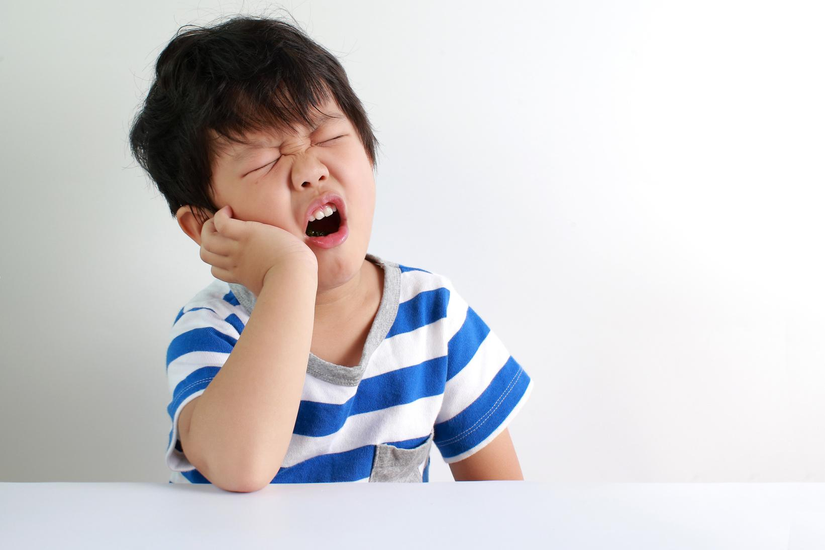
toothache

Slide 16

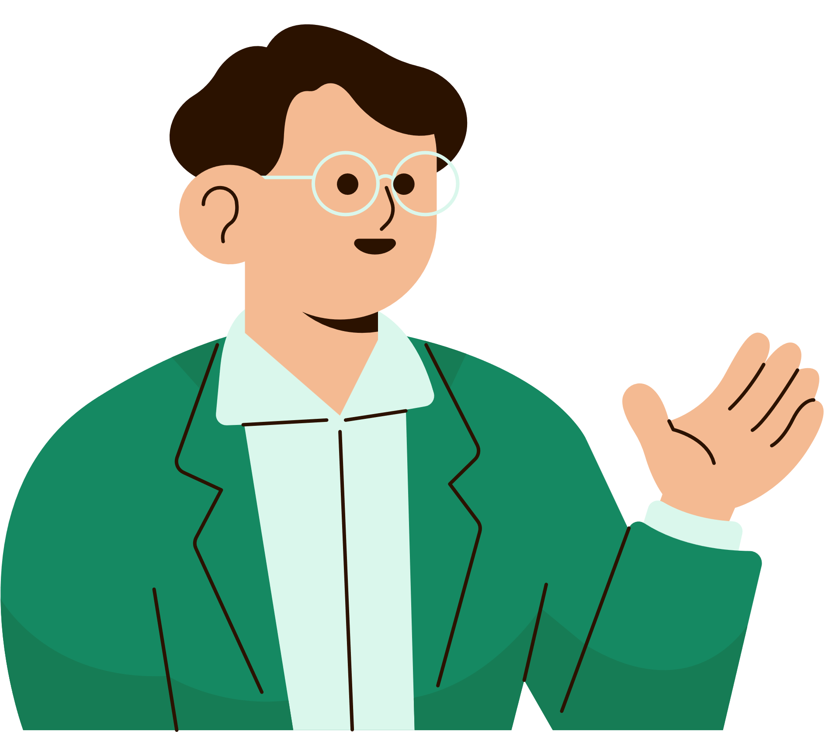
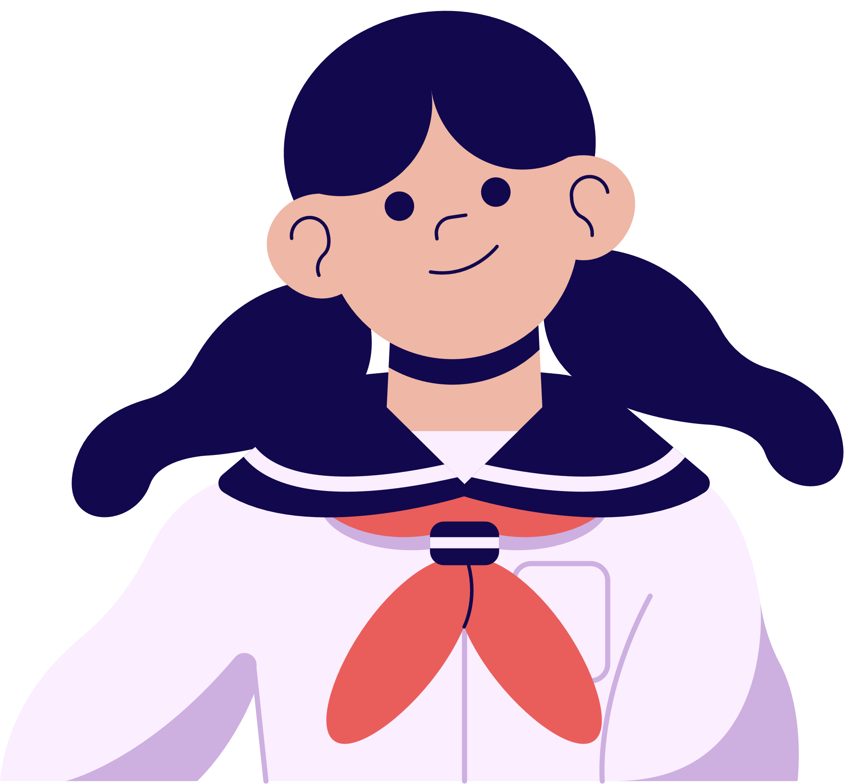
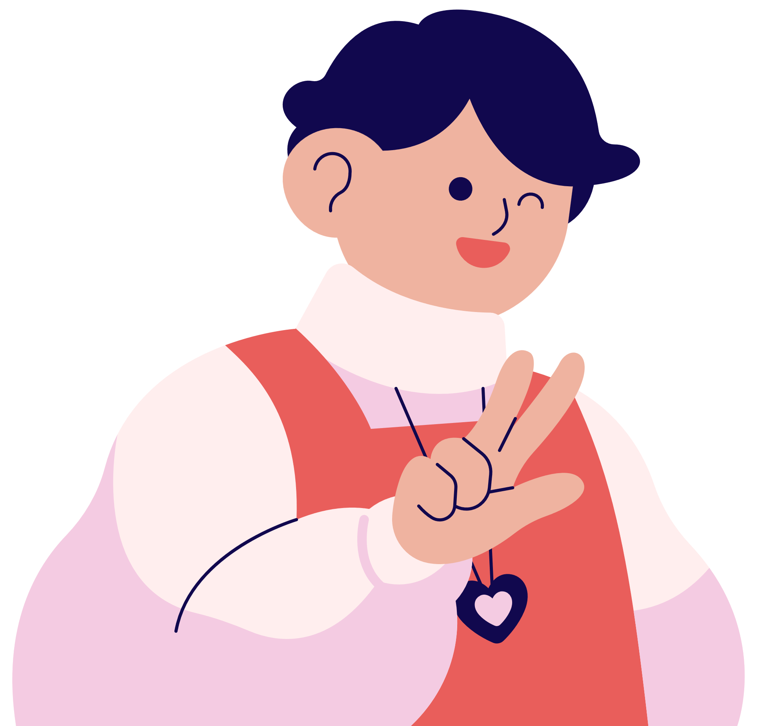
THANK YOU!
SEE YOU NEXT TIME.

Slide 17
02
Activity 1
Listen and repeat.

Slide 18



Listen and point.
ˈ
ˈ
What’s the matter?
Notes:
Step 1: Ask pupils to pay attention to the stress marks on the key words What and matter in the sentence What’s the matter?

Slide 19
Listen and repeat.
ˈ
ˈ
What’s the matter?
Notes:
Have them listen to the recording and repeat the sentence until they feel confident. Correct their pronunciation if necessary.

Slide 20
Listen and point.
ˈ
ˈ
What should I do?
Notes:
Step 2: Repeat the procedure with the second sentence.

Slide 21
Listen and repeat.
ˈ
ˈ
What should I do?
Notes:
Step 2: Repeat the procedure with the second sentence.

Slide 22
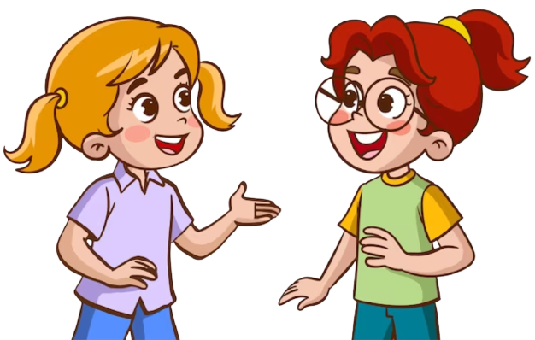
Work in pairs.
ˈ
ˈ
What’s the matter?
ˈ
ˈ
What should I do?
Notes:
Step 3: Give pupils a time limit to practise saying the sentences in pairs or groups. Go round the class and give corrections when necessary. Invite some pupils to say the sentence, give feedback and correction when necessary.

Slide 23





Slide 24
03
Activity 2
Listen, underline and repeat.

Slide 25

Read and guess.
1. How are you feeling today?
Notes:
Step 1: Have pupils read Question 1 and guess the words that can carry sentence stress.

Slide 26
Listen and underline.
ˈ
1. How are you feeling today?
Notes:
Explain that they have to listen to the recording and underline one more stressed word.

Slide 27
Read and guess.
2. What time do you go to bed?
Notes:
Step 2: Do the same with Questions 2 - 4.

Slide 28
Listen and underline.
2. What time do you go to bed?
Notes:
Step 2: Do the same with Questions 2 - 4.

Slide 29
Read and guess.
3. When should I go to the dentist?
Notes:
Step 2: Do the same with Questions 2 - 4.

Slide 30
Listen and underline.
3. When should I go to the dentist?
Notes:
Step 2: Do the same with Questions 2 - 4.

Slide 31
Read and guess.
4. What’s wrong with your teeth?
Notes:
Step 2: Do the same with Questions 2 - 4.

Slide 32
Listen and underline.
4. What’s wrong with your teeth?
Notes:
Step 2: Do the same with Questions 2 - 4.

Slide 33
Practice!!!
1. How are you feeling today?
2. What time do you go to bed?
3. When should I go to the dentist?
4. What’s wrong with your teeth?
Notes:
Step 3: Invite a few pupils to read the sentences in front of the class. Give corrections and feedback where necessary.

Slide 35
04
Activity 3
Let’s chant.

Slide 36
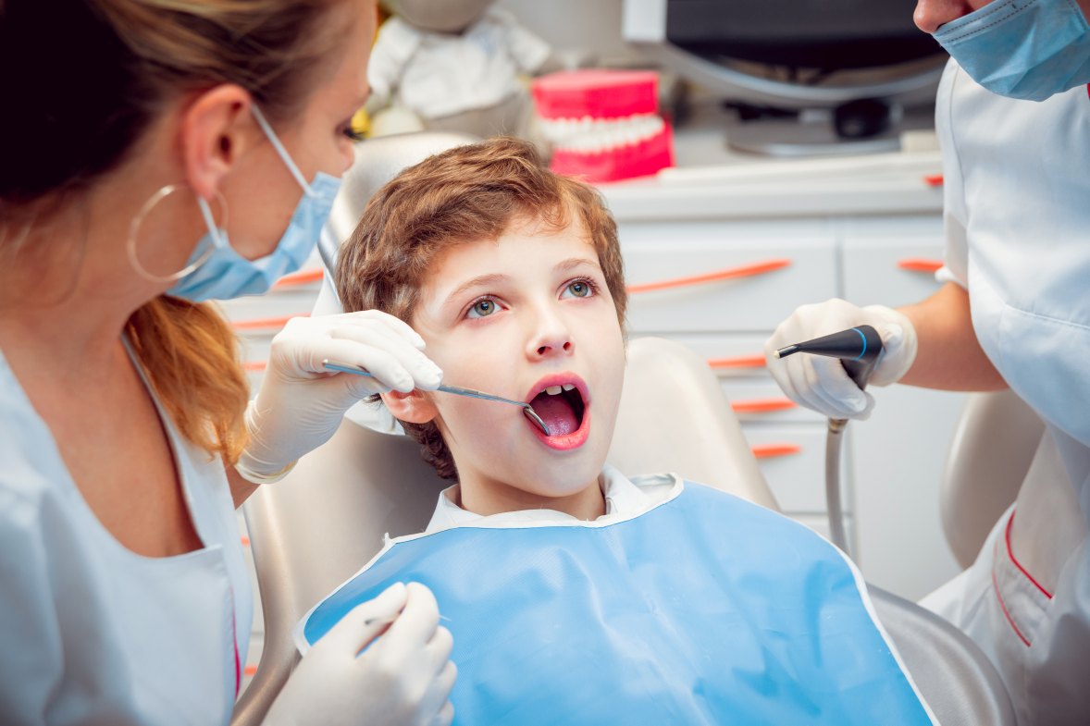
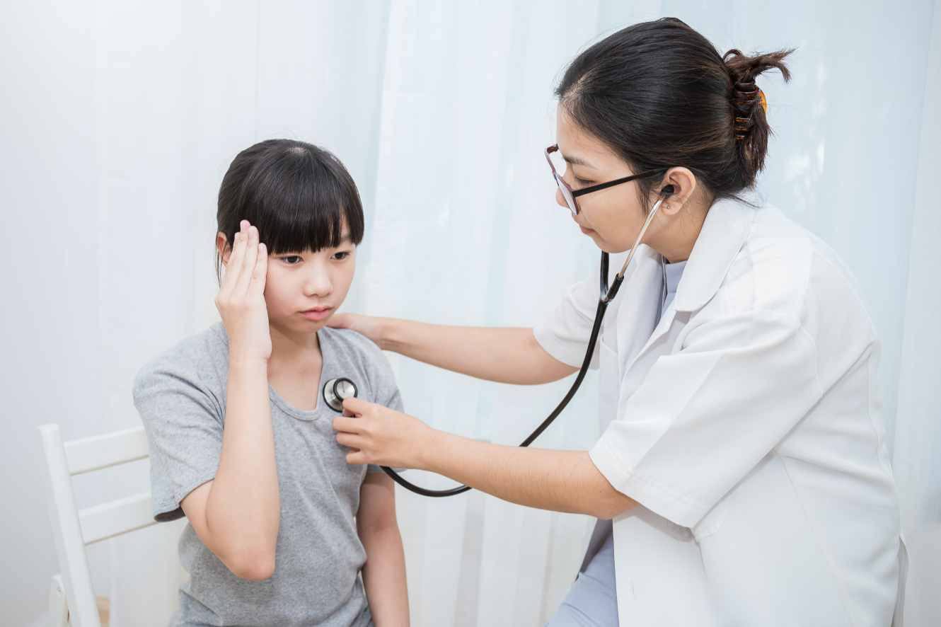

Look and answer.
Notes:
Ask pupils to look at the pictures. They will be the boy and the girl. Then answer the question “What’s the matter?”.

Slide 37
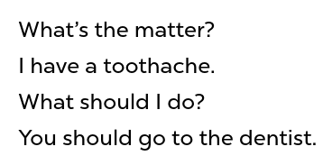
Read and find out key words.
ˈ
ˈ
ˈ
ˈ
ˈ
ˈ
ˈ
ˈ
ˈ
ˈ
ˈ
ˈ
Notes:
Step 1: Have pupils scan the first verse of the chant. Draw their attention to the keywords in each sentence.

Slide 38

Listen and repeat.
ˈ
ˈ
ˈ
ˈ
ˈ
ˈ
ˈ
ˈ
‘
Notes:
Step 2: Play the recording and ask pupils to listen and repeat the first verse, line by line. Show them how to chant and clap their hands.

Slide 39
Listen and chant.
ˈ
ˈ
ˈ
ˈ
ˈ
ˈ
ˈ
ˈ
ˈ
Notes:
Step 3: Play the recording of the whole verse again for pupils to do choral and individual repetition. Give corrections and feedback where necessary.

Slide 40
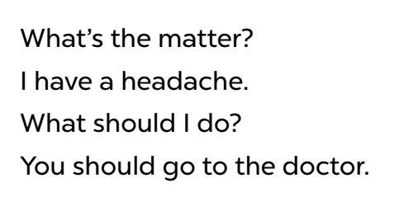
Read and find out key words.
ˈ
ˈ
ˈ
ˈ
ˈ
ˈ
ˈ
ˈ
ˈ
Notes:
Step 4: Repeat Steps 1 to 3 for the second verse of the chant. Draw pupils’ attention to the keywords in each sentence.

Slide 41
Listen and repeat.
ˈ
ˈ
ˈ
ˈ
ˈ
ˈ
ˈ
ˈ
Notes:
Step 4: Repeat Steps 1 to 3 for the second verse of the chant. Draw pupils’ attention to the keywords in each sentence.

Slide 42
Listen and chant.
ˈ
ˈ
ˈ
ˈ
ˈ
ˈ
ˈ
ˈ
ˈ
Notes:
Step 4: Repeat Steps 1 to 3 for the second verse of the chant. Draw pupils’ attention to the keywords in each sentence.

Slide 44
05
Fun corner and Wrap-up

Slide 45


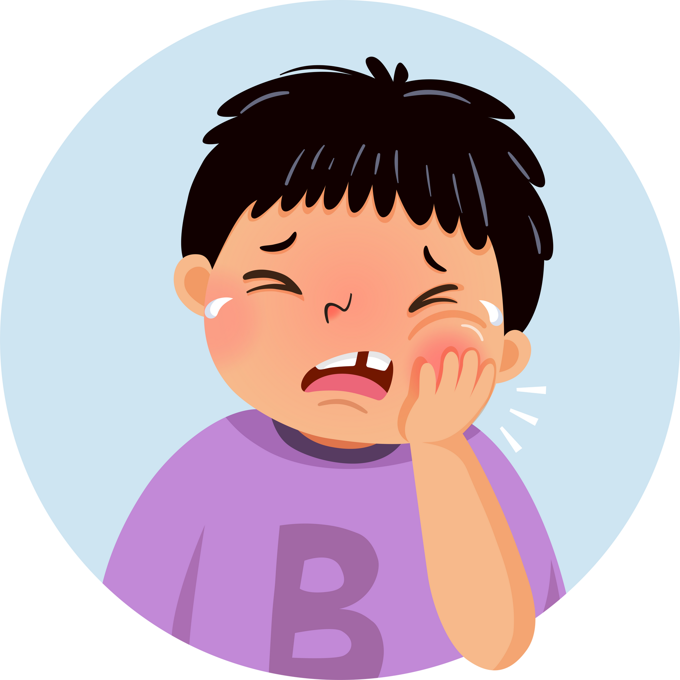
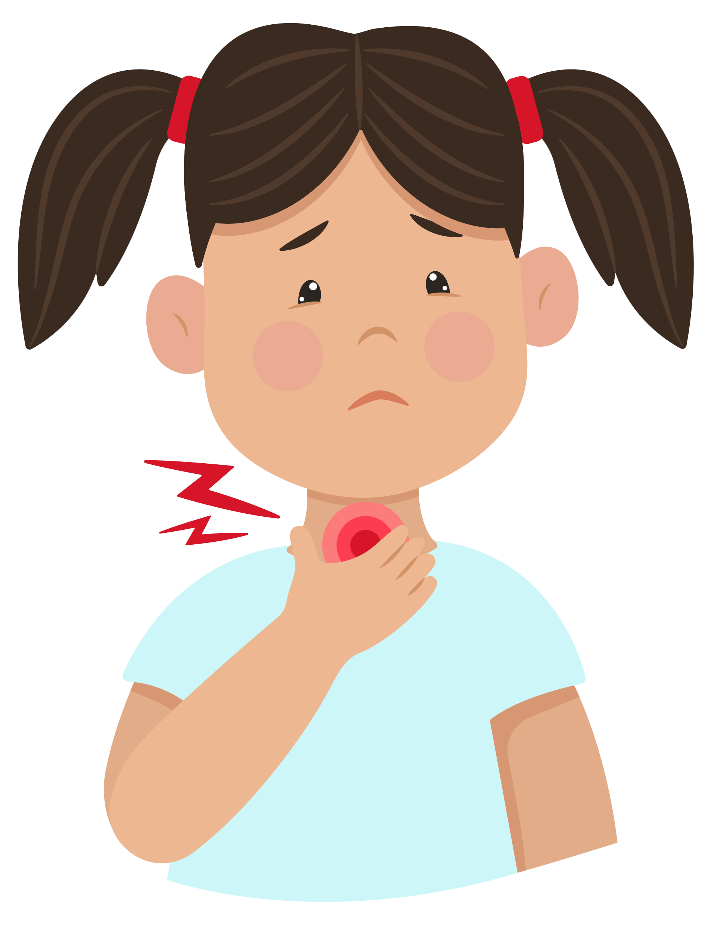
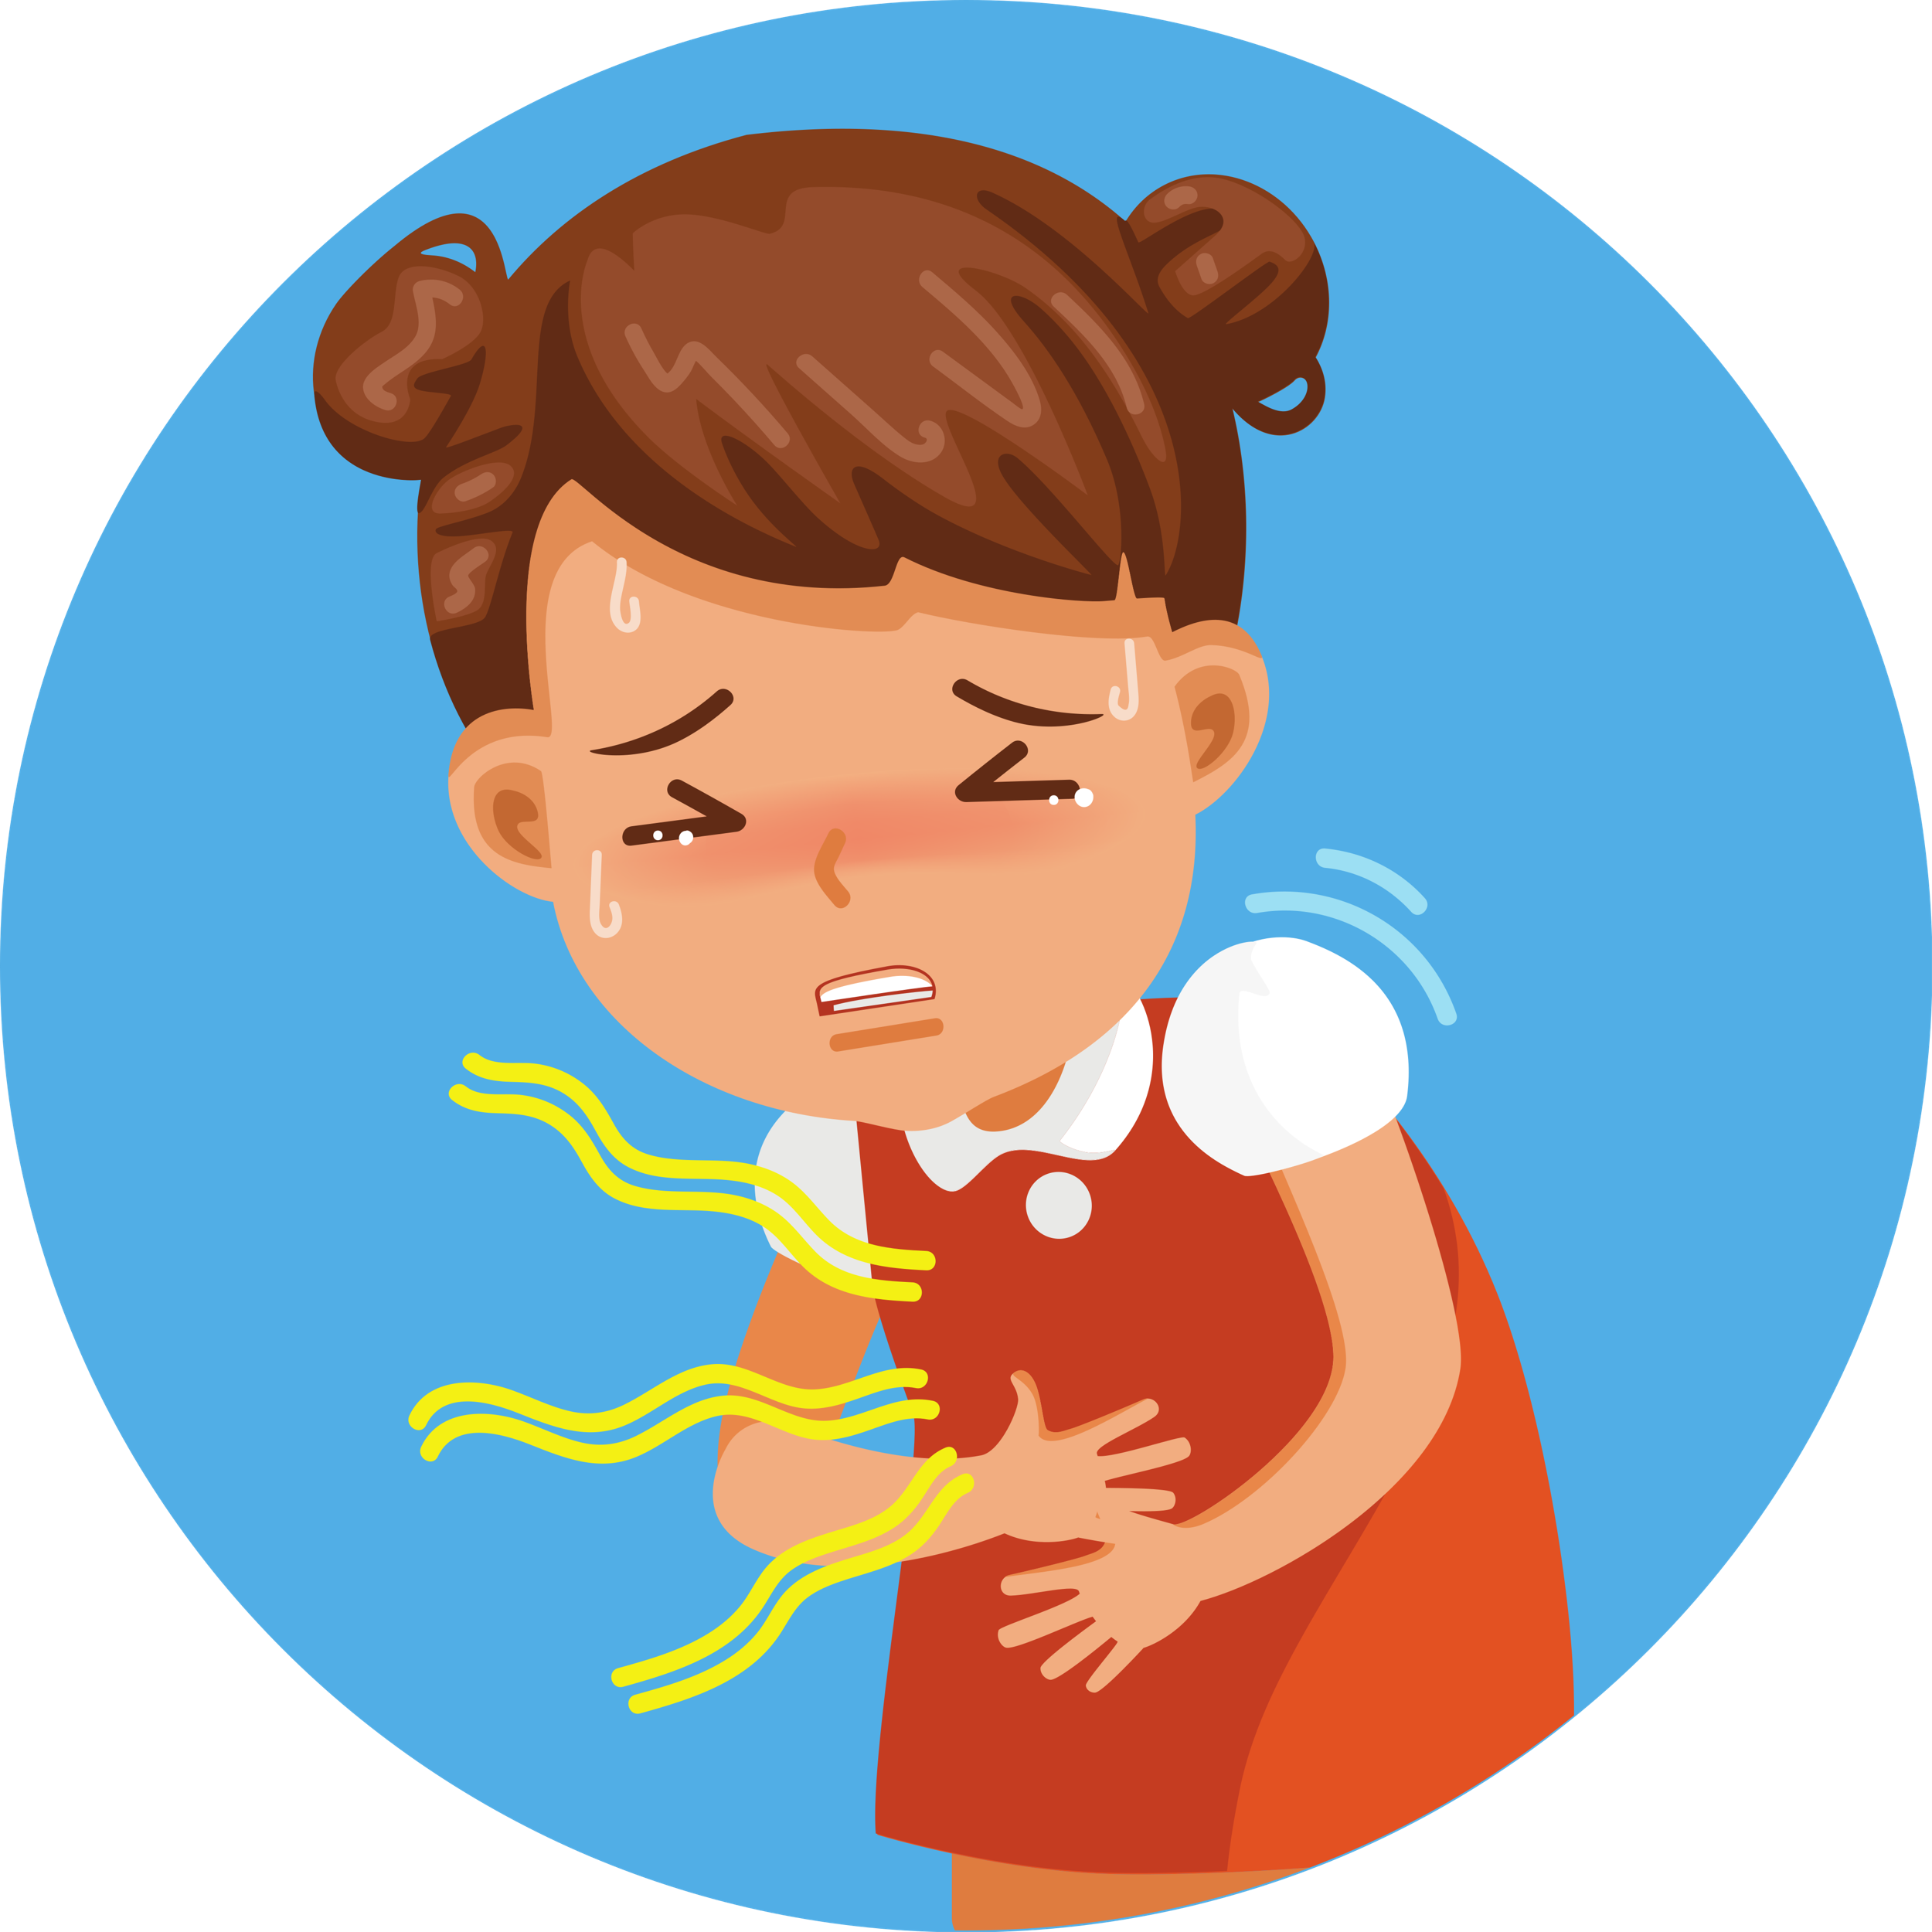
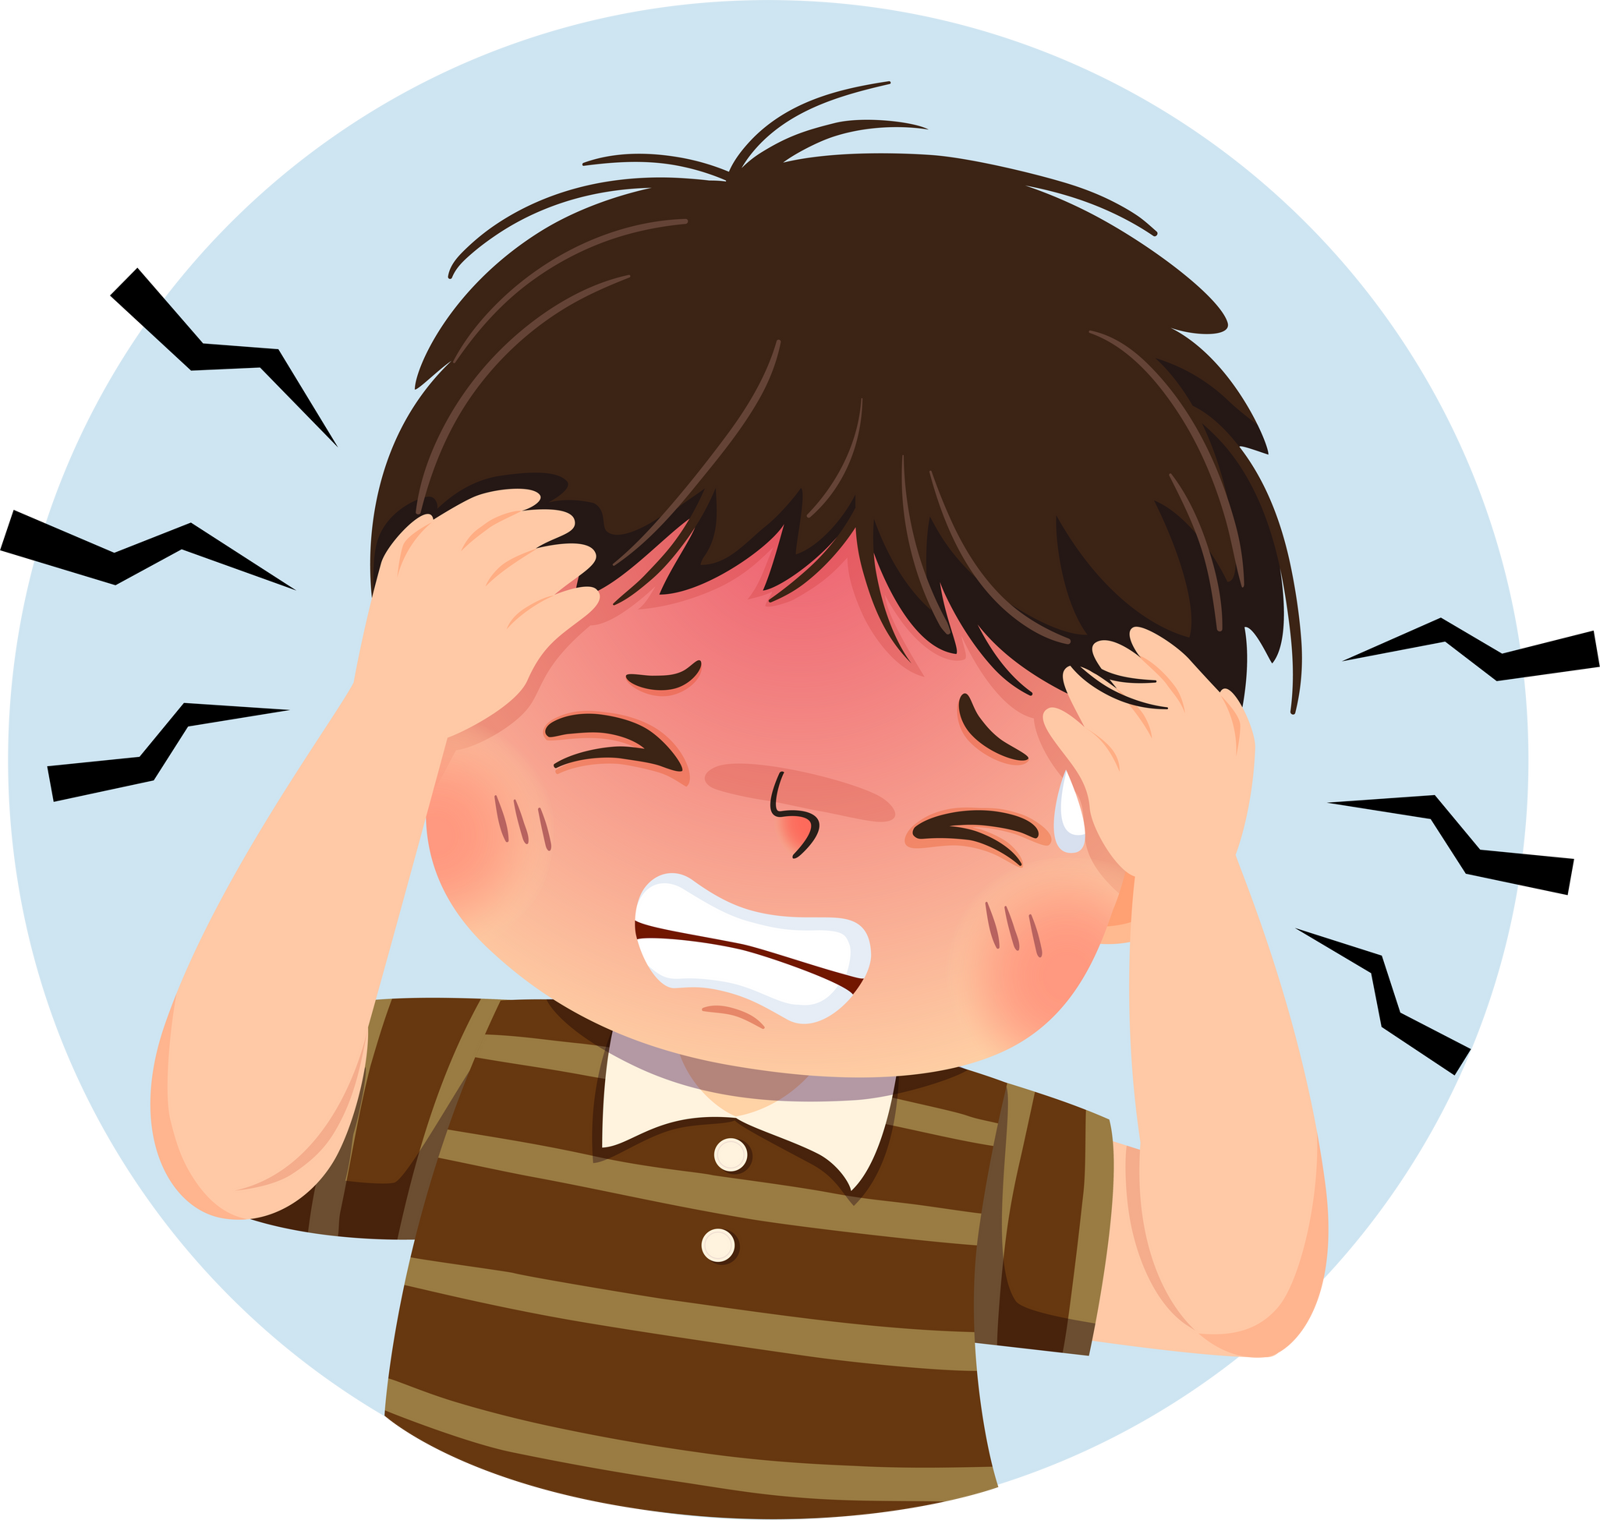
Game: Musical Cards
Notes:
Stick the cards on the board. Ask pupils to say the words related to the cards (toothache, sore throat, headache, stomach ache).
Hand out the cards to different pupils around the class.
Play the song “What’s the matter?” (Track 50). Ask pupils to pass the cards to the pupils next to them while the music is playing.
Stop the music suddenly. Invite a few pupils to ask the questions “What’s the matter?”. Ask pupils who are holding the card to answer the questions, e.g. I have a toothache.
Play the music again and repeat the activity.
Ask pupils to check their friends’ pronunciation.

