Slide 1




UBND QUẬN DƯƠNG KINH
TRƯỜNG TIỂU HỌC ANH DŨNG
ENGLISH - GRADE 5
UNIT 18: MEANS OF TRANSPORT
LESSON 3 (4, 5, 6)

Slide 2

Unit 18 Means of transport
Lesson 3 – Period 6

Slide 3
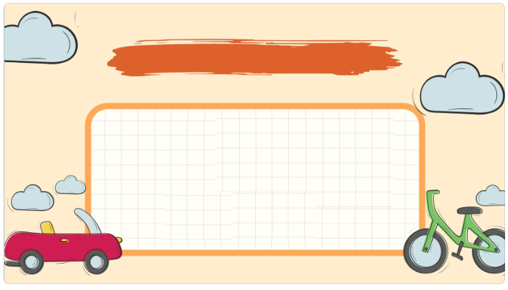
01
Warm-up and Review

Slide 4


Slide 5

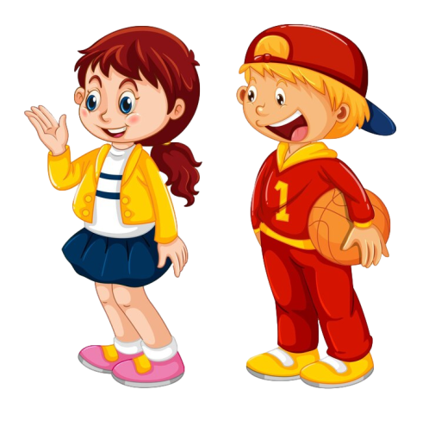

You can get there ____.
Tic-Tac-Toe
I want to visit ___.
museum | bus | pagoda
lake | bridge | taxi
bicycle | foot | aquarium

Slide 6
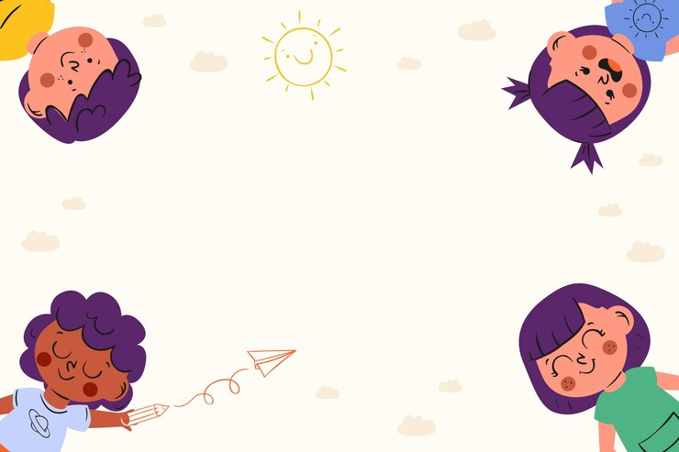



Slide 7
02
Read and answer.

Slide 8
Read and answer.
Hi Linh,
Welcome to Sydney! Tomorrow, we can take a hop-on hop-off bus to explore the city centre in a day. Firstly, we will see Sydney Harbour Bridge and Sydney Opera House. Next, we can go to Sea Life Sydney Aquarium by train. Also, we can get to Circular Quay on foot from my house and then go to Taronga Zoo by ferry. It is home to over 4,000 animals. Then, we can go back to Circular Quay to watch a beautiful sunset.
See you soon,
Mary
1. What sights will they see by taking a hop-on hop-off bus?
2. How can they get to Sea Life Sydney Aquarium?
3. How can they get to Circular Quay?
4. How many animals are there at Taronga Zoo?

Slide 9
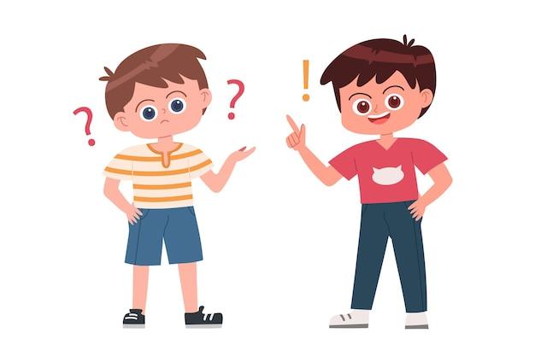
Hi Linh,
Welcome to Sydney! Tomorrow, we can take a hop-on hop-off bus to explore the city centre in a day. Firstly, we will see Sydney Harbour Bridge and Sydney Opera House. Next, we can go to Sea Life Sydney Aquarium by train. Also, we can get to Circular Quay on foot from my house and then go to Taronga Zoo by ferry. It is home to over 4,000 animals. Then, we can go back to Circular Quay to watch a beautiful sunset.
See you soon,
Mary
What sights will they see by taking a hop-on hop-off bus?
Sydney Harbour Bridge and Sydney Opera House.

Slide 10
Hi Linh,
Welcome to Sydney! Tomorrow, we can take a hop-on hop-off bus to explore the city centre in a day. Firstly, we will see Sydney Harbour Bridge and Sydney Opera House. Next, we can go to Sea Life Sydney Aquarium by train. Also, we can get to Circular Quay on foot from my house and then go to Taronga Zoo by ferry. It is home to over 4,000 animals. Then, we can go back to Circular Quay to watch a beautiful sunset.
See you soon,
Mary
How can they
get to Sea Life Sydney Aquarium?
By train
__________.

Slide 11
Hi Linh,
Welcome to Sydney! Tomorrow, we can take a hop-on hop-off bus to explore the city centre in a day. Firstly, we will see Sydney Harbour Bridge and Sydney Opera House. Next, we can go to Sea Life Sydney Aquarium by train. Also, we can get to Circular Quay on foot from my house and then go to Taronga Zoo by ferry. It is home to over 4,000 animals. Then, we can go back to Circular Quay to watch a beautiful sunset.
See you soon,
Mary
How can they get to Circular Quay?
On foot
__________.

Slide 12
Hi Linh,
Welcome to Sydney! Tomorrow, we can take a hop-on hop-off bus to explore the city centre in a day. Firstly, we will see Sydney Harbour Bridge and Sydney Opera House. Next, we can go to Sea Life Sydney Aquarium by train. Also, we can get to Circular Quay on foot from my house and then go to Taronga Zoo by ferry. It is home to over 4,000 animals. Then, we can go back to Circular Quay to watch a beautiful sunset.
See you soon,
Mary
How many animals are there at Taronga Zoo?
4,000
______.

Slide 13
03
Let’s write.

Slide 14
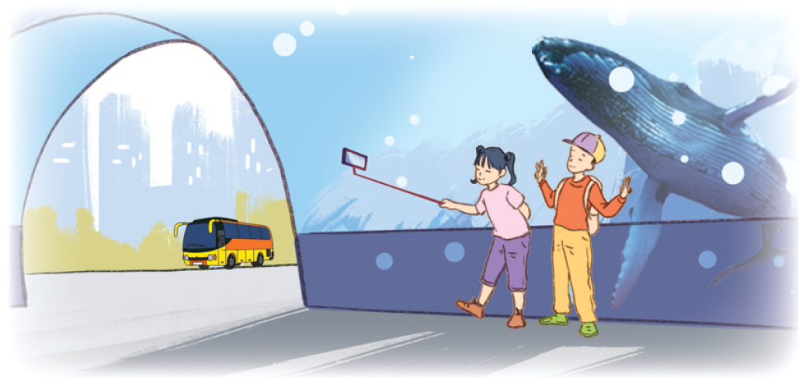
Let’s write.
Write about a morning trip. (about 40 words)
Today is Sunday. We want to visit _______. We will get there by__________ ___________________________________________________________.

Slide 15
Let’s write.
Suggested answer:
Today is Sunday. We want to visit the aquarium in the city. We will get there by bus. We will take photos with the shark in the tank. Also, we want to learn more about the sharks and other fish.

Slide 16
Let’s write.
Write about a morning trip. (about 40 words)
Today is Sunday. We want to visit _________. We will get there by _______ ______________________________________________.

Slide 17

Let’s write.

Slide 18
04
Project

Slide 19
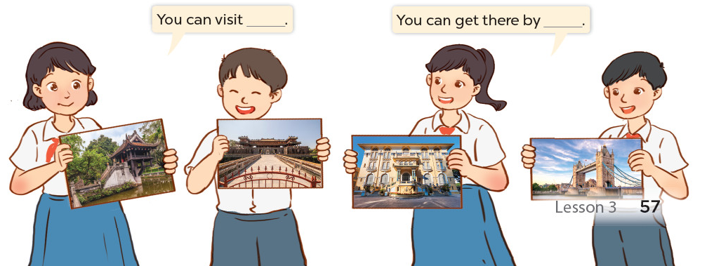
Project
Means of transport
You can visit ___.
You can get there by ___.

