Slide 1




UBND QUẬN DƯƠNG KINH
TRƯỜNG TIỂU HỌC ANH DŨNG
ENGLISH - GRADE 5
UNIT 19: PLACES OF INTEREST
LESSON 2 (1, 2, 3)

Slide 2













UNIT 19
Places of interest
Lesson 2- Period 3

Slide 3







01
Warm-up and Review
Let’s sing.

Slide 4



Let’s sing.
What do you think of ...?
What do you think of Ba Na Hills?
I think it’s fantastic.
I think it’s exciting.
Ba Na Hills is fantastic and exciting.
What do you think of Dau Go Cave?
I think it’s peaceful.
I think it’s beautiful.
Dau Go Cave is peaceful and beautiful.

Slide 5
02
Look, listen and repeat.

Slide 6
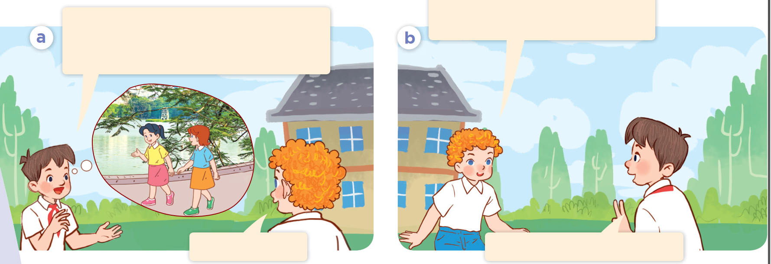
Where are they going to?
Who are they?

Slide 7

Look, listen and repeat.
How far is it from our school to Ho Guom Walking Streets?
We’re going to Ho Guom Walking Streets this weekend. Do you want to come with us?
Add text
Add text
Add text
Click here to add content, content to match the title.
Click here to add content, content to match the title.
Click here to add content, content to match the title.
Yes, I’d love to.
It’s about two kilometres.

Slide 8
03
Listen, point and say.

Slide 9
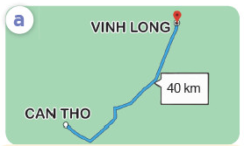
a
VINH LONG
40 km
CAN THO
Can Tho – Vinh Long

Slide 10
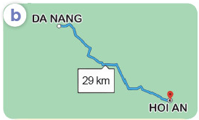
b
DA NANG
29 km
HOI AN
Da Nang – Hoi An

Slide 11
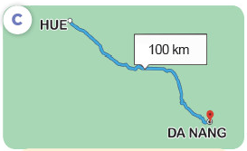
c
HUE
100 km
DA NANG
Hue - Da Nang

Slide 12
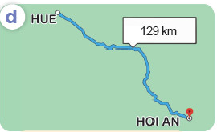
d
HUE
129 km
HOI AN
Hue – Hoi An

Slide 13

How far is it from __ to __?
It’s about __ kilometres.

Slide 14


How far is it from Can Tho to Vinh Long?
a
VINH LONG
40 km
CAN THO
It’s about 40 kilometres.

Slide 15
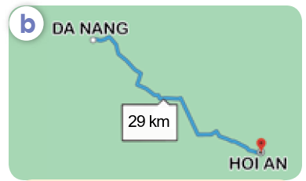
How far is it from Da Nang to Hoi An?
b
DA NANG
29 km
HOI AN
It’s about 29 kilometres.

Slide 16

How far is it from Hue to Da Nang?
c
HUE
100 km
DA NANG
It’s about 100 kilometres.

Slide 17
How far is it from Hue to Hoi An?
d
HUE
129 km
HOI AN
It’s about 129 kilometres.

Slide 18
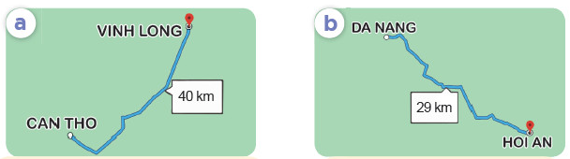
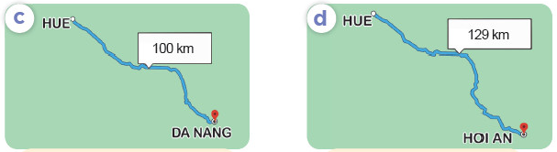
Act it out.
DA NANG
VINH LONG
How far is it
from __ to __?
CAN THO
HOI AN
Can Tho – Vinh Long / 40
Da Nang – Hoi An / 29
It’s about __ kilometres.
HUE
HUE
DA NANG
HOI AN
Hue – Da Nang / 100
Hue – Hoi An / 129

Slide 19
04
Let’s talk.

Slide 20
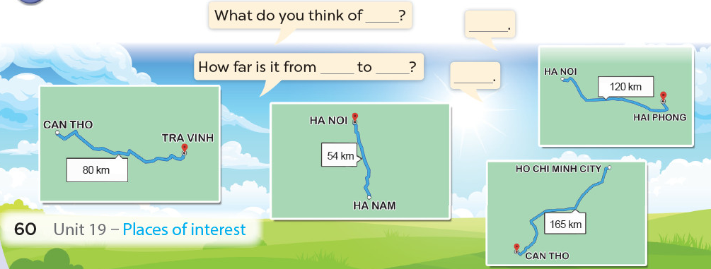
Act it out.
What do you think of ___?
___.
How far is it from ___ to ___?
___.
HA NOI
120 km
CAN THO
HA NOI
HAI PHONG
TRA VINH
54 km
80 km
HO CHI MINH CITY
HA NAM
165 km
CAN THO

Slide 21
05
Fun corner and Wrap-up
Madagascar game

Slide 22
Rule:
Work in 2 teams (Boys and Girls).
Answer the questions.
Pick a crate to get points.

Slide 23
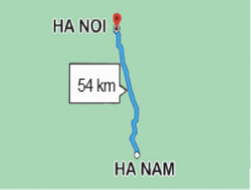
How far is it from Ha Noi to Ha Nam?
HA NOI
54 km
HA NAM
It’s about 54 kilometres.

Slide 24



Pick a crate!

Slide 25

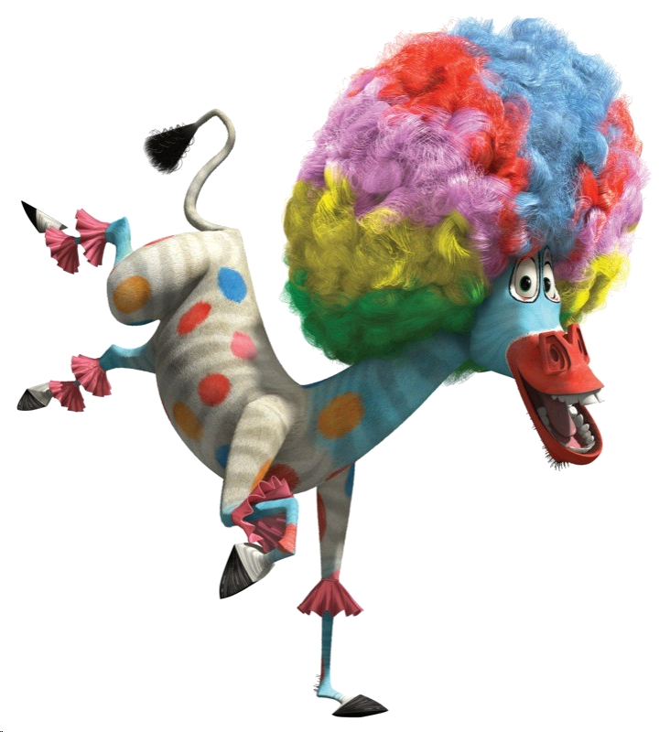

Add 5 points!

Slide 26


Steal 3 points!

Slide 27


Everyone loses 2 points!

Slide 28
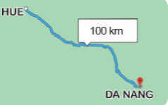
How far is it from Hue to Da Nang?
HUE
100 km
DA NANG
It’s about 100 kilometres.

Slide 29
Pick a crate!

Slide 30

Lose 1 point!

Slide 31






Add 5 points!

Slide 32
Steal 3 points!

Slide 33
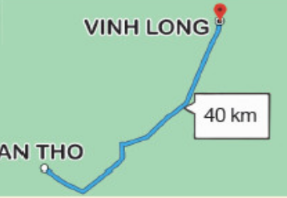
How far is it from Vinh Long to Can Tho?
VINH LONG
40 km
CAN THO
It’s about 40 kilometres.

Slide 34
Pick a crate!

Slide 35
Lose 3 points!

Slide 36
Add 2 points!

Slide 37
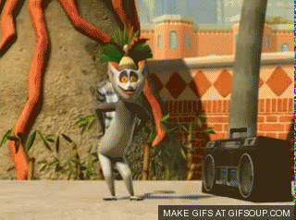
5 points
You like to move it!

Slide 38
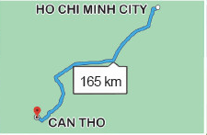
How far is it from Ho Chi Minh City to Can Tho?
HO CHI MINH CITY
165 km
CAN THO
It’s about 165 kilometres.

Slide 39
Pick a crate!

Slide 40
You like to move it!
10 points

Slide 41
Add 6 points!

Slide 42

Steal 3 points!

Slide 43
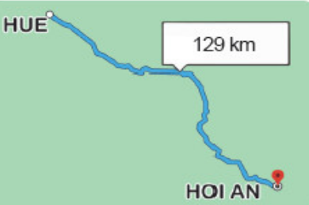
How far is it from Hue to Hoi An?
HUE
129 km
HOI AN
It’s about 129 kilometres.

Slide 44
Pick a crate!

Slide 45
Lose 1 point!

Slide 46
Steal 2 points!

Slide 47
Add 4 points!

