Slide 1




UBND QUẬN DƯƠNG KINH
TRƯỜNG TIỂU HỌC ANH DŨNG
ENGLISH - GRADE 5
UNIT 20: OUR SUMMER HOLIDAYS
LESSON 1 (1, 2, 3)

Slide 2







Our Summer Holidays
Lesson 1 - Period 1

Slide 3
01
Warm-up and Review
Let's play!

Slide 4

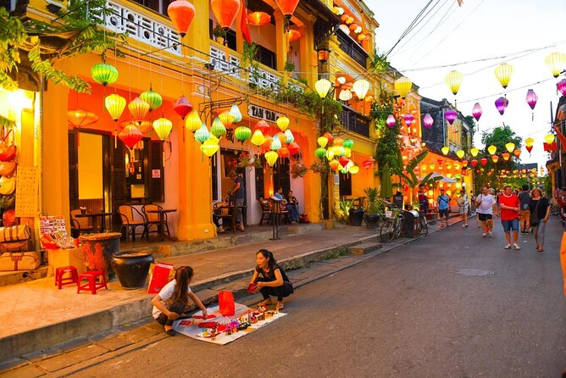
Guess the place
Hoi An Old Town
SHOW

Slide 5
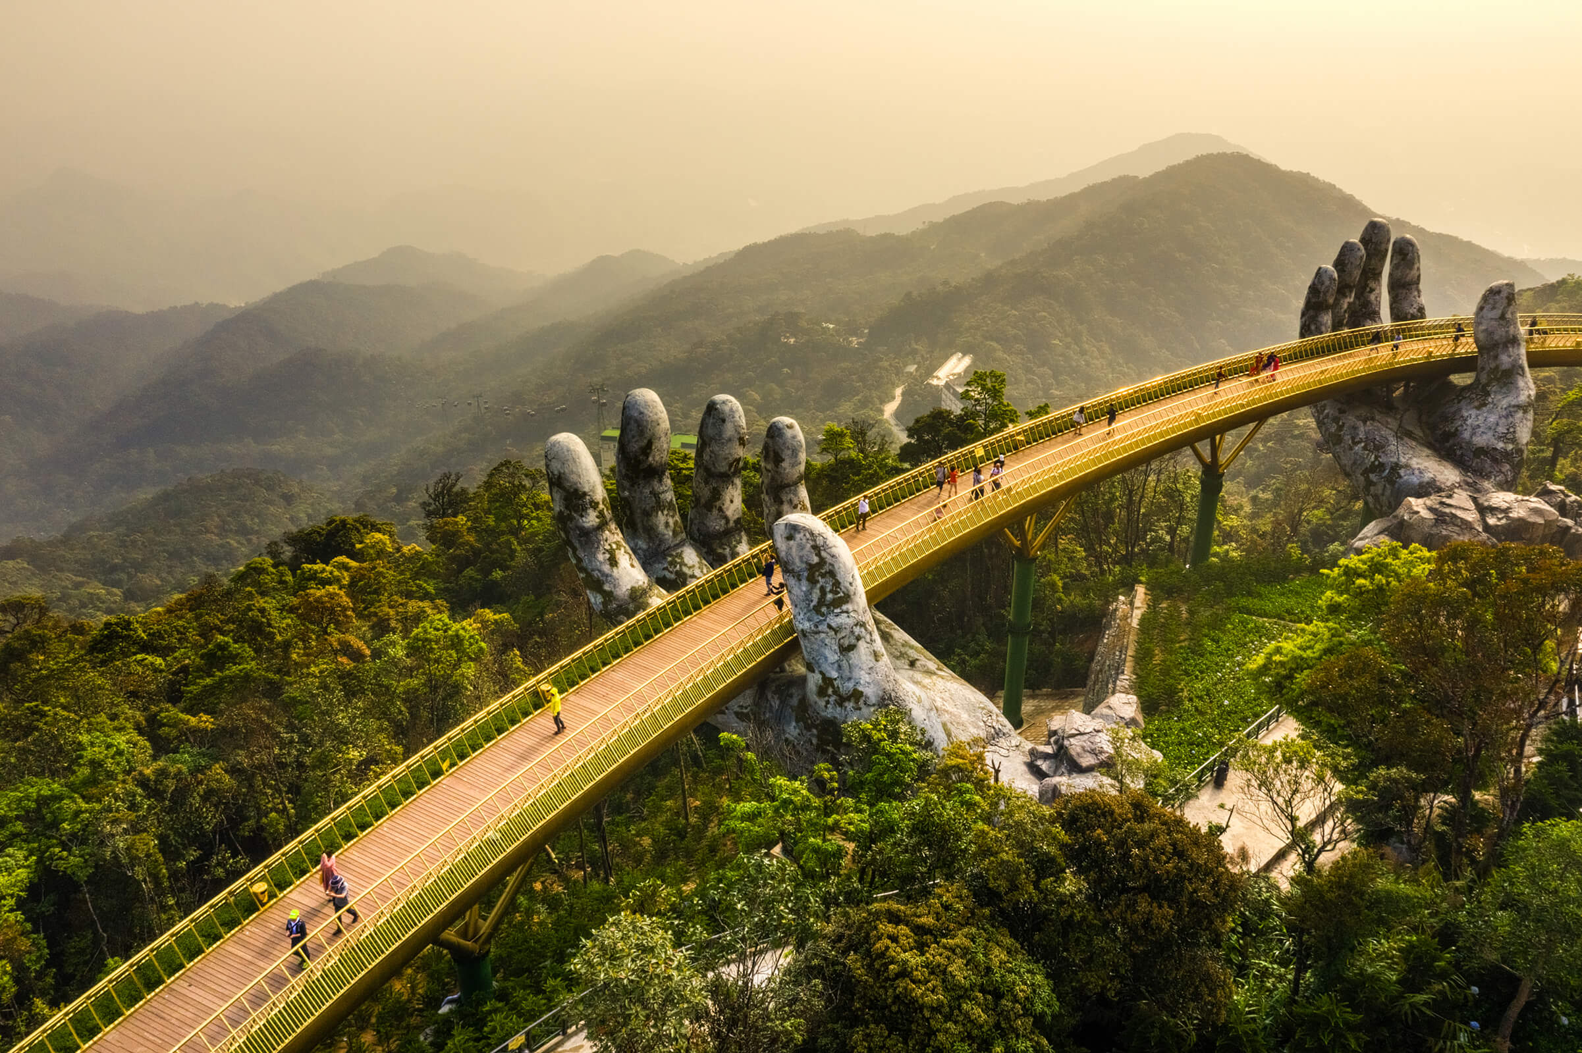
Guess the place
SHOW
Ba Na HillS

Slide 6
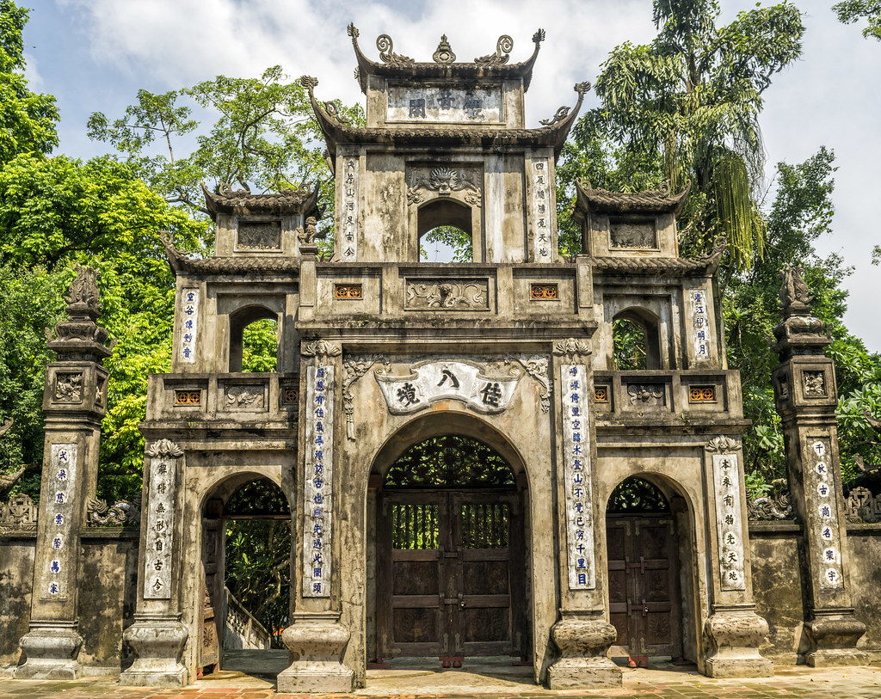
Guess the place
Huong Pagoda
SHOW

Slide 7
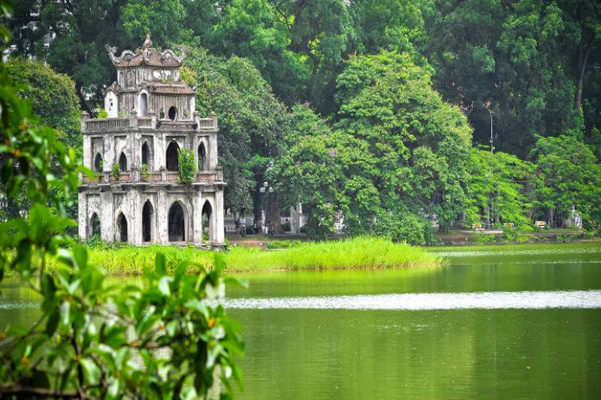
Guess the place
Hoam Kiem Lake
SHOW

Slide 8
02
Look, listen and repeat.

Slide 9

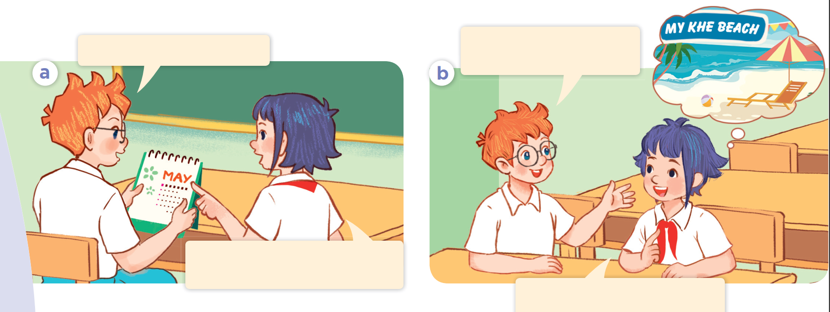
Look at the picture. Who are they?
What are they talking about?

Slide 10
Where are you going
to visit this summer?
Summer’s almost here!
Yes! Our summer holidays start next week.
I’m going to visit My Khe
Beach in Da Nang City.

Slide 11
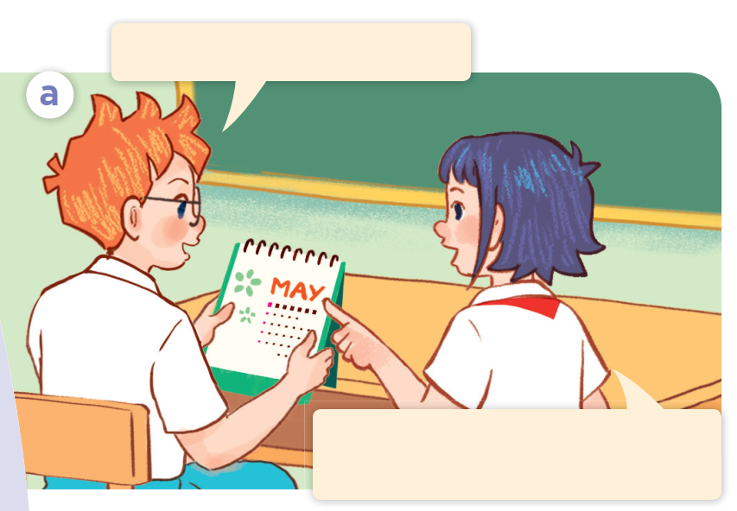
Look, listen and repeat.
Summer’s almost here!
Yes! Our summer holidays start next week.

Slide 12
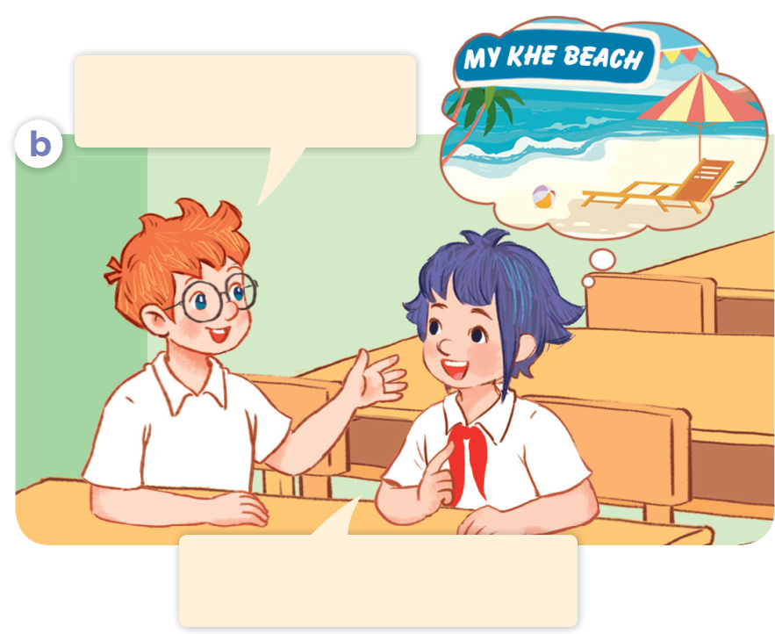
Look, listen and repeat
Where are you going
to visit this summer?
Where are you going
to visit this summer?
I’m going to visit My Khe
Beach in Da Nang City.

Slide 13


Where are you going
to visit this summer?
I’m going to visit My Khe
Beach in Da Nang City.

Slide 14
Act it out.
Where are you going
to visit this summer?
Summer’s almost here!
Yes! Our summer holidays start next week.
I’m going to visit My Khe
Beach in Da Nang City.

Slide 15
03
Listen, point and say.

Slide 16
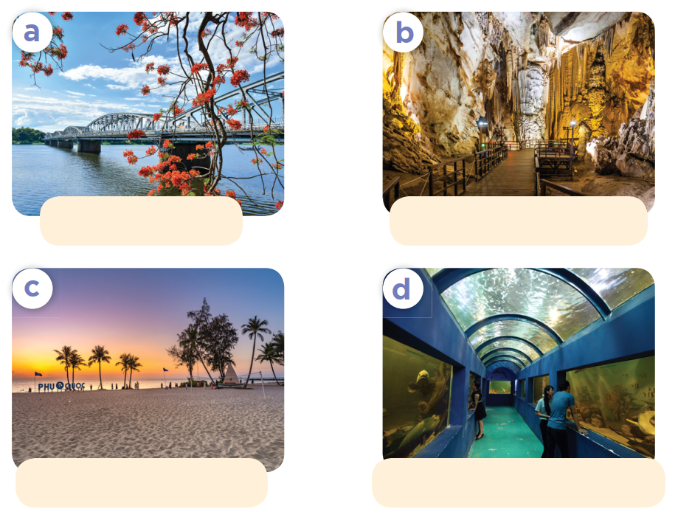
Look at the pictures. Listen and repeat.
Huong River
Phong Nha Cave
Phu Quoc Island
Dam Sen Aquarium

Slide 17

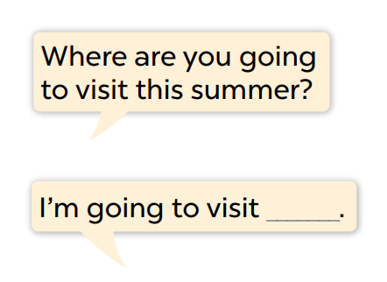
Look and read the question and answer.
Where are you going
to visit this summer?
Huong River
Phong Nha Cave
I’m going to visit ___.
Phu Quoc Island
Dam Sen Aquarium

Slide 18
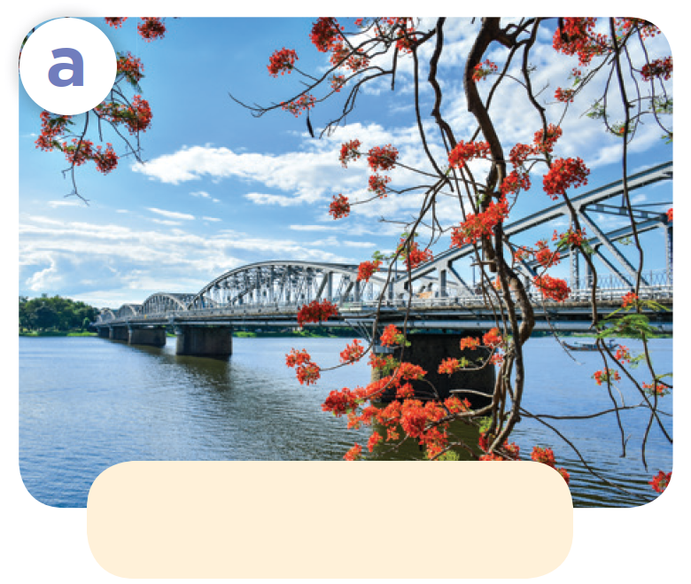
Where are you going to visit this summer?
Huong River
I’m going to visit Huong River.

Slide 19
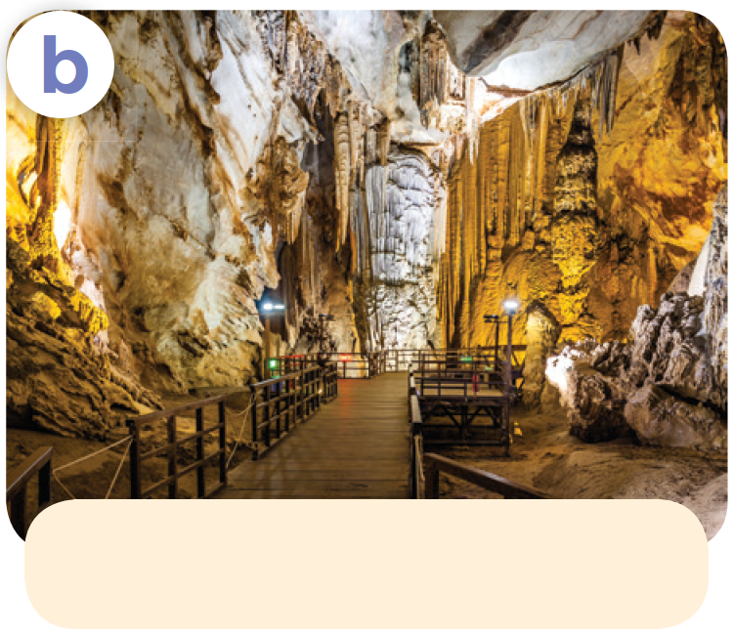
Where are you going to visit this summer?
Phong Nha Cave
I’m going to visit Phong Nha Cave.

Slide 20
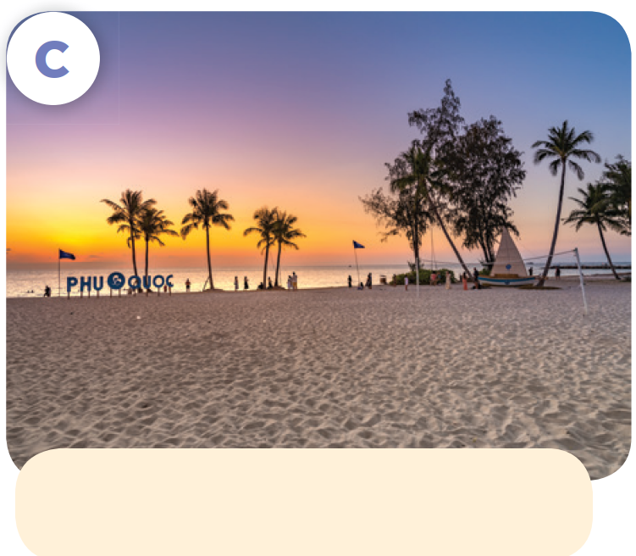
Where are you going to visit this summer?
Phu Quoc Island
I’m going to visit Phu Quoc Island.

Slide 21
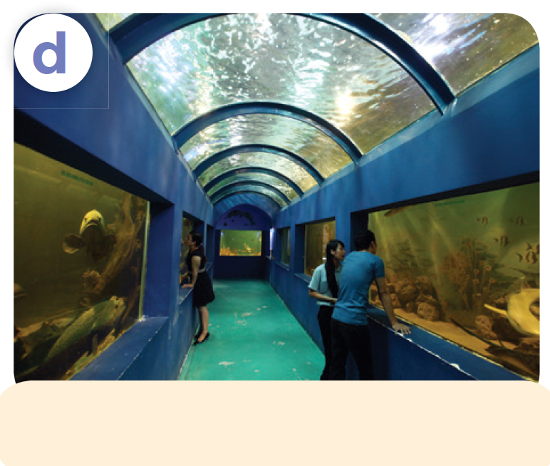
Where are you going to visit this summer?
Dam Sen Aquarium
I’m going to visit Dam Sen Aquarium.

Slide 22
Work in pairs. Ask and answer.
Listen and repeat.
Where are you going
to visit this summer?
Huong River
Phong Nha Cave
I’m going to visit ___.
Phu Quoc Island
Dam Sen Aquarium

Slide 23

04
Let's talk.

Slide 24
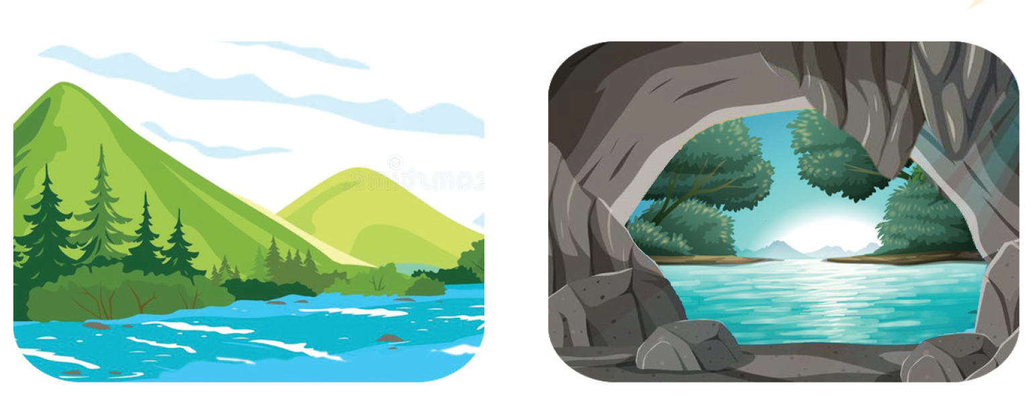
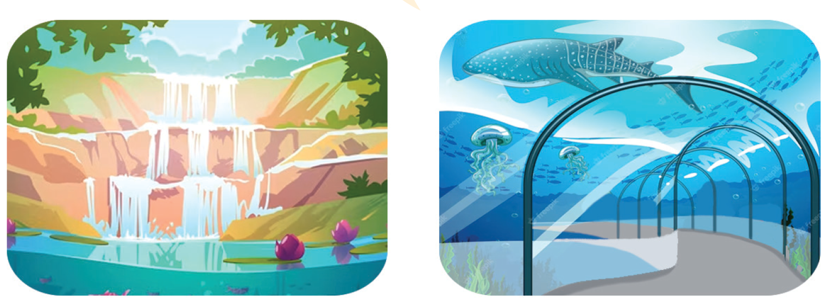
Look and say
Listen and repeat.
Work in pairs. Ask and answer.
Where are you going to visit this summer?
I’m going to visit ___.
river
cave
waterfall
aquarium

Slide 25
05
Fun corner and Wrap-up
Let’s play!
LUCKY MONSTERS

Slide 26





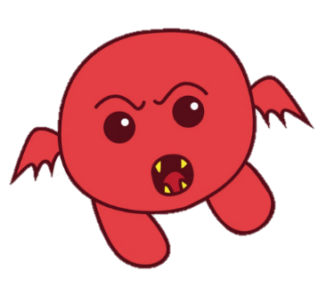




LUCKY MONSTERS
Notes:
bomb= 0 point

Slide 27

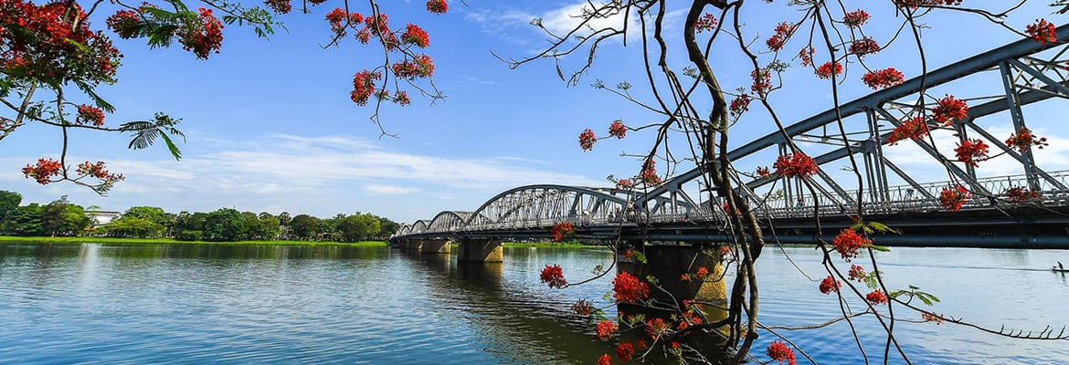

Where are you going to visit this summer?
Huong River
I’m going to visit Huong River.

Slide 28
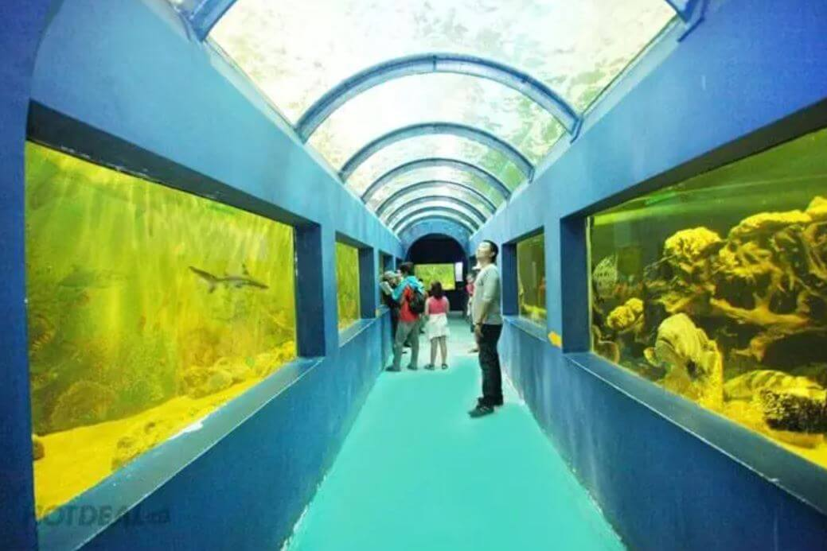

Where are you going to visit this summer?
Dam Sen Aquarium
rock - paper - scissors
Winner takes 5
I’m going to visit
Dam Sen Aquarium.

Slide 29
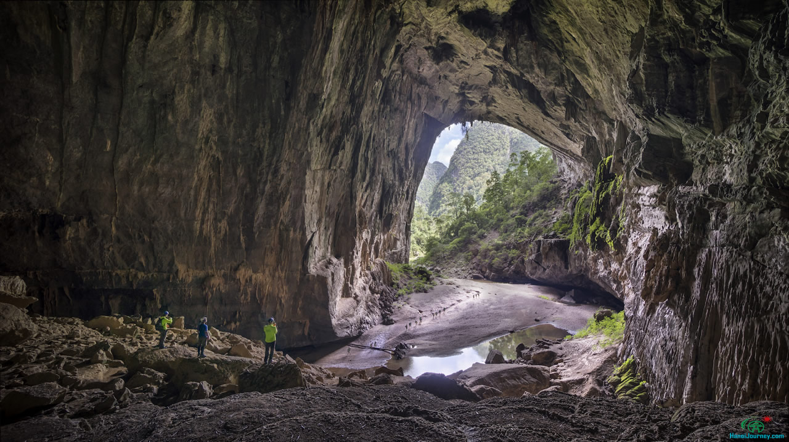
Where are you going to visit this summer?
Phong Nha Cave
I’m going to visit Phong Nha Cave .

Slide 30
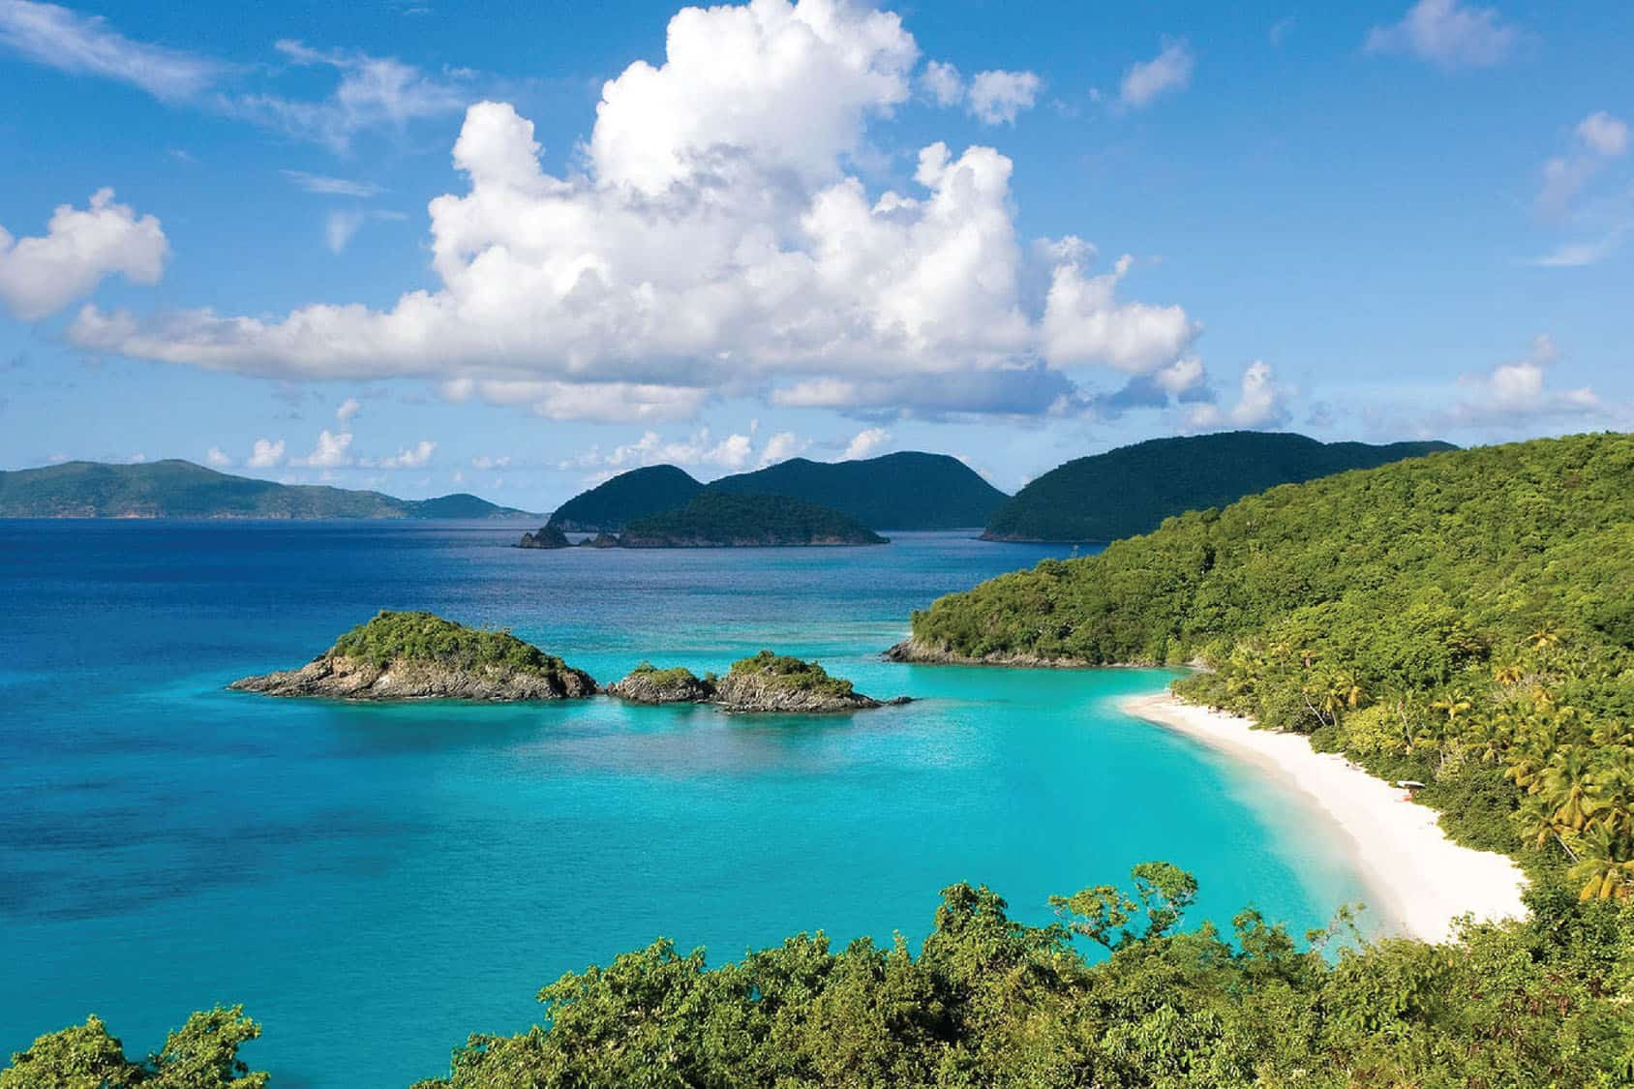
Where are you going to visit this summer?
Phu Quoc Island
I’m going to visit Phu Quoc Island.

Slide 31


are
going to
Where ___ you _______ visit this summer?
My sand castle

Slide 32
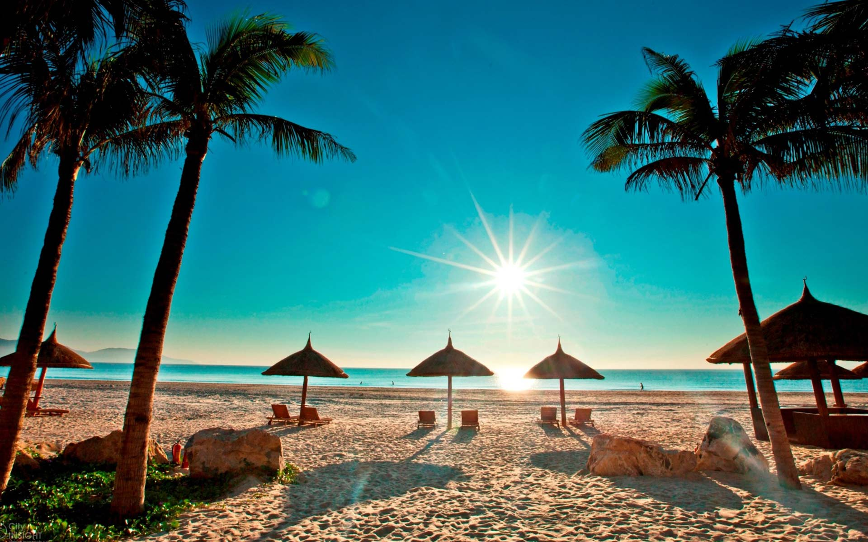
Where are you going to visit this summer?
My Khe Beach
I’m going to visit My Khe Beach.

Slide 33
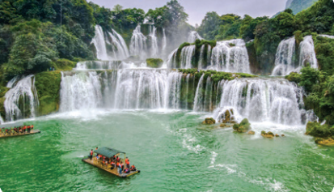
Where are you going to visit this summer?
Ban Gioc Waterfall
I’m going to visit Ban Gioc Waterfall.

Slide 34
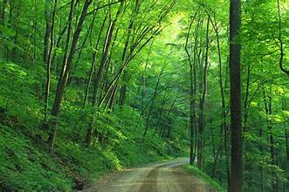
Where are you going to visit this summer?
I’m going to visit a forest.

