Slide 1




UBND QUẬN DƯƠNG KINH
TRƯỜNG TIỂU HỌC ANH DŨNG
ENGLISH - GRADE 5
UNIT 7: OUR FAVOURITE SCHOOL ACTIVITIES
LESSON 2 (1, 2, 3)

Slide 2


01
Warm-up
& Review

Slide 3

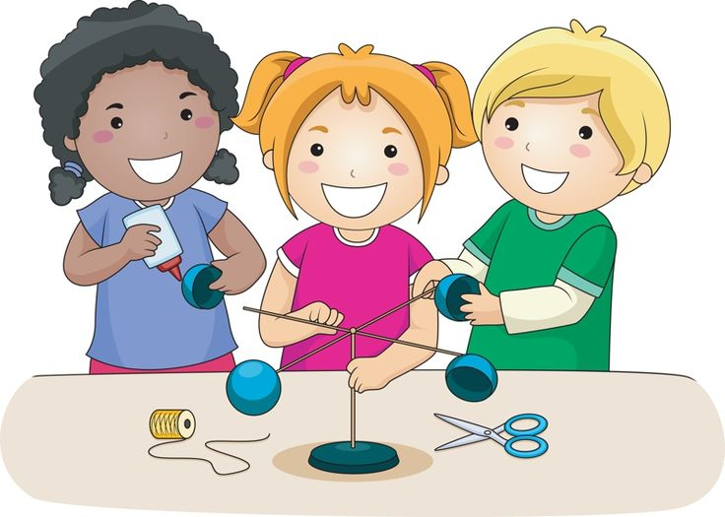
do projects

Slide 4
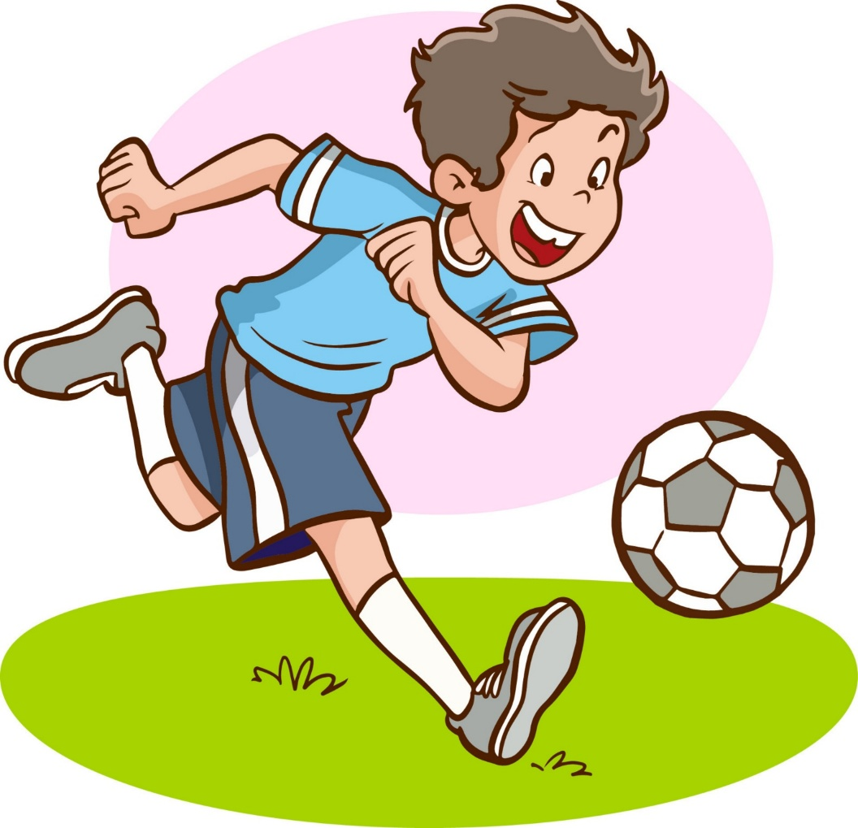
play football

Slide 5

read books

Slide 6
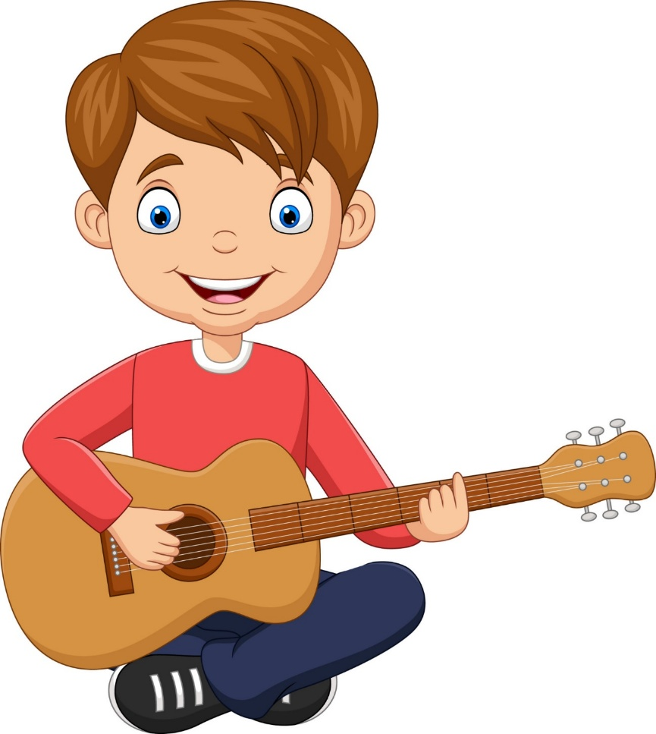
play the guitar

Slide 7
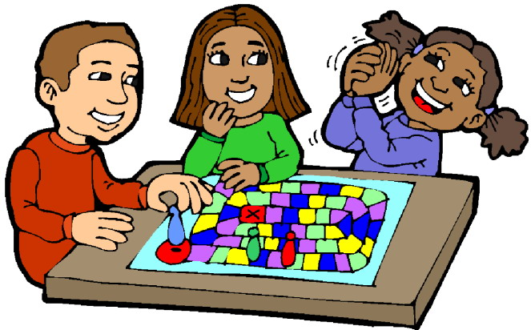
play games

Slide 8
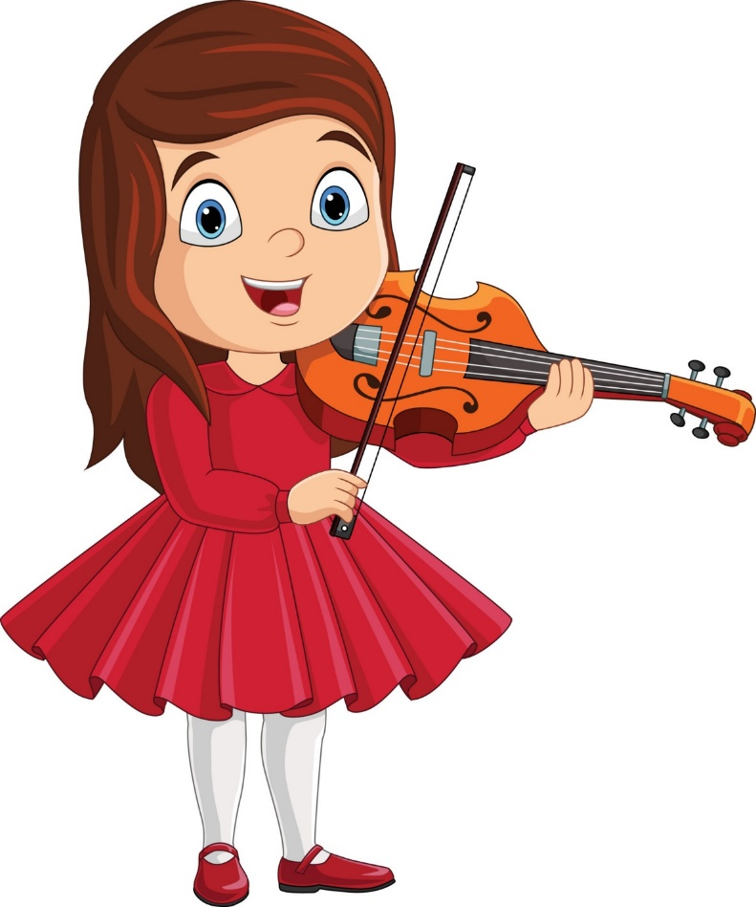
play the violin

Slide 9
02
Look, listen
and repeat.

Slide 10
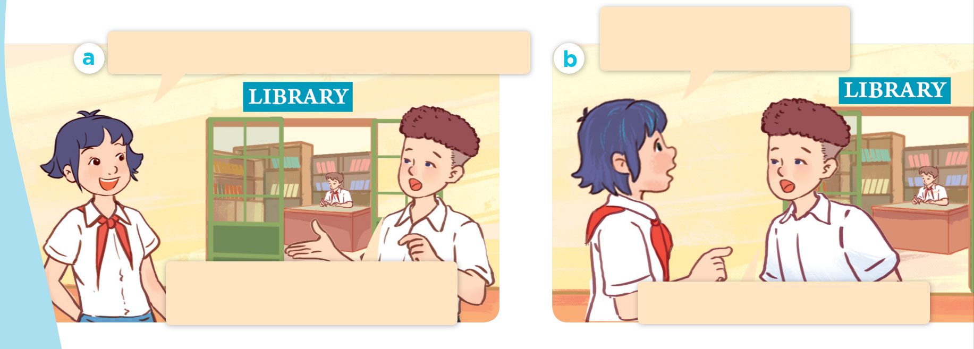
What are they talking about?
Why does he like solving maths problems?
Hi, Tom. I can’t see Minh. What’s he doing?
He’s solving maths problems in the library. He likes maths.
Because he thinks it’s useful.

Slide 11
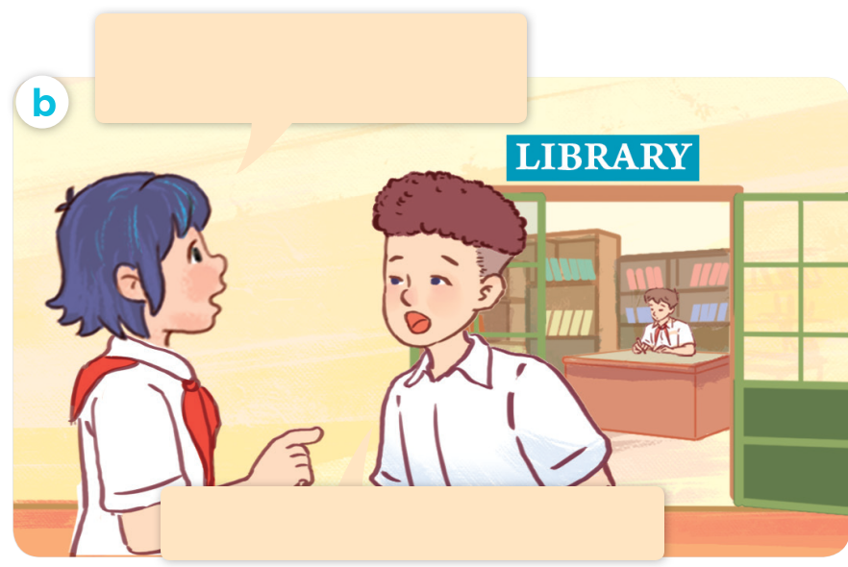
We use “Why” to ask about reasons.
Why does he like solving maths problems?
Because he thinks it’s useful.
Reason why he likes maths.

Slide 12

Listen and repeat.
Why does he like solving maths problems?
Hi, Tom. I can’t see Minh. What’s he doing?
He’s solving maths problems in the library. He likes maths.
Because he thinks
it’s useful.

Slide 13
Why does he like
solving maths problems?
Because he thinks it’s useful.

Slide 14
03
Listen, point
and say.

Slide 15
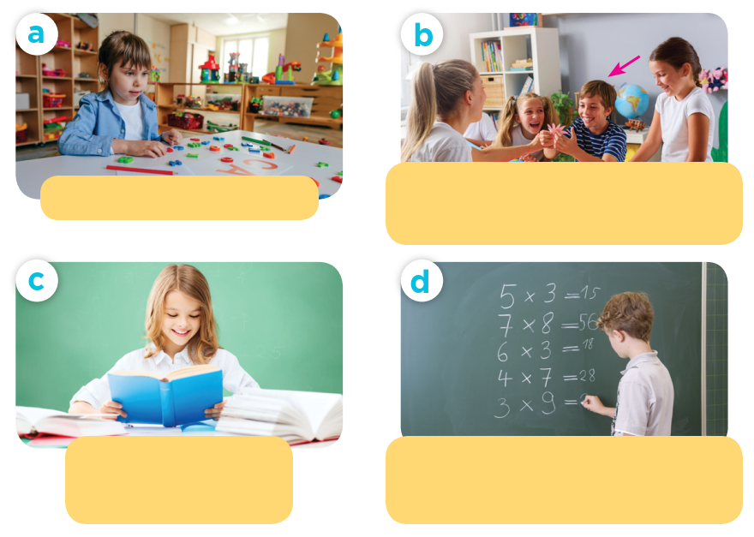
Look and guess.

Slide 16
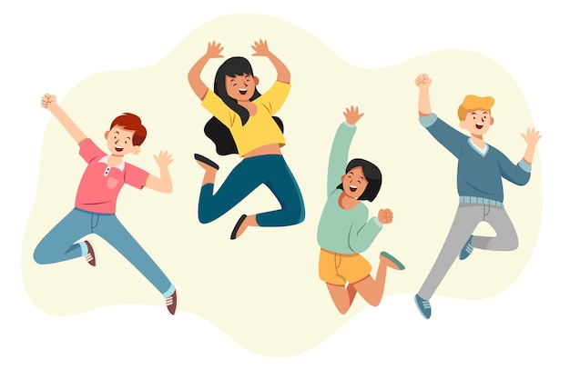
fun
We had a lot of fun.

Slide 17

useful
This tools are useful.

Slide 18
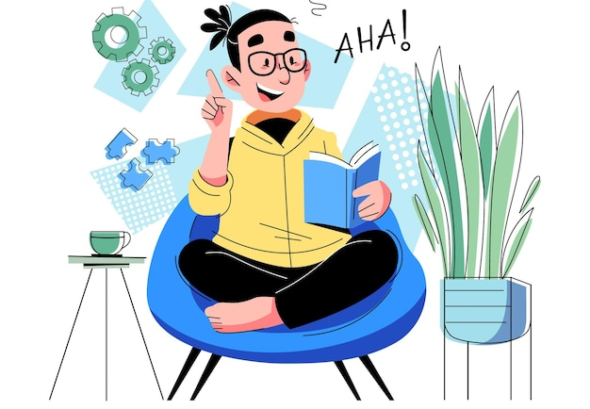
interesting
This book is interesting.

Slide 19
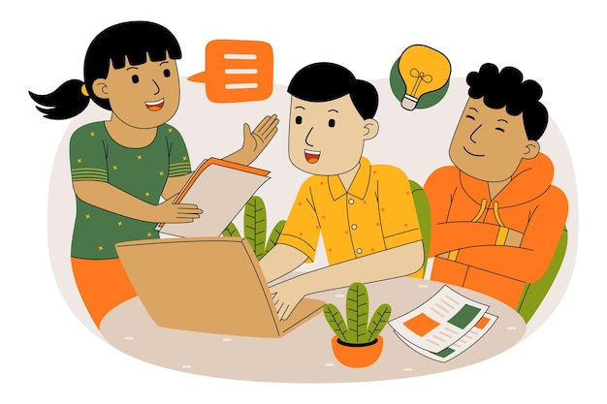
good for group work
Doing projects is good for group work.

Slide 20
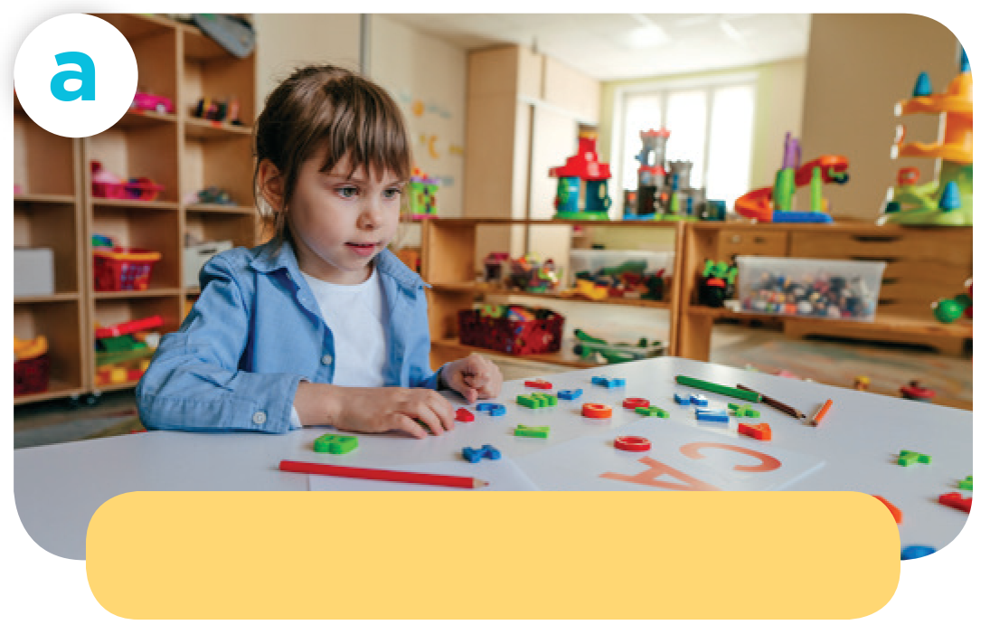
Why does she like playing games?
play games / fun
Because she thinks it’s fun.

Slide 21
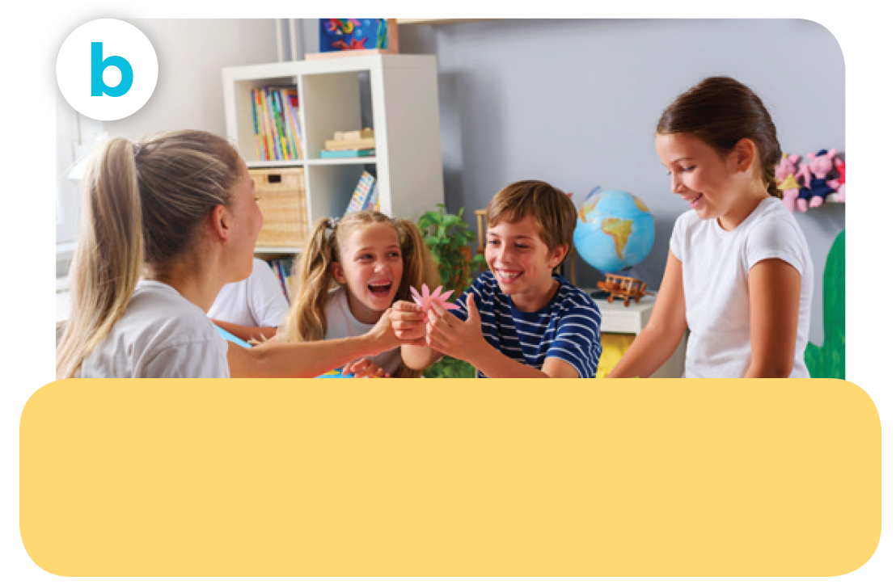
Why does he like doing projects?
do projects / good for group work
Because he thinks
it’s good for group work.

Slide 22

Why does she like reading books?
read books / interesting
Because she thinks it’s interesting.

Slide 23
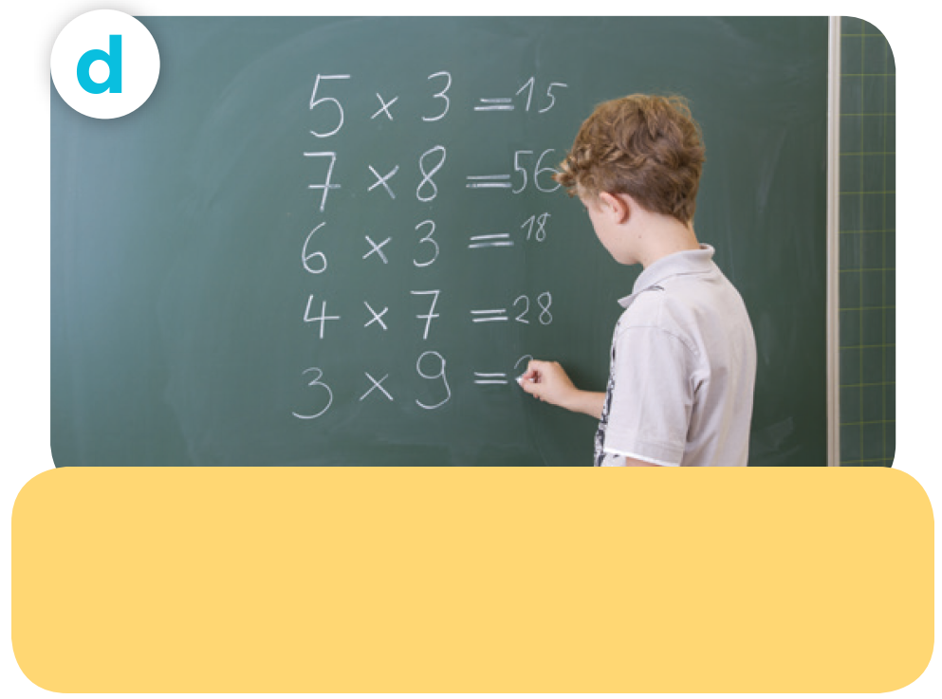
Why does he like
solving maths problems?
solve maths problems / useful
Because he thinks it’s useful.

Slide 24
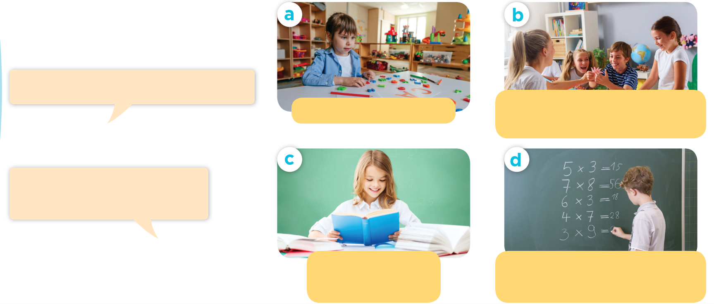
Listen and repeat.
Work in pairs. Ask and answer.
Why does he / she like __?
play games / fun
do projects / good for group work
Because he / she thinks it’s _______.
read books / interesting
solve maths problems/ useful

Slide 25
04
Let’s talk.

Slide 26
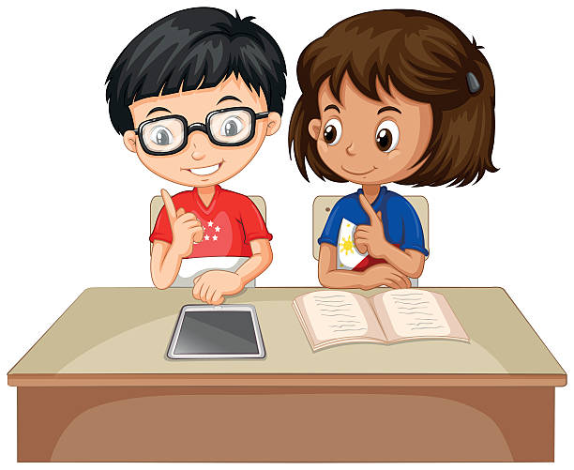
Why does he / she like _______?
Because he / she thinks ______.

Slide 27
05
Fun corner & Wrap-up

Slide 28

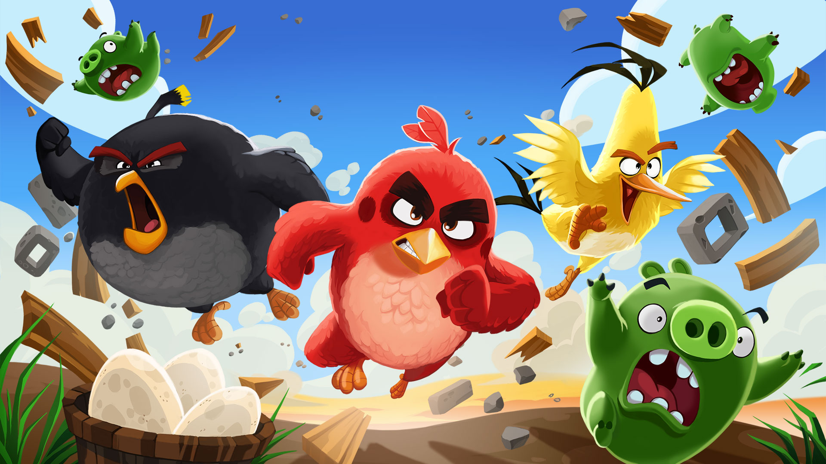

Slide 29

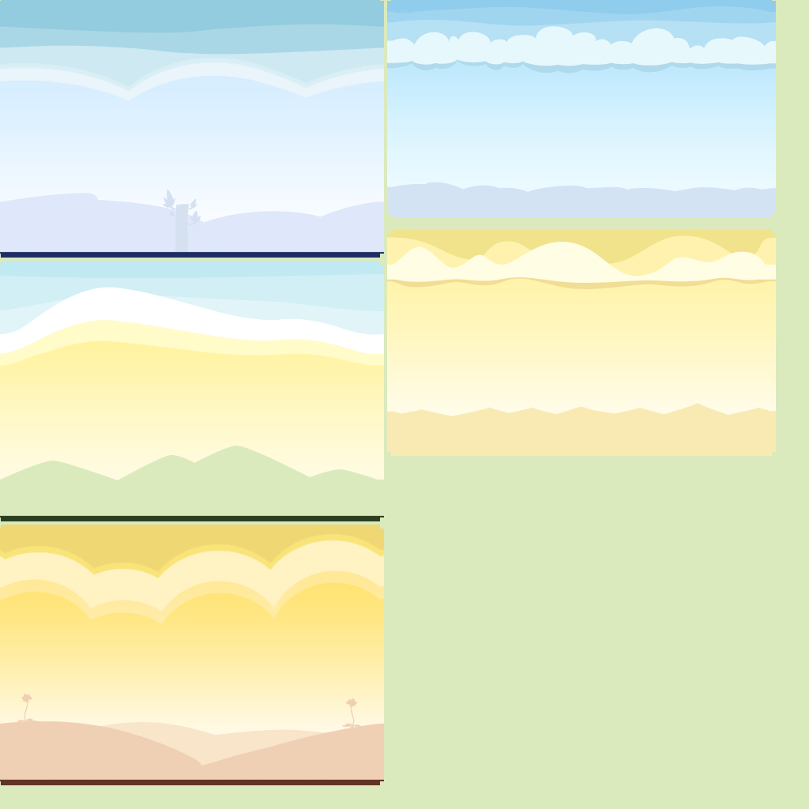



















1
2
3
4
5
6
7
8
1
2
3
4
5
6
7
8
1 point
3 points
Take 5 points
2 points
4 points
Notes:
29

Slide 30
she / Because / it’s / thinks / fun /.
Because she thinks it’s fun.

Slide 31

reading / Why / books / like / does / she / ?
Why does she like reading books?

Slide 32
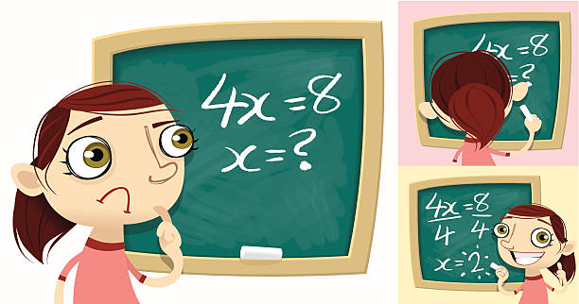
Why does he like …?
solving math problems
reading books
play games
solving maths problems

Slide 33
Why does he like doing project?
fun
Because he thinks it’s good for … .
group work
interesting
group work

Slide 34
Why does she like …?
reading book
doing project
playing games
playing games

Slide 35
Why
… does he like playing game?
What
How
Because he thinks it’s fun.
Why

Slide 36
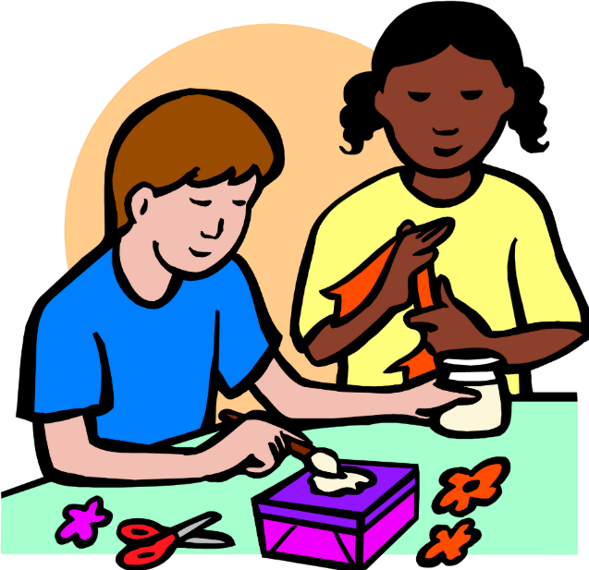
Why does she like … ?
playing football
doing project
reading books
doing project

Slide 37
Why does she like playing games?
Because she … it’s fun.
think
does
thinks
thinks

Slide 38
Why does she like solving maths problems?
… he thinks it’s useful.
Because

Slide 39
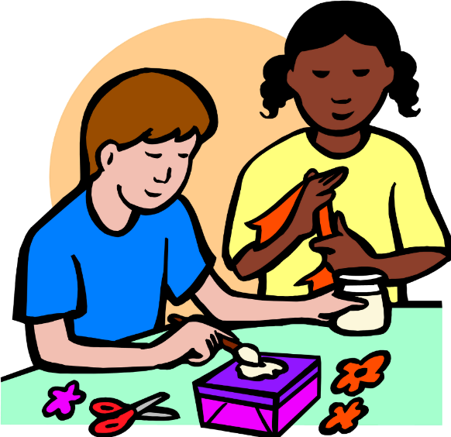
they / do / Why / projects / like / doing / ?
Why do they like doing projects?

