Slide 1




UBND QUẬN DƯƠNG KINH
TRƯỜNG TIỂU HỌC ANH DŨNG
ENGLISH - GRADE 5
UNIT 8: IN OUR CLASSROOM
LESSON 1 (1, 2, 3)

Slide 2




01
Warm-up & Review

Slide 3
02
Look, listen and repeat.

Slide 4




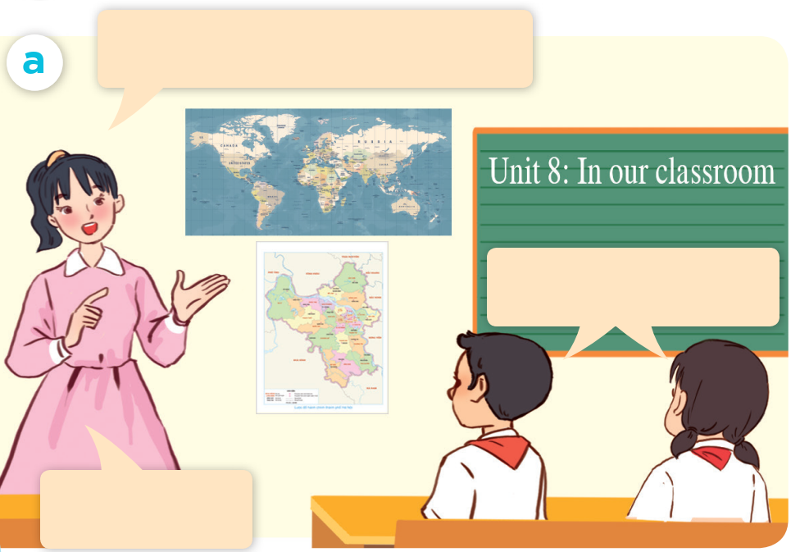

LOOK AND SAY.

Slide 5
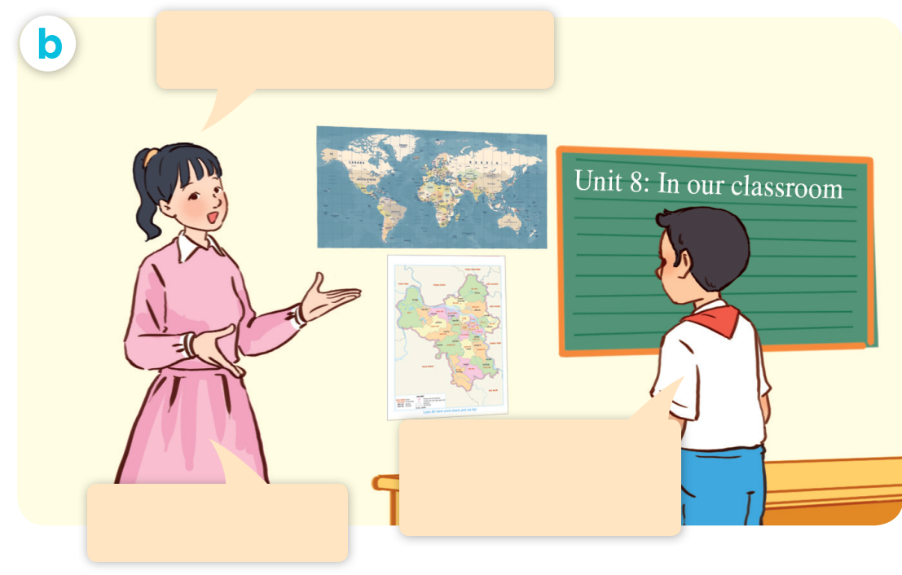
LOOK AND SAY.

Slide 6


LISTEN AND POINT.

Slide 7
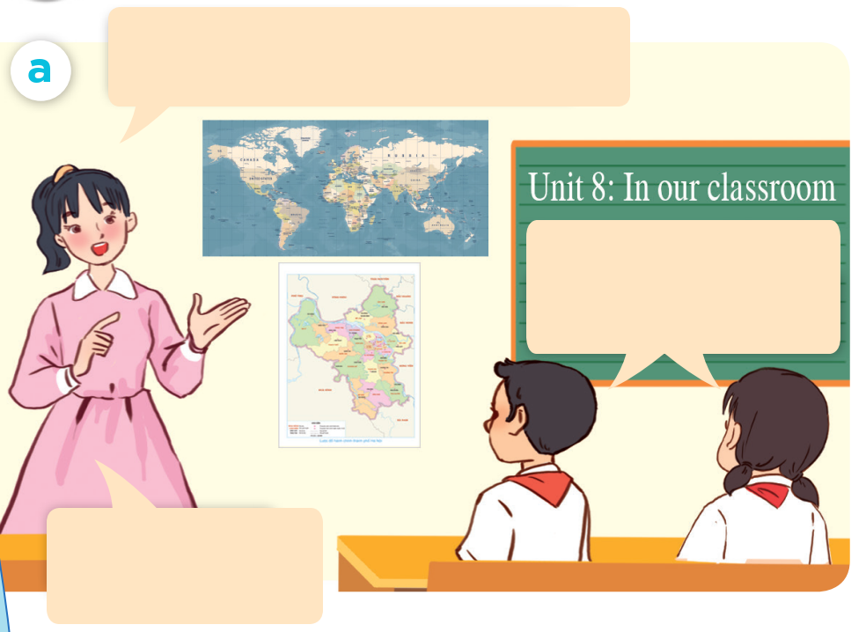
LISTEN AND REPEAT.
Class, what are these?
They are maps.
Well done.

Slide 8
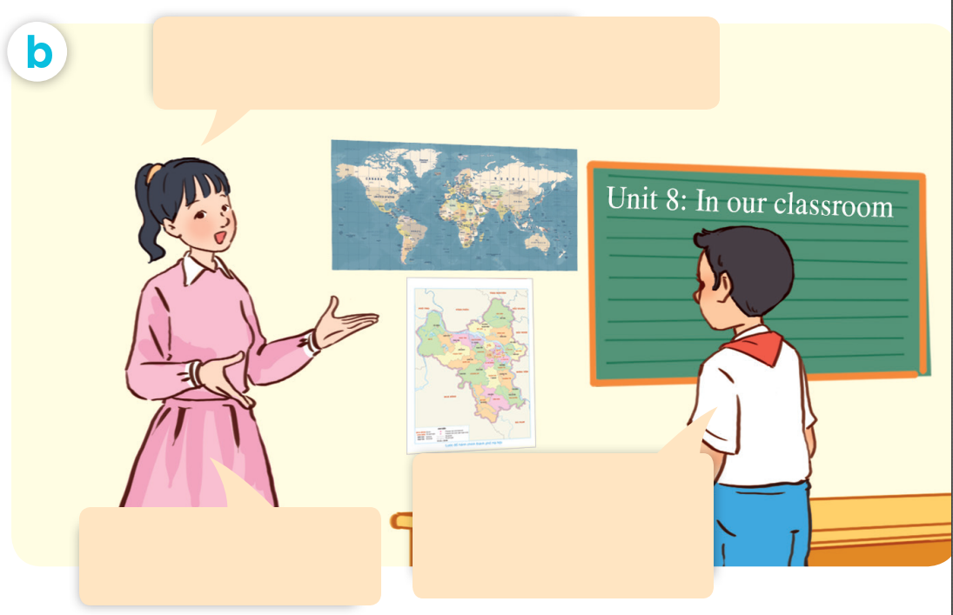
LISTEN AND REPEAT.
Where are the maps ?
They’re beside the board.
That’s right.

Slide 9
LISTEN AND REPEAT.
Where are the maps?
Class, what are these?
They are maps.
Well done.
They’re beside the board.
That’s right.

Slide 10
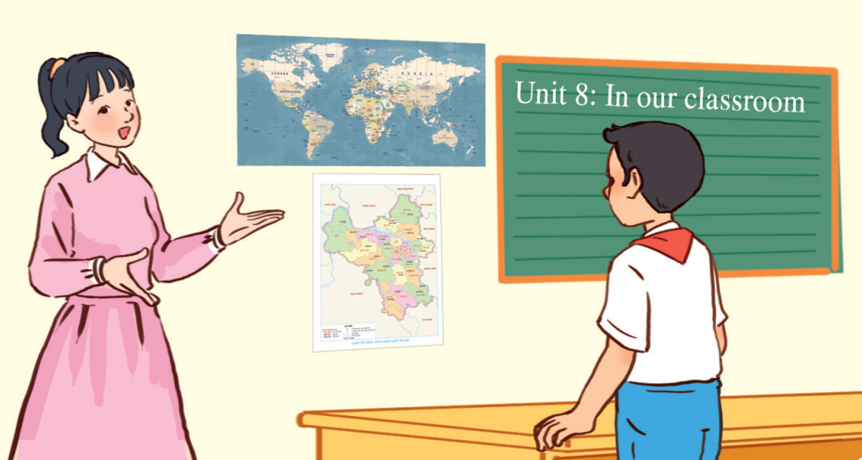

LISTEN AND REPEAT.
Where are the maps?
They’re beside the board.

Slide 11
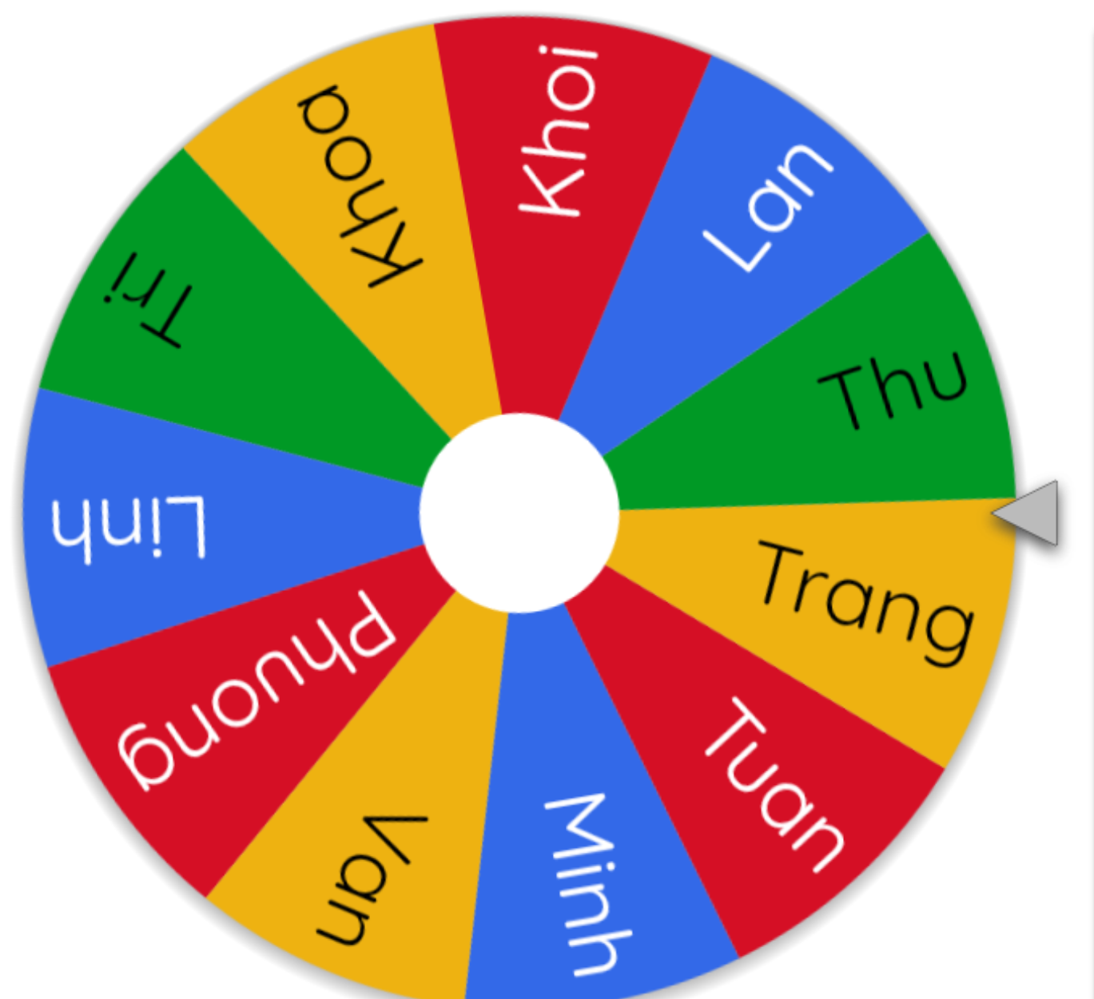
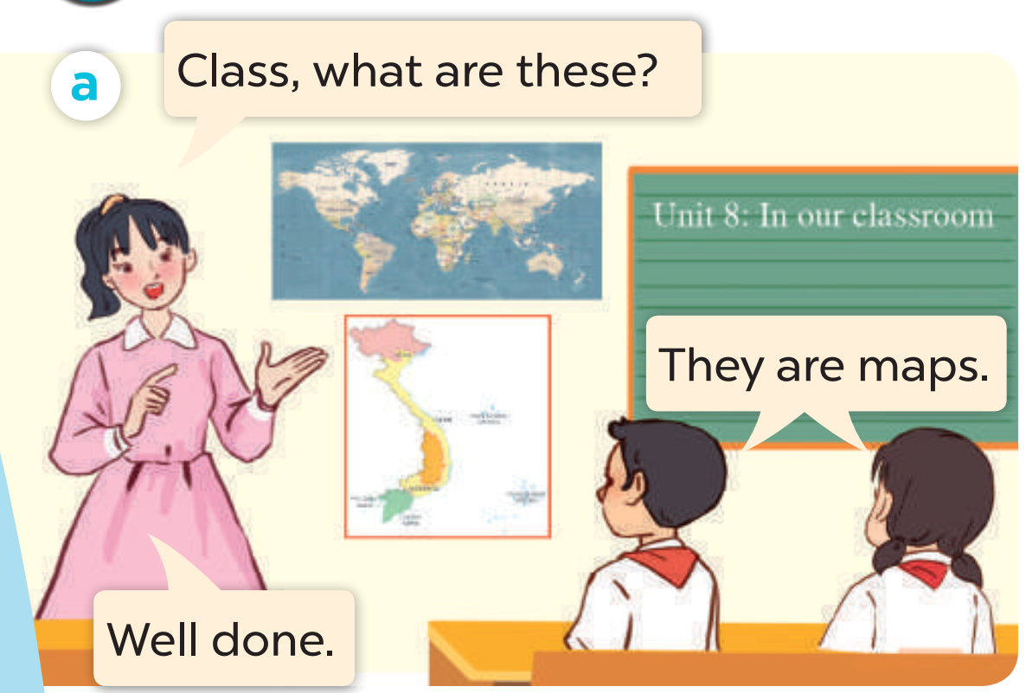
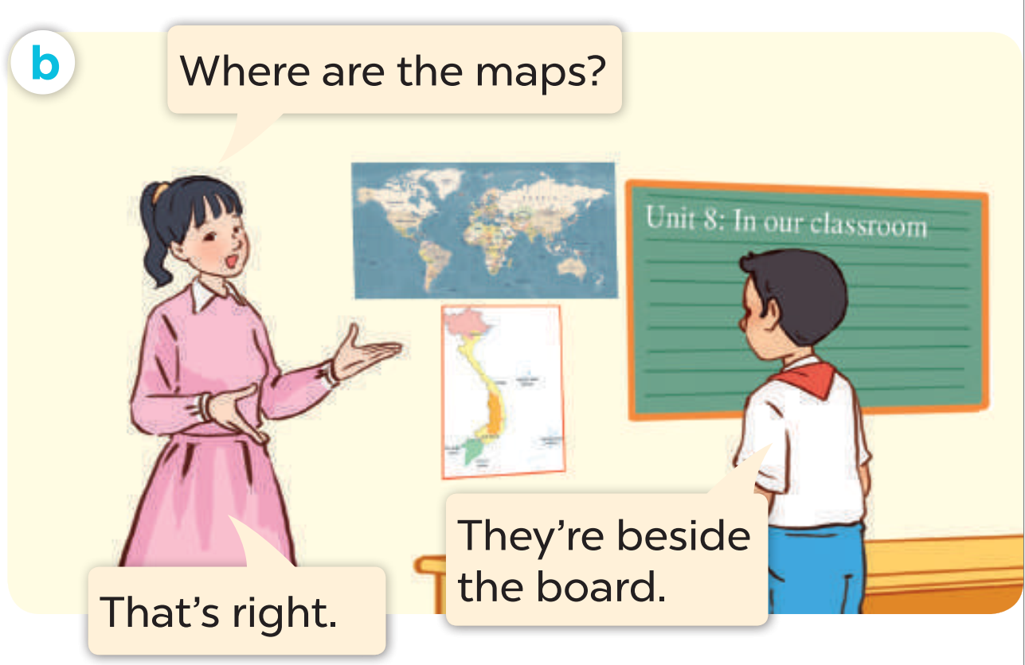
ASK AND ANSWER.

Slide 12











Slide 13
03
Listen, point and say.

Slide 14





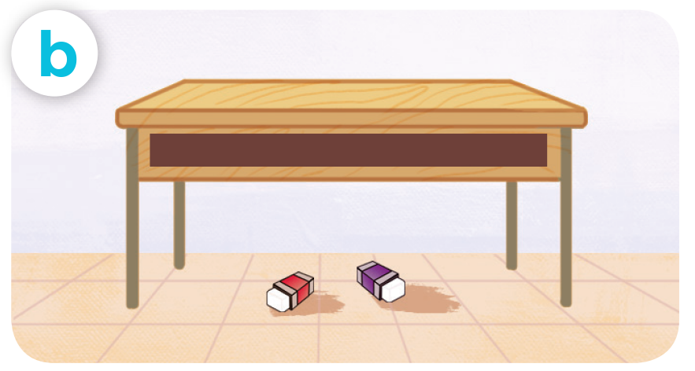
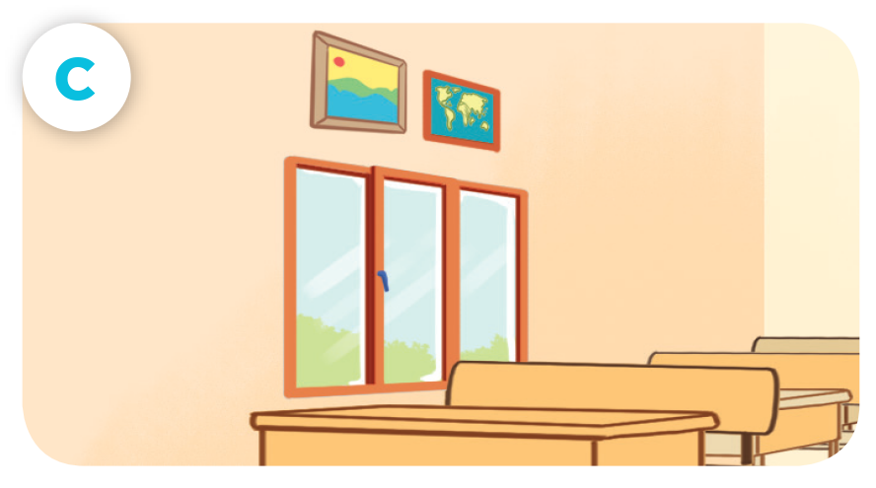
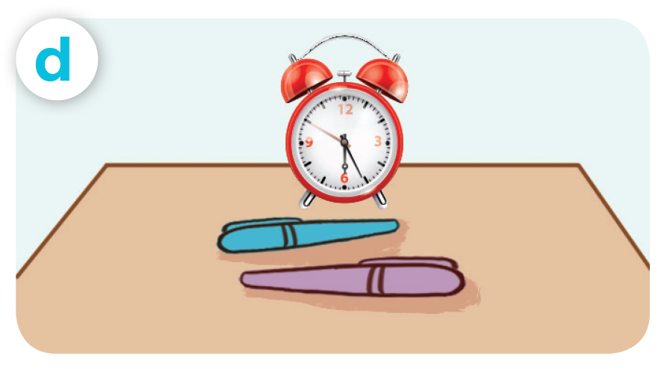
LOOK AND SAY
pencils / beside / book
erasers / under / desk
pictures / above / window
pens / in front of / clock

Slide 15





LISTEN AND REPEAT.
pencils / beside / book

Slide 16
LISTEN AND REPEAT.
erasers / under / desk

Slide 17
LISTEN AND REPEAT.
pictures / above / window

Slide 18
LISTEN AND REPEAT.
pens / in front of / clock

Slide 19




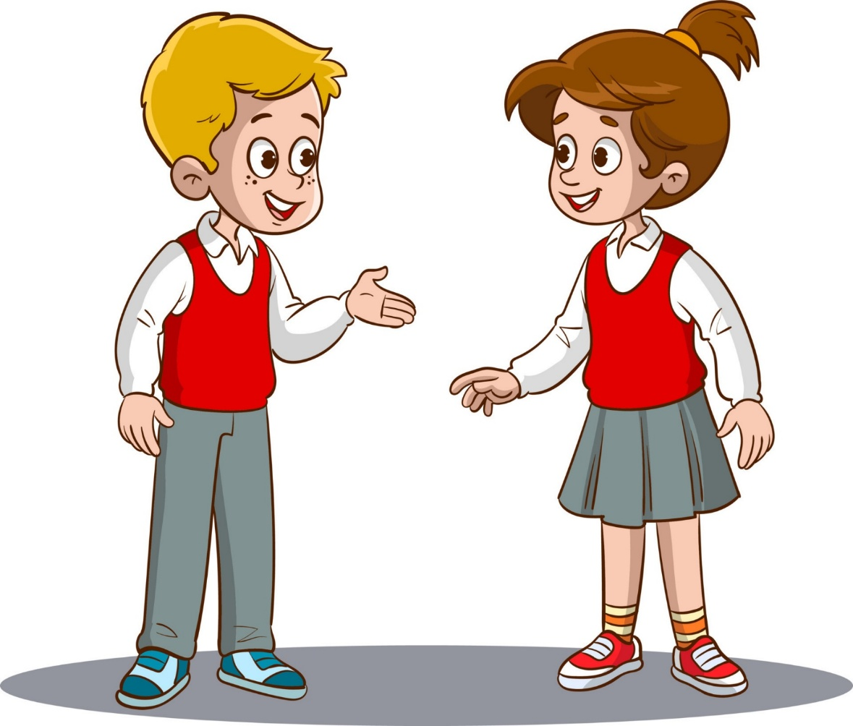

LISTEN AND REPEAT.
Where are the pencils?
pencils / beside / book
They’re beside
the book.

Slide 20

LISTEN AND REPEAT.
Where are the erasers?
erasers / under / desk
They’re under
the desk.

Slide 21


LISTEN AND REPEAT.
Where are the pictures?
pictures / above / window
They’re above
the window.

Slide 22
LISTEN AND REPEAT.
Where are the pens?
pens / in front of / clock
They’re in front of
the clock.

Slide 23


ASK AND ANSWER
pencils / beside / book
erasers / under / desk
pictures / above / window
pens / in front of / clock

Slide 24
ASK AND ANSWER
pencils / beside / book
erasers / under / desk
pictures / above / window
pens / in front of / clock

Slide 26
04
Let’s talk.

Slide 27


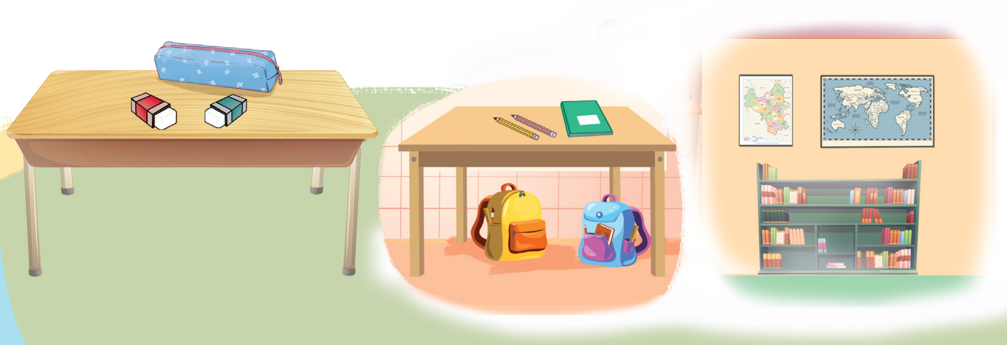
LOOK AND SAY.

Slide 28
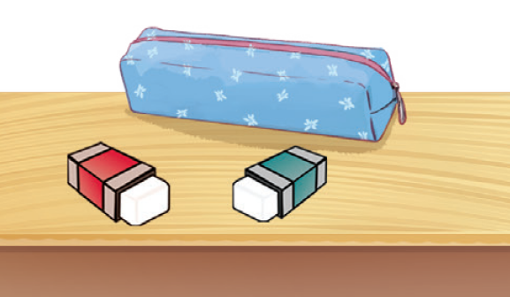
ASK AND ANSWER.
Where are
the erasers?
They’re beside the pencil case.

Slide 29
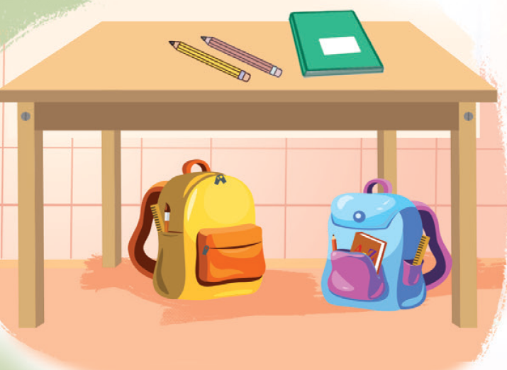

ASK AND ANSWER.
Where are the bags?
They’re under the desk.

Slide 30
ASK AND ANSWER.
Where are the pencils?
They’re beside the notebook.

Slide 31
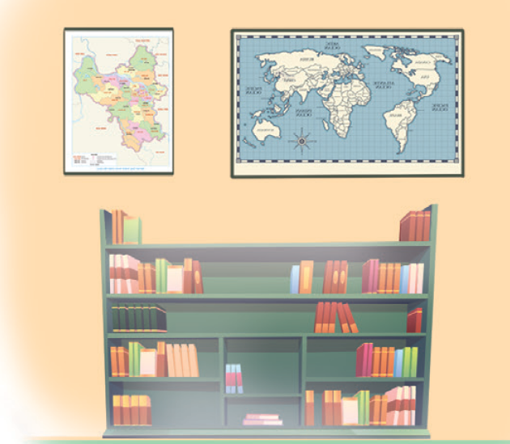
ASK AND ANSWER.
Where are the maps?
They’re above the bookcase.

Slide 32


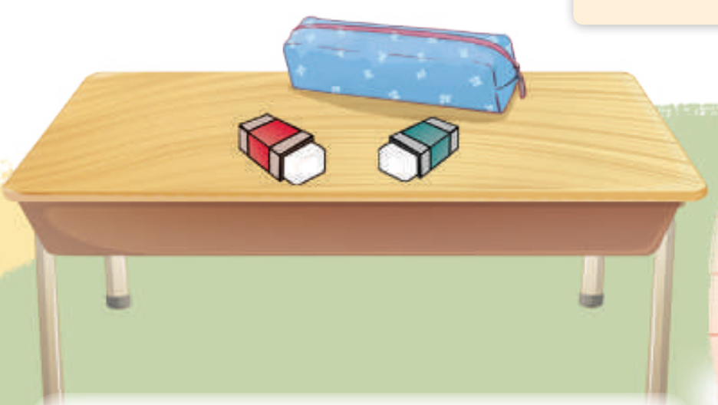
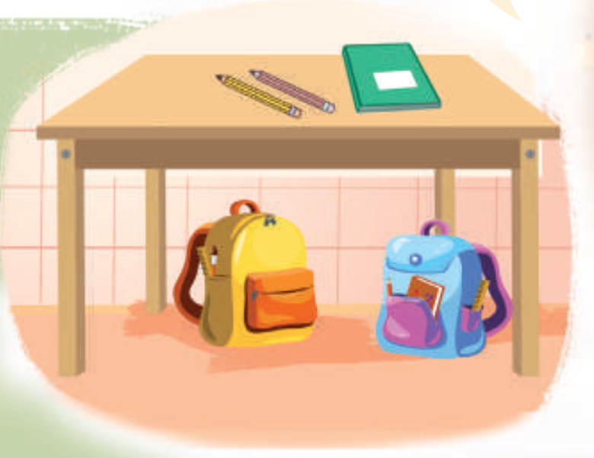
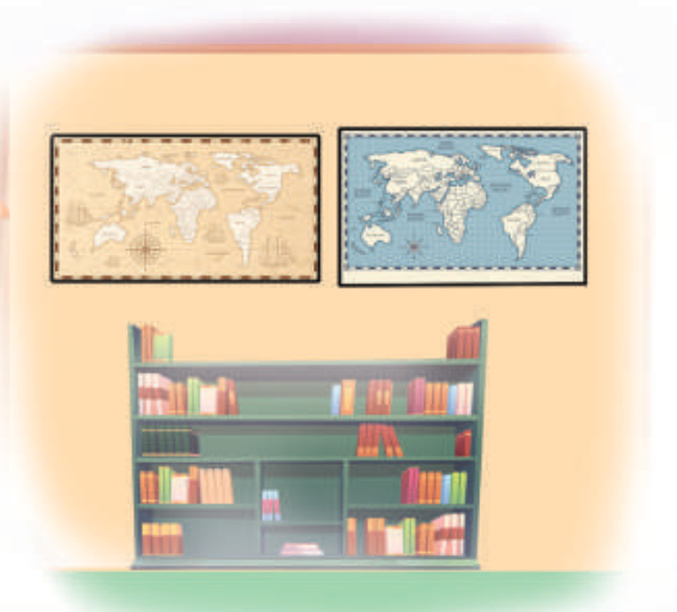
WORK in PAIRS
Ask and answer.

