Slide 1




UBND QUẬN DƯƠNG KINH
TRƯỜNG TIỂU HỌC ANH DŨNG
ENGLISH - GRADE 5
UNIT 9: OUR OUTDOOR ACTIVITIES
LESSON 2 (1, 2, 3)

Slide 2


01
Warm-up and Review

Slide 3


Slide 4


Were you at the ____ yesterday?
No, we weren’t.
Yes, we were.

Slide 5
02
Activity 1.
Look, listen and repeat.

Slide 6

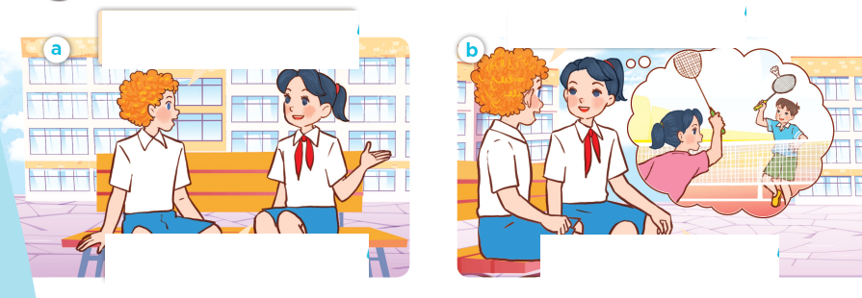
Look, listen and repeat.

Slide 7
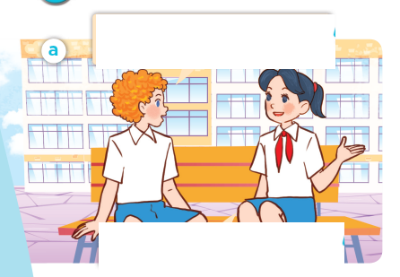
Look, listen and repeat.
I didn’t see you and Minh last Saturday. Where were you?
We were at the sports centre.
Notes:
Nháy vào hội thoại để nghe lại âm thanh từng câu.

Slide 8

Look, listen and repeat.
What did you do there?
We played badminton.
Notes:
Nháy vào hội thoại để nghe lại âm thanh từng câu.

Slide 9
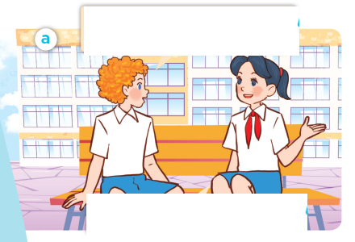
Look, listen and repeat.
I didn’t see you and Minh last Saturday. Where were you?
What did you do there?
We were at the sports centre.
We played badminton.

Slide 10
Where were you?
We were ____.
What did you do there?
We _______.

Slide 11
03
Activity 2.
Listen, point and say.

Slide 12
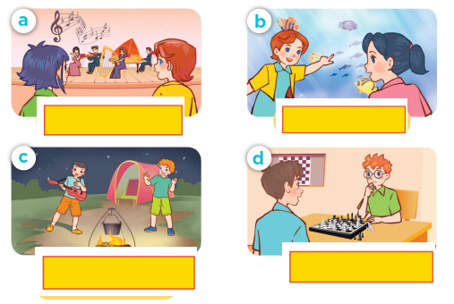
Listen, point and say.

Slide 13
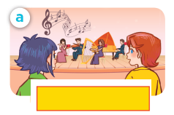
Listen, point and say.
listen to music

Slide 14
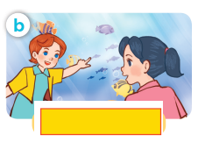
Listen, point and say.
watch the fish

Slide 15
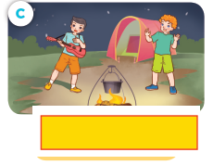
Listen, point and say.
dance around
the campfire

Slide 16
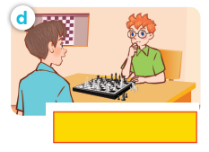
Listen, point and say.
play chess

Slide 17
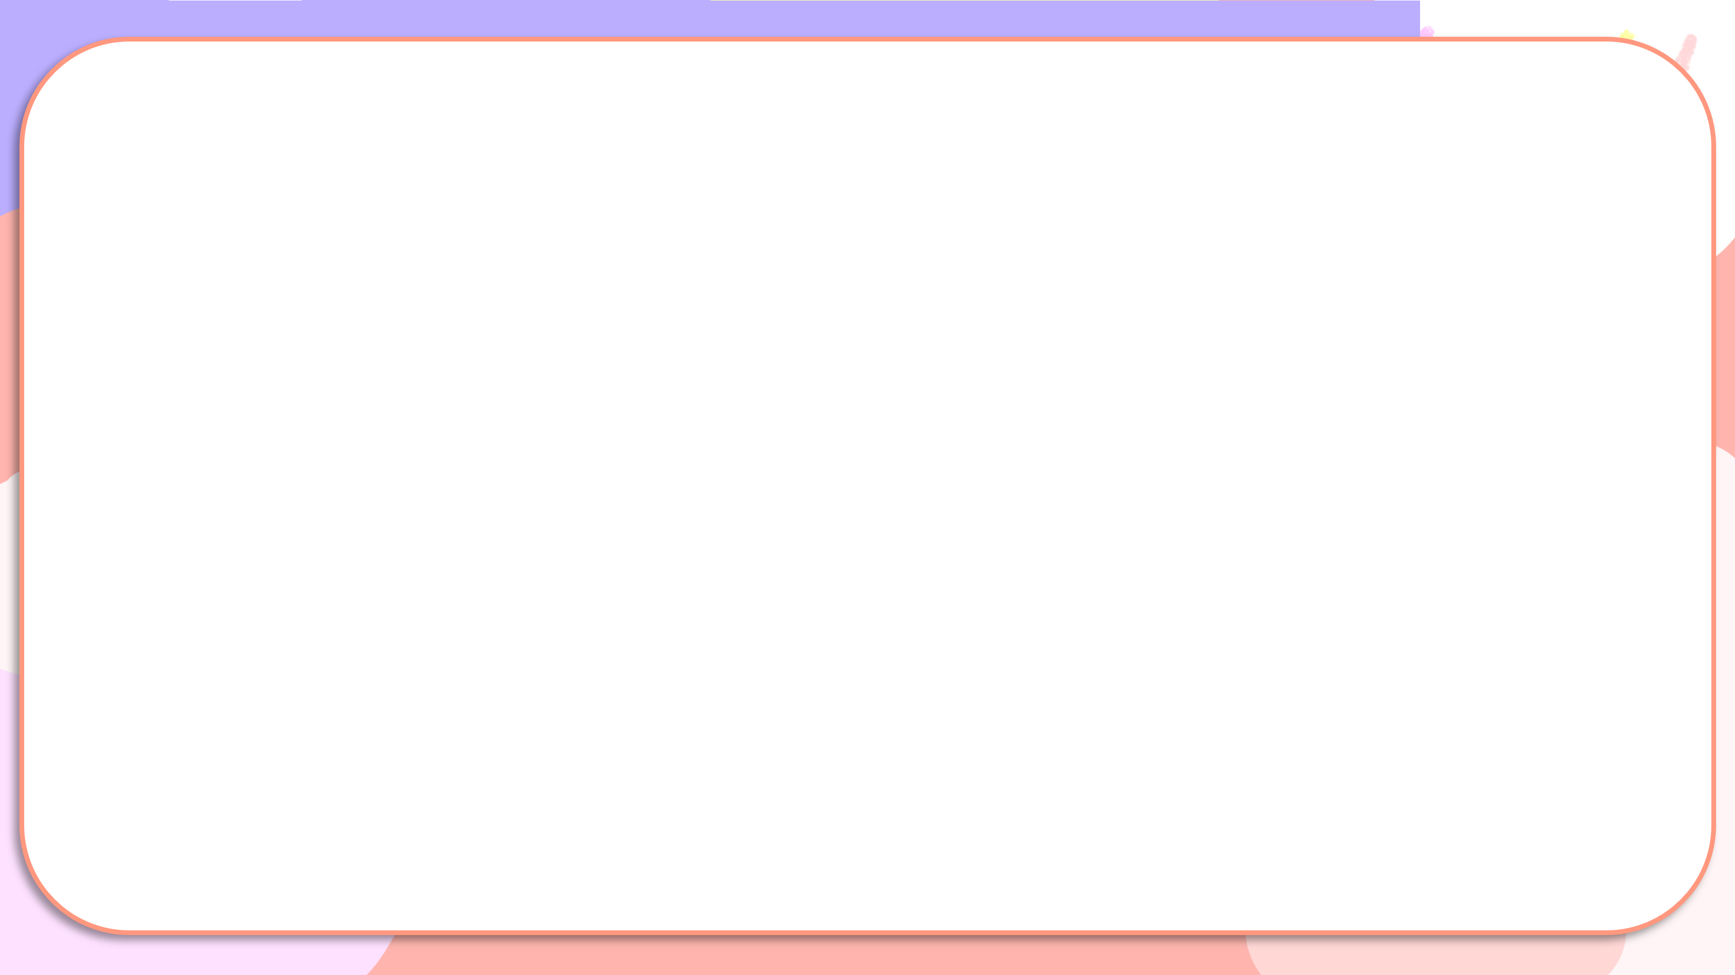


What did you do yesterday?
We ____.

Slide 18
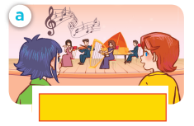
Listen, point and say.
What did you do yesterday?
We listened to music.
listen to music

Slide 19
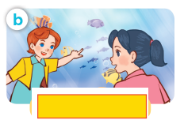
Listen, point and say.
What did you do yesterday?
We watched the fish.
watch the fish

Slide 20
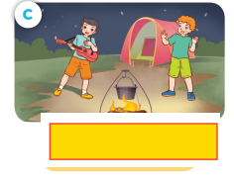
Listen, point and say.
What did you do yesterday?
We danced around the campfire.
dance around the campfire

Slide 21
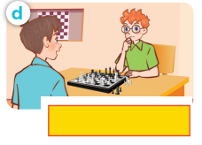
Listen, point and say.
What did you do yesterday?
We played chess.
play chess

Slide 22
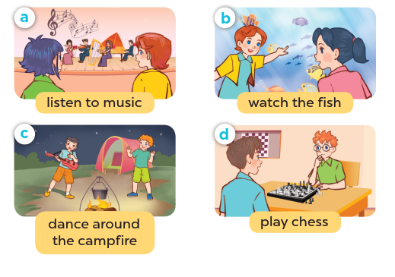
What did you do yesterday?
We ____.

Slide 23
04
Activity 3. Let’s talk.

Slide 24
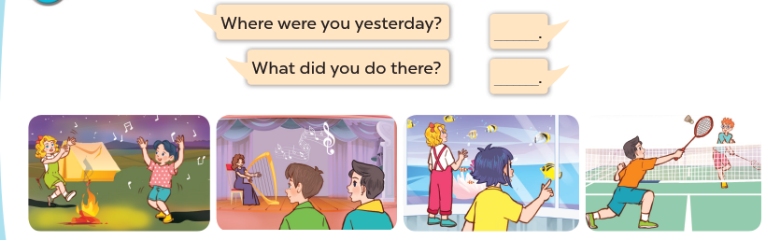
Let’s talk.

Slide 25
05
Fun corner and Wrap-up

Slide 26
What were you yesterday?
We ____.
What did you do there?
We ____.

Slide 27

05
Fun corner and Wrap-up

Slide 28
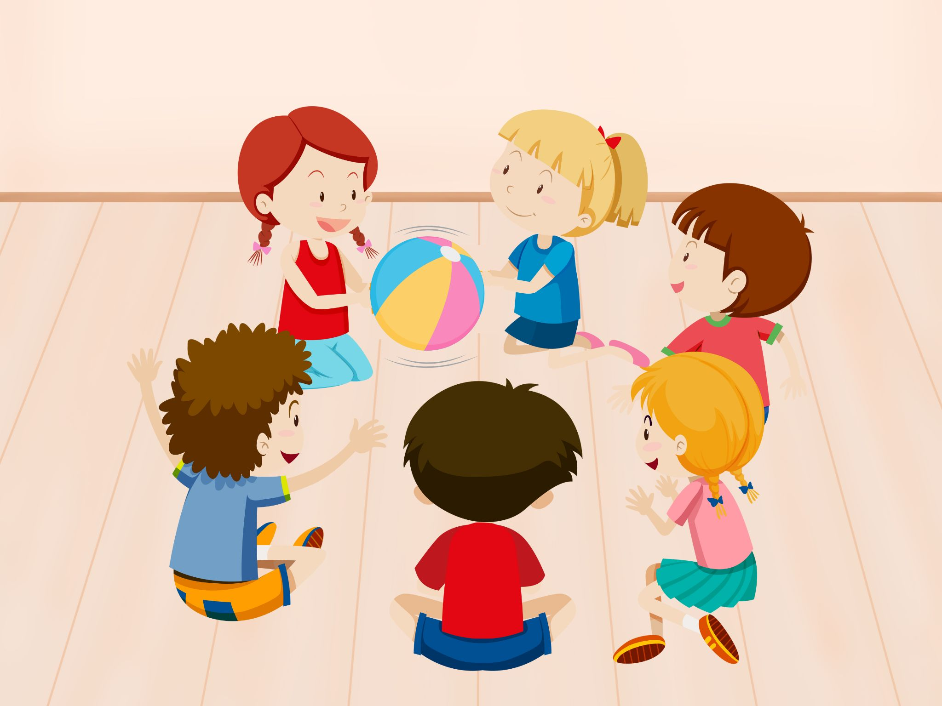
PASS THE BALL
Notes:
Giáo viên nháy choột để bật nhạc và dừng nhạc. Dừng nhạc bạn nào cầm bóng thì trả lời câu hỏi.

Slide 29

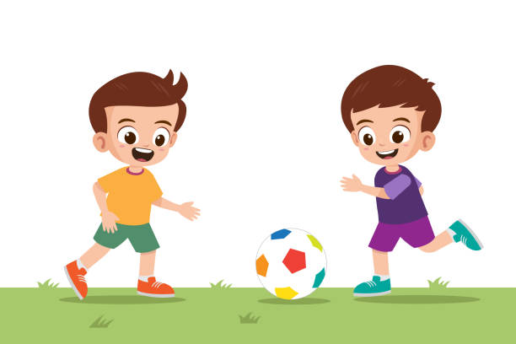
Fill in the blanks.
What ___ you do yesterday?
did
played football
We ____________.

Slide 30
PASS THE BALL
Notes:
Giáo viên nháy choột để bật nhạc và dừng nhạc. Dừng nhạc bạn nào cầm bóng thì trả lời câu hỏi.

Slide 31

Fill in the blanks.
What did you ___ yesterday?
do
We watched the ______.
dolphin

Slide 32
PASS THE BALL
Notes:
Giáo viên nháy choột để bật nhạc và dừng nhạc. Dừng nhạc bạn nào cầm bóng thì trả lời câu hỏi.

Slide 33
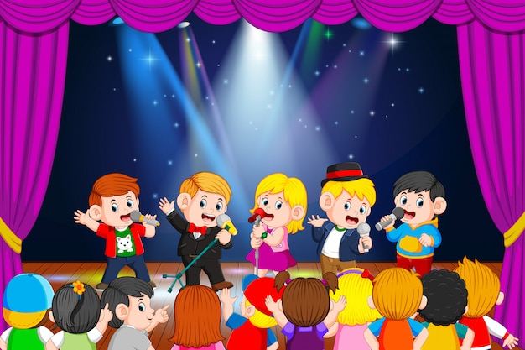
Fill in the blanks.
What did you do __________?
yesterday
We _______ to music.
listened

Slide 34
PASS THE BALL
Notes:
Giáo viên nháy choột để bật nhạc và dừng nhạc. Dừng nhạc bạn nào cầm bóng thì trả lời câu hỏi.

Slide 35

Fill in the blanks.
What did you
___________do yesterday?
We __________
the campfire.
danced around

Slide 36


Very Good!

