Slide 1



13
MY house
LESSON 1 – Part 1,2,3

Slide 2
TABLE OF CONTENTS
Warm-up and review
Look, listen and repeat.
01.
02.
03.
04.
Let’s talk.
Listen, point and say.
05.
Fun corner and wrap-up

Slide 3
1
Warm-up and review

Slide 4

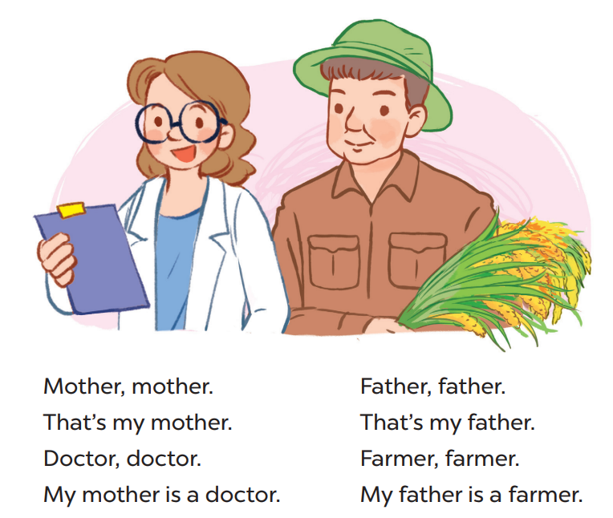
Say the chant

Slide 5
2
Look, listen and repeat. .

Slide 6
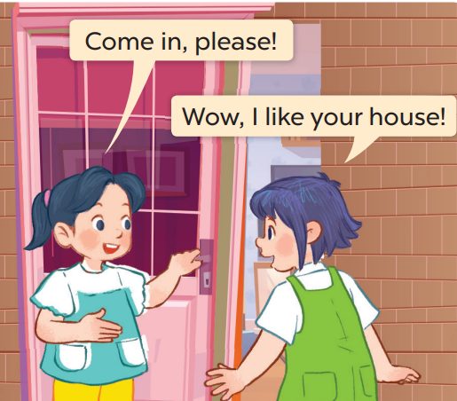
Who are they?
Where are they?

Slide 7
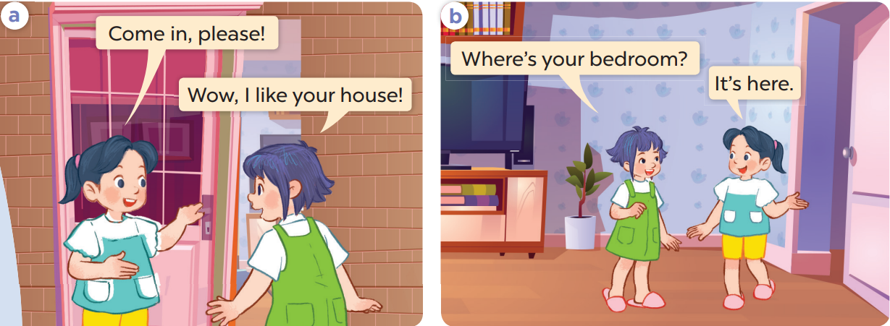
Work in pairs and repeat.

Slide 8
3
Listen, point and say..

Slide 9
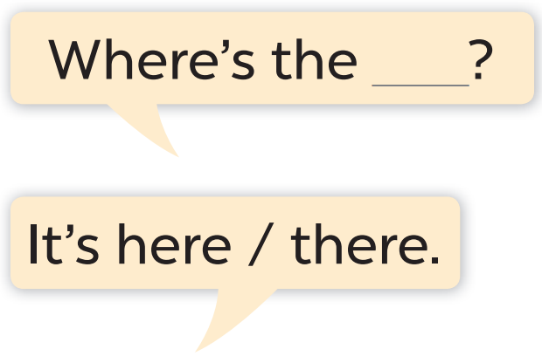
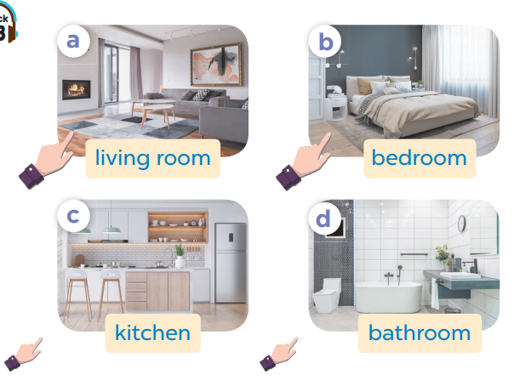

Slide 10
Work in pairs. Ask and answer.

Slide 11
Work in pairs.
Ask and answer.

Slide 12
4
Let’s talk.

Slide 13
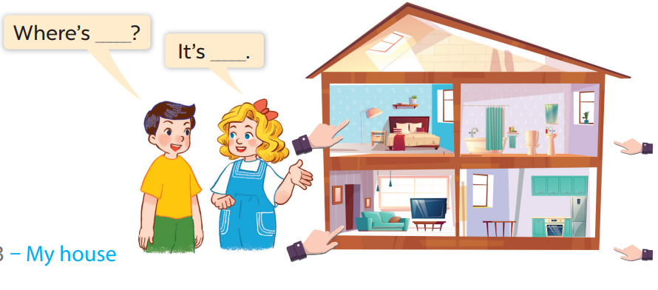
Work in pairs.
Ask and answer.

Slide 14
5
Fun corner and wrap-up

Slide 15

Play
What’s behind the square?

Slide 16





1
2
3
4
5
6
7
8
Next
tekhnologic

Slide 17
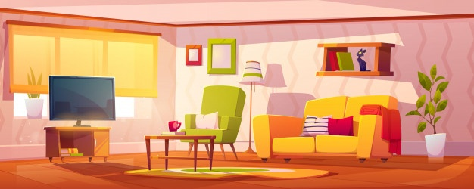

Where
………is the living room?
BACK
How
What

Slide 18
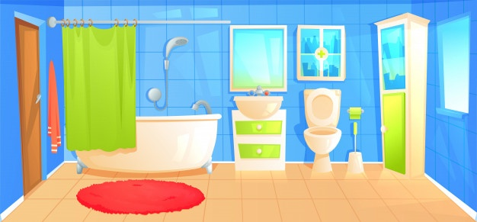
living room
Where is the………..?
BACK
kitchen
bathroom

Slide 19
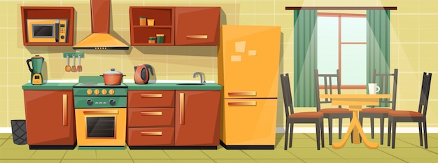

Where is the kitchen?
BACK
It’s there.
It’s here.

Slide 20
Where is the living room?
BACK
It’s there.
It’s here.

Slide 21
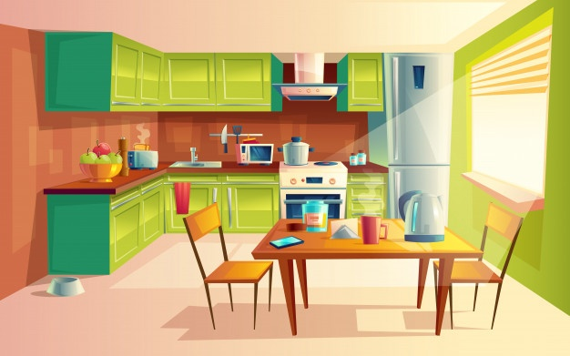
living room
Where is the………..?
BACK
kitchen
bathroom

Slide 22
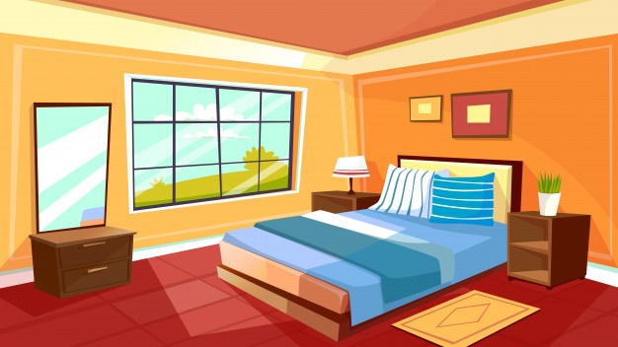
living room
Where is the………..?
BACK
bathroom
bedroom

Slide 23
Where is the kitchen?
BACK
It’s there.
It’s here.

Slide 24
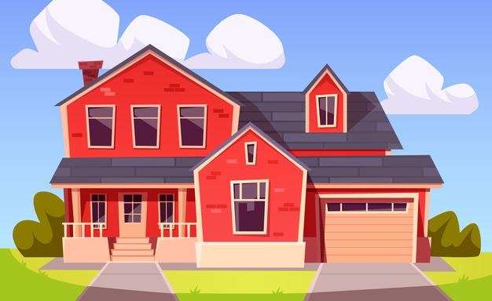
Where is the house?
BACK
It’s there.
It’s here.

