Slide 1



13
My house
LESSON 3 – Part 1,2,3

Slide 2
TABLE OF CONTENTS
Warm-up and review
Listen and repeat.
1
2
3
4
Let’s chant.
Listen and circle.
5
Fun corner and wrap-up

Slide 3
1
Warm-up and review

Slide 4

2
5
7
4
1
8
3
6
Notes:
Review the previous lesson by having the class play the game Lucky number, using the model sentences.
Click the number to go to the question.

Slide 5




=
-
=
Notes:
There’s a bomb and an egg. The number with the egg is the lucky number.

Slide 6

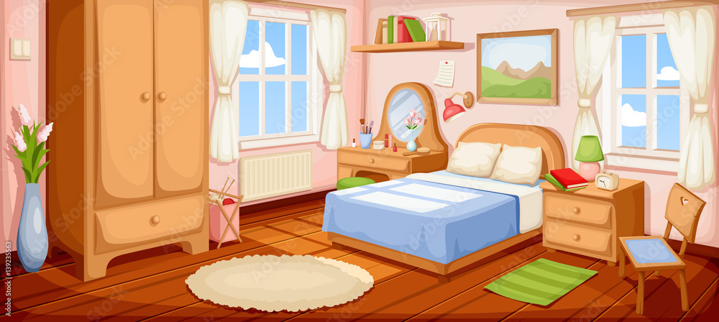



Where is the bedroom?
It’s here.
Notes:
Teacher asks the question. Students reply using the model sentences in the previous lesson. Click the rabbit to go back to the question slide.

Slide 7
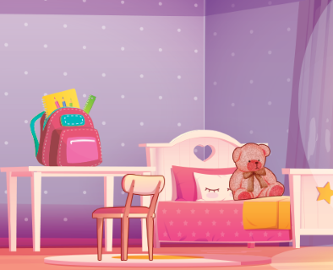

Where is the bed?
You have an egg!
It’s there.

Slide 8
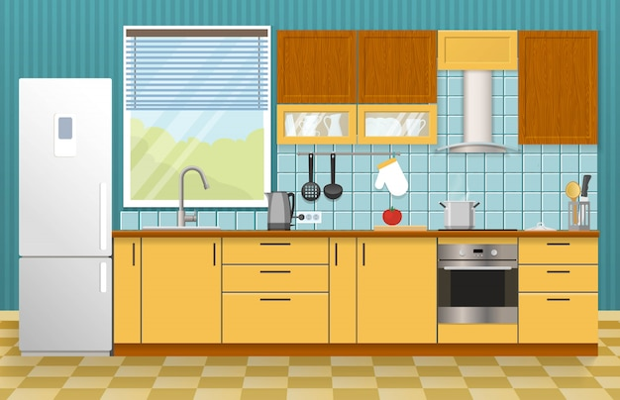
Where is the kitchen?
It’s here.
It’s here!

Slide 9

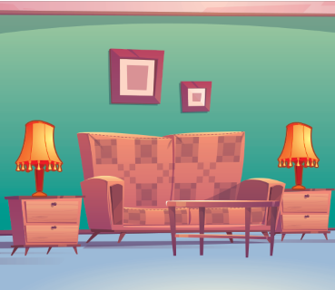
Where are the lamps?
Good luck next time!
They are in the living room.

Slide 10
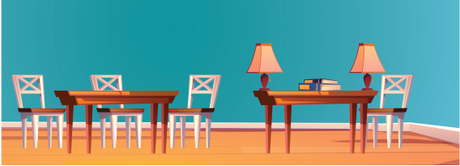
Where are the books?
They are on the table.

Slide 11
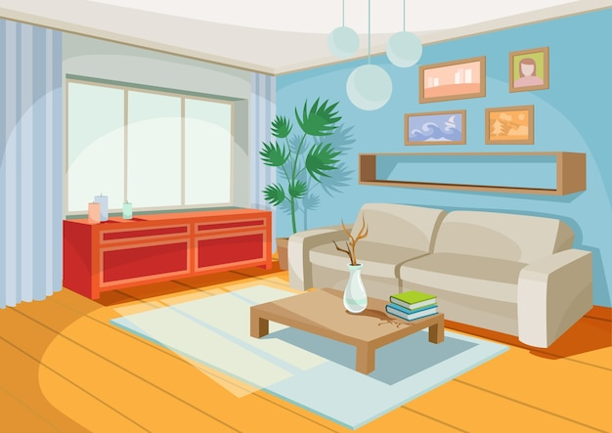
Where is the living room?
It’s here.

Slide 12
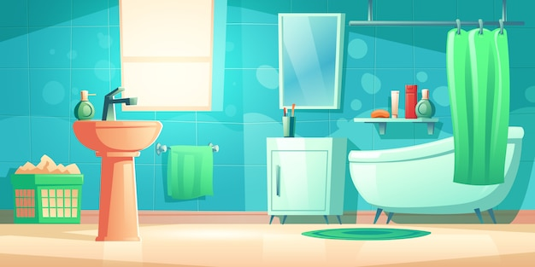
Where is the bathroom?
It’s there.

Slide 13
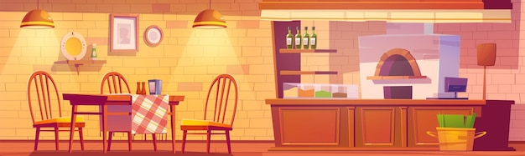
Where are the table?
It’s in the kitchen.

Slide 14
2
Listen and repeat.

Slide 15

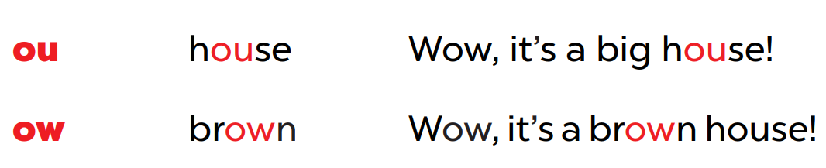

Slide 16
/aʊ/
ou
h
se
Wow, it’s a big house!

Slide 17
/aʊ/
ow
br
n
Wow, it’s a brown house!

Slide 18
3
Listen and circle.

Slide 19
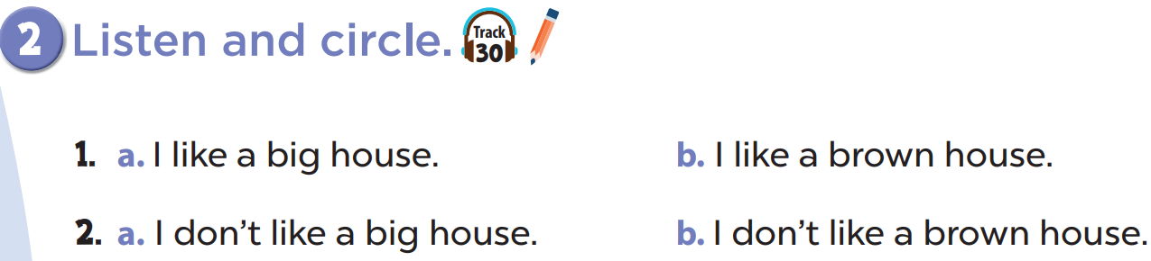

Slide 20
4
Let’s chant.

Slide 21
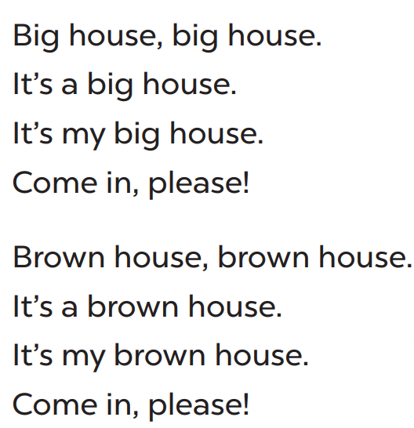
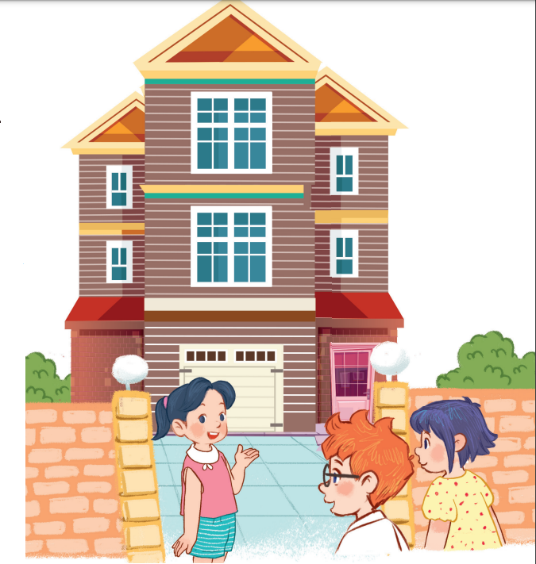

Slide 22
5
Fun corner and wrap-up

